Slide 1
State and Local Public Finance
Professor Yinger
Spring 2017
Lecture 9
State and Local Sales and Income Taxes

Slide 2
State and Local Public Finance
Lecture 9: State and Local Sales and Income Taxes
Class Outline
Sales Taxes
Efficiency
Equity
Administrative Issues
Income Taxes
Design of Federal Tax
Link to State Income Taxes
Design of Local Income Taxes

Slide 3
State and Local Public Finance
Lecture 9: State and Local Sales and Income Taxes
Sales Tax Distortion
All taxes cause distortion (i.e. inefficiency), measured by excess burden.
The sales tax is no exception.
A sales tax distorts choices between taxed and untaxed items.
All else equal, the best tax has the lowest excess burden.

Slide 4
State and Local Public Finance
Lecture 9: State and Local Sales and Income Taxes
Sales Tax Distortion, 2
Government Revenue
P
Excess Burden
P₂
S + Tax
ΔP = t
P₁
S
ΔQ
D
The Market for Taxed Goods
Q₂
Q₁
Q
Q

Slide 5
State and Local Public Finance
Lecture 9: State and Local Sales and Income Taxes
Sales Tax Distortion, 3
Tax to Offset Externality
Government Revenue
P
Excess Burden Avoided with Tax = SMC
P₂
S + Tax = PMC+SMC
ΔP = t
P₁
S = PMC
ΔQ
D
Q₂
Q₁
Q
Q
The Market for Taxed Goods

Slide 6
State and Local Public Finance
Lecture 9: State and Local Sales and Income Taxes
Excess Burden And Policy
Distortions are smallest for taxed goods with inelastic demand, such as medicine or cigarettes (but equity factor differ!).
Distortions arise when goods are taxed and services are not.
Distortions arise when intermediate goods or services (i.e. inputs) are
taxed.
Taxes can reduce distortions when there are externalities.

Slide 7
State and Local Public Finance
Lecture 9: State and Local Sales and Income Taxes
Excess Burden And Policy, 2
Driving (=gasoline use) causes air pollution and emits greenhouse
gases; a gas tax therefore promotes efficiency by discouraging driving!
The federal gas tax has declined 40% in real terms since 1993.
One study finds that new fuel-efficiency standards for new cars will cost the U.S. 6 times as much for the same reduction in gas use as setting the gas tax at $0.45 per gallon. See Karplus, New York Times, February 21, 2013.

Slide 8
State and Local Public Finance
Lecture 9: State and Local Sales and Income Taxes
Sales Tax Incidence
P
P₂
S+tax
P₁=P₃
S
D
Q
Many goods have elastic supply curves, so most of the burden of sales taxes falls on consumers.

Slide 9
State and Local Public Finance
Lecture 9: State and Local Sales and Income Taxes
Sales Tax Incidence, Cont.
The ratio of consumption to income declines as income rises.
In other words, rich people save a larger share of their income.
So a sales tax is regressive overall.
  Some components of a sales tax (e.g. a sales tax on luxury goods or services) might be progressive.

Slide 10
State and Local Public Finance
Lecture 9: State and Local Sales and Income Taxes
Sales Tax Incidence, Cont.
T
Y
Progressive
Proportional
Regressive
Y

Slide 11
State and Local Public Finance
Lecture 9: State and Local Sales and Income Taxes
A Key Administrative Issue In The Design Of A Sales Tax
According to the U.S. Supreme Court, sales taxes on mail order or
internet sales can only be collected if the seller has a business “nexus”
in a state.
This is based on the inter-state commerce clause of the U.S.
Constitution, which prohibits one state from placing an undue burden
on businesses in other states.

Slide 12
State and Local Public Finance
Lecture 9: State and Local Sales and Income Taxes
Administrative Issue, Point 1
The sales tax is actually a sales and use tax; someone who buys from by mail order or over the internet using a firm without nexus or from a store in another state still owes the use tax.
But the use tax is hard to administer, for example:
        Massachusetts police parked at New Hampshire liquor stores.
        Interstate agreements to share credit card information.

Slide 13
State and Local Public Finance
Lecture 9: State and Local Sales and Income Taxes
Administrative Issue, Point 2
States are losing revenue as internet sales grow but cannot violate the
Supreme Court rule.
        The internet “exemption” is also a source of distortion!
        The distortion and revenue loss increase with the state tax rate.
State are not prohibited from taxing catalog or internet sales by in-state
firms—and the federal government cannot change this!

Slide 14
State and Local Public Finance
Lecture 9: State and Local Sales and Income Taxes
Administrative Issue, Point 3
One possible solution: an interstate compact.
          Devise common definitions of goods and services.
          Provide all firms with a computer program to calculate sales taxes.
The Streamlined Sales Tax Project (22 states) does this.
          Legislatures must amend tax laws.
          And the U.S. Congress must authorize the approach (i.e. certify that there is no undue burden).
          The U.S. Senate has passed this, with an exception for small firms.

Slide 15
State and Local Public Finance
Lecture 9: State and Local Sales and Income Taxes
Administrative Issue, Point 4
One partial solution: establish nexus through affiliates.
  Initiated by New York State.
  Requires Amazon to collect tax because it has many affiliates with establishments in New York State.
  Amazon resisted at first, but then discovered that it could pick up customers with distribution centers (=nexus!) in big states.
  Upheld by the U.S. Supreme Court.

Slide 16
State and Local Public Finance
Lecture 9: State and Local Sales and Income Taxes
Administrative Issue, Point 5
The current situation:.
  Amazon is now collecting sales tax in a total of 30 states. See: http://www.urban.org/urban-wire/do-you-pay-sales-tax-your-online-holiday-shopping.
  In the 16 remaining states with sales taxes (plus D.C.), Amazon is not yet collecting sales taxes.

Slide 17
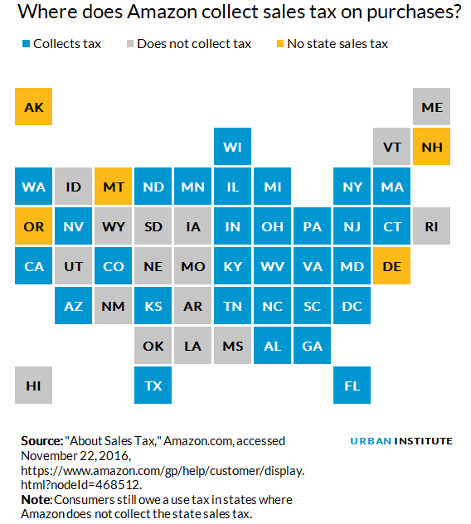
State and Local Public Finance
Lecture 9: State and Local Sales and Income Taxes
Administrative Issue,
Point 6

Slide 18
State and Local Public Finance
Lecture 9: State and Local Sales and Income Taxes
Administrative Issue, Point 7
Another partial solution: require reporting transactions.
  On 12/12/2016, “The U.S. Supreme Court on Monday left in place a Colorado law dubbed the "Amazon tax" designed to make it easier for the state to collect sales taxes on out-of-state internet purchases...
  The 2010 law was enacted to encourage residents to pay the 2.9 percent sales tax on purchases they make out-of-state, including from online retailers. Companies operating within the state collect the sales tax themselves but out-of-state companies are not required to do so. The law requires them to notify consumers that they are required to pay the tax.”
  The law also requires the out-of-state companies to notify the state about these sales.
  See: http://www.nytimes.com/reuters/2016/12/12/us/12reuters-usa-court-colorado.html

Slide 19
State and Local Public Finance
Lecture 9: State and Local Sales and Income Taxes
The Federal Income Tax
We start with the federal income tax because most state taxes are
linked to it.
We will discuss the broad issues in the design of the federal income
tax.
Then we will turn to state and local income taxes.

Slide 20
State and Local Public Finance
Lecture 9: State and Local Sales and Income Taxes
Federal Income Tax Design
Comprehensive Income
- Exclusions
= Adjusted Gross Income
- Exemptions
- Deductions (Itemized or Standard)
= Taxable Income
× Tax Table
= Gross Tax
- Tax Credits
= Net Tax

Slide 21
State and Local Public Finance
Lecture 9: State and Local Sales and Income Taxes
Exclusions & Exemptions
Exclusions
Interest income on municipal bonds
Implicit rent on owner-occupied housing
Exemptions
Personal exemptions ($4,050)
Exemptions for dependents
Exemptions for age and some categories of disability

Slide 22
State and Local Public Finance
Lecture 9: State and Local Sales and Income Taxes
Deductions
Itemized Deductions
    Mortgage interest on primary residence (and some secondary)
    Property taxes on primary residence (and some secondary)
    State income taxes (or state sales taxes—but not both!)
    Charitable contributions
    Excess medical expenses
Standard Deduction
    Fixed amount (used by most taxpayers)
    $12,600 for joint return.

Slide 23
State and Local Public Finance
Lecture 9: State and Local Sales and Income Taxes
Federal Tax Expenditures
Relating to State and Local Government, FY2007
Tax Expenditure for: | $(billions)
State and Local Tax Deductions | 44.1
Real property | 13.8
Income | 26.2
Sales | 3.0
Personal property | 1.1
Tax Exempt Bonds | 36.3
General | 27.9
Private Activity | 8.3
Total | 80.5
From: Gravelle and Gravelle, NTJ, Sept. 2007

Slide 24
State and Local Public Finance
Lecture 9: State and Local Sales and Income Taxes
Tax Calculations
Tax Tables
      Separate tables for married and single.
        A marriage penalty for equal-earning couples due to standard deduction.
        A marriage bonus for one-earner couples due to broader brackets.
      The alternative minimum tax (AMT) tries to ensure that exemptions and deductions do not push the average tax rate too low.
      The AMT affects a growing number of taxpayers
      And serves to reclaim some revenue lost to other provisions.
Tax Credits
      Earned income tax credit

Slide 25
State and Local Public Finance
Lecture 9: State and Local Sales and Income Taxes
Tax Table, Joint Returns, 2016
Marginal Rate
39.6%
10%
$18,550
$466,950
Taxable Income

Slide 26
State and Local Public Finance
Lecture 9: State and Local Sales and Income Taxes
Marginal To Average Rates
The translation from marginal to average rates is complicated.
        Marginal rate tables are highly misleading due to phase outs and the EITC.
        All the other features of the tax code affect average rates.
        Deductions are particularly powerful at the highest income levels.

Slide 27
State and Local Public Finance
Lecture 9: State and Local Sales and Income Taxes
Tax Table For Joint Returns
Possible
Marginal Rate
Schedule
with
Phase Outs
Marginal Rate
39.6%
10%
$18,550
$466,950
Taxable Income

Slide 28
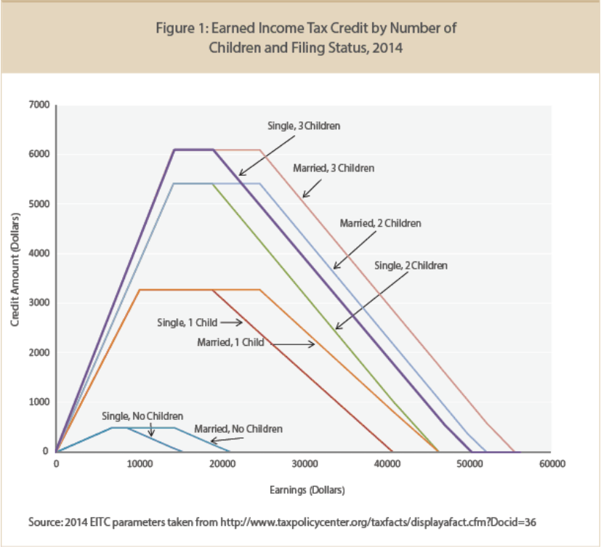
State and Local Public Finance
Lecture 9: State and Local Sales and Income Taxes
The Earned Income Tax Credit

Slide 29
State and Local Public Finance
Lecture 9: State and Local Sales and Income Taxes

Slide 30
State and Local Public Finance
Lecture 9: State and Local Sales and Income Taxes
Possible Average Rate Figure
Itemized Deductions,
AMT
T
Y
Zero Income Amount (Exemptions + Standard Deduction)
?
0
Comprehensive Income
EITC

Slide 31
State and Local Public Finance
Lecture 9: State and Local Sales and Income Taxes
Source: IRS. Note that negative rates form the EITC cannot be identified in the IRS data.

Slide 32
State and Local Public Finance
Lecture 9: State and Local Sales and Income Taxes
Tax Reform Act Of 1986 (TRA)
Remarkable bi-partisan reform that closed loopholes (favored by liberals) and lowered marginal rates (favored by conservatives).
These two are linked—broadening the base makes lower rates possible.
Since then loopholes have been added at a furious pace.
This reform also shifted the burden from individuals to corporations.

Slide 33
State and Local Public Finance
Lecture 9: State and Local Sales and Income Taxes
Link To State Income Taxes
Most state income taxes either
        A. use federal taxable income and their own tax tables, or
        B. set their tax as a percentage of federal tax.
The “A” states gained from base broadening in the 1986 TRA.
The “B” states lost from the shift away from individual income taxes in the 1986 TRA.

Slide 34
State and Local Public Finance
Lecture 9: State and Local Sales and Income Taxes
Progressivity In State Taxes
The “A” States, the ones with federal taxable income, have less
progressive rate structures than the federal tax.
These taxes are even less progressive than they seem because of
federal (or federal and state) deductibility of income taxes paid.
Progressivity is limited by the ability of rich individuals to move to
another state in response to a high state income taxes—but this effect
is small.

Slide 35
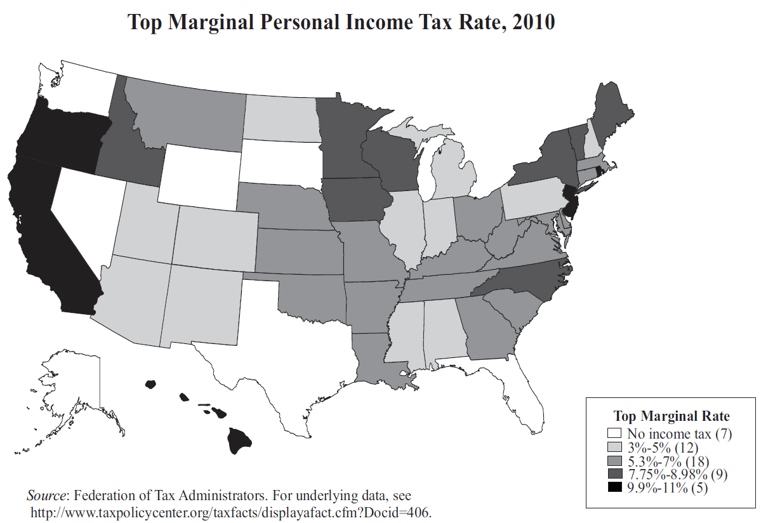
State and Local Public Finance
Lecture 9: State and Local Sales and Income Taxes
Top Rates For State Income Taxes (From Urban Institute)

Slide 36
State Income Tax Thresholds for Two-Parent Families of Four, 2011
Rank | State | Threshold |  | Rank | State | Threshold
Below Poverty Line |  |  |  | Above Poverty Line
1 | Montana | 12,500 |  | 16 | North Carolina | 23,400
2 | Alabama | 12,600 |  | 17 | Arizona | 23,600
3 | Illinois | 13,100 |  | 18 | North Dakota | 26,400
4 | Georgia | 15,900 |  | 18 | Colorado | 26,400
5 | Ohio | 16,600 |  | 20 | Idaho | 26,500
6 | Hawaii | 17,800 |  | 21 | Utah | 26,900
7 | Missouri | 18,300 |  | 22 | Wisconsin | 27,500
8 | Iowa | 19,300 |  | 23 | Virginia | 27,700
9 | Mississippi | 19,600 |  | 24 | Oklahoma | 28,400
10 | Oregon | 20,200 |  | 25 | Massachusetts | 29,500
11 | Indiana | 20,500 |  | 26 | Maine | 29,700
12 | Louisiana | 21,300 |  | 27 | Michigan | 30,800
13 | Arkansas | 22,200 |  | 28 | Kansas | 31,200
14 | West Virginia | 22,400 |  | 29 | Pennsylvania | 32,000
14 | Kentucky | 22,400 |  | 30 | Delaware | 32,100
Average Threshold |  | $18,313 |  | 31 | District of Columbia | 32,800
 |  |  |  | 32 | South Carolina | 32,900
 |  |  |  | 33 | Nebraska | 33,700
 |  |  |  | 34 | New Jersey | 35,200
 |  |  |  | 35 | Maryland | 37,300
 |  |  |  | 36 | Rhode Island | 39,000
 |  |  |  | 37 | Minnesota | 39,300
 |  |  |  | 37 | Vermont | 39,300
 |  |  |  | 39 | New Mexico | 40,000
 |  |  |  | 40 | Connecticut | 40,500
 |  |  |  | 41 | New York | 40,700
 |  |  |  | 42 | California | 49,400
 |  |  | Average Threshold |  |  | $32,674
Poverty line: $23,018
Average Threshold (All): $27,545
Note: A threshold is the lowest income level at which a family has state income tax liability. In this table thresholds are rounded to the nearest $100. The threshold calculations include earned income tax credits, other general tax credits, exemptions, and standard deductions. Credits that are intended to offset the effects of taxes other than the income tax or that are not available to all low-income families are not taken into account.
Source:
Phil Oliff, Chris Mai, and Nicholas Johnson, "The Impact of State Income Taxes on Low-Income Families in 2011," Table 1B, Center on Budget and Policy Priorities (April 2012).

Slide 37
State and Local Public Finance
Lecture 9: State and Local Sales and Income Taxes
Local Income Taxes
A few cities (e.g. Baltimore, Detroit, New York) have income taxes of
their own, usually linked to their state tax.
Most local income taxes are limited to wages and salaries and take the
form of either
        an earnings tax (with the legal incidence on the worker)
        a payroll tax (with the legal incidence on the firm)

Slide 38
State and Local Public Finance
Lecture 9: State and Local Sales and Income Taxes
Commuter Taxes
A few cities (e.g. Newark, San Francisco, Cleveland, Philadelphia)
collect taxes on the wages and salaries earned by non-residents within the city.
Payroll taxes do this automatically.

Slide 39
State and Local Public Finance
Lecture 9: State and Local Sales and Income Taxes
Commuter Taxes, 2
Commuter taxes only work if cities have access to them but suburbs do not.
The first claim on taxable resources goes to the jurisdiction of residence. So if a city passes an income tax, the suburbs can pass one and claim all the taxes paid by their commuting residents—with no increase in the tax on those residents!
This happened in Pittsburgh.

Slide 40
State and Local Public Finance
Lecture 9: State and Local Sales and Income Taxes
Commuter Taxes, 3
Commuter taxes have the advantage that they can help satisfy the
benefit principle—people who benefit from the services in the city
where they work help pay for these services.
Commuter taxes have the disadvantage that they may encourage firms
(not households) to leave a city (so they can pay lower wages), although the evidence on this effect is
mixed.

