Slide 1
The Causes of Housing Discrimination
ECN741: Urban Economics
Based on: Jan Ondrich, Stephen L. Ross, and John Yinger, “Now You See It, Now You Don’t: Why Do Real Estate Agents Withhold Available Houses from Black Customers?” Review of Economics and Statistics, November 2003
Professor John Yinger, The Maxwell School, Syracuse University, 2022

Slide 2
Now You See It, Now You Don’t
Housing Audit Research
Matched Pair Design
  Two teammates equally qualified for housing
  Same characteristics, training, timing, and request
  Differ on ethnicity
Used to Measure How Much Discrimination Exists
Used to Test Hypotheses About the Causes of Discrimination
  This is the focus of this paper

Slide 3
Now You See It, Now You Don’t
The Main Contribution of This Study
In Each Audit:
  Teammates inquire about (and usually inspect) an advertised housing unit
  Teammates are told about (and often inspect) other units similar to the advertised unit
This Study Shifts the Unit of Analysis from an Audit to an Inspected Housing Unit
  Previous studies examine differences in the average number of units shown to black and white auditors
  We examine whether agents tend to market certain types of units just to whites (or just to blacks)

Slide 4
Now You See It, Now You Don’t
Advantages of a Unit-Based Approach
We can determine whether discrimination is related to the characteristics of an individual housing unit, such as
  whether it is in an integrated area
  its asking price
We can avoid an endogeneity problem that arises from explanatory variables that are influenced by agent choices
  such as the average racial composition of the units the agent decides to show
We can explore agent marketing behavior toward all customers
  including redlining

Slide 5
Now You See It, Now You Don’t
The Housing Discrimination Study
A 1989 study national housing audit study
  Funded by HUD
  Designed to give nationally representative estimates of discrimination
Involved black-white audits and Hispanic-white audits in both the sales and rental markets
We focus on the 1081 black-white sales audits, which were conducted in 20 randomly selected metropolitan areas
  Audits were based on a random sample of advertisements from the major metropolitan newspaper

Slide 6
Now You See It, Now You Don’t
Hypotheses About Housing Discrimination
Agent Prejudice
  Agents may act out of own prejudice
White Customer Prejudice
  Agents may act to protect an existing white customer base
Statistical Discrimination
  Agents may make a greater effort if transaction is thought to be more likely
  Could reflect perceived preferences of customers
  Could reflect agent stereotypes
  Could reflect perceived constraints, such as discrimination or redlining by lenders

Slide 7
Now You See It, Now You Don’t
Our Unit-Based Data Set
Includes all units shown to either auditor during an audit:
  advertised units (i.e., those inquired about)
  other units
We observe whether each unit was shown to both teammates, to the white only, or to the black only
We observed detailed characteristics of the unit and of its neighborhood
We match each unit with the advertised unit that is the basis for the audit, so for each unit we have
  characteristics of the unit (which may or may not be an advertised unit)
  characteristics of the associated advertised unit (which are the same for all units in a given audit)

Slide 8
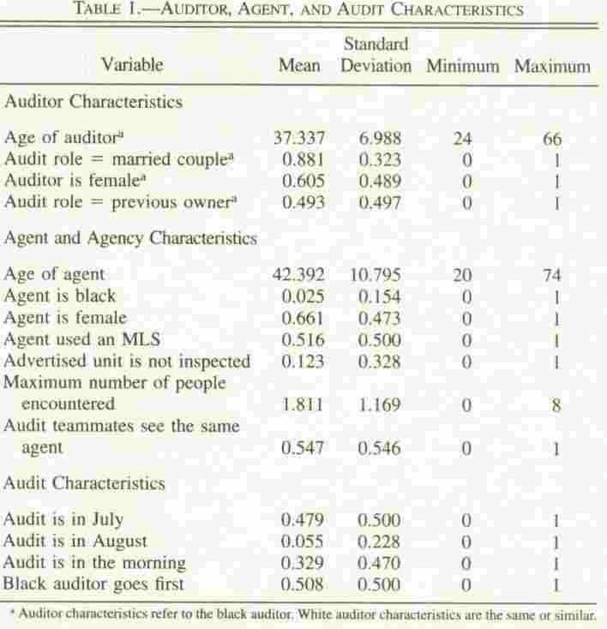
Now You See It, Now You Don’t

Slide 9
Now You See It, Now You Don’t

Slide 10
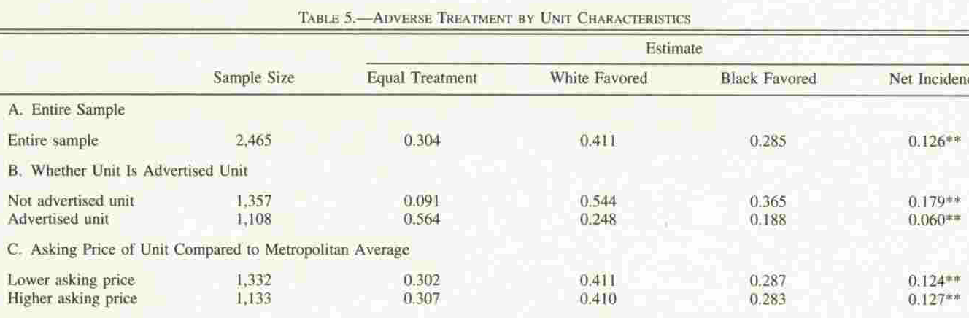
Now You See It, Now You Don’t

Slide 11
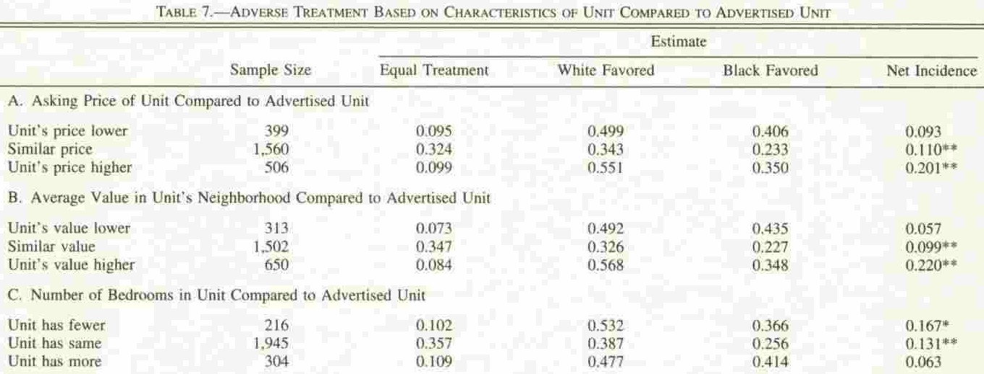
Now You See It, Now You Don’t

Slide 12
Now You See It, Now You Don’t
Estimation Strategy
For each unit, four outcomes are possible:
  Show to both teammates
  Show to white auditor only
  Show to black auditor only
  Show to neither auditor
We treat this as a multinomial logit model
  Because we do not observe the last outcome, we correct for the possibility of sample selection bias
  We condition on unobserved audit random effects. (This step ensures that the 3 remaining choices are independent.)
  We investigate auditor-pair effects, too, but find them to be insignificant

Slide 13
Now You See It, Now You Don’t
Variables and General Hypotheses

Slide 14
Now You See It, Now You Don’t
Example 1: Audit with 3 Units, Discrete Variable

Slide 15
Now You See It, Now You Don’t
Example 2: Audit with 3 Units, Continuous Variable

Slide 16
Now You See It, Now You Don’t
Key Findings, I: Marketing
Asking Price
  Sales effort increases with asking price
Inferred Preferences
  Agents make inferences about a customer’s preferences on the basis of her initial request
  And then concentrate on showing units most consistent with those preferences
  For example, agents are less likely to show a unit if it has either more or fewer bedrooms than the advertised unit
Redlining
  Agents are less likely to show a unit if it is in suburban integrated neighborhood (even if the customer inquired about such a unit)

Slide 17
Now You See It, Now You Don’t

Slide 18
Now You See It, Now You Don’t

Slide 19
Now You See It, Now You Don’t
Key Findings II: Discrimination
Audit, Agent, and Auditor Characteristics
  These variables, which are the only ones available in previous studies, have little impact on discrimination.
  Audit teams with a married couple role encounter less discrimination.
  Larger agencies are less likely to discriminate (due perhaps to more diversified customers or better knowledge of the law).
Note
  A negative sign means more discrimination (less likely to show when the customer is black); a positive sign means less discrimination.

Slide 20
Now You See It, Now You Don’t

Slide 21
Now You See It, Now You Don’t
Key Findings II: Discrimination, Continued
Asking Price
  Agents’ marketing effort increases with asking price for whites but not for blacks
  For blacks, not whites, a unit is more likely to be shown if it is cheaper than the advertised unit.
  These results suggest that agents have preconceptions about blacks’ ability to pay for expensive houses
Neighborhood
  Redlining against suburban neighborhoods is less likely for black customers
  Units in integrated central city neighborhoods are less likely to be shown to blacks than to whites

Slide 22
Now You See It, Now You Don’t

Slide 23
Now You See It, Now You Don’t

Slide 24
Now You See It, Now You Don’t
Summary and Conclusions
The initial request is interpreted as an indication of a customer’s preferences
Real estate agents practice redlining in the suburbs
No evidence of discrimination based on agent prejudice
Some evidence of discrimination based on white customer prejudice
Strong evidence of statistical discrimination
  Not found by previous studies
  Helps explain why discrimination is difficult to detect and eliminate

Slide 25
Now You See It, Now You Don’t
Addendum
A subsequent correspondence audit study by Ewens, Tomlin, and Wang (ReStat, March 2014), looks for landlord prejudice and statistical discrimination.
This study conducted over 14,000 unpaired e-mail audits of small apartments in 35 U.S. cities.
These audits looked at discrimination in return e-mails to applicants identified by typical black and white names.
They do not cite Ondrich, Ross, and Yinger despite being in the same journal on the same topic with the same conclusion! (Hint: Use Google Scholar!)

Slide 26
Now You See It, Now You Don’t
Addendum, 2
Ewens et al. argue that if landlords are prejudiced, they will be more likely to discriminate in largely white than in largely black areas.
They reject landlord prejudice as an explanation because discrimination is not lower in largely black than in largely white areas.

Slide 27
Now You See It, Now You Don’t
Addendum, 3
They argue that landlords practicing statistical discrimination will find signals about the “quality” of an applicant from a particular racial or ethnic group to be more believable if they have more experience dealing with that group.
They find support for this hypothesis: landlords respond more favorably to positive information (such as an indication that the applicant has a desirable job) about a black applicant in a largely black neighborhood than in a largely white neighborhood.

Slide 28
Now You See It, Now You Don’t
Supplementary Slides
1. Marketing behavior by unit location
2. Econometric specification

Slide 29
Now You See It, Now You Don’t

Slide 30
Now You See It, Now You Don’t

Slide 31
Now You See It, Now You Don’t

Slide 32
Now You See It, Now You Don’t

Slide 33
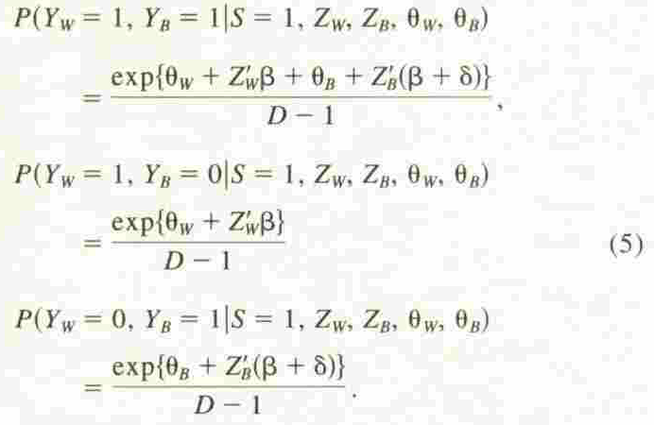
Now You See It, Now You Don’t

