Slide 1
ECN741: Urban Economics
Multiple Worksites and Full Labor Markets
Professor John Yinger, The Maxwell School, Syracuse University, 2022

Slide 2
Multiple Worksites
  Class Outline:
    1. Actual Employment Location
    2. Modeling a Full Labor Market
    3. Models with a Beltway
    4. Models with a Suburban Business District
    5. Models with Endogenous Employment Location
    6. Wasteful Commuting?

Slide 3
Multiple Worksites
  Class Outline:
    1. Actual Employment Location
    2. Modeling a Full Labor Market
    3. Models with a Beltway
    4. Models with a Suburban Business District
    5. Models with Endogenous Employment Location
    6. Wasteful Commuting?

Slide 4
Multiple Worksites
Defining Worksites
Worksites can be identified using data on the number of jobs within each zip code, which is available from the census.
The definition of a worksite considers both the concentration of jobs in a core zip code and the clustering of jobs in related zip codes.
Yinger’s study of Cleveland (JUE, March 2015) defines a worksite as a set of zip codes
  each with at least 5,000 jobs,
  that contain at least one zip code with 25,000 jobs,
  that contain at least 45,000 total jobs,
  and that are all within 6 miles of a central point.
Similar informal methods for identifying employment centers, along with some more formal ones based on employment density, are discussed in McMillan and McDonald (JUE, March 1998).

Slide 5
Multiple Worksites
  The Final Worksites
Because many jobs are clustered near a beltway around Cleveland defined by two interstate highways (I-480 and I-271), one worksite was defined as a ring 7 to 11 miles from the center of the downtown site.
These definitions led to five worksites: downtown Cleveland, the beltway, Mentor/Painesville, Bedford/Solon, and Lorain/Elyria.
These five worksites accounted for 75.8 percent of the jobs in the Cleveland area in 2000; their job shares were 35.3, 40.7, 9.3, 7.7, and 7.0 percent, respectively.

Slide 6
Multiple Worksites
Mentor/Painesville
Downtown
Beltway
Bedford/Solon
Lorain/Elyria

Slide 7
Multiple Worksites
    The Cleveland Beltway

Slide 8
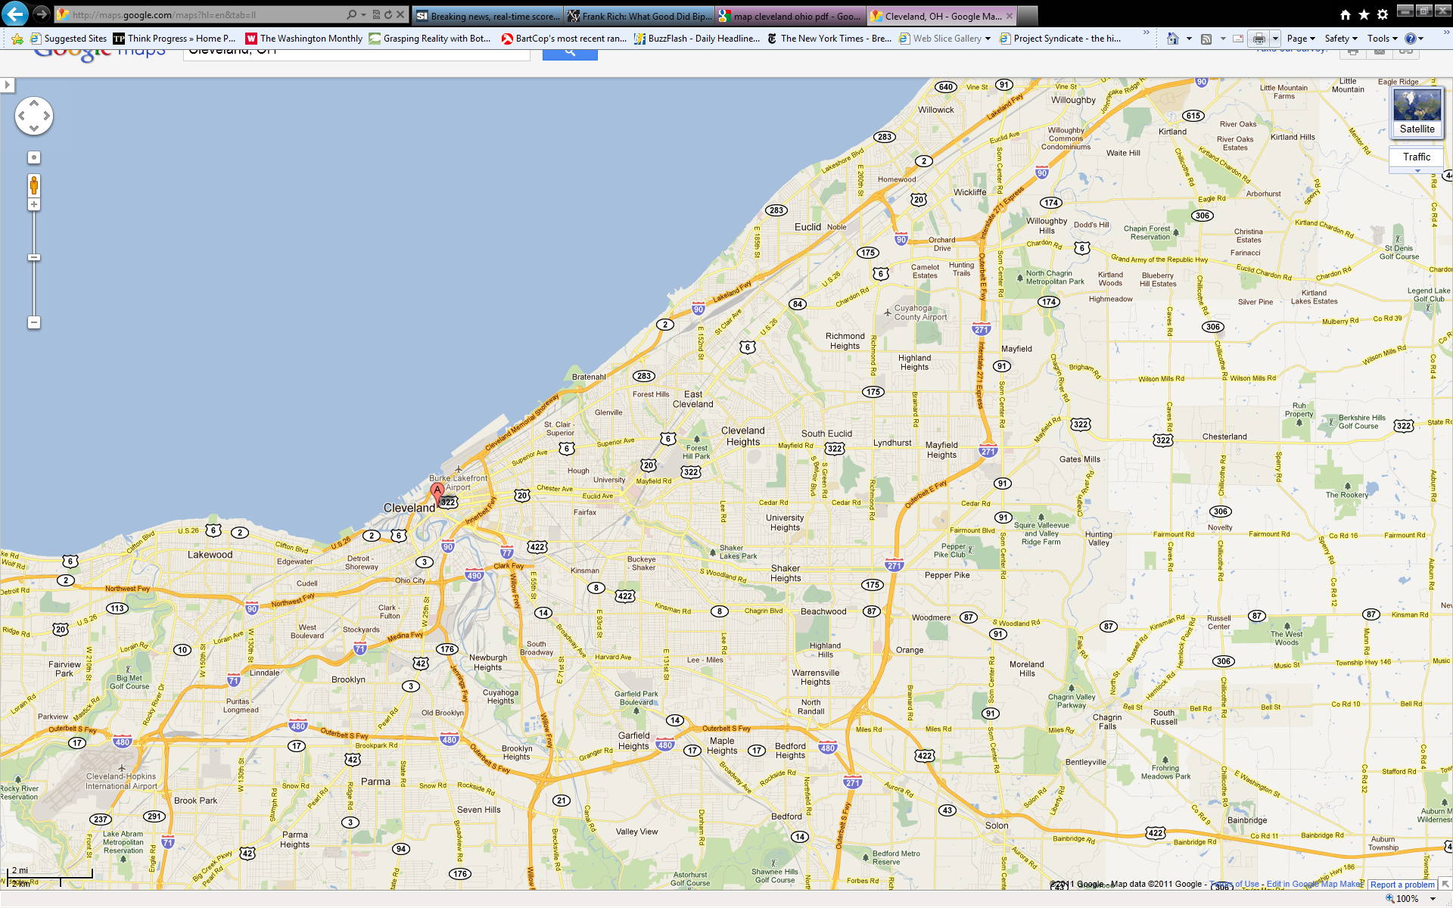
Multiple Worksites

Slide 9
Multiple Worksites
  Class Outline:
    1. Actual Employment Location
    2. Modeling a Full Labor Market
    3. Models with a Beltway
    4. Models with a Suburban Business District
    5. Models with Endogenous Employment Location
    6. Wasteful Commuting?

Slide 10
Multiple Worksites
  A Full Labor Market
    Before turning to suburban worksites, it is useful to consider a full labor market, not just fixed N and Y.
    The demand for labor is a derived demand—derived from the production of an export good Q.
    Let v be the location of a firm (miles from CBD), t = commuting cost, s = shipping cost to export point, W = daily wage; and P_{Q} = price of the export good.
      Net wage paid to worker = W – (t)(v)
      Net price to firm = P_{Q} – (s)(v)

Slide 11
Multiple Worksites
  The Wage Gradient
    Note that W – tv is what the firm pays; W is the wage at the center, not the gross wage.
    Firms located far from the center do not have to pay as much to attract workers as firms near the center because their workers do not have to commute as far.
    So one should observe a wage gradient within the CBD.
    More on wage gradients later.

Slide 12
Multiple Worksites
  The CBD Boundary
R{u}
R_{f}
R_{h}
_
R
_
u
^
u
u

Slide 13
Multiple Worksites
  A Full Labor Market, 2
    Define n as the ratio of labor to land, i.e., the amount of labor per unit land.
    Define f{n} as the production function for Q per unit of land.
    Then the firm’s problem is to maximize its bid per unit of land for a given level of revenue less its wage payment on that land.

Slide 14
Multiple Worksites
  A Full Labor Market, 3
    We can use the envelope theorem to find associated comparative statics results:

Slide 15
Multiple Worksites
  A Full Labor Market, 4
    We can also use the envelope theorem to find the locational equilibrium condition for firms = their bid function:
    This expression could be positive or negative, but for the model to be internally consistent (i.e., to be consistent with the assumed location of firms around the CBD), R_{f} must have a negative slope—and be steeper than R_{h} !

Slide 16
Multiple Worksites
  A Full Labor Market, 5
    Ross and Yinger (RSUE, Oct. 1995) use these and other results to obtain the comparative statics tables for an open urban model with a full labor market.
    Most of the comparative statics results do not hold up when a full labor market is added—primarily because of role played by the CBD boundary.
    They conclude that “the determinacy of many comparative statics results in the standard open urban model depends on the unrealistic assumption of perfectly elastic labor demand.”

Slide 17
Multiple Worksites
    Basic Open Model Comparative Statics
 | Parameter
Variable | Y | t |  | U*
 | + | - | - | -
R{u} or P{u} or D{u} | + | - | 0 | -
N | + | - | - | -

Slide 18
Multiple Worksites
    Open Model CS with Full Labor Market
 | Parameter
Variable | Y | t |  | U* | P_{Q} | s
 | n.a. | ? | - | ? | + | -
R{u}, P{u} | n.a. | ? | + | ? | ? | ?
N | n.a | ? | - | ? | ? | ?
W | n.a. | + | + | + | + | -
 | n.a. | ? | - | ? | ? | ?

Slide 19
Multiple Worksites
  A Full Labor Market, 6
    For example, an increase in t now leads to an increase in W, because firms must compensate workers for higher commuting costs, holding utility constant.
    As a result, the increase in t has an ambiguous impact on urban size, ; the original effect is that a higher t and hence a steeper R{u} leads to a lower .
    But this effect could be offset by the wage effect, because a higher W leads to a higher .
    The impact of an increase in t on N is also now ambiguous for the same reasons.

Slide 20
Multiple Worksites
  Class Outline:
    1. Actual Employment Location
    2. Modeling a Full Labor Market
    3. Models with a Beltway
    4. Models with a Suburban Business District
    5. Models with Endogenous Employment Location
    6. Wasteful Commuting?

Slide 21
Multiple Worksites
  The White Beltway Model
    White (JUE, October 1976) introduced a beltway a given distance from the CBD (but no full labor market).
    This keeps the model monocentric and the math tractable. A second beltway could be added.
    It provides a rough approximation to the employment distribution in some urban areas.

Slide 22
Multiple Worksites
  The White Beltway Model, 2
R{u}
Bid function for CBD workers
Bid function for beltway workers
_
R
_
u
u
u*
b

Slide 23
Multiple Worksites
  The White Beltway Model, 3
    So this model, like the mode-choice model, has sorting, now between the residential zones of CBD and beltway workers.
    It has a new variable, u*, the zone boundary.
    If workers are mobile across worksites, the bid-function peaks must have the same height.
    It is theoretically possible for CBD workers to commute through the beltway workers’ zone.

Slide 24
Multiple Worksites
  The White Beltway Model, 4
    The bid function for a beltway worker is:
    If the αs and U*s are the same, the zone boundary, u*, is determined where:

Slide 25
Multiple Worksites
  The White Beltway Model, 4
    Solving for u*, we have

Slide 26
Multiple Worksites
  The White Beltway Model, 4
    This leads to some simple CS results:

Slide 27
Multiple Worksites
  The White Beltway Model, 4
    Finally, the population integrals in a beltway model (with no through-commuting) look like this:

Slide 28
Multiple Worksites
  Two-Worker Households
    Hotchkiss and White (JUE, September 1993) show that this framework can consider two-worker households.
    If commuting costs are the same in both directions, the bid function is flat between worksites, because changing location has offsetting impacts on the household’s total commuting costs,
    But the bid function is twice as steep as the bid function for one-worker families outside the ring.

Slide 29
Multiple Worksites
  Two-Worker Households, 2
R{u}
Bid function for CBD workers
Bid function for
2-worker households
Bid function for ring workers
_
R
_
u
u
u*
b

Slide 30
Questions
Multiple Worksites
Questions
How can firm’s bid function for land be derived?
How does endogenous firm demand for land alter an urban model’s comparative statics results?
Where do two-earner families locate in an urban area with an employment ring?

Slide 31
Multiple Worksites
  Class Outline:
    1. Actual Employment Location
    2. Modeling a Full Labor Market
    3. Models with a Beltway
    4. Models with a Suburban Business District
    5. Models with Endogenous Employment Location
    6. Wasteful Commuting?

Slide 32
Multiple Worksites
  Models of Suburban Business Districts (SBDs)
    Several scholars have modeled urban areas with SBDs at a particular point, which means the models are no longer monocentric.
    The models assume the SBD is at a given location; they do not determine this location endogenously.
    Many different assumptions about the street networks have been used.

Slide 33
Multiple Worksites
  Models of Suburban Business Districts
    Wieand (JUE, May 1987): assumes radial streets out of the CBD and SBD; shows that the zone boundary is a hyperbola; cannot solve the population integral.
    Yinger (JUE, March 1992): assumes radial arteries and circular streets; solves for the shapes of CBD and SBD residential zones. (See the next two slides.)
    Yinger (JUE, May 1993): assumes a street grid plus, in come cases, arteries; solves for the shapes of CBD and SBD residential zones.

Slide 34
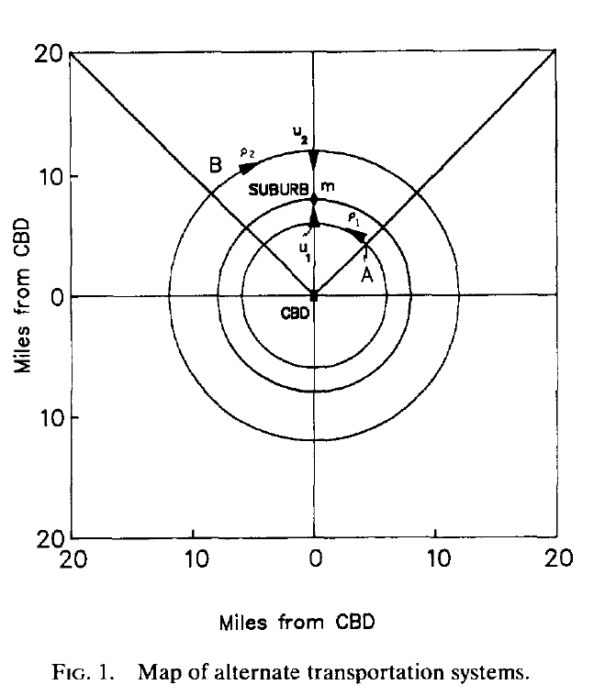
Multiple Worksites

Slide 35
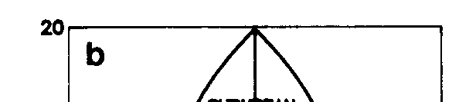
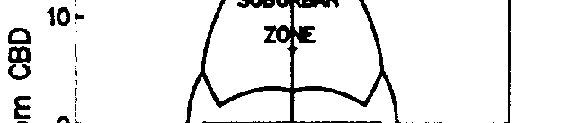
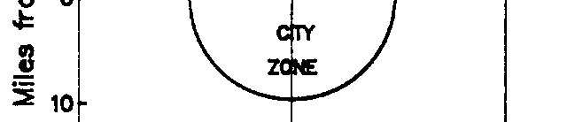
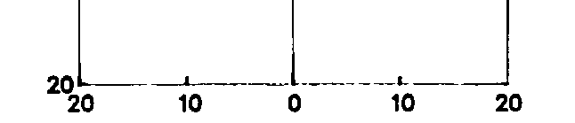
Multiple Worksites
    Miles from CBD

Slide 36
Multiple Worksites
  “City and Suburb”
    This paper solves for the boundary between the residential zones of CBD and SBD workers.
    Along the artery that runs between the SBD and the CBD, for example, the boundary is as follows, where the bars indicate net incomes at :

Slide 37
Multiple Worksites
  “City and Suburb,” 2
    One can differentiate this equation to get some CS results for an open model, as in the case of a beltway model.
    Note that if incomes and commuting costs are equal for the two worksites, this equation reduces to

Slide 38
Multiple Worksites
  “City and Suburb,” 3
    The cases of infinite and finite radial arteries lead to quite different maps.
    These maps are illustrated on the following two slides.
    This paper also shows how it is possible, in principle, to have more than one SBD, although the model is complex if the residential zones of two SBDs overlap.

Slide 39
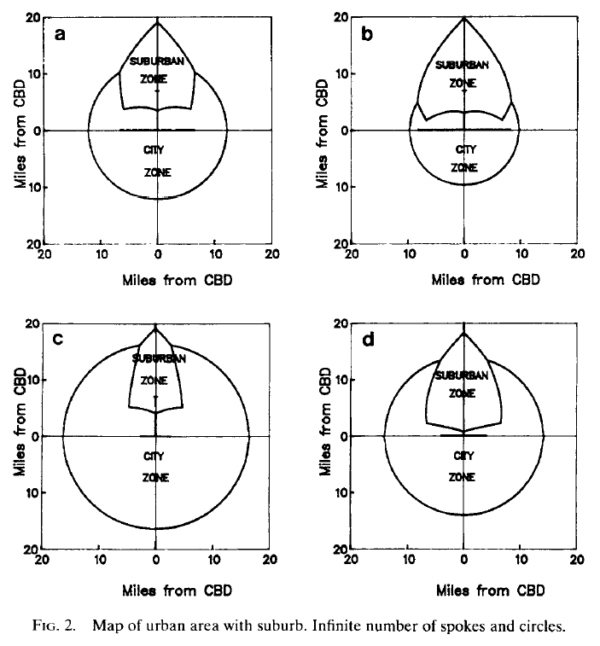
Multiple Worksites

Slide 40
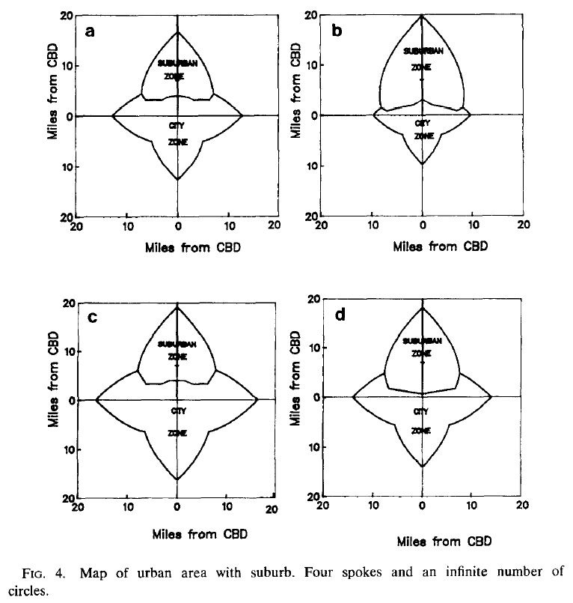
Multiple Worksites

Slide 41
Multiple Worksites
  Addendum on CS with A Full Labor Market
    Ross and Yinger also obtain CS results with a full labor market plus a beltway and an SBD. They find:
      Wages tend to move together in city and suburb.
      Changes in boundaries are usually impossible to sign.
      CS results for a beltway are virtually identical to those for an SBD.

Slide 42
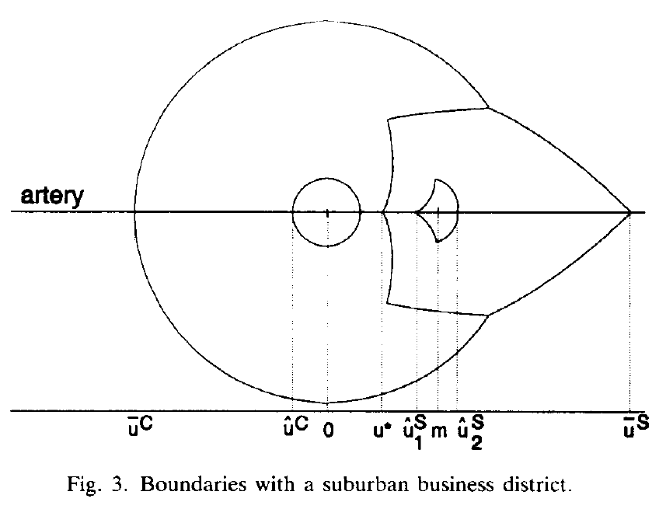
Multiple Worksites

Slide 43
Questions
Multiple Worksites
Questions
What are some alternative ways to model more than one work site?
How is household sorting affected by a suburban work site?

Slide 44
Multiple Worksites
  Class Outline:
    1. Actual Employment Location
    2. Modeling a Full Labor Market
    3. Models with a Beltway
    4. Models with a Suburban Business District
    5. Models with Endogenous Employment Location
    6. Wasteful Commuting?

Slide 45
Multiple Worksites
  Endogenous Employment Location
    An important question that is difficult to answer is: Why do SBDs arise where they do?
    To some degree, the answer may be about historical events or political decisions, such as where to build a beltway.
    But there are economic incentives, too.

Slide 46
Multiple Worksites
  Endogenous Employment Location, 2
    As discussed in White’s 1999 Handbook chapter, firms may be able to save money by moving from a CBD to an SBD.
    The savings arises because they can save workers commuting costs—and hence pay them lower wages.
    In the following picture, a firm that locates at A saves commuting costs equal to the distance between A and the CBD for all workers outside A on the artery between the CBD and A.
    If it raises wages, it picks up workers outside some arc, such as bbb (or, with equal wages, cc, and with higher wages, ddd).

Slide 47
Multiple Worksites
  Zone in which Wages Can Be Lowered
d
CBD
d
d
c
c
b
A
b
b
a

Slide 48
Multiple Worksites
  Other Factors in Firm Location
    Many other hard-to-model factors might influence the emergence of an SBD, or course, such as:
      Agglomeration economies (i.e. productivity advantages from being near other firms);
      Access to transportation;
      Access to productivity-related amenities or public services;
      Access to certain types of workers;
      Distance from competitors.

Slide 49
Multiple Worksites
  Solving for Employment Locations
    An amazing article by Lucas and Rossi-Hansberg (Econometrica, July 2002) solves for the equilibrium location of export employment in a monocentric city.
    Employment can be in any ring, and some rings might have an employment/housing mix.
    Labor productivity can be influenced by employment in nearby rings.
    The mathematics is advanced!

Slide 50
Multiple Worksites
  Local Employment and the Wage Gradient
    Brueckner (JUE, October 1979), introduces local employment, which consists of jobs in dry cleaners, fast-food restaurants, and so on.
    These jobs serve residents where they live—so they follow people.
    The price of housing is determined by commuters to the CBD, so local market workers have to be “uncompensated” at distant locations by receiving a lower wage rate—generating a wage gradient.

Slide 51
Multiple Worksites
  The Wage Gradient
    There is a large empirical literature on wage gradients.
    See, for example, Timothy and Wheaton (JUE, September 2001).
    This literature is not limited to local jobs; indeed, a wage gradient seems to exist for all jobs; recall the wage gradient within the CBD with a full labor market.
    As Timothy and Wheaton put it, “there is inconclusive evidence as to whether wage/commuting cost differences result from equilibrium agglomeration effects or from a disequilibrium distribution of employment.”

Slide 52
Multiple Worksites
  Class Outline:
    1. Actual Employment Location
    2. Modeling a Full Labor Market
    3. Models with a Beltway
    4. Models with a Suburban Business District
    5. Models with Endogenous SBD Location
    6. Wasteful Commuting?

Slide 53
Multiple Worksites
  Wasteful Commuting
    Hamilton and Röell (JPE, October 1982) proposed testing urban models by comparing the average job location (distance from CBD) and the average residential location.
    They said this was the amount of commuting predicted by an urban model.
    They found that actual commuting is 10 times this predicted commuting, so much of it is “wasteful”—and urban models are a poor guide to commuting.

Slide 54
Multiple Worksites
  Hamilton’s Wasteful Commuting
D{u},
J{u}
J{u} = job density
J{u}
D{u}
_
J
_
D
u
Minimum Average Required Commute

Slide 55
Multiple Worksites
  What Hamilton Missed
    White’s 1999 Handbook chapter reviews the subsequent debate. Hamilton did not consider
      Non-central employment,
      Non-radial streets,
      Multiple-worker households.

Slide 56
Multiple Worksites
  Post-Hamilton Studies of Wasteful Commuting
    White (JPE, October 1988) uses data on actual job and housing locations, commuting distance between zones (e.g. zip codes), and linear programming to make all job or housing trades that would lower commuting costs—the spirit of an urban model.
    She finds that actual commuting is only 10% greater than predicted—not 10 times as in Hamilton.
    As she recognizes, she does not consider within-zip-code commuting.

Slide 57
Multiple Worksites
  Post-Hamilton Studies of Wasteful Commuting, 2
    Kim (JUE, September 1995) has data for 1,500 zones in LA.
    He can identify 1- and 2-worker households.
    His linear program also finds trades that cut commuting distance, but 2-worker households can only trade jobs, not houses (so partners are not separated).
    He finds that actual commuting is 50 percent above predicted for 1-worker households and 26 percent above predicted for 2-worker households.

Slide 58
Multiple Worksites
  Post-Hamilton Studies of Wasteful Commuting, 2
    Work still to do:
      Add other benefits from job or housing location.
      Introduce optimal job location.
      Improve measures of commuting costs (e.g. by introducing congestion).

Slide 59
Questions
Multiple Worksites
Questions
What are some of the factors that determine where firms decide to locate?
What is “wasteful commuting,” and how does it shed light on urban models?

