Slide 1
ECN741: Urban Economics
Mortgage Markets and Predatory Lending
Professor John Yinger, The Maxwell School, Syracuse University, 2018

Slide 2
Predatory Lending
Class Outline
  1. The mortgage market today
  2. Predatory lending
  3. The default crisis and its aftermath
  4. The new Consumer Finance Protection Bureau

Slide 3
Predatory Lending
Class Outline
  1. The mortgage market today
  2. Predatory lending
  3. The default crisis and its aftermath
  4. The new Consumer Finance Protection Bureau

Slide 4
Predatory Lending
“It’s A Wonderful Life”
Mortgage markets used to be simple.
  People opened savings accounts in S&Ls; these S&Ls loaned out their deposits to other people in the form of mortgages.
  At any given time, all mortgages were issued at the same interest rate; but people with credit problems were turned down for a loan.

Slide 5
Predatory Lending
New Institutions
How times have changed!
  Now commercial banks can issue mortgages.
  Most mortgages are now issued by mortgage brokers, who do not have deposits, but instead raise capital from depository lenders or investors .
  Secondary mortgage market institutions (Fannie Mae, Freddie Mac) bring investors and borrowers together by buying mortgages and packaging them into “mortgage backed securities,” which anyone can buy.

Slide 6
Predatory Lending
Types of Service in a Mortgage
A mortgage offers four types of services:
  Mortgage origination (using “underwriting”)
  Mortgage servicing
  Default and prepayment risk acceptance
  Capital provision
An S&L did all of these things; now they are often provided by different institutions.

Slide 7
Predatory Lending
The Emergence of Mortgage Brokers
Mortgage brokers, often working as independent entities, originate a large share of loans and may provide the only contact with the borrower until closing.
The mortgage broker plays an important role in pricing the loan, and the broker’s compensation may depend on the interest rate and fees paid by the consumer.

Slide 8
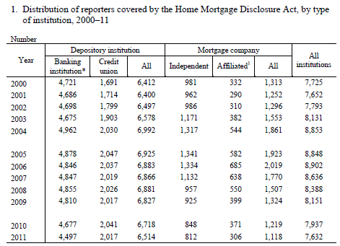
Predatory Lending
New Institutions

Slide 9
Predatory Lending
The Loss of Connection with Borrowers (and Scholars)
Mortgages are sold and re-sold; packaged and re-packaged.
Data systems do not trace the participants and may not even keep track of the title.
Links to the original broker may be lost—with no way to hold the broker accountable for poor underwriting decisions.

Slide 10
Predatory Lending
The Secondary Mortgage Market
Of the 20.2 million home loans originated or purchased in 2004 by lenders covered by HMDA, 14.1 million, or roughly 70 percent, were sold in 2004.
An unknown number of these loans were (or will be) sold on the secondary market in later years.

Slide 11
Predatory Lending
The Role of the GSEs, Pre-Crash
Fannie Mae and Freddie Mac, originally government-sponsored enterprises (GSEs), were private companies widely thought (correctly) to have implicit government backing.
They mainly purchased conventional, low-risk loans for purchase or refinancing.
They bought 35% of the loans purchased by secondary-market institutions.
Other purchasers included banks (8%), private securitization pools (5%), and mortgage and insurance companies (9%).
About 11% of purchases were by firms affiliated with the original lender.

Slide 12
Predatory Lending

Slide 13
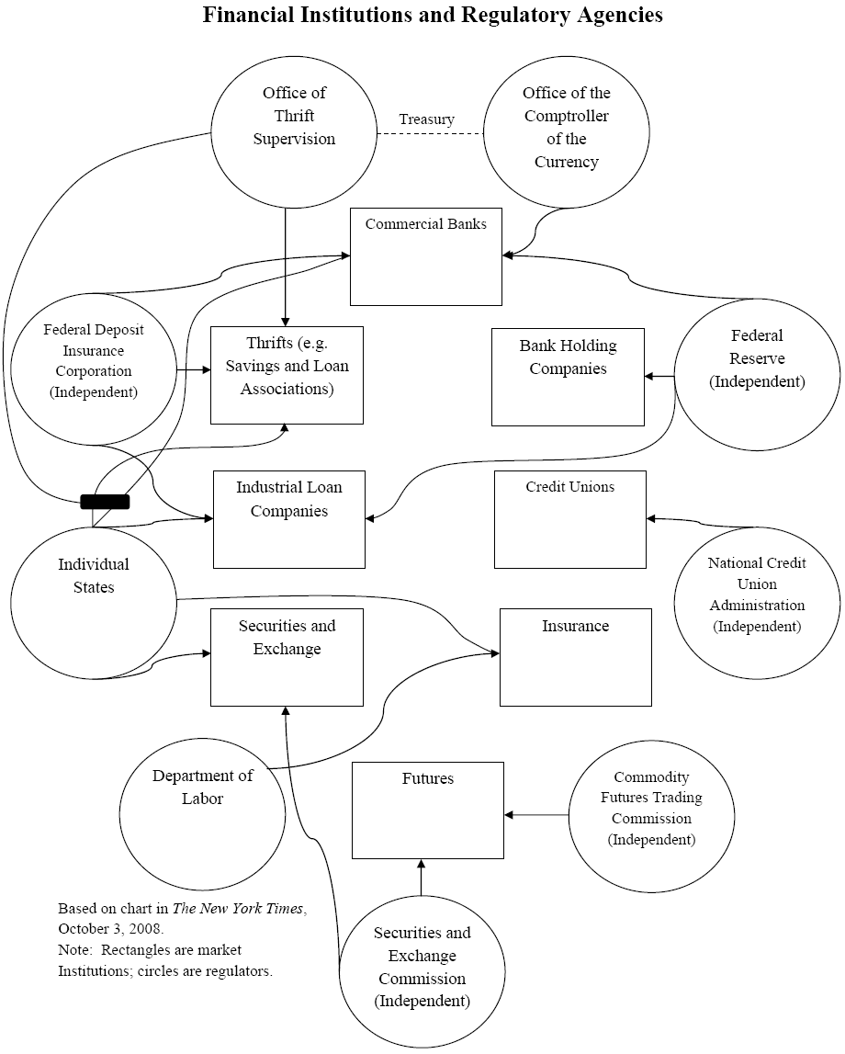
Note: This mess is the system before the Dodd-Frank Act and the CFPB

Slide 14
Predatory Lending
New Products
These changes have led to new products.
  Many types of mortgages are now issued, some of them, called subprime, at high interest rates.
  Many high-risk borrowers can now get a mortgage if they are willing to pay a high rate.
  Lenders buy credit scores and automated underwriting systems to predict which potential borrowers are most likely to default.

Slide 15
Predatory Lending
The Pros and Cons of New Products
These new products dramatically changed mortgage markets.
  This products had the great advantage that they expanded the set of people who could obtain mortgages.
  And the great disadvantage that they opened the door for a lot of mischief in the form of unwarranted fees and pricing practices and in the form of charging some people more that they should have paid.

Slide 16
Predatory Lending
Class Outline
  1. The mortgage market today
  2. Predatory lending
  3. The default crisis and its aftermath
  4. The new Consumer Finance Protection Bureau

Slide 17
Predatory Lending
New Practices
With new products come new practices.
  The complexity of today’s mortgage market puts consumers at a disadvantage.
  Some unscrupulous lenders use misleading or fraudulent tactics to collect interest payments or fees above competitive levels, which is called predatory lending.

Slide 18
Predatory Lending
Types of Predatory Lending
Questionable or illegal practices include:
  Making loans that exceed the borrower’s ability to pay, sometimes with “teaser rates” (2/28 or 3/27 loans);
  Inducing repeated refinancing accompanied by high fees (‘‘loan flipping’’);
  Inducing the consumer, through deception or fraud, to accept loan add-ons, such as credit insurance;
  ‘‘Steering’’ borrowers qualified for lower-rate loans into higher-priced loans;
  Overestimating the value of the collateral to overstate available equity or induce a consumer to pay an inflated price for a home.

Slide 19
Predatory Lending
The Extent of Predatory Lending
Nobody knows how much predatory lending existed before the crisis or how much remains.
  Even without predatory lending, subprime loans would be more common in places with more credit problems.
But there were dramatic increases in high-interest loans, especially in minority and low-income neighborhoods,

Slide 20
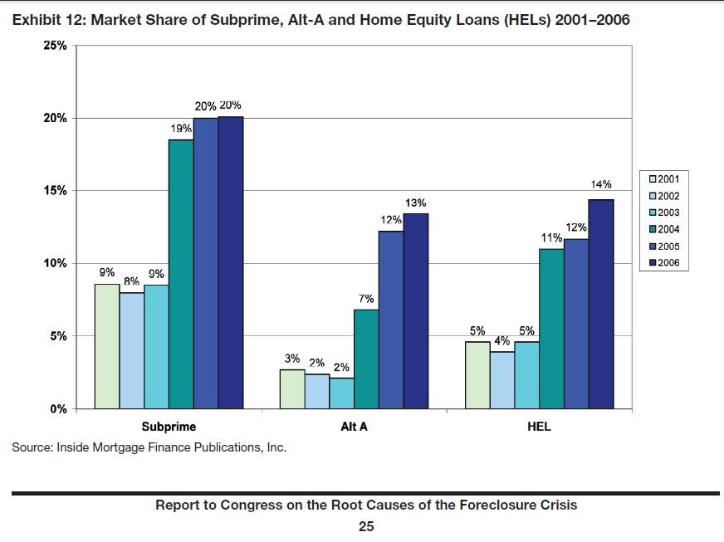
Predatory Lending
Increases in High Cost Loans (HUD)

Slide 21
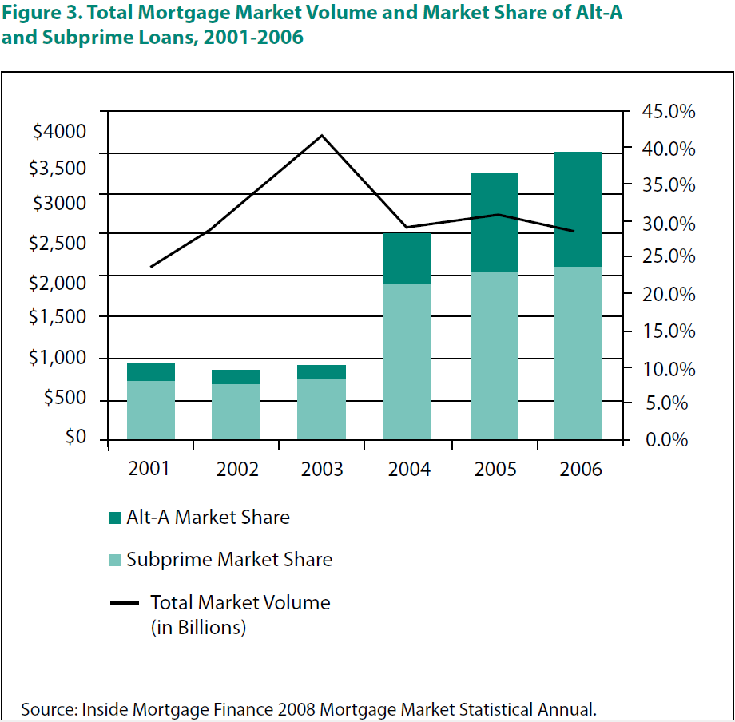
Predatory Lending
Downloaded from:
http://www.responsiblelending.org/state-lending/mortgages

Slide 22
Predatory Lending

Slide 23
Predatory Lending

Slide 24
Predatory Lending

Slide 25
Predatory Lending
Evidence on Predatory Lending
For a recent discussion of predatory lending practices, see
  http://www.responsiblelending.org/tools-resources/signs-of-predatory-lending.html

Slide 26
Predatory Lending
Class Outline
  1. The mortgage market today
  2. Predatory lending
  3. The default crisis and its aftermath
  4. The new Consumer Finance Protection Bureau

Slide 27
Predatory Lending
The Default Crisis
Starting about 2005, the number of defaults, i.e. missed mortgage payments, started to increase.
When payments are missed over 3 or more months, lenders foreclose, that is, they take over the house.
Re-negotiation is rare; the lender holding the loan is unlikely to be the party who issued it.
Millions of homeowners have lost their homes, and it is not over yet.

Slide 28
Predatory Lending
Homeowners in Trouble
A homeowner is “underwater” if its mortgage is greater than the value of its house.
The number of homeowners underwater increased rapidly when the financial crisis hit.
The share of homeowners underwater went from 7% in 1997 to 16% in 2009, to over 31% in 2012 (see chart in a few slides).

Slide 29
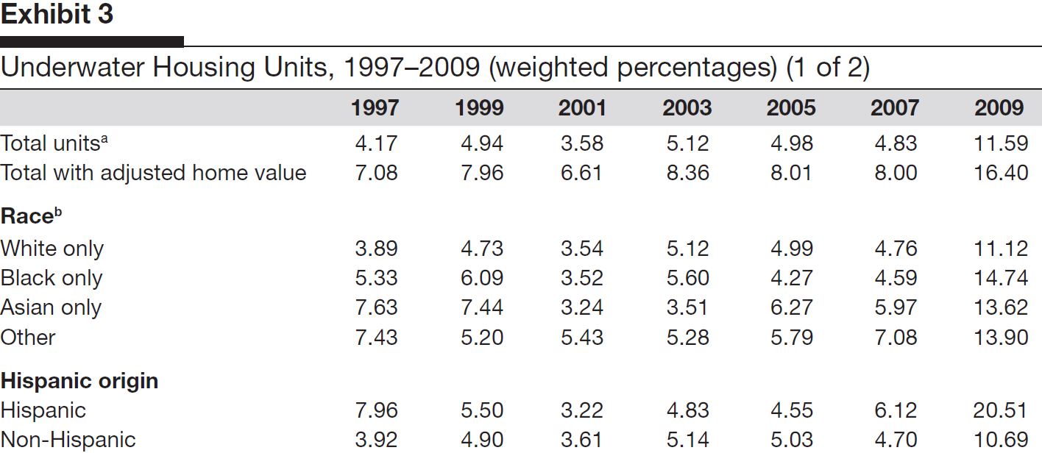
Predatory Lending
Source: Carter (Cityscape 2010)

Slide 30
Predatory Lending
Homeowners in Trouble, Continued
Because of the recession, many homeowners fell behind on their mortgage payments and could not, because they were “under water,” solve the problem by borrowing against their home equity.
Cumulative missed payments constitute default on a mortgage.
Three months of default puts a homeowner in danger of foreclosure, which is the process by which the lender takes over title to the house.

Slide 31
Predatory Lending
Foreclosures
The financial crisis and accompanying housing market crash led to a huge increase in delinquencies and foreclosures.
These increases were concentrated in subprime mortgages.

Slide 32
Predatory Lending

Slide 33
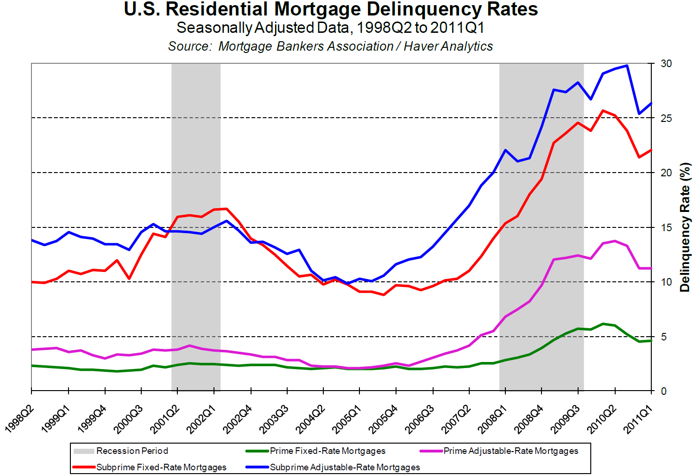
Predatory Lending

Slide 34
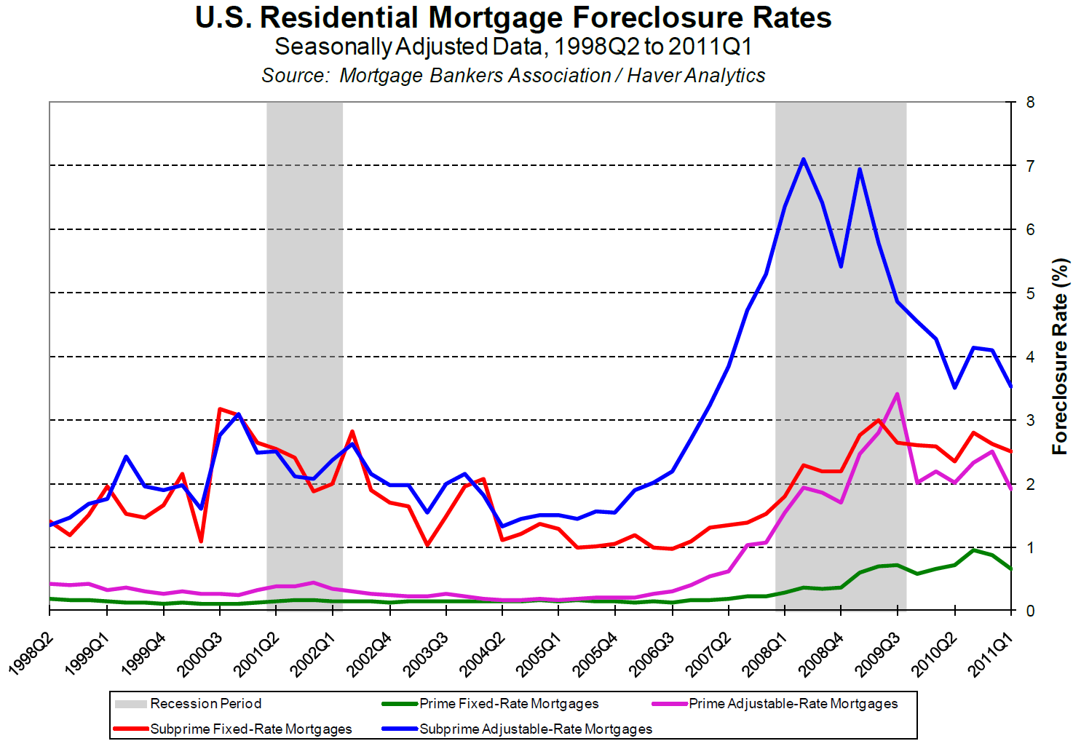
Predatory Lending

Slide 35
Predatory Lending
Impact of Foreclosures
Foreclosures affect housing prices:
  Many neighborhoods have empty houses, which brings down housing prices.
  Some lenders place many foreclosed houses on the market, which drives down prices still further.
Lower housing prices lead to more foreclosures, because they push more owners under water.

Slide 36
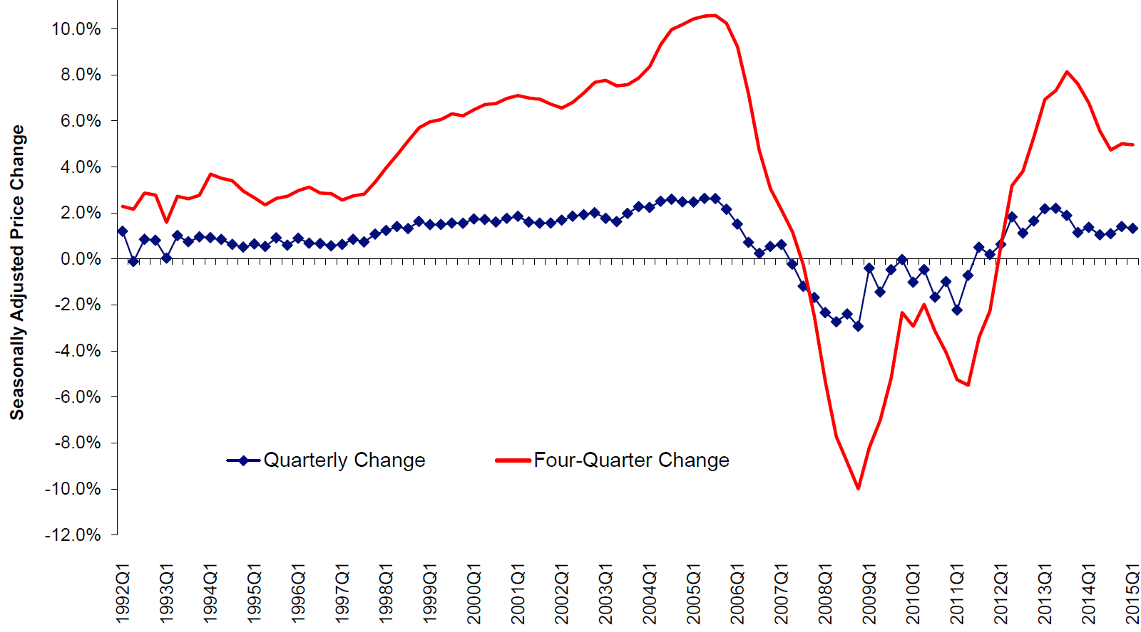
Predatory Lending
FHFA HOUSE PRICE INDEX HISTORY FOR USA
Seasonally Adjusted Price Change Measured in Purchase-Only Index
Seasonally Adjusted Price Change

Slide 37
Predatory Lending
The Financial Crisis
The default crisis grew into a major financial crisis in 2008.
Several large institutions specialized in insuring others against the risk of default (e.g., through Credit Default Swaps, CDSs).
  When defaults spiraled upward, these institutions went under.
  Some were rescued by the federal government, others were not.
  The trouble in these financial institutions spilled over into others, including large banks and mortgage insurance companies.

Slide 38
Predatory Lending
What Caused the Financial Crisis?
1. “Predatory” lending and fraud.
2. Inadequate regulation.
2. Incentives of mortgage brokers and other parties to initiate high-risk loans.
4. Complex links with financial institutions, particularly those spreading risk. (This topic is beyond the scope of today’s class!)

Slide 39
Predatory Lending
Moral Hazard
Mortgage brokers could initiate a risky loan and sell it, thereby insulating themselves from default risk.
  This is called moral hazard (= being insured against a risk over which one has control)
Moreover, the housing market was booming, so people bought these mortgages without being very concerned about default.
CDSs and other risk-shifting assets were developed so people could avoid risk when they were worried about it.
Everyone (including the credit ratings agencies and the institutions specializing in CDSs) underestimated the probability of market-wide problems.

Slide 40
Predatory Lending
Evidence on Moral Hazard
Mian and Sufi (QJE, November 2009) find evidence that moral hazard was at work starting in about 2002:
  The share of high loan-to-value loans went up.
  The share of loans being sold went up.
  Neighborhoods where people had been turned down for loans in 2001 (and where income had not grown thereafter), called “subprime” zip codes, experienced large increases in loan approval—and in defaults.

Slide 41
Predatory Lending
Evidence on Moral Hazard
The following charts are from the Mian and Sufi on-line appendix, which is available at:
http://www.princeton.edu/~atif/OnlineAppendix_MortgageCrisis.pdf .

Slide 42
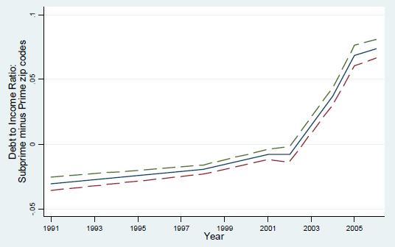
Predatory Lending
Huge Decrease in Quality of Approved Loans

Slide 43
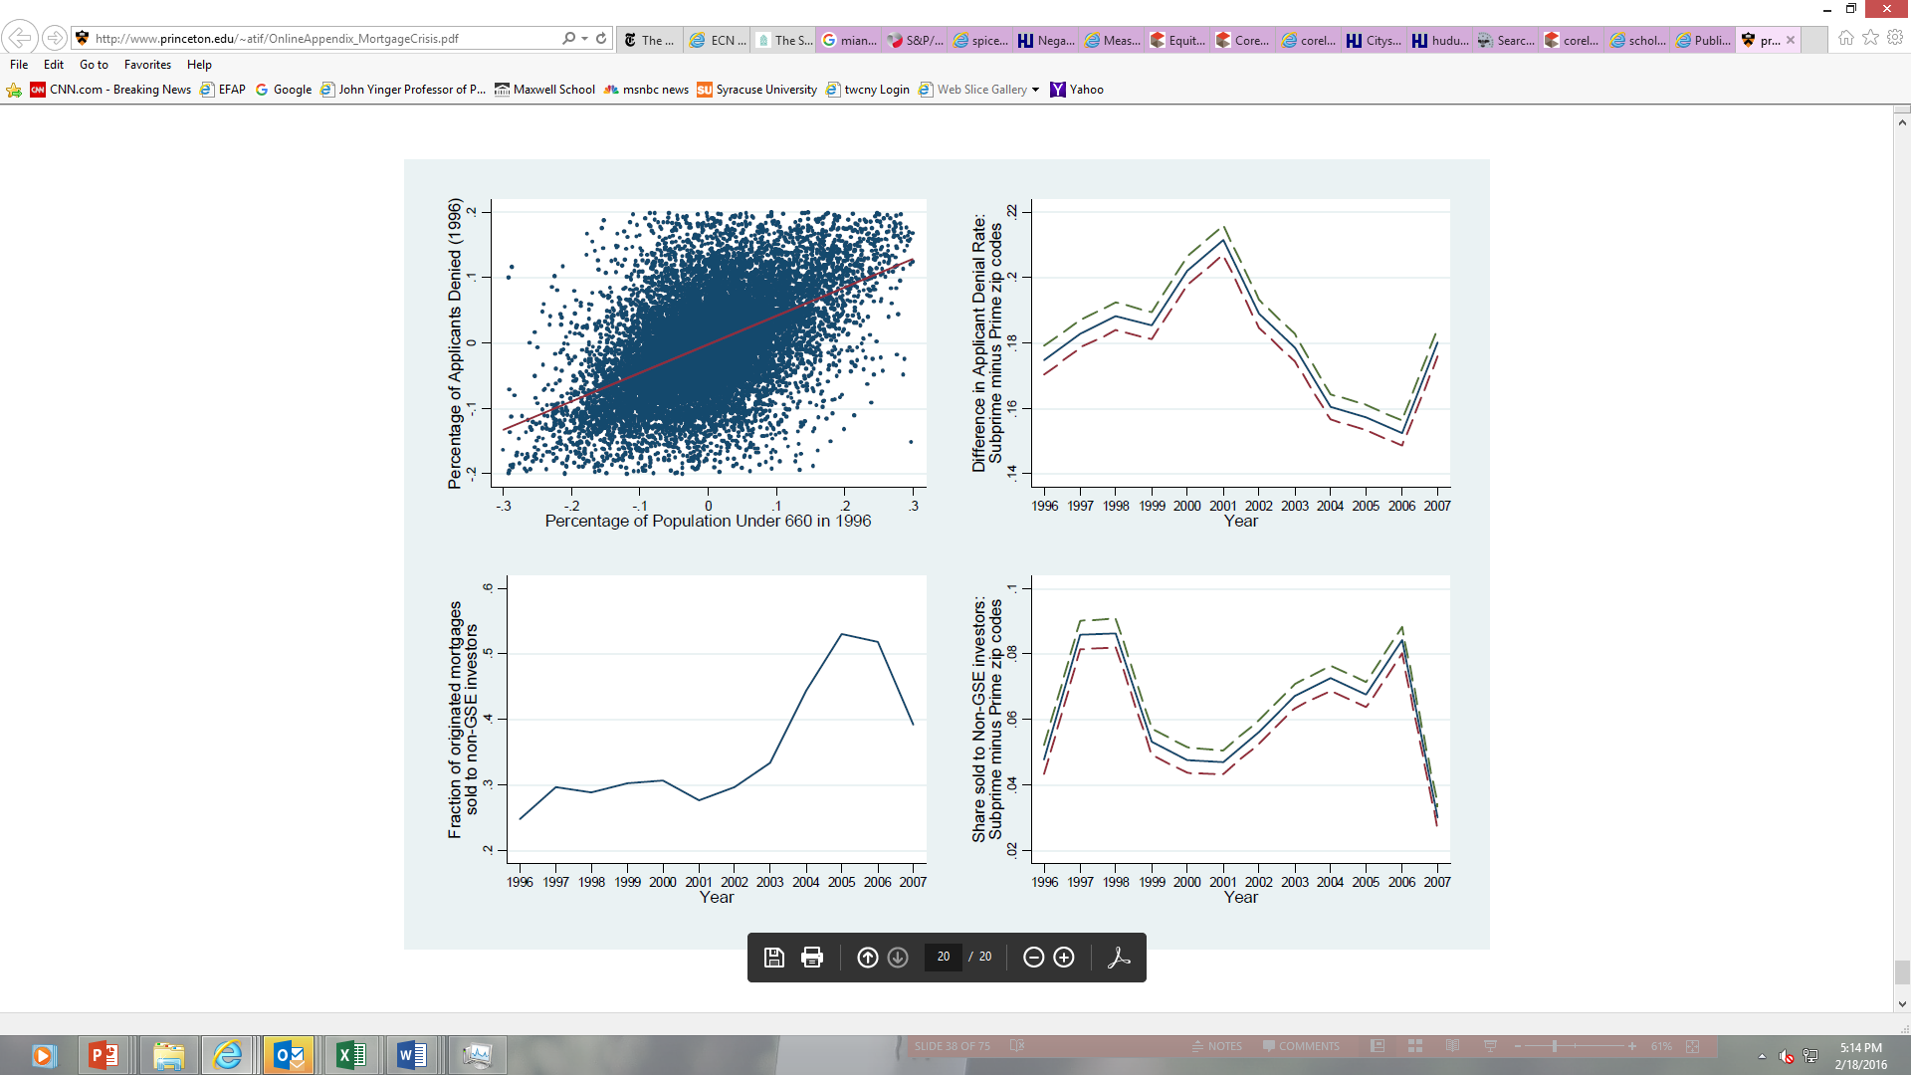
Predatory Lending
Huge Increase in Sales of Mortgages—and Not to the GSEs

Slide 44
Predatory Lending
Huge Decrease in Mortgage Denial Rate

Slide 45
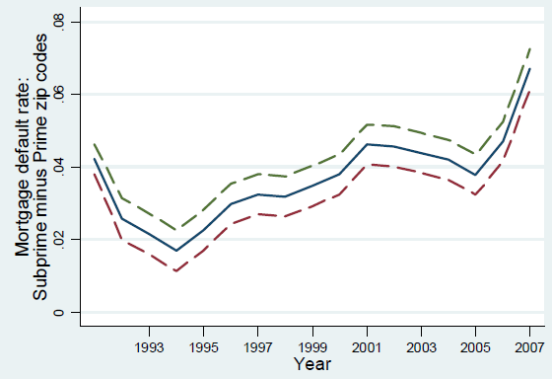
Predatory Lending
Huge Increase in Mortgage Default Rate

Slide 46
Predatory Lending
Foreclosures and Disadvantaged Groups
The impact of foreclosures has not been even; historically disadvantaged groups have been hit particularly hard.
  Due to past discrimination, Blacks and Hispanics have poorer credit characteristics and were more likely to have sub-prime or predatory loans—even without current discrimination.
  Some lenders marketed sub-prime or predatory loans in minority neighborhoods and often gave those loans to households that qualified for more favorable terms.
  The result: Relatively high foreclosure rates—and a huge loss of equity—for Black and Hispanic households.

Slide 47
Predatory Lending

Slide 48
Predatory Lending
Newman and Holupka (Real Estate Economics, Summer 2016)
From Johns Hopkins University press release:
The researchers analyzed data from the Panel Study of Income Dynamics.
They focused on first-time buyers. About 40 percent of all homebuyers are first-time buyers and more than 60 percent of those buyers are low-to moderate income.
During the Great Recession, between 2007 and 2009, the net worth for new white homebuyers dropped 33 percent, while new black homebuyers lost 43 percent of their wealth.
During the boom, between 2005 and 2007, white first-time buyers enjoyed net worth gains of 50 percent while new black homebuyers lost 47 percent. In dollar terms, while whites were gaining about $24,000, blacks were losing $16,911.
Even in good times, appreciation is lower (or negative!) in black neighborhoods.

Slide 49
Predatory Lending
It Was Not the Fault of Fannie and Freddie
Fannie Mae and Freddie Mac were large, profitable private organizations that packaged loans meeting certain standards. During the crisis, they were bought (back) by the federal government.
Some people say they caused the crisis by going too far in encouraging homeownership. This is nonsense.
They mainly purchased conventional, low-risk loans for purchase or refinancing; they purchased very few sub-prime loans before the crisis.
Starting in about 2004, however, they started to invest in institutions that purchased sub-prime loans, so they took huge losses when the crisis came. That’s why the federal government had to buy them back—and why they may be dismantled.

Slide 50
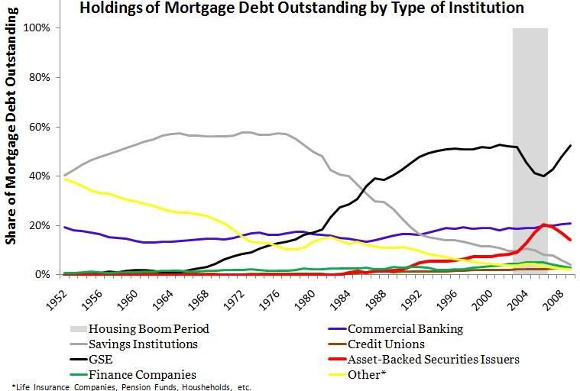
Predatory Lending

Slide 51
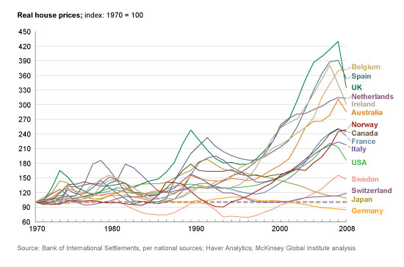
Predatory Lending
No Other Country Had Fannie, Freddie, or CRA,
but…….

Slide 52
Predatory Lending
It Was Not the Fault of CRA
The Community Reinvestment Act of 1977 requires depository lenders to serve all parts of their traditional lending areas.
  Lenders who do not serve low-income or minority areas may be denied the ability to set up new offices or make other business changes.
  Lenders have altered their practices because of CRA regulations, which were strengthened in the Clinton Administration.
Some people say CRA’s push to serve low-income areas is a key cause of the crisis. Nonsense.
CRA only applies to depository lenders. They were not the ones issuing subprime loans. CRA does not apply to mortgage brokers or the institutions that package mortgage loans.

Slide 53
Predatory Lending
Where Are We Now?
What is happening in housing and mortgage markets today?
Are foreclosures still a big problem?
What is going on with federal policy?

Slide 54
Predatory Lending
Post-Crash Housing & Mortgage Markets
After the collapse of the housing bubble in 2008, housing prices continued to decline until 2012; now they are rising again.
Because of the recession, household incomes declined until recently, too.
These trends slowed the recovery from all the trouble in mortgage markets.

Slide 55
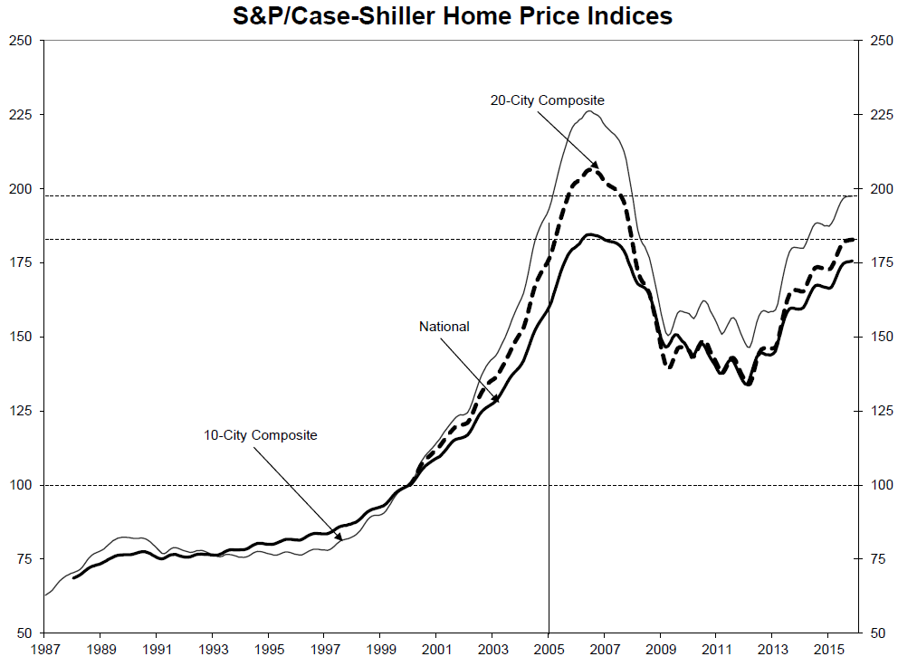
Predatory Lending

Slide 56
Predatory Lending
Homeowners Still in Trouble
The share of homeowners “underwater” (also called households with negative equity) continued to increase until 2012.
It has declined quite a bit in recent years and is now down to about 14%.

Slide 57
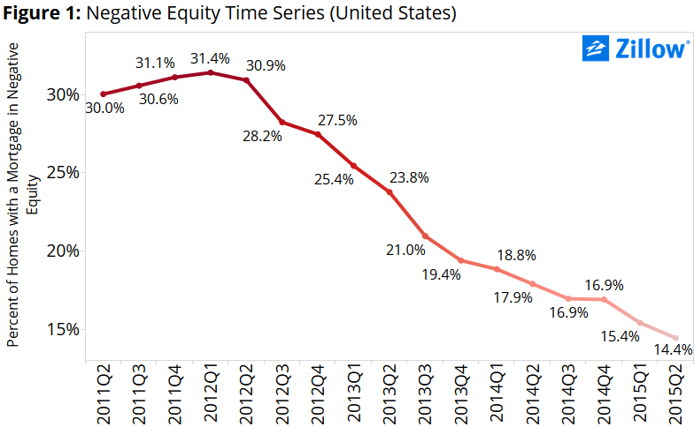
Predatory Lending

Slide 58
Predatory Lending
Homeowners Still in Trouble, 2
The default and foreclosure rates have both fallen substantially since 2012.
But rates of default and foreclosure are still relatively high by historical standards.

Slide 59
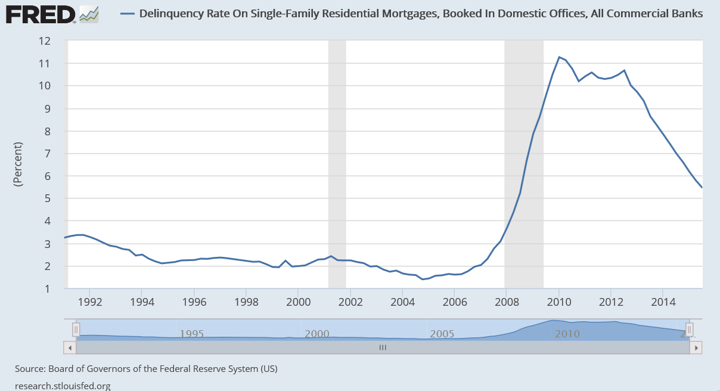
Predatory Lending

Slide 60
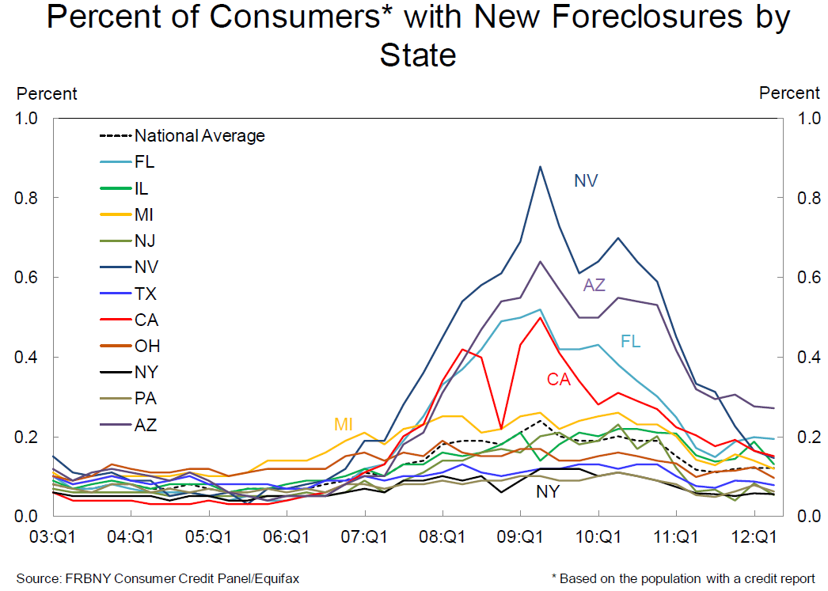
Predatory Lending

Slide 61
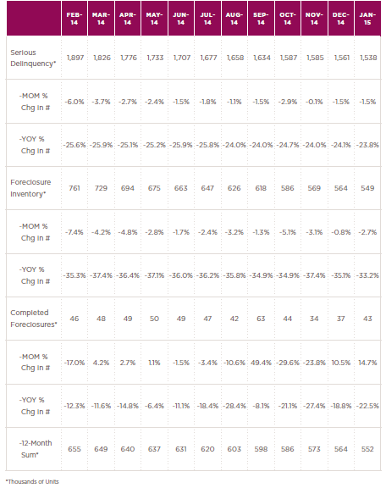
Predatory Lending
Recent developments in serious delinquency and foreclosure .
MOM = Month over month
YOY = Year over year.
Source: CoreLogic
http://www.corelogic.com/research/foreclosure-report/national-foreclosure-report-january-2015.pdf

Slide 62
Predatory Lending
Other Changes
Lenders have become much more conservative; that is, the number of mortgage loans has dropped a lot.
Moreover, sub-prime loans have become much less common.

Slide 63
Predatory Lending

Slide 64
Predatory Lending
Source: Bhutta and Ringo, Federal Reserve Bulletin

Slide 65
Predatory Lending

Slide 66
Predatory Lending
Class Outline
  1. The mortgage market today
  2. Predatory lending
  3. The default crisis and its aftermath
  4. The new Consumer Finance Protection Bureau

Slide 67
Predatory Lending
The Dodd-Frank Wall Street Reform and Consumer Protection Act of 2010
During the default crisis, laws to prevent predatory lending proved to be ineffective.
The Dodd-Frank Act established the Consumer Finance Protection Bureau (CFPB).
This act is designed to improve procedures for protecting consumers in credit markets.

Slide 68
Predatory Lending
The Consumer Finance Protection Bureau
The CFPB will
  Make sure that consumers have the information they need to understand the terms of their agreements with financial companies
  Make regulations and guidance as clear and streamlined as possible so providers of consumer financial products and services can follow the rules on their own.

Slide 69
Predatory Lending
The Consumer Finance Protection Bureau, 2
The CFPB will also implement and enforce new protections under the Dodd-Frank Act that will:
  Require mortgage lenders to determine that a borrower has the ability to repay a loan by verifying income and making sure borrowers can afford loans even after teaser rates expire and payments rise.
  Prohibit prepayment penalties, which can make it expensive to refinance, for high cost loans and adjustable-rate mortgages.
  Put an end to practices like paying bonuses to mortgage brokers and loan officers who steer borrowers into higher-cost loans than they otherwise qualify for.

Slide 70
Predatory Lending
Predatory Lending and Fair Lending
The CFPB is also now the principal enforcer of fair lending laws.
  Which are discussed in our next class.

