Slide 1
ECN741: Urban Economics
Testing Urban Models
Professor John Yinger, The Maxwell School, Syracuse University, 2018

Slide 2
Testing Urban Models
  Approaches
    1. Estimate P{u}
    2. Estimate R{u} (land rent)
    3. Estimate D{u} (density)
    4. Bring in buyer perceptions
    5. Estimate theoretically derived envelopes

Slide 3
Testing Urban Models
  Approaches
    1. Estimate P{u}
    2. Estimate R{u} (land rent)
    3. Estimate D{u} (density)
    4. Bring in buyer perceptions
    5. Estimate derived envelope and bid functions

Slide 4
Testing Urban Models
  Dozens of studies include distance to CBD as an explanatory variable.
    Some include actual commuting time (available in the census), which is endogenous!
  Examples of recent studies that look at several different ways of measuring time or distance:
    Ottensmann, John R., Seth Payton, and Joyce Man. 2008. “Urban Location and Housing Prices within a Hedonic Model.” Journal of Regional Analysis and Policy 38 (1):19-35.
    Waddell, Paul, Brian J. L. Berry, and Irving Hoch. 1993. “Residential Property Values in a Multinodal Urban Area: New Evidence on the Implicit Price of Location.” The Journal of Real Estate Finance and Economics 7 (2) (September): 117-141.

Slide 5
Testing Urban Models
  Example: Ottensmann et al.
  These scholars identify many different measures of commuting time and distance.
  They compare models with different measures.
  No clear winner emerges.
  Their results are summarized in the following table (where TAZ = traffic analysis zone).

Slide 6
Testing Urban Models

Slide 7
Testing Urban Models
  Limitations
  These studies do not use theory to derive functional forms.
  Moreover, many of them forget the most basic fact about an envelope: Moving along the envelope reflects both a change in bids from a given household type and a change from one household type to another: bidding and sorting!
    The coefficient of a time or distance variable does not indicate household willingness to pay for access to jobs.
    A point on a nonlinear envelope indicates a point on a household’s marginal willingness to pay (i.e. inverse demand function) for access to jobs—a point that depends on the nature of the existing market equilibrium.
    But a linear (or semi-log) envelope essentially assumes that no sorting exists and cannot be given a willingness to pay interpretation.

Slide 8
Household Heterogeneity
Bid-Rent Functions and Their Envelope
Envelope
Bid Functions

Slide 9
Testing Urban Models
  Deriving a Functional Form
  One study tried to bring in theoretically derived functional forms.
    Yinger, John. 1979. “Estimating the Relationship between Location and the Price of Housing.” 1979. Journal of Regional Science, 19 (3) (August): 271‑286.
  But the price was too high:
    Assumed Cobb-Douglas utility.
    Assumed people in a given income-taste class lived in a ring around the CBD.
    Ignored non-central worksites.

Slide 10
Testing Urban Models
  Approaches
    1. Estimate P{u}
    2. Estimate R{u} (land rent)
    3. Estimate D{u} (density)
    4. Bring in buyer perceptions
    5. Estimate derived envelope and bid functions

Slide 11
Testing Urban Models
  Land rent summarizes the derived demand for land, and some studies estimate R{u} instead of P{u}.
    Example: D.P. McMillen, "One Hundred Fifty Years of Land Values in Chicago: A Nonparametric Approach," JUE (July 1996), pp. 100-124.
  These studies do not use theoretically derived functional forms.

Slide 12
Testing Urban Models
  Approaches
    1. Estimate P{u}
    2. Estimate R{u} (land rent)
    3. Estimate D{u} (density)
    4. Bring in buyer perceptions
    5. Estimate derived envelope and bid functions

Slide 13
Testing Urban Models
  A huge literature, going back to the 1950s, estimates population density functions, D{u}.
  Fairly recent reviews can be found in:
    Small and Song, "Population and Employment Densities: Structure and Change," JUE, (November 1994), pp. 292-313.
    Anas, Arnott, and Small, “Urban Spatial Structure,” Journal of Economic Literature (September 1998), pp. 1426-1464
  There is not much theory in this literature, apart from the (incorrect) derivation of the exponential form from an urban model, which we discussed in an earlier class.

Slide 14
Testing Urban Models
  Some informal theory is offered in the case of multiple worksites.
  The paper below identifies three assumptions: that different worksites are substitutes, complements, or somewhere in between.
    Heikkila, E., P. Gordon, J. I. Kim, R. B. Peiser, H. W. Richardson, and D. Dale-Johnson. 1989. “What Happened to the CBD-Distance Gradient?: Land Values in a Policentric City.” Environment and Planning A 21 (2): 221-232.
  Allocating each household to a worksite, as in the models discussed earlier, is an example of the first assumption.

Slide 15
Testing Urban Models
  Lots of room for more work on density with big data.
  Three-dimensional maps.
    How they change over time.
    How they correlate with job locations or transportation systems.

Slide 16
Testing Urban Models
  Another approach is to focus on light at night.
  Light is a sign of activity.
    Recent photographs from space show the lack of active after a hurricane.
    Some studies look at light patterns to indicate economic growth as indicated by changes in density.
    Some city light pictures are on the following slides.

Slide 17
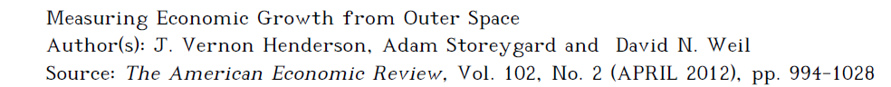
Testing Urban Models
  See, also:

Slide 18

Testing Urban Models
  Boston

Slide 19
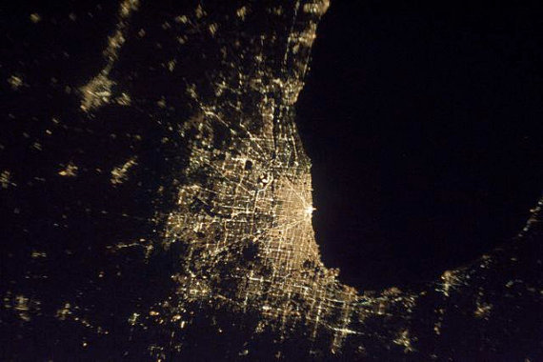
Testing Urban Models
  Chicago

Slide 20

Testing Urban Models
  Shanghai

Slide 21
Testing Urban Models
  Approaches
    1. Estimate P{u}
    2. Estimate R{u} (land rent)
    3. Estimate D{u} (density)
    4. Bring in buyer perceptions
    5. Estimate derived envelope and bid functions

Slide 22
Testing Urban Models
  Another way to think about the issue here is that it concerns home buyer perceptions.
  What information do home buyers have about the time or distance to work sites?
  Do they care about time or distance?
  Do they care only about time or distance to one worksite, or do they care about many worksites because the household has multiple workers, might change jobs in the future, or might sell to someone with a different worksite?

Slide 23
Testing Urban Models
  These questions have led me and Carlos Diaz to define as many reasonable time and distance measures as possible with my Cleveland data.
  And then to determine which ones work the best.
    This is essentially what Ottensmann et al. did, too.
  In other words, I want the data to answer the above questions.
  We have looked at 9 distance and 9 time measures:

Slide 24
Testing Urban Models
 | Mean | Std. Dev. | Minimum | Maximum
Distance Measures
Actual commuting distance | 7.97 | 2.79 | 3.01 | 29.04
Distance to Terminal Tower (straight-line) | 13.39 | 9.12 | 1.11 | 41.36
Distance to Terminal Tower (Google) | 47.54 | 16.09 | 0.84 | 89.26
Employment-weighted distance (straight-line) | 13.20 | 7.45 | 7.27 | 39.51
Employment-weighted distance (Google) | 17.02 | 9.35 | 8.39 | 51.26
Distance with beltway (straight-line) | 7.28 | 7.53 | 0.01 | 33.66
Distance with beltway (Google) | 10.04 | 10.04 | 0.01 | 46.80
Principal components distance (straight-line) | 0.00 | 1.81 | -1.80 | 6.23
Principal components distance (Google) | 0.00 | 1.79 | -1.95 | 6.27
Time Measures
Actual commuting time | 25.87 | 4.28 | 11.11 | 46.53
Time to Terminal Tower (straight-line) | 44.51 | 16.90 | 9.87 | 87.48
Time to Terminal Tower (Google) | 63.29 | 15.90 | 2.37 | 104.58
Employment-weighted time (straight-line) | 46.31 | 14.17 | 25.97 | 86.26
Employment-weighted time (Google) | 23.39 | 10.02 | 11.11 | 55.77
Time with beltway (straight-line) | 40.78 | 25.36 | 4.24 | 107.85
Time with beltway (Google) | 13.69 | 11.67 | 0.02 | 50.77
Principal components time (straight-line) | 0.00 | 1.77 | -2.55 | 5.80
Principal components time (Google) | 0.00 | 1.74 | -2.01 | 5.77

Slide 25
Testing Urban Models
  One tricky issue is how to allocate households to worksites with multi-site measures.
    Recall that finding the boundaries between the residential zones of suburban and central city workers is pretty complicated.
    But the allocation problem in this case is not so complicated because we already know (1) how many workers are at each worksite and (2) how many households live in each neighborhood (CBG).
      So the idea is just to pick the closest CBGs until there are enough people to fill the jobs at each worksite.

Slide 26
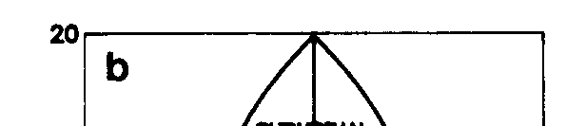
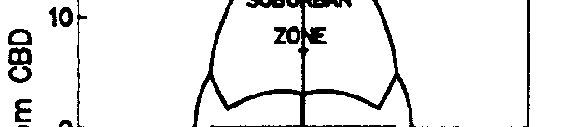
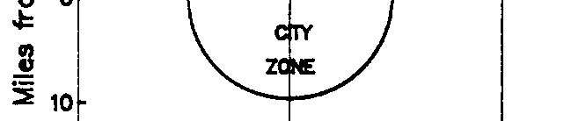
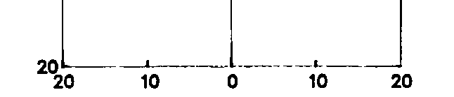
Testing Urban Models
    Miles from CBD

Slide 28
Testing Urban Models
  Which Measure Is Best in Theory?
    Time has the advantage over distance that it accounts for actual routes, mode choice, and congestion.
    Distance has the advantage over time that it incorporates operating costs.
    Distance also may be more easily perceived by a house buyer. But we really do not know what people perceive—that is, what information about commuting costs they rely on when they make a housing bid.

Slide 29
Testing Urban Models
  Which Measure Is Best in Practice?
    The Diaz/Yinger paper uses a variety of specification tests to find the measures with the greatest explanatory power.
      These tests are all based on a quadratic specification of the access variable.
      In the case of distance, the 2 best measures are actual commuting distance and straight-line distance to the Terminal Tower.
      The analogous measures are best for time: actual commuting time and time to the Terminal Tower along a straight line.
      The best overall measure is actual commuting distance.
      I am using these selected measures in my current empirical work.

Slide 30
Testing Urban Models
  Approaches
    1. Estimate P{u}
    2. Estimate R{u} (land rent)
    3. Estimate D{u} (density)
    4. Bring in buyer perceptions
    5. Estimate derived envelope and bid functions

Slide 31
Testing Urban Models
  Controls
    These results given below come from a regression with many controls for housing characteristics, neighborhood characteristics, and public services.
    More on this later!
    The initial regression has about 23,000 house sales and 1,665 neighborhood (CBG) fixed effects.
    The housing price (=P{u}) regression is based on 1,665 neighborhoods (CBGs).

Slide 32
Testing Urban Models
Table 3. Correlations for Distance and Time Measures
 | Dist 1 | Dist 2 | Dist 3 | Dist 4 | Dist 5 | Dist 6 | Dist 7 | Dist 8 | Dist 9
Distance 1 | 1.00
Distance 2 | 0.99 | 1.00
Distance 3 | 0.71 | 0.73 | 1.00
Distance 4 | 0.64 | 0.63 | 0.55 | 1.00
Distance 5 | 0.97 | 0.98 | 0.79 | 0.62 | 1.00
Distance 6 | 0.79 | 0.80 | 0.66 | 0.56 | 0.78 | 1.00
Distance 7 | 0.77 | 0.79 | 0.66 | 0.53 | 0.78 | 0.96 | 1.00
Distance 8 | 0.64 | 0.65 | 0.87 | 0.58 | 0.69 | 0.72 | 0.73 | 1.00
Distance 9 | 0.79 | 0.80 | 0.79 | 0.60 | 0.82 | 0.91 | 0.92 | 0.85 | 1.00
 | Time 1 | Time 2 | Time 3 | Time 4 | Time 5 | Time 6 | Time 7 | Time 8 | Time 9
Time 1 | 1.00
Time 2 | 0.70 | 1.00
Time 3 | 0.30 | 0.57 | 1.00
Time 4 | -0.03 | 0.07 | 0.28 | 1.00
Time 5 | 0.82 | 0.87 | 0.61 | 0.10 | 1.00
Time 6 | 0.95 | 0.67 | 0.34 | 0.06 | 0.78 | 1.00
Time 7 | 0.94 | 0.68 | 0.34 | 0.04 | 0.76 | 0.99 | 1.00
Time 8 | 0.61 | 0.54 | 0.66 | 0.25 | 0.66 | 0.70 | 0.71 | 1.00
Time 9 | 0.90 | 0.79 | 0.52 | 0.10 | 0.89 | 0.94 | 0.95 | 0.76 | 1.00

Slide 33
Testing Urban Models
Semi-Log Bid-Price Function Envelopes, Part 1
Distance Measure | Coefficient | t-Statistic | R-Squared
Distance 1 | -0.0070482 | -4.58 | 0.7142
Distance 2 | -0.0069594 | -4.61 | 0.7143
Distance 3 | -0.0061207 | -4.39 | 0.7138
Distance 4 | -0.0018316 | -0.82 | 0.7103
Distance 5 | -0.0078257 | -4.81 | 0.7145
Distance 6 | -0.0015973 | -1.84 | 0.7110
Distance 7 | -0.0012967 | -1.55 | 0.7108
Distance 8 | -0.0023002 | -2.43 | 0.7118
Distance 9 | -0.0019577 | -2.01 | 0.7112

Slide 34
Testing Urban Models
Semi-Log Bid-Price Function Envelopes, Part 2
Time Measure | Coefficient | t-Statistic | R-Squared
Time 1 | -0.0043931 | -4.46 | 0.7145
Time 2 | -0.0030373 | -1.72 | 0.7112
Time 3 | -0.0008516 | -1.89 | 0.711
Time 4 | -0.0027473 | -2.21 | 0.7113
Time 5 | -0.0040401 | -4.59 | 0.7145
Time 6 | -0.0029835 | -2.31 | 0.7115
Time 7 | -0.0023512 | -1.82 | 0.711
Time 8 | -0.0022187 | -2.19 | 0.7115
Time 9 | -0.0041787 | -2.94 | 0.7121

Slide 35
Testing Urban Models
  The next step is to estimate theoretically derived bid-price function envelopes.
  These are the envelopes covered in the slides and notes on household heterogeneity.
  The regressions on which these pictures are based work very well, with highly significant coefficients for the two variables that define the envelope, which were derived in an earlier class—but they are preliminary!
  Distance 5 works best and distance works better than time, but the differences in SSE are small.

Slide 36
Testing Urban Models

Slide 37
Testing Urban Models

Slide 38
Testing Urban Models

Slide 39
Testing Urban Models
  A Big Puzzle: Many of these envelopes turn up for the longest commutes.
    I do not know what this means.
    It could mean that some people actually enjoy commuting.
    It could mean that I have an omitted variable that is highly correlated with distance, such as peace and quiet.
    Note that this puzzle show up in the simple quadratic forms, too—it is not a product of my functional form.

Slide 40
Testing Urban Models
  The next step: Look for normal sorting.
    The functional form used in these estimations makes it possible to separate bidding and sorting.
    It also makes it possible to test for normal sorting: that is, do higher-income households tend to live in more distant locations. This test was described in an earlier class.
    I have not conducted these tests yet, but will let you know if I get to them this fall.

