Slide 1
School District Consolidation
William Duncombe and John Yinger
The Maxwell School,
Syracuse University
February 2019

Slide 2
History of Consolidation
Consolidation has eliminated over 100,000 school districts since 1938.
  This is a drop of almost 90 percent.
  Consolidation continues today, but at a slow pace.
Consolidation is a big issue in state aid programs.
  Several states have aid programs to encourage district “reorganization,” typically in the form of consolidation
  Other states encourage consolidation through building or transportation aid
  About 1/3 of the states compensate school districts for sparsity or small scale—thereby discouraging consolidation.

Slide 3
Economies of Size and Consolidation
Economies of size exist if education cost per pupil declines with enrollment.
  Consolidation lowers cost per pupil if there are economies of size.
Previous studies estimate cross-section cost functions.
  Most find a U-shaped relationship between cost per pupil and size
  No previous statistical study looks at consolidation directly
This study estimates economies of size using panel data for New York State.
  The data include all rural school districts, including 12 pairs that consolidated
  The sample period is 1985 to 1997
  We estimate economies of size (and other cost effects of consolidation) with panel methods.

Slide 4
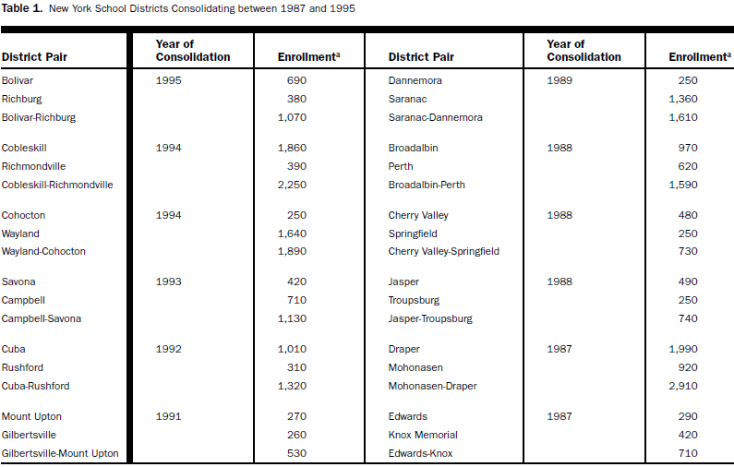

Slide 5
Are There Economies of Size?
Potential Sources of Economies of Size
  Indivisibilities (i.e. Publicness)
  Increased Dimension (i.e. Efficient Use of Capital)
  Specialization
  Price Benefits of Scale
  Learning and Innovation
Potential Sources of Diseconomies of Size
  Higher Transportation Costs
  Labor Relations Effects
  Lower Staff Motivation and Effort
  Lower Student Motivation and Effort
  Lower Parental Involvement

Slide 6
The Cost Model in Duncombe/Yinger
E = E{S, P, N, M, C, Z}
E = spending per pupil (total or in a subcategory)
S = school performance (test scores, dropout rate)
P = input prices (teacher wage)
N = enrollment
M = student characteristics
C = consolidation
Z = variables that influence school-district efficiency
Data for 212 districts over 13 years.

Slide 7
Methodological Challenge #1
Challenge:
  Consolidation might be endogenous.
Response:
  Use district-specific fixed effects
  Use district-specific time trends
  Control for change in superintendent
  Standard simultaneous-equations procedure not feasible; use a control function as final check

Slide 8
Structure of D/Y Fixed Effects

Slide 9
Implications of Fixed Effects & Time Trends
Because consolidation is a long process, not an event, we believe this approach is adequate protection against endogeneity.
This approach highlights the impact of enrollment change.
This price is that we cannot estimate the coefficients of other variables with precision.

Slide 10
Methodological Challenge #2
Challenge:
  Consolidation may have non-enrollment effects that change over time.
Responses:
  Include post-consolidation fixed effect for each pair
  Include post-consolidation time trend for each pair

Slide 11
Methodological Challenge #3
Challenge:
  Performance, teacher salaries, and state aid are endogenous.
Responses:
  Use two-stage least squares
  Select instruments from exogenous characteristics of comparable districts (e.g. income and aid in neighboring districts, manufacturing wage)
  Conduct over-identification test
  Conduct weak-instrument test

Slide 12
Methodological Challenge #4
Challenge:
  Capital spending and associated state aid are lumpy.
Responses:
  Use 4-year averages in capital spending regression (for spending, enrollment, aid, property value)
  Adjust fixed effects and time trends
  Adjust post-consolidation fixed effects

Slide 13
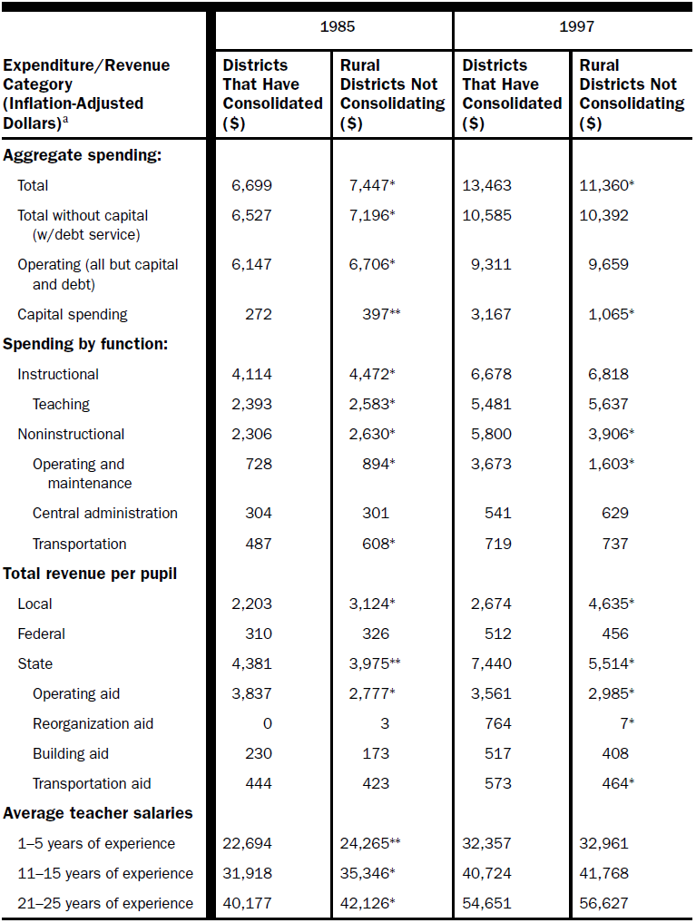

Slide 14
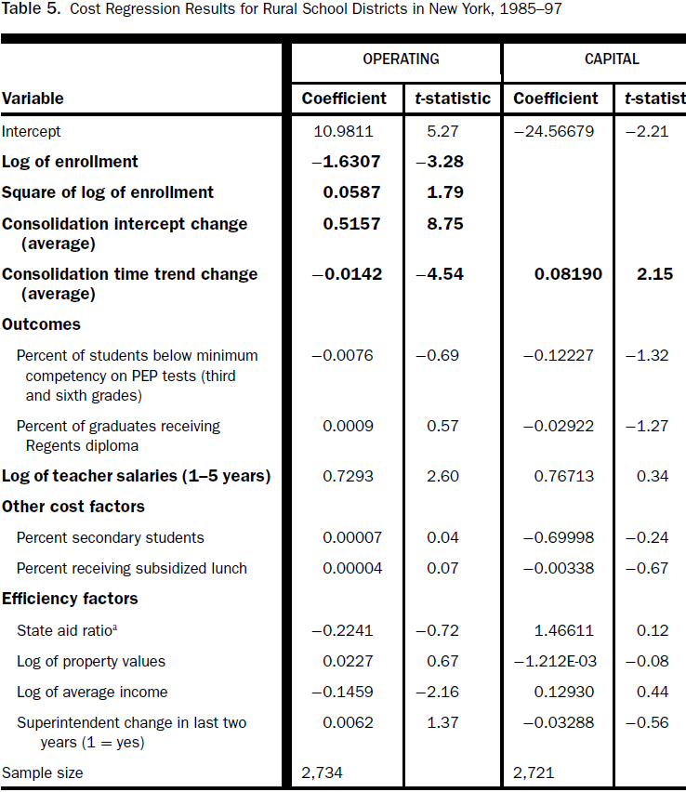

Slide 15
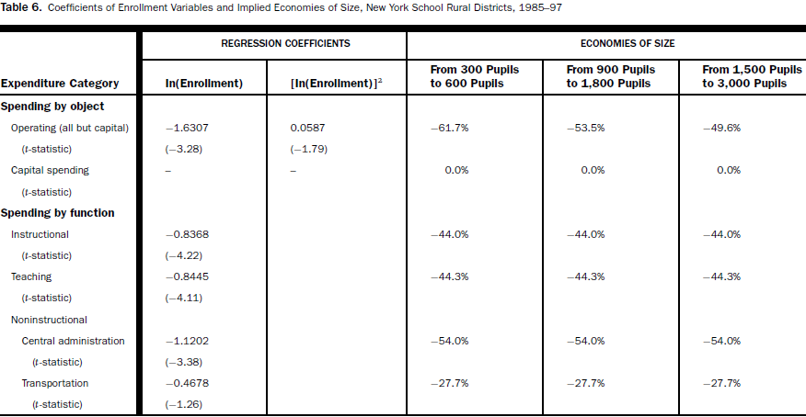

Slide 16
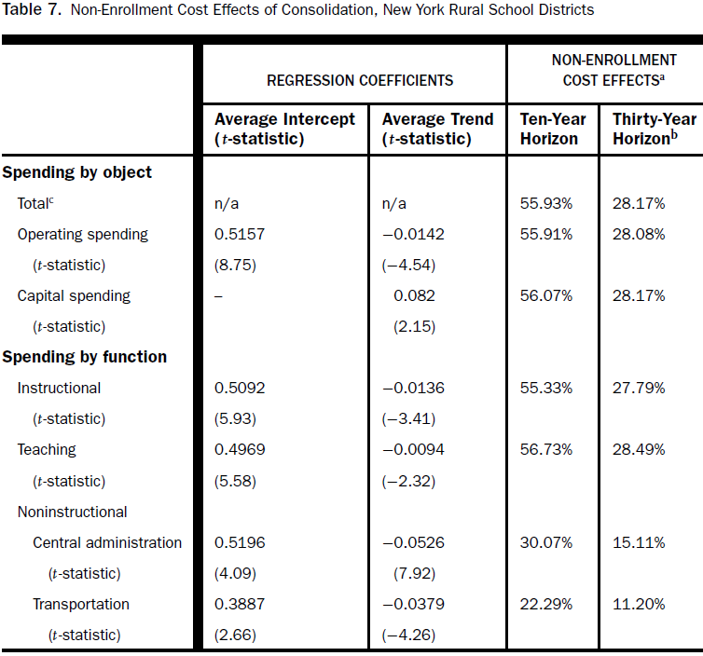

Slide 17
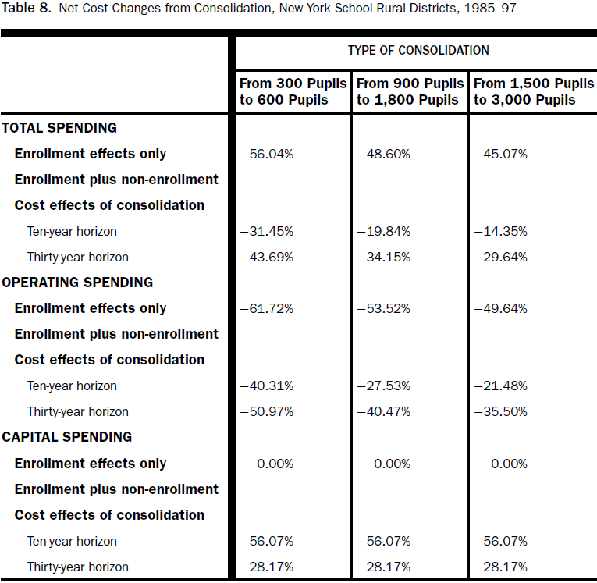

Slide 18
Conclusions, Part 1
Operating Costs
  Thanks to economies of size, consolidation cuts operating costs for rural school districts in New York by up to one-third over 10 years.
  Adjustment costs exist, but they phase out quickly over time—except in transportation.
  The cost savings are largest when consolidation combines two very small districts; two 1,500-pupil districts can only save 14 percent per pupil.

Slide 19
Conclusions, Part 2
Capital Costs
  There are no economies of size in capital spending.
  The state aid that accompanies consolidation raises inefficiency so that no capital cost savings result.
  This short-run inefficiency increase may be partially offset by long-run increases in student performance.

Slide 20
Policy Implications
Encourage Consolidation
  New York, and probably many other states can lower education costs by encouraging school districts to consolidate.
Focus on Small, Rural Districts
  Consolidation incentives should concentrate on small districts; the benefits of consolidation disappear for consolidated districts above about 4,000 pupils.
Be Careful to Monitor Capital Spending and to Minimize Aid Changes After Consolidation
  State policy makers should not encourage (or even allow) wasteful capital spending in recently consolidated districts.

Slide 21
Other Possible Consequences of Consolidation
Cost equations cannot measure
  Losses of consumer surplus
  Higher transportation costs for students and parents
  Changes in dimensions of school performance other than test scores and drop-out rates
Consolidation is a choice
  Net benefits must be positive
  But they need not equal cost savings
  Property value impacts provide one measure

Slide 22
Estimating Other Consequences:
Hu and Yinger, NTJ 2008
Regress Change in House Value (Tract Level) on Consolidation (Plus Controls)
  Interact with enrollment to pick up scale economies
  Control for change in state aid to pick up other effects
  Treat consolidation as endogenous, using consolidations in 1960s and number of districts, both at county level, as instruments.

Slide 23
Estimating Other Consequences: Hu/Yinger, Continued
Results
  Consolidation raises value in small-enrollment districts
  Net benefits run out at about 3,000 pupils
  After controlling for state aid increases associated with consolidation, net benefits run out at about 2,000 pupils
  Even in small districts, net benefits are negative in high-wealth tracts

Slide 24
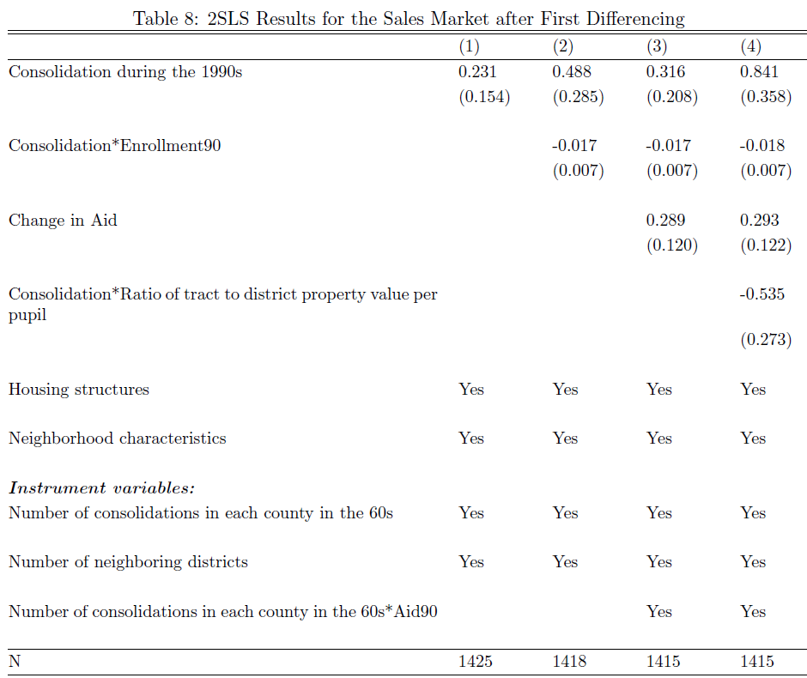

Slide 25
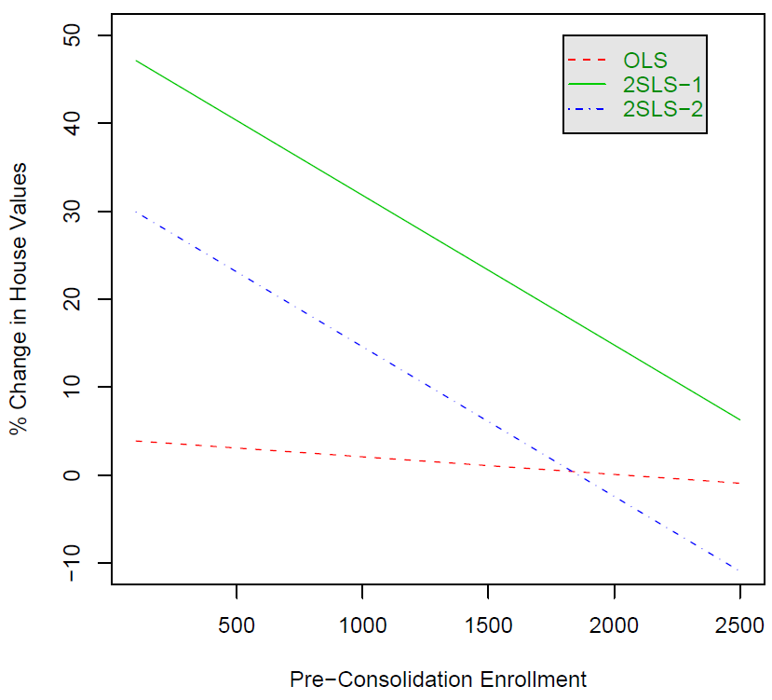

Slide 26
Estimating Other Consequences:
Duncombe, Yinger, and Zhang, PFQ 2016
This article is based on house sales in upstate New York State from 2000 to 2012.
Double sales are used to difference out time-invariant unobservables.
Consolidation occurred in three sets of districts.
Propensity score matching (PSM) is used to make sure the with- and without-consolidation observations are comparable.

Slide 27
Duncombe, Yinger, and Zhang, 2
The key intuition for PSM:
The impact of a program or event may depend on other variables.
So if the with- and without-program samples have different values for other variables, estimates of program effect may be biased.
PSM is a technique to ensure that the two samples have the same distribution of other variables, so this bias disappears.
PSM does not account for unobservables.

Slide 28
Duncombe, Yinger, and Zhang, 3
Findings
  Except in one large district, consolidation has a negative impact on house values during the years right after it occurs
  This effect then fades away and is eventually reversed.
  This pattern suggests that it takes time either for the advantages of consolidation to be apparent or for the people who prefer consolidated districts to move in.

Slide 29
Duncombe, Yinger, and Zhang, 4

Slide 30
Duncombe, Yinger, and Zhang, 5
Findings, Continued
  As in previous studies, the long-run impacts of consolidation on house values are positive in census tracts that initially have low incomes,
  but negative in high-income census tracts, where parents may have a relatively large willingness to retain the nonbudgetary advantages of small districts.

Slide 31
Duncombe, Yinger, and Zhang, 6

Slide 32
  Supplement: D/Y’s Instruments for 2SLS
  (performance and teacher wage are endogenous)
For the operating cost models, the final set of instruments includes the
log of average values of per pupil income and per pupil operating aid in adjacent districts and the log of average private sector wages, the log of average manufacturing wages, the unemployment rate, and the ratio of employment to students in the district’s county.

Slide 33
  Supplement: D/Y’s Control Function Estimation (for potential endogeneity of consolidation decision)
[O]ur logit model estimates the probability of consolidation in a given year as a function of the number of years since the previous consolidation in the same county, the preceding three-year change in the district’s enrollment, the total state aid ratio in districts with similar enrollment, and the instruments identified for our cost regression.

Slide 34
Supplement: D/Y’s cost function estimates

