Slide 1
Public Finance Seminar
Spring 2021, Professor Yinger
Research on Economic Development

Slide 2
Research on Economic Development
Class Outline
The Impact of Tax Rates on Economic Development
The Impact of Tax breaks on Economic Development

Slide 3
Research on Economic Development
Tax Rates and Economic Development
Most state and local politicians run on the platform of “jobs, jobs, jobs,” and it is important to try to figure out what policies actually affect the number of jobs (and the incomes they generate) in a given jurisdiction.
Today we are going to start with the most basic question: Can a jurisdiction promote economic development by lowering its tax rates?
Then we will examine research on tax breaks for specific firms.

Slide 4
Research on Economic Development
Bania and Stone
Based on state panel for 1962-2002 (data every 5 years).
They look at the growth rate in income (log change in real personal income per capita) as a function of taxes and spending.
Because of the state budget constraint, they must leave one thing out.
  They leave out “productive” spending, defined as spending on infrastructure, education, safety, and some other things.
  So they regress growth on tax rates and “unproductive” spending.
  The coefficient of taxes indicates the impact on income of an increase in taxes that goes into productive spending.

Slide 5
Research on Economic Development
Bania and Stone, 2
“Unproductive” spending consists of health and welfare.
  In some regressions health is also treated as productive with little impact on the results.
There could be a serious endogeneity problem, so they:
  Lag the right-side variables 5 years.
  Add state fixed effects.
  Add period fixed effects.
  One version adds state trends.

Slide 6
Research on Economic Development
Bania and Stone, 3

Slide 7
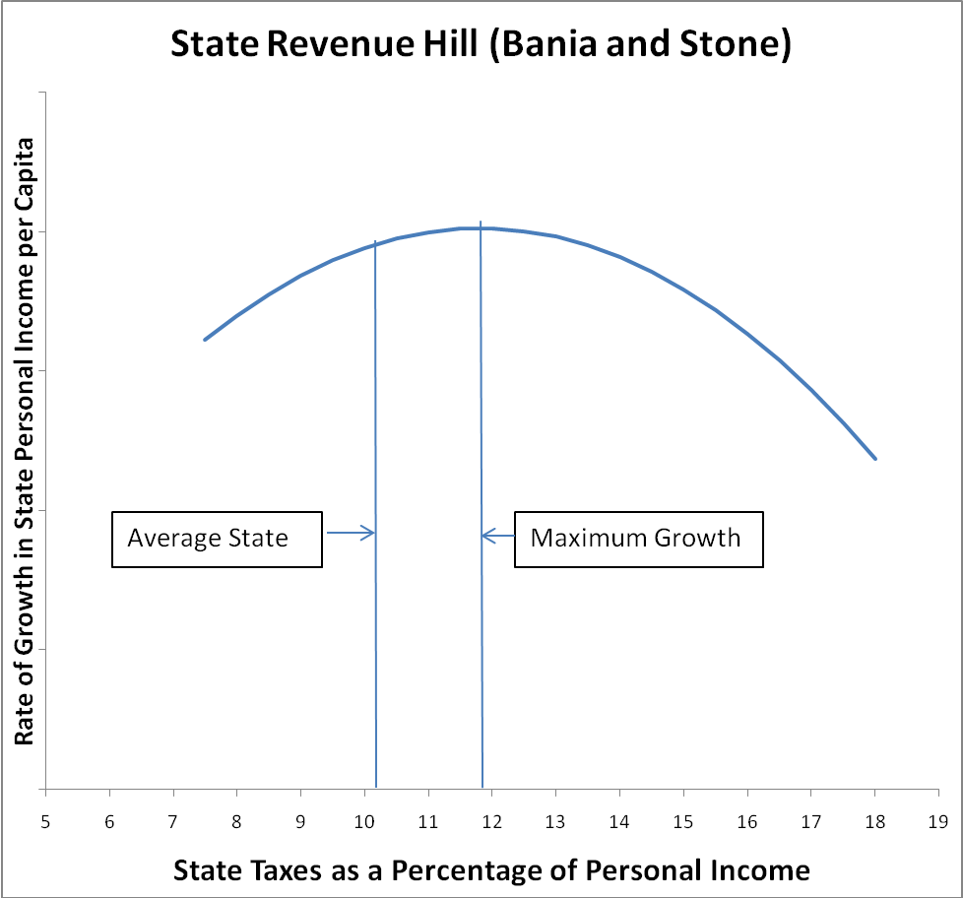
Research on Economic Development
Bania and Stone, 4

Slide 8
Research on Economic Development
Bania and Stone, 5
Interpretation:
  The right mix of productive spending and taxes raises the 5-year growth rate 2.3 percentage points above the median;
  The wrong mix lowers this growth rate up to 4 points below the median.
  The average state spends too little!

Slide 9
Research on Economic Development
Bania and Stone, 6
B&S also do a policy experiment in which they raise taxes as a % of personal income by 1 %age point in every state and assume the money goes to productive spending.
This a not a very compelling experiment because it involves a much larger tax increase in NY and other high-income states than in low-income states.
Why not have the same tax increase per capita?

Slide 10
Research on Economic Development
Srithongrung and Kriz (JPAM 2014)
A more recent article in JPAM estimates a dynamic model of economic development that builds on the insights in Bania and Stone.
“[T]axes have a slight negative effect on economic growth. In addition to current year effect, this tax effect is only a year lagged and is transient, rather than persistent.
Operational spending has a positive effect on growth approximately at about a one-to-one ratio. The positive effect of operational spending persists through the six-year estimation period.
Public capital spending demonstrates a positive effect on economic growth for two years after the investment occurs. The effect is more than a one-to-one ratio and lasts for three years including the current year. “

Slide 11
Research on Economic Development
Srithongrung and Kriz, 2
“[T]he wisdom of cutting taxes as a way to boost a state economy must be seriously reexamined. While cutting taxes may produce a short-term boost in the economy, if those cuts are accompanied by cuts in spending (especially operational spending), the short-run gains are going to be offset and perhaps even exceeded by the drag on growth created by lower spending.
[T]he assertions that spending reduces growth…must also be reexamined. Our results strongly support a view that spending on local public goods is complementary with private economic activity. …and provides strong multiplier effects.”

Slide 12
Research on Economic Development
Wong
Wilson Wong’s dissertation (Maxwell, 1998) looks at the impact of local property tax rates and public service quality on economic development in New York.
This dissertation takes advantage of the variation in local tax rates generated by the Homestead Option.
  This option gives cities the right to use a classified property tax, with a higher rate on business than on residential property, when they complete a revaluation.
  In cities that adopt this option, therefore, there is a change in property tax rates that does not come from the usual budget processes.
  This extra variation is like a natural experiment that gives the researcher some leverage to study the impact of property taxes on economic development.

Slide 13
Research on Economic Development
Wong, 2
Wong estimates the following equation
where
  Y = a measure of economic development, such as jobs or payroll (in city i and time y)
  t = effective property tax rate on commercial and industrial property
  s = sales tax rate
  G = a measure of performance (for government service k)
  μ, γ, δ, ε = error components for city, time, city time trend, and random stuff, respectively

Slide 14
Research on Economic Development
Wong, 3
He faces 2 challenging issues.
The first is that effective tax rate may be endogenous, so he uses 2SLS.
His instruments are of 3 types:
  Deviations in the endogenous variable (from a city’s own average).
  Variable identifying above-median values (grouping method).
  Variables that come from the Homestead Option (reassessment dummy, Homestead Option dummy, years since Homestead Option).
He did not use all the fancy IV tests, which were not yet available.

Slide 15
Research on Economic Development
Wong, 4
The second challenge is that government performance is hard to measure.
He did an amazing job finding variables to measure government performance, including:
  the crime rate,
  property loss from fire
  school test scores (from grades 3 through 6).

Slide 16
Research on Economic Development
Wong, 5 (Findings)
He looks at employment and payroll in the following categories: total, manufacturing, trade, transportation and utilities, finance plus insurance plus real estate, and service.
In the IV estimations, the property tax rate is statistically significant with a negative sign in almost every regression for both employment and payroll.
The employment results are stronger than the payroll results.
Property taxes matter.

Slide 17
Research on Economic Development
Wong, 6 (More Findings)
The crime rate is significant with a negative sign for total, trade, FIRE, and service.
The education scores are significant with a positive sign in all employment regressions and for FIRE and service payroll regressions.
The fire loss variable is negative and significant in about half the cases (including total) but in different cases for employment and payroll.
Public services matter.

Slide 18
Research on Economic Development
Wong, 7 (More Findings)
The impact of taxes is amazingly small.
Wong estimated the impact of eliminating the property tax altogether and replacing it with some other source with no impact (such as state aid).
 | Employment | Payroll
Total | 1.36% | 3.23%
Manufacturing | 1.71% | 12.00%
Trade | 0.43% | 1.40%
Transportation/Utilities | 1.63% | 10.89%
Finance, insurance, and real estate | 7.00% | 6.22%
Service | 5.13% | 4.94%

Slide 19
Research on Economic Development
Wong, 8 (More Findings)
Finally, remember that services matter, too.
Wong’s results indicate that one cannot cut property taxes and services and expect a boost in economic development.
  Wong did not do any cost calculations, but the significant role of services suggest that such a step might undermine economic development because firms do care about safety and education.

Slide 20
Research on Economic Development
Tax Breaks and Economic Development
Research on tax breaks is limited by their heterogeneous nature. Many are negotiated on a case-by-case basis. They do not appear in any standardized data sets.
The following slides review a few studies that make progress on studying tax breaks despite these challenges.

Slide 21
Research on Economic Development
Wassmer/Anderson (Econ. Dev’t. Quart. 2001)
112 Cities in Detroit metropolitan areas; 4 years (1977, 1982, 1987, 1992).
Outcomes: Employment rate, poverty rate, manufacturing property value, commercial property value.
Key policy variables: Property tax abatements, IDBs, TIFA, DDA, municipal expenditures per capita, property tax rate.
  Great data!

Slide 22
Research on Economic Development
Wassmer/Anderson, 2
Abatements=cumulative real value of abatements for manufacturing or commercial developments
IDB=cumulative value of industrial development bonds
TIFA=tax increment financing authority exists
DDA=downtown development authority exists
Estimated simultaneously with assumed exclusion restrictions; second two dependent variables are in first two regressions; first two dependent variables are in second two regressions.

Slide 23
Research on Economic Development
Wassmer/Anderson, 3
Estimated with year and city fixed effects.
Controls include socio-economic characteristics, percentage of property in various categories, and property composition of surrounding areas.
Spending and property tax rate are treated as exogenous.

Slide 24
Research on Economic Development
Wassmer/Anderson, 4
Manufacturing abatements boost manufacturing property values—in the first year only.
  They guess that, since this is right after the program started, it is before other jurisdictions jumped in. (Capitalization or development?) Commercial abatements actually lower commercial property value in 1992.
TIFAs, DDAs, and municipal spending boost commercial property values.
  TIFAs and DDAs may only makes sense when commercial property values are growing.
Higher tax rate leads to higher commercial property values!
  This could be a tax-price effect. High commercial property leads to low tax price and hence to a higher local property tax rate. Another reason to treat property taxes as endogenous!

Slide 25
Research on Economic Development
Wassmer/Anderson, 5
Higher residential employment rate leads to lower commercial property values. (Bizarre!)
  This finding is discouraging; higher property values without employment is not the idea!
They also find weak evidence that higher business property values lead to lower employment and lower poverty.
  This could be displacement (as firm expansion drives out poor households).

Slide 26
Research on Economic Development
Kang, Reese, and Skidmore, JPAM 2016
A recent study of property tax abatements for new or improved industrial property in southeast Michigan finds that the abatements increase industrial property values (= capitalization!) but also have small spillovers onto commercial and residential property values.
However, this study also finds that the benefits from these abatements are very small relative to the foregone revenue. Under the most favorable scenario in this study, $1.00 of lost revenue brings in $0.03 in benefits.

Slide 27
Research on Economic Development
Nguyen-Hoang
“Tax Increment Financing and Education Expenditures: The Case of Iowa,” Education Finance and Policy, Fall 2014
“This is the first study to directly examine the relationship between tax increment financing (TIF) and education expenditures, using the state of Iowa as a case study. I find that greater use of TIF is associated with reduced education expenditures. I also find little evidence to support the commonly held proposition that school spending increases when TIF districts expire. Finally, the negative price effect of TIF on education spending is increasingly larger for school districts in lower wealth or income groups compared with their counterparts in higher wealth or income groups. The negative, though small, effect of TIF on education spending, coupled with no gain from the often-claimed long-run benefits of TIF, justifies policy measures to protect school districts from TIF.”

Slide 28
Research on Economic Development
Hanson (RSUE 2009)
Andrew Hanson (2008 economics Ph.D. from Syracuse; RSUE 2009) studies the federal empowerment zone program (EZ). This program gave various tax breaks to firms locating in specified areas in Atlanta, Baltimore, Chicago, Detroit, Philadelphia/Camden, and New York.
The following table lists the benefits:

Slide 29
Research on Economic Development
Hanson, 2

Slide 30
Research on Economic Development
Hanson, 3
Note that in some other large cities were runner-ups designated to be “Enterprise Communities” (EC).
They received a smaller set of benefits—and are the control group.

Slide 31
Research on Economic Development
Hanson, 4
He uses a triple-difference strategy.

Slide 32
Research on Economic Development
Hanson, 5
His method has two equations

Slide 33
Research on Economic Development
Hanson, 6
He then points out that the EZ cities are not randomly selected and that the selection process in Congress could reflect anticipated economic health or growth.
So he uses an IV approach. His instruments for the EZ variable are whether the city has a member of Congress on the Ways and Means Committee (which selected the cities) and the tenure of that person on the committee.

Slide 34
Research on Economic Development
Hanson, 7
With OLS, the impacts on income and growth look positive; with IV these impacts go away.

Slide 35
Research on Economic Development
Hanson, 8

Slide 36
Research on Economic Development
Hanson, 9
Note the positive impact on property values in the IV regressions.
This result supports the notion that EZs provide a gift to property owners in the designated zone, because firms are willing to pay more for property to gain access to the EZ benefits.
He detects no other impacts. Capitalization at work!

Slide 37
Research on Economic Development
Hanson, 10
Another study of EZ’s appeared in 2013 (Busso, Gregory, and Kline, AER). It neither cited Hanson nor used an IV.
This paper concluded “EZ designation substantially increased employment in zone neighborhoods and generated wage increases for local workers without corresponding increases in population or the local cost of living.”
A lively debate about methods and results has since taken place; most studies agree with Hanson. See Neumark and Young, RSUE, 2019.

Slide 38
Research on Economic Development
Bartik
Timothy Bartik (UpJohn Institute) has assembled an amazing data set of local economic development incentives.
His preliminary analysis of these data finds no statistically significant impacts of these incentives on measures of economic well being.
See: http://research.upjohn.org/reports/225/

Slide 39
Economic Development: Slattery and Zidar
Research on Economic Development
Economic Development: Slattery and Zidar
  “[I]ndustries with larger multiplier effects are more likely to receive subsidies, and receive more subsidy dollars per job. We also find that poorer places spend more per job.
  [W]e find limited evidence that these subsidized firms have employment spillovers in the local economy.
  In that case, the argument for this place-based policy rests more heavily on equity considerations.
  Journal of Economic Perspectives, Spring 2020

Slide 40
Economic Development: Slattery and Zidar, 2
Research on Economic Development
Slattery and Zidar, 2
  Many questions remain unanswered.
    How much do these policies improve the well-being of underemployed and low-income workers?
    Are the most distressed places able to attract firms with tax incentives?
    How effective are these approaches relative to other policies?
    Does targeting subsidies at the largest firms have anticompetitive effects in the product market?

Slide 41
Economic Development: Slattery and Zidar, 3
Research on Economic Development
Slattery and Zidar, 3
  More questions:
    At the local level, is the newly-attracted firm stimulating hiring of local residents that were previously unemployed and working in low-wage jobs?
    Or as was argued in the case of Amazon's proposal for putting a headquarters in New York City, are all the good jobs going to people moving in from other locations, while leaving locals with more congestion and higher prices?

Slide 42
Economic Development: Slattery and Zidar, 5
Research on Economic Development
Slattery and Zidar, 4
  Policymakers can design incentives with these considerations in mind and evaluate the extent to which these policies actually trickle down.
  Bartik (2019a) calls for targeting tax incentives to hard-hit regions, and to employers who promise to hire local residents.
  He also notes that targeting marginal investments and job creation in tradable industries with high multipliers, instead of individual firms, could reduce political influence.
  More evidence on the conditions under which these policies are effective and for whom would help improve policy recommendations.

Slide 43
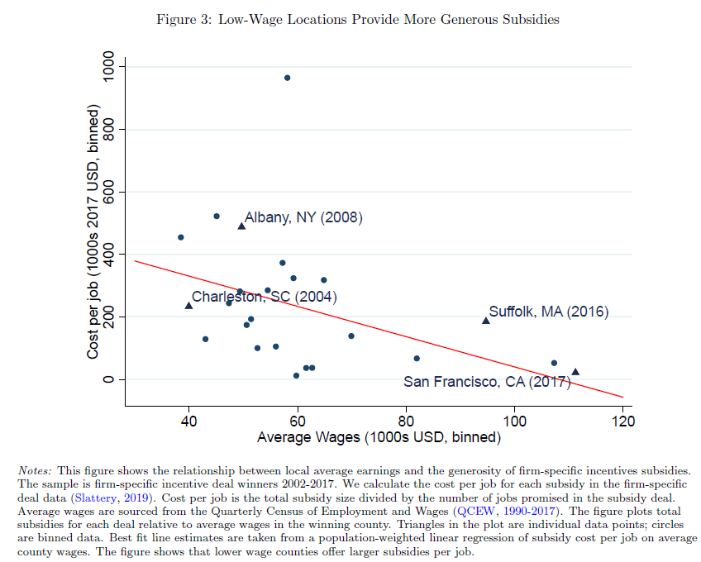
Low-Wage Locations Provide More Generous Subsidies
Research on Economic Development

Slide 44
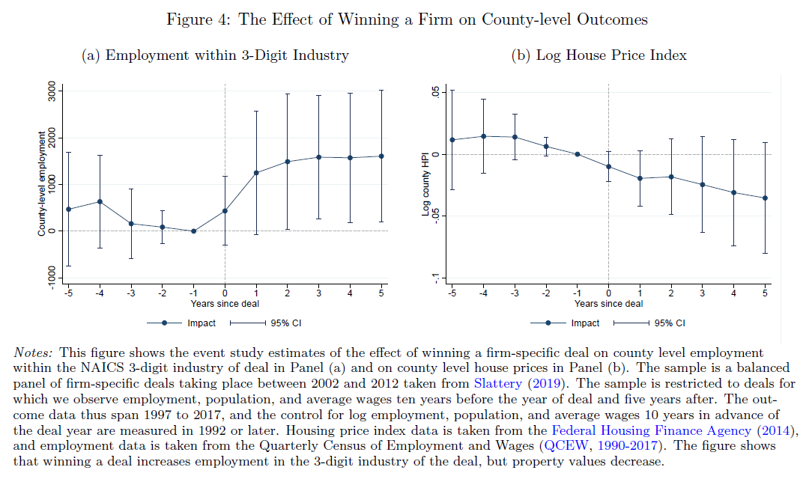
The Effect of Winning a Firm on County-Level Outcomes
Research on Economic Development

Slide 45
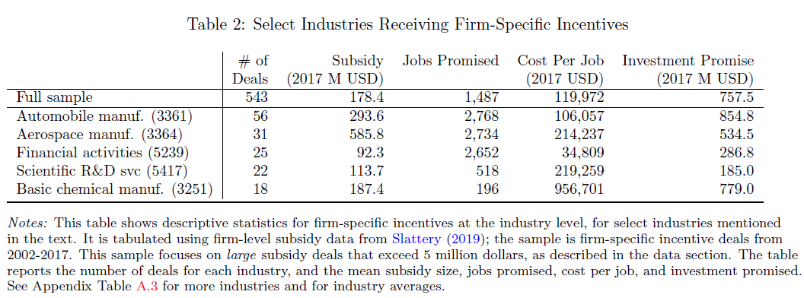
Select Industries Receiving Firm-Specific Incentives
Research on Economic Development

Slide 46
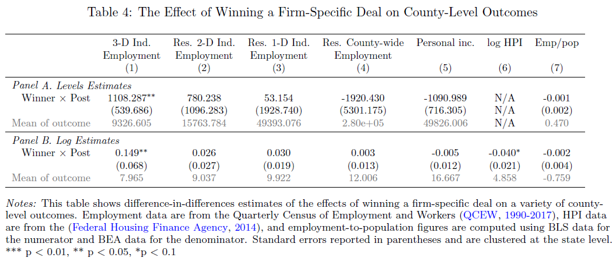
The Effect of Winning a Firm-Specific Deal on County-Level Outcomes
Research on Economic Development

Slide 47
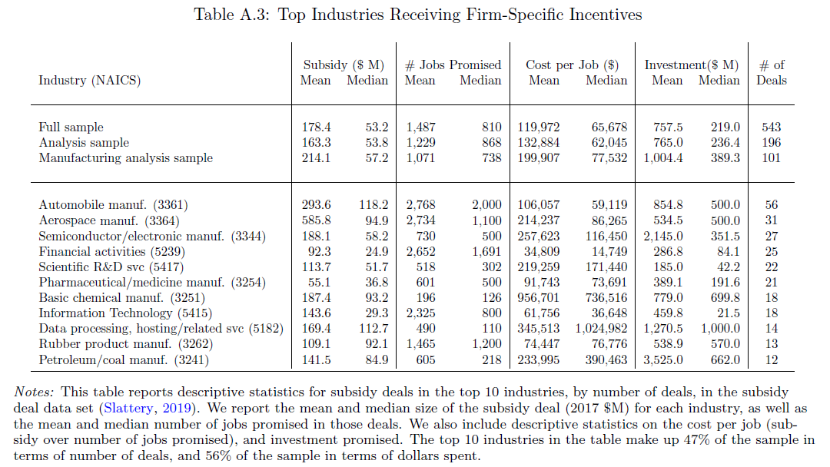
Top Industries Receiving Firm-Specific Incentives
Research on Economic Development

