Slide 1
State and Local Public Finance
Professor Yinger
Spring 2019
Lecture 14
Issuing bondS

Slide 2
State and Local Public Finance
Lecture 14: Issuing Bonds
Class Outline
Features of Municipal Bonds
      Maturity
      Taxability
      Rating
Issuing Bonds

Slide 3
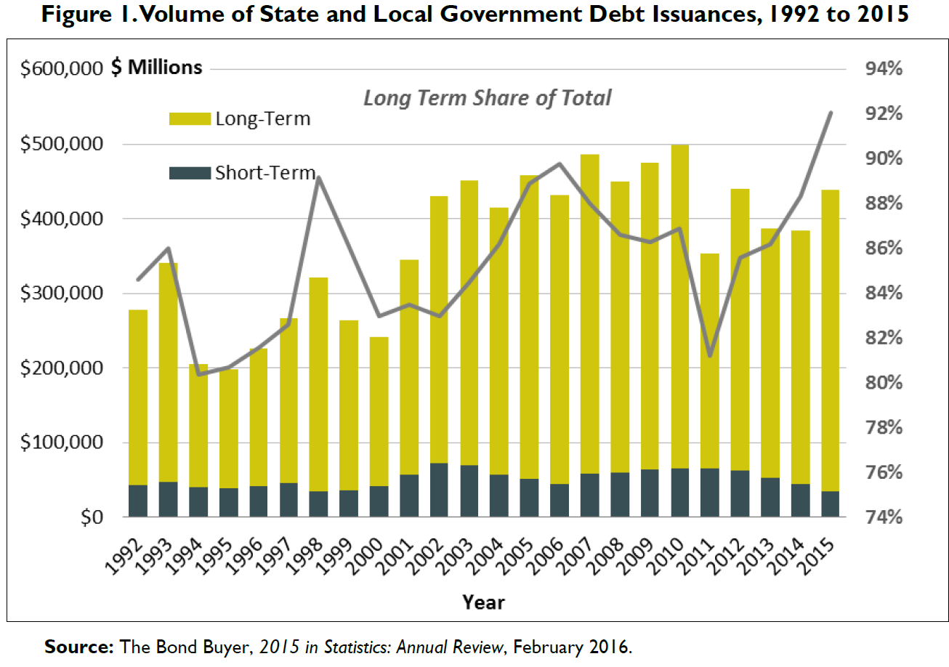
State and Local Public Finance
Lecture 14: Issuing Bonds
Market Overview

Slide 4
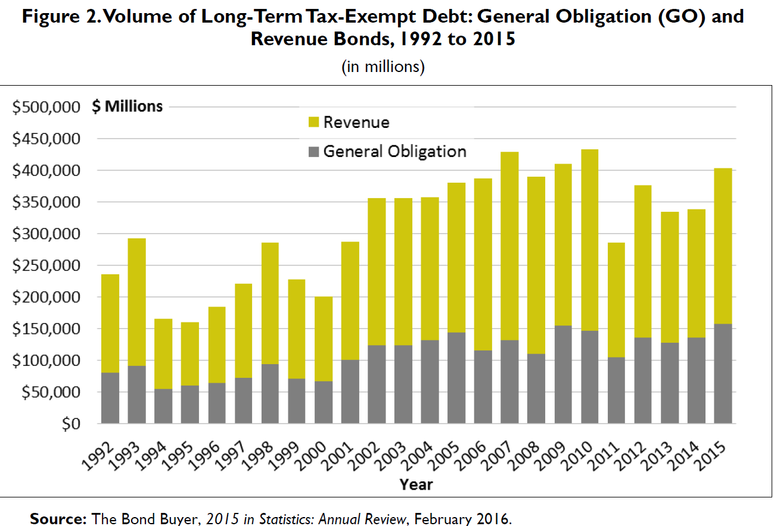
State and Local Public Finance
Lecture 14: Issuing Bonds
Market Overview, 2

Slide 5
State and Local Public Finance
Lecture 14: Issuing Bonds
Market Overview, 3
Source:
“Tax-Exempt Bonds: A Description of State and Local Government Debt,” Grant A. Driessen, Congressional Research Service, December 23, 2016
https://fas.org/sgp/crs/misc/RL30638.pdf

Slide 6
State and Local Public Finance
Lecture 14: Issuing Bonds
Impacts of the 2017 TCJA
1. By eliminating the SALT deductions, the TCJA raises the price of local public services (including infrastructure) in high-tax states. This price change leads to fewer muni issues.
2. The top marginal tax rate for high-income individuals did not change much, but they might want to add tax-free assets to their portfolios in high-tax states.
3. The top corporate tax rate was cut significantly, thereby lowering the attractiveness of municipal bonds for corporate investors.
4. Interest earned on “advanced refunding bonds” is now taxable, so state and local government can no longer use this type of bond to lower interest costs.
https://www.bondbuyer.com/opinion/breaking-down-the-muni-market-impact-of-the-various-tax-reform-provisions

Slide 7
State and Local Public Finance
Lecture 14: Issuing Bonds
Features of Municipal Bonds: Maturity
Because municipal bonds are serial issues, they have different maturities.
In a market, yields generally must rise with maturity, because investors must be compensated for being locked in for a longer time. But:
Call and put options are equivalent to lowering maturity from the issuer or the investor’s perspective, respectively.
Market conditions are more volatile in the short-run than in the long-run, so an “inverted” yield curve (i.e. higher rates for shorter-term bonds) can arise under some circumstances.

Slide 8
State and Local Public Finance
Lecture 14: Issuing Bonds
Yield Curves For Bonds
i = interest
rate
= yield to
maturity
Inverted Yield Curve
Actual
Range
Put Option or Variable Rate
Normal Yield Curve
Maturity

Slide 9
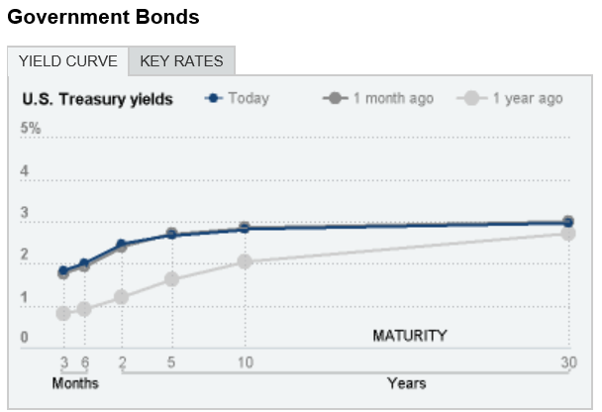
State and Local Public Finance
Lecture 14: Issuing Bonds
Yield Curves For U.S. Treasury Bonds (from The New York Times)

Slide 10
State and Local Public Finance
Lecture 14: Issuing Bonds
Features Of Municipal Bonds: Tax Exemption
Municipal bonds are free from federal tax (and usually from state taxes if they are held by residents of the issuing state).
  The U.S. Supreme Court has ruled that this is not a constitutional issue, but the federal government has declined to alter this time-honored policy.
This tax exemption implies that:
  Municipal bonds are particularly attractive to taxpayers with the highest federal marginal income tax rates.
  The subsidy for municipal bonds is inefficient (but politically protected).

Slide 11
Tax Exemption, 2
Source: Federal Reserve Board via www.sifma.org

Slide 12
State and Local Public Finance
Lecture 14: Issuing Bonds
Bonds and Tax Brackets
Suppose the taxable rate of return is 12% and the tax-free (i.e. municipal) rate is 9%.
Then someone in the 25% income tax bracket is indifferent between taxable investments and munis:
12×(1-.25) = 9
Someone in the 35% tax bracket prefers munis:
12×(1-.35) < 9
Someone in the 15% tax bracket prefers a taxable investment:
12×(1-.15) > 9

Slide 13
State and Local Public Finance
Lecture 14: Issuing Bonds
Bonds and Tax Brackets, 2
The actual break-even tax rate has varied a great deal over the last 30 years, with a high of 27% in 2001 and a low of 7% in 2013.
The lower the break-even tax rate, the greater the share of taxpayers who will benefit from the tax exemption.
A large drop in the break-even tax rate from 2002 to 2003, combined with new access to information about municipal bonds on the internet, led to the large increase in 2004 in the share of bond holders who are individuals.

Slide 14
State and Local Public Finance
Lecture 14: Issuing Bonds

Slide 15
State and Local Public Finance
Lecture 14: Issuing Bonds
The Tax Exemption is Inefficient
Suppose a government issues $1 million in bonds and half are purchased by people in each of the top two brackets (25% and 50%).
The savings to the issuing government is
  (.03)($1 million) = $30,000
The cost to the federal government is
  ($500,000)(.12)(.5) = $30,000 (top bracket)
  + ($500,000)(.12)(.25) = $15,000 (middle br.)
  = $45,000 total
This is inefficient, because the cost to the federal government exceeds the savings to the issuer.

Slide 16
State and Local Public Finance
Lecture 14: Issuing Bonds
The Tax Exemption is Inefficient, 2
The federal subsidy for bonds is inefficient because anyone with a marginal tax rate above the “break-even rate” receives a benefit greater than what is needed to induce them to buy a municipal bond.
Direct subsidies would avoid this, but would have to go through the budget process, which is reviewed each year and is therefore less protected.

Slide 17
State and Local Public Finance
Lecture 14: Issuing Bonds
Removing the Subsidy
In 2017 some Republicans in Congress proposed eliminating the interest rate subsidy.
  See http://www.routefifty.com/finance/2017/02/state-local-leaders-defend-tax-exempt-muni-bonds/135679/ .
This would save the U.S. Treasury about $617 over 10 years, but would obviously cost state and local governments the same amount.
Moreover, this change would reverse a long-standing policy to subsidize state and local infrastructure because of its importance to the national economy.
The change did not pass.

Slide 18
State and Local Public Finance
Lecture 14: Issuing Bonds
Private Purpose Bonds
State and local governments have a strong incentive to use tax-exempt bonds for private purposes, such as economic development, education loans, and mortgages.
This costs the federal government a lot of money and raises the price of bonds generally.
So the use of tax-exempt bonds for private purposes is limited by the federal government.

Slide 19
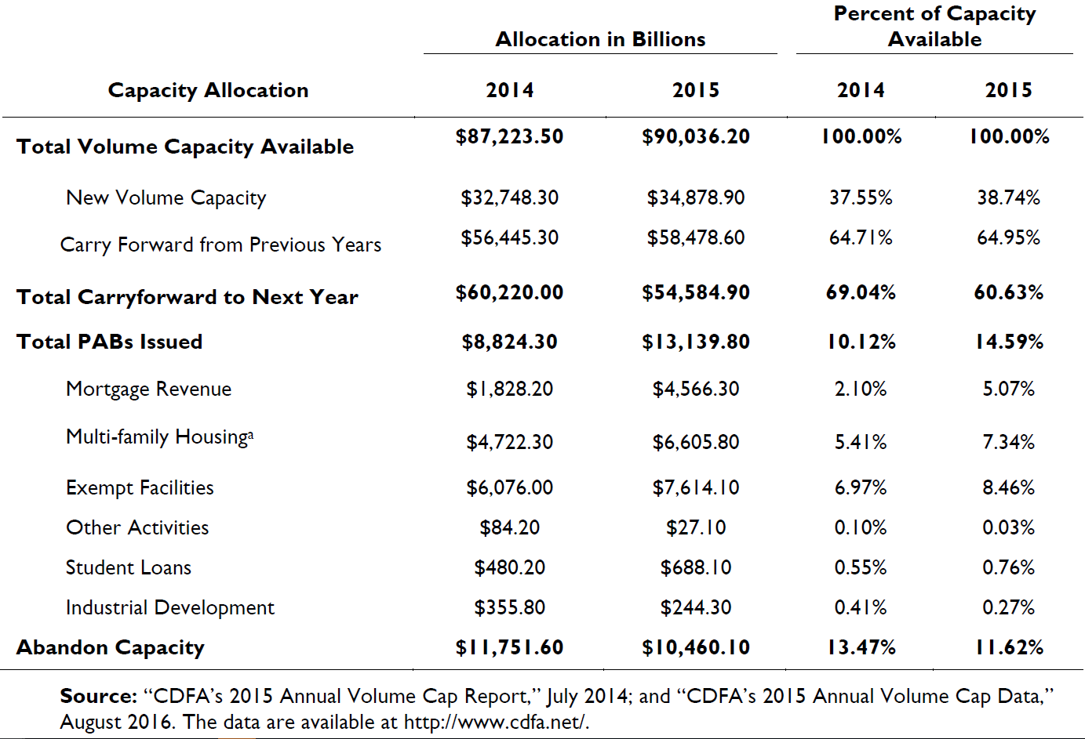
Private Purpose Bonds, 2
Table 2. Private-Activity Bond Volume by
Type of Activity in 2014 and 2015 (Driessen)

Slide 20
State and Local Public Finance
Lecture 14: Issuing Bonds
Features of Municipal Bonds: Ratings
Three companies, Moody’s, Standard and Poor’s, and Fitch provide 99% of the ratings for municipal bonds.
  Several smaller agencies are also designated “Nationally Recognized Statistical Ratings Organizations” by the SEC and rate a few municipal bonds.
  See https://www.sec.gov/ocr/reportspubs/annual-reports/2017-annual-report-on-nrsros.pdf .
Governments pay a fee to have their bonds rated because the ratings provide information to investors.
Ratings are attached to bond issues, except in the case of GO bonds, where the issuing government has a rating.

Slide 21
State and Local Public Finance
Lecture 14: Issuing Bonds
What Do Ratings Measure?
The rating agencies say that ratings measure default risk, that is, the risk that the issuer will not make all the payments on time.
Ratings are based on economic, financial, and political characteristics of the issuer, but the formulas are proprietary—and closely guarded.
Ratings have a big impact on interest cost. A highly rated bond might be able to pay one percentage point less in interest than a bond with a poor rating.
Issuers do not have to buy a rating, but they usually do.

Slide 22
Investment Grade Ratings
 | Moody’s | Standard & Poor’s | Fitch
Best Quality | Aaa | AAA | AAA
High Quality | Aa1 Aa2 Aa3 | AA+ AA AA- | AA+ AA AA-
Upper Medium Grade | A1 A2 A3 | A+ A A- | A+ A A-
Medium Grade | Baa1 Baa2 Baa3 | BBB+ BBB BBB- | BBB+ BBB BBB-

Slide 23
State and Local Public Finance
Lecture 14: Issuing Bonds
Extent of Ratings by Moody’s

Slide 24
State and Local Public Finance
Lecture 14: Issuing Bonds
Distribution of Moody’s Ratings

Slide 25
State and Local Public Finance
Lecture 14: Issuing Bonds
Default Risk
Default risk is real, at least for revenue bonds.
Consider the following tables from a Standard and Poor’s document: “A Complete Look at Monetary Defaults During the 1990s.”
  http://www.kennyweb.com/kwnext/mip/paydefault.pdf
For perspective, outstanding muni debt in 2002 was about $1 trillion for revenue bonds and $600 billion for GOs.

Slide 26
Revenue Bond Defaults, 1990s
Sector | # of Defaults | Defaulted $ Amount | Avg. Time to Default | # Rated | # Non-Rated
Industrial Dev (IDBs) | 288 | $2,839,915,892 | 88 | 33 | 255
Healthcare | 239 | 1,994,158,951 | 58 | 24 | 215
Multifamily Housing | 153 | 2,050,092,293 | 63 | 51 | 102
Land-Backed Debt | 141 | 1,037,790,699 | 72 | 2 | 139
COPs/Lease Revs | 30 | 146,505,781 | 57 | 2 | 28
Other Revenues | 25 | 826,992,000 | 47 | 7 | 18
Single Family Housing | 16 | 36,877,076 | 137 | 13 | 3
General Obligations | 14 | 827,550,000 | 10 | 5 | 9
Utilities | 8 | 39,450,000 | 70 | 0 | 8
Education | 3 | 10,530,000 | 44 | 0 | 3
Totals | 914 | $9,809,862,692 | 71 | 137 | 780

Slide 27
Go Bond Defaults, 1990s
Year | # of Defaults | Defaulted $ Amounts | Avg. Time to Default | # Rated | # Non-Rated
1990 | 1 | $2,000,000 | 18 | 0 | 1
1995 | 3 | $800,000,000 | 12 | 3 | 0
1996 | 4 | $5,860,000 | 8 | 0 | 4
1997 | 1 | $2,800,000 | 11 | 0 | 1
1998 | 4 | $15,475,000 | 8 | 2 | 2
1999 | 1 | $1,415,000 | 9 | 0 | 1
Totals | 14 | $827,550,000 | 10 | 5 | 9
Defaults in 1995 were tied to 3 short-term note deals issued by Orange County, California.
7 out of the 14 monetary defaults were tied to late payments caused by administrative oversights and were not related to financial difficulties.

Slide 28
Go Default Settlements, 1990s
Settlement Type | # of Settlements | Avg. Time to Settlement | Avg. Recovery
Resumptions | 7 | 1 | N/A
Cash Distributions | 3 | 11 | 100
Redemptions | 2 | 4 | 100
Exchange | 1 | 7 | N/A
Totals | 13 | 4
Holders of the three Orange County, California note deals were made whole (recovered 100 cents on the dollar) through cash distributions when the County emerged from bankruptcy during June of 1996.

Slide 29
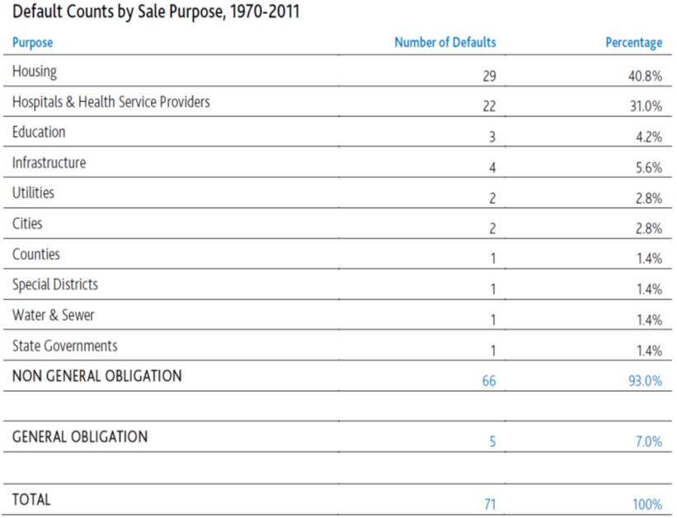
Moody’s Defaults

Slide 30
State and Local Public Finance
Lecture 14: Issuing Bonds
Impacts of Ratings
Because high ratings lower interest costs, governments have in interest in obtaining a high rating.
So many governments strive to meet the tax and management standards set by the rating agencies.
Many other governments buy bond insurance, which can raise ratings (and therefore save money).
In some cases, states insure the bonds of their local governments.
Some small governments form bond pools to broaden their resource base and lower the risk of default.

Slide 31
State and Local Public Finance
Lecture 14: Issuing Bonds
Impacts of Ratings, 2
Ratings also influence investor’s response to events in the market place.
When New York City defaulted in 1974, the premium paid for highly rated bonds went up noticeably.
  When Cleveland defaulted in 1979, nobody noticed.
  When Orange county defaulted in 1995, the impact was small and short-lived.
From an investor’s point of view, therefore, ratings also indicate market risk.

Slide 32
State and Local Public Finance
Lecture 14: Issuing Bonds
Rating the Raters
The private rating agencies play an important public role—i.e., they influence the cost of infrastructure.
Under these circumstances, one would think that they would be regulated, i.e., that some government agency would ask whether their actions are in the public interest.
Regulation of ratings was prohibited by the Credit Rating Agency Reform Act of 2006.
  The Dodd-Franks Act of 2010 gives the SEC some regulatory powers, but their impact is not yet clear.
My 2010 article in the American Law and Economics Review suggests that some regulation may be needed.

Slide 33
State and Local Public Finance
Lecture 14: Issuing Bonds
Rating the Raters, 2
GO bonds essentially never default.
As a result, no government characteristic has any value in predicting default.
So any rating policy that puts cities with certain characteristics at a disadvantage cannot be justified by a connection to default risk.
My work shows that all three large ratings agencies hand out GO ratings that decline with the percentage of a city’s population that is black.
This is not fair, and a federal regulator should be looking into it.

Slide 34
State and Local Public Finance
Lecture 14: Issuing Bonds
Rating the Raters, 3
I have looked into the same issue with school bonds in California.
Again I found this type of “redlining” also arises in this case.
School districts with high black or Hispanic concentrations receive lower GO bond ratings than largely white districts—despite having the same probability of default.
Lower ratings lead, of course, to higher interest costs for black and Hispanic than for white districts.
http://cpr.maxwell.syr.edu/efap/about_efap/ie/June13.pdf

Slide 35
State and Local Public Finance
Lecture 14: Issuing Bonds
Rating The Raters, 4
One might think that my focus on default risk is inappropriate because ratings also indicate market risk.
But from society’s point of view, this argument is circular—at least in the case of GO bonds.
Ratings cannot predict default but they do predict market risk if investors believe they do. The link to market risk is therefore based on investor illusion.
It makes no sense to justify unfair ratings for some cities because these ratings are successful in deluding investors!

Slide 36
State and Local Public Finance
Lecture 14: Issuing Bonds
Rating the Raters, 5
The point here is not that rating agencies are bad.
In fact, they serve the public interest by encouraging governments to follow good practices.
  Good practices lead to higher ratings and lower interest costs.
  Or good practices lead to lower costs for bond insurance.
Ratings provided by a higher level of government would undoubtedly not have as much credibility—or so much impact on government practices.
But ratings agencies are out to make profits—not serve the public interest—and they should be regulated.

Slide 37
State and Local Public Finance
Lecture 14: Issuing Bonds
Issuing Bonds
Many institutions are involved in issuing bonds.
The issuing government is required by the Consumer Finance Protection Bureau to hire an independent public finance advisor to help figure out the characteristics of the bond issue.
An underwriter buys the bonds from the issuing government, and then sells them to investors.
In rare cases, the issuing government uses a broker to sell directly to investors.

Slide 38
State and Local Public Finance
Lecture 14: Issuing Bonds
Selecting a Bid
The issuing government must select a bid, which is a combination of prices, face values, and interest rates for a set of bonds.
  Sometimes the bid is negotiated with a single underwriter.
  Sometimes many underwriters bid and the issuing government decides which bid to accept.
The amount raised by a bond is the price in the bid, not the face value.
  But an issuing government typically includes a constraint requiring that the total amount of the bid (the sum of the prices) must be equal to (or nearly equal to) the amount that needs to be raised.

Slide 39
State and Local Public Finance
Lecture 14: Issuing Bonds
Selecting a BID, 2
The best bid is the one with the lowest true interest cost (TIC), which is the internal rate of return of the whole issue.
This is found by solving the following equation for r:

Slide 40
State and Local Public Finance
Lecture 14: Issuing Bonds
Selecting a Bid, 3
For a long time, local governments did not understand TIC and selected the bid with the lowest total interest payments.
Underwriters did understand TIC and made bids with large interest payments up front where they had greater present value.
      This means higher interest rates on shorter maturities—the opposite of what one usually observes in a market.
Restrictions, such as no interest rate inversion, can go a long way toward eliminating these problems, but TIC is better. Discounting matters!

Slide 41
State and Local Public Finance
Lecture 14: Issuing Bonds
Competition Vs. Negotiation
An issuing government must decide whether to use competitive bidding.
If the bond issue is unusual and a certain underwriter has the needed expertise, negotiation makes sense.
But competition, which is used for ¾ of bond issues, lowers costs.
In his PA dissertation from Maxwell and later work, Mark Robbins (now at University of Connecticut) found that competition lowers TIC by about 35 basis points (= 0.35 percentage points).

