Slide 1
PAI786: Urban Policy
Class 4:
Household Sorting
and Neighborhood Amenities

Slide 2
Urban Policy: Sorting and Amenities
Why Housing Prices Vary
On January 27, 2012, The New York Times ran a story called: “So You’re Priced Out. Now What?”
It compared condominium prices per square foot in pairs of neighborhoods, “a popular, expensive area, and a cheaper option, perhaps less well known.”

Slide 3
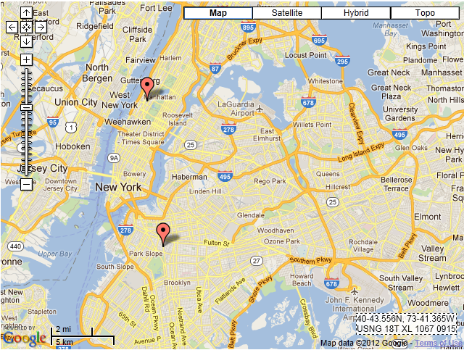
Urban Policy: Sorting and Amenities
Upper West Side
$896 per square foot
Prospect Park
$446 per square foot

Slide 4
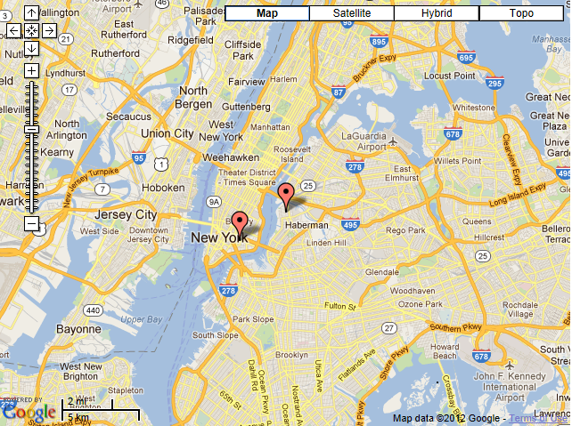
Urban Policy: Sorting and Amenities
Lower East Side
$1,020 per square foot
Greenpoint
$563 per square foot

Slide 5
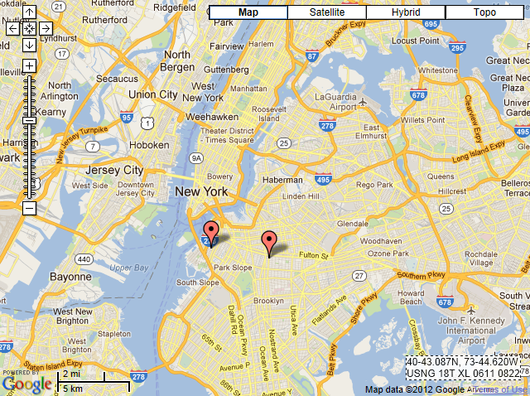
Urban Policy: Sorting and Amenities
Carroll Gardens
$602 per square foot
Crown Heights North
$384 per square foot

Slide 6
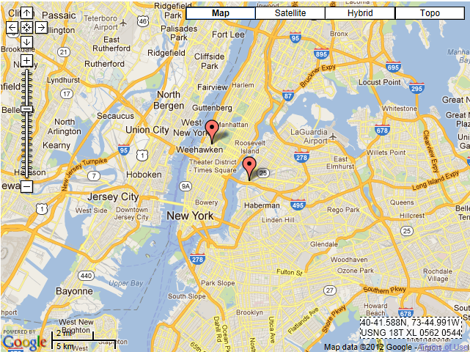
Urban Policy: Sorting and Amenities
Hell’s Kitchen
$854 per square foot
Long Island City
$555 per square foot

Slide 7
Urban Policy: Sorting and Amenities
Why Housing Prices Vary, 2
The NYT article listed many reasons for housing price differences, including
  Access to subways and highways,
  The attractiveness and condition of the housing stock,
  Access to parks and waterfronts,
  Quality of the local elementary school,
  Access to museums or the Lincoln Center,
  Access to bars, restaurants, and coffee shops, and
  Access to boutiques, galleries, and clubs.

Slide 8
Urban Policy: Sorting and Amenities
Why Housing Prices Vary, 3
In the last class, we learned why housing prices depend on access to jobs.
Today we will focus on why different types of households live in different places, and why housing prices depend on all those neighborhood amenities listed in the NYT article—and others!

Slide 9
Urban Policy: Sorting and Amenities
Class Outline
  Review bid functions and locational equilibrium
  Introduce household types and sorting
  Introduce neighborhood amenities

Slide 10
Urban Policy: Sorting and Amenities
Housing Bids with One Household Class
  Recall from last class that, with all households alike, the bid function for housing services, P{u}, meets the condition
  that is, until the slope of the P{u} function equals –t/H.

Slide 11
Urban Policy: Sorting and Amenities
Adding Many Household Types
  Now consider more than one household type, each with its own t and it own demand for housing, H.
  Then different types of households may have different bid functions with different slopes, -t/H.
  Differences in slopes lead to sorting by household type.

Slide 12
Urban Policy: Sorting and Amenities
Adding Many Household Types , Continued
  Housing sellers will sell to the household type that bids the most per unit of H.
  A landlord would rather rent a given apartment, for example, to 2 households paying $600 per month (& willing to double up) than to 1 household paying $1,000.
  It follows that household types with steeper bid functions will live closer to the CBD.

Slide 13
PPA786, Class 4: Housing Concepts Household Bids
Household Bids and Household Sorting
household household
type 1 type 2
lives here lives here

Slide 14
Urban Policy: Sorting and Amenities
Sorting and Income
  Under most conditions lower-income households will have higher t/H ratios and hence steeper bid functions than higher-income households.
  Hence, lower-income households win the competition for housing closer to worksites.
  This analysis helps to explain why poor people tend to be concentrated in neighborhoods near downtowns!

Slide 15
Urban Policy: Sorting and Amenities
Sorting and Income, 2
  Some people wonder how low-income people ever outbid high-income people for housing.
  Remember that bids are expressed per unit of H.
  Hence low-income people win the competition when they bid a high amount per unit of H but consume a relatively low quantity of H (by doubling up or by renting small or low-quality apartments).

Slide 16
Urban Policy: Sorting and Amenities
Sorting and Income, 3
  A low H for low-income people raises their t/H ratio (i.e., their bid-function slope) and helps to explain why they tend to live near the center.
  A locational equilibrium with low-income people near the city center is not inevitable, however.
    Some evidence suggest that the current generation of young adults is quite averse to commuting—giving them (you?) a relatively steep bid function.
    As we will see, neighborhood amenities might pull high-income people to some city neighborhoods, too.

Slide 17
Urban Policy: Sorting and Amenities
Sorting and Multiple Worksites
  People tend to select housing locations that cluster around their worksite.
  Hence, we also see sorting by place of work.
  People who work in the suburbs tend not to live in the CBD.

Slide 18
PPA786, Class 4: Housing Concepts Household Bids
Sorting with a Suburb
suburban workers live here

Slide 19
Urban Policy: Sorting and Amenities
Neighborhood Amenities
  People also care about neighborhood amenities, such as good schools, clean air, nice parks, good views, and attractive houses and yards.
    Remember that NY Times article!
  They may also care about the ethnicity of their neighbors. (More on this in a later class.)
  So people bid up the price of housing in neighborhoods with desired amenities.

Slide 20
Urban Policy: Sorting and Amenities
Neighborhood Amenities and Sorting
  People compete for entry into neighborhoods with good amenities.
  The people willing to pay more for an increment in amenities have steeper bid functions—and win the competition where amenities are best.
  Recent work of mine finds that housing prices in the Cleveland area are up to 30% higher in school districts with better schools and that higher-income people win the competition for housing in good school districts.

Slide 21
PPA786, Class 4: Housing Concepts Household Bids
Sorting with Amenities
the rich live here

Slide 22
Urban Policy: Sorting and Amenities
Neighborhood Amenities and Sorting, 2
  Because suburban areas tend to have better amenities, the sorting based on access to employment alone is often reinforced and magnified by the sorting based on amenities.
  Competition in the housing market (not zoning!) therefore sorts higher-income households into nicer neighborhoods—farther from worksites.

Slide 23
Urban Policy: Sorting and Amenities
Neighborhood Amenities and Sorting, 3
  Thanks to sorting, the link between income and sorting is very strong.
  Scholars have developed a comprehensive measure of the value to homebuyers of all neighborhood amenities and public services in a given location (=neighborhood housing value).
  The following figure shows the relationship between this measure and income in the Cleveland area in 2000.

Slide 24
Urban Policy: Sorting and Amenities
Neighborhood Amenities and Sorting, 4
  Income Sorting in the Cleveland Area, 2000

Slide 25
Urban Policy: Sorting and Amenities
History Matters
  One implication of this analysis is that history matters.
  Neighborhoods that attract high-income people in one period typically obtain higher levels of amenities and hence attract high-income people in later periods—even if other factors change.
  Similarly, it is often difficult to turn around low-income neighborhoods due to their poor amenities.

Slide 26
Urban Policy: Sorting and Amenities
The Role of Zoning
  This is where zoning comes in: It is insurance against future neighborhood decline.
  If low-income people want to bid a high P to win the competition in a high-income neighborhood, they have to accept a very low H; zoning prevents them from doing so.
  That is, zoning prevents low-income households from buying small units or doubling up.

Slide 27
Urban Policy: Sorting and Amenities
Building Codes
  Another tool to think about is building codes.
  Some people see building code enforcement as a way to turn around a declining neighborhood.
  But building code enforcement raises housing quality (H) and may drive out the low-income people living in the neighborhood by shutting off their bidding advantage (they will accept low H) or by raising rents beyond their ability to pay.

