Slide 1
PAI786: Urban Policy
Class 9:
Race and Ethnicity,
Prejudice and Discrimination

Slide 2
Urban Policy: Race and Ethnicity
Class Outline
  Definitions
  Civil Rights Legislation
  Discussion of Race and Medicine

Slide 3
Urban Policy: Race and Ethnicity
Concepts to be Defined
  Ethnicity
  Race
  Prejudice
  Discrimination
  Segregation & Integration

Slide 4
Urban Policy: Race and Ethnicity
Ethnicity
  Ethnicity is a socially defined identity based on language, religion, dress, customs, and/or country of origin
  “Hispanic” (some prefer “Latino”) is an ethnic designation

Slide 5
Urban Policy: Race and Ethnicity
Race
    Race is a socially defined category in which people are grouped according to visible physical characteristics, such as skin color, eye shape, hair type, or the shape of facial features.
    Racial distinctions are social, not biological.
      A person’s race has no demonstrable connection to his or her intrinsic abilities or skills in any human endeavor.
      Racial distinctions do not have a significant genetic component beyond the superficial traits on which they are based (more on this shortly).
      But past and current mistreatment based on race can lead to observable average differences across races in, say income, that feed stereotypes (defined below).

Slide 6
Urban Policy: Race and Ethnicity
Race, Continued
    Because it is socially defined, race can be defined as a subset of ethnicity, in which the social distinctions consider superficial physical traits, perhaps along with religion, custom, or country of origin.
    In the U.S.,
      “Blacks” include all people with superficial physical traits that appear “African,” regardless of their ancestry
      “Hispanics” include many people with darker skin, which generally reflects African or Native-American ancestry.

Slide 7
Urban Policy: Race and Ethnicity
Race and Ethnicity in the U.S. Census
  The U.S. Census asks people to indicate one or more races to which they belong and (separately) to indicate whether they are Hispanic.
  Very few people indicate that they are of mixed “race,” although many, if not most, people are!
  Before 2000, people were asked to pick one race.
  Before 1980, the “Hispanic” designation was based on surname.

Slide 8
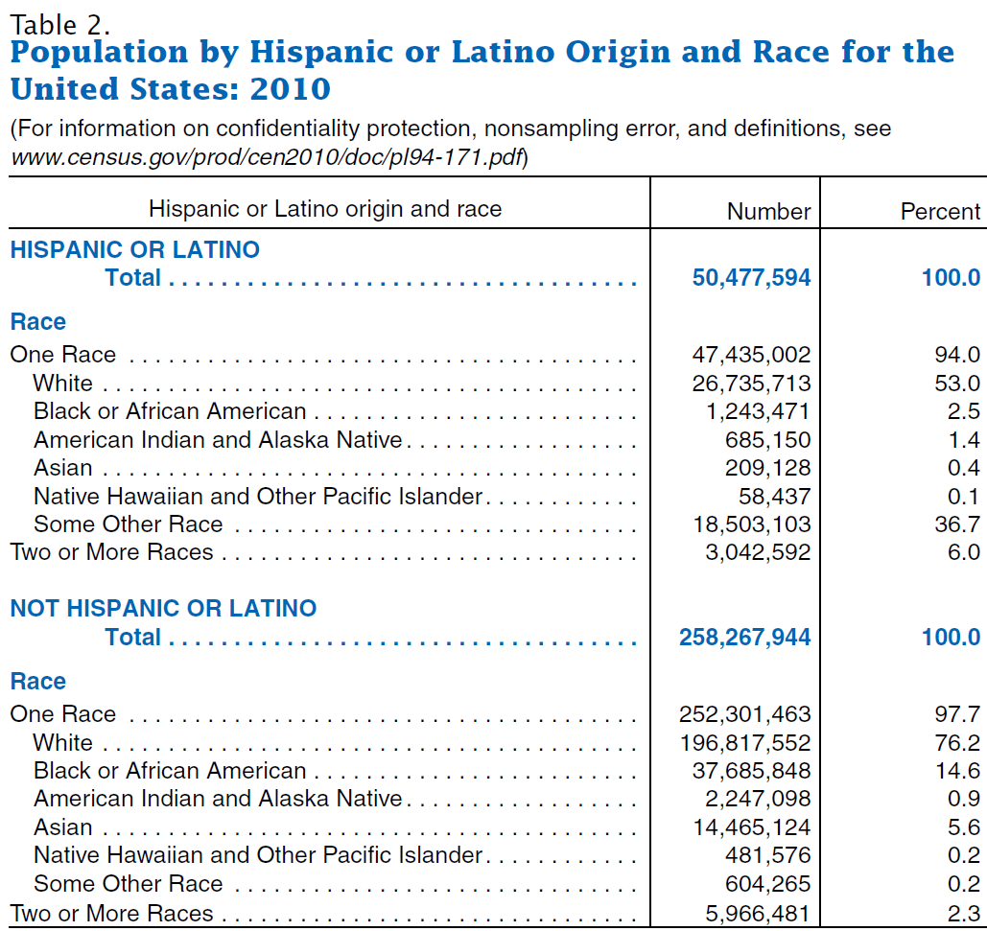
Urban Policy: Race and Ethnicity
16.3% of total population
83.7% of total population

Slide 9
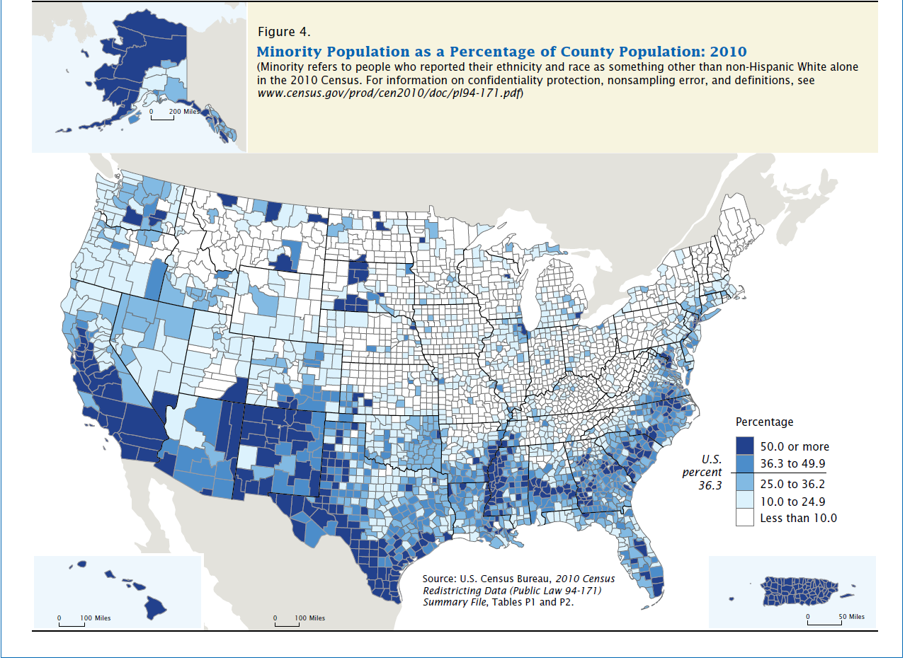
Urban Policy: Race and Ethnicity

Slide 10
Urban Policy: Race and Ethnicity
Race and Genetics
    Genetic Basics:
      DNA: Molecules that contain genetic instructions; come in the shape of a double helix; are repeated in every cell.
      Gene: Section of DNA for a given purpose; instructions come from the pattern of 4 base chemicals; only 2% of DNA has been linked to a purpose.
      Chromosome: A package of DNA; humans have 23 chromosomes.
      Genome: The entire package of information in a person’s DNA.

Slide 11
Urban Policy: Race and Ethnicity
Race and Genetics, 2
    The link between socially defined races and genetics has been widely studied.
      There are over 3 billion “base pairs” in the human genome = rungs on the double helix “ladders” of DNA.
      Of these, 99.9% are shared by all people.
      Of the 0.1% that varies across people, 85-90% varies within groups with different geographic origins.
      The other 10-15% of 0.1% varies across groups and can be used to identify the geographic origins of a person’s ancestors (with some error).

Slide 12
Urban Policy: Race and Ethnicity
Race and Genetics, 3
    However, the 10-15% of the 0.1% of the human genome that can be linked to geographic origins
      Does not closely correspond to socially defined races,
      And does not appear to have any links to a person’s “phenotype,” that is, to a person’s talents and tendencies.
    Moreover, the ability to predict geographic origins is limited for some groups, including South Asians and African Americans.

Slide 13
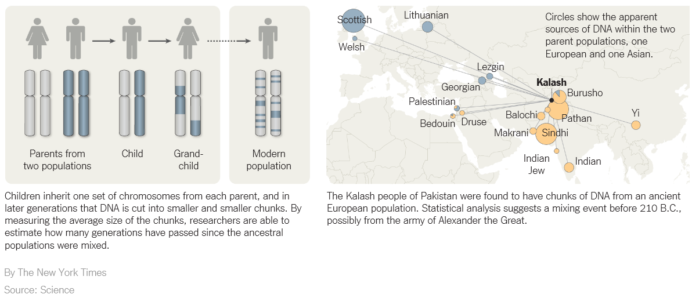
Urban Policy: Race and Ethnicity
Race and Genetics, 4

Slide 14
Urban Policy: Race and Ethnicity
Prejudice
  Prejudice is an emotional, rigid attitude toward particular group of people.
  Prejudice is often based on a stereotype, which is a social caricature of a group that is used to make judgments about all the members of a group regardless of their individual traits.
    A stereotype is partly based on the false assumption that all members of a group are like the average member,
    And is often based on inaccurate beliefs about the average.

Slide 15
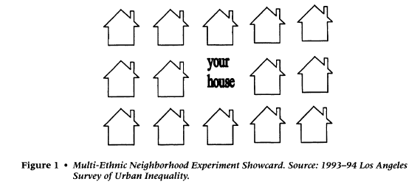
Urban Policy: Race and Ethnicity
Evidence About Prejudice
  Survey “showcard” (from Charles, Social Forces, 2000, as are next two slides):

Slide 16
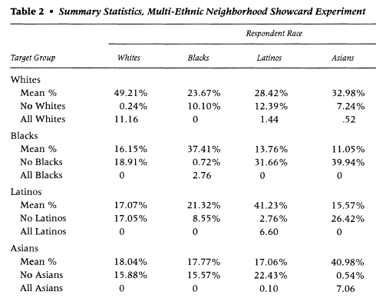
Urban Policy: Race and Ethnicity
Evidence About Prejudice, 2
  “Ideal” neighborhoods by group

Slide 17
Urban Policy: Race and Ethnicity
Evidence About Prejudice, 3
  Determinants of neighborhood preferences
  “All homeowners prefer fewer Black neighbors than non-owners do.
  This is consistent with the long-standing belief that when Blacks move into a neighborhood, crime and declining properties undoubtedly follow.
  Effects also vary to some degree by respondent race/nativity.…
  These results do not suggest a simple desire to preserve one's cultural heritage; rather, they suggest that openness to integration varies by one's investment in their neighborhood, but more importantly by both respondent and target-group race.”

Slide 18
Urban Policy: Race and Ethnicity
Evidence About Prejudice, 4
  Krysan et al. (AJS 2009)
    Using video portraits of various neighborhoods and random assignment of the race of the actors posing as residents
    “For whites living in metropolitan Chicago and Detroit, neighborhoods portrayed as having only black residents were viewed less favorably than identical neighborhoods with either only white residents or a mix of white and black residents.”
    “When neighborhoods had identical observable social class characteristics, it was the all-white neighborhood that was evaluated as least desirable by African-Americans. The evaluations for the racially mixed and the all-black neighborhoods were generally indistinguishable.

Slide 19
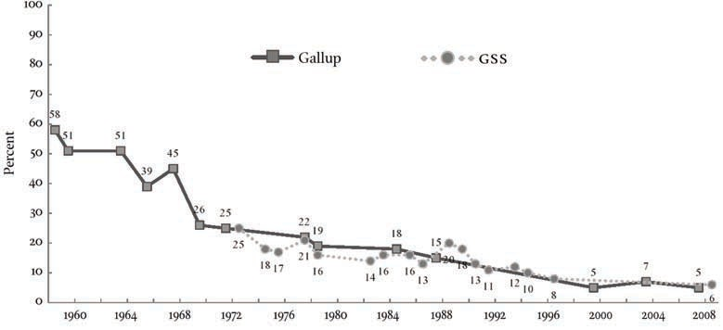
Urban Policy: Race and Ethnicity
Evidence About Prejudice, 5
  From L. Bobo, Daedalus, 2011
Percent of Whites Who Said They Would Not Vote for a Black Presidential Candidate, 1958 to 2008

Slide 20
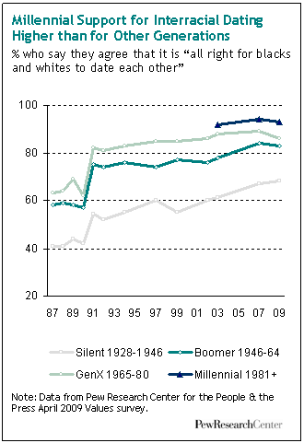
Urban Policy: Race and Ethnicity
Evidence About Prejudice, 6

Slide 21
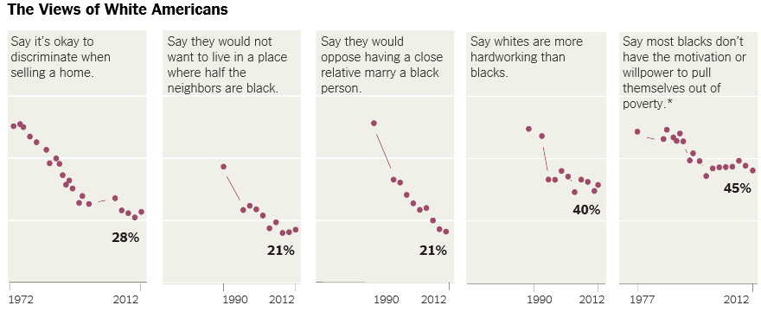
Urban Policy: Race and Ethnicity
Evidence About Prejudice, 7
Sources: General Social Survey; Social Trends in American Life: Findings from the General Social Survey since 1972 (as reported in the NY Times 4/30/2014)

Slide 22
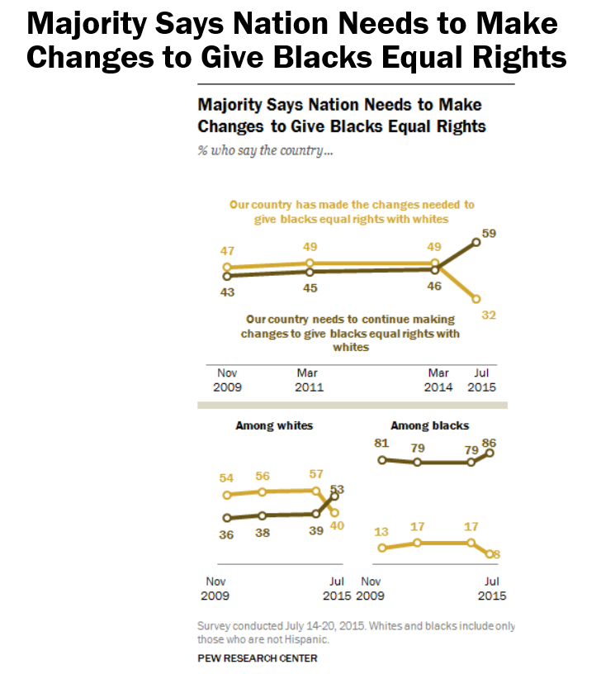
Urban Policy: Race and Ethnicity
Evidence About Prejudice, 8

Slide 23
Urban Policy: Race and Ethnicity
Discrimination (To Be Covered in Later Classes)
  Unfavorable treatment of the people in a group solely because of their membership in that group.
  Unfavorable treatment of the members in a group that is not justified based on the circumstances.
    Refusing to hire a poorly qualified black person is not discrimination.
    Refusing to hire a qualified black person (while hiring equally qualified white people) is discrimination.

Slide 24
Urban Policy: Race and Ethnicity
Segregation (To Be Covered in a Later Class)
  Segregation is a synonym for sorting, that is, it is the physical separation of different groups.
  Racial residential segregation refers to the extent to which two different two racial groups live in different neighborhoods.
  Racial occupational segregation refers to the extent to which two racial groups work in different occupations.

Slide 25
Urban Policy: Race and Ethnicity
Integration
  Integration is the inverse of segregation.
  An integrated neighborhood is one in which different racial or ethnic groups live together.
  Stable racial integration refers to a situation in which different racial groups live together in a given neighborhood for an extended period of time.
  Stable racial integration with equals shares of blacks and whites tends not to arise in this country without active involvement of neighborhood groups or local government (as discussed in our next case).

Slide 26
Urban Policy: Race and Ethnicity
Key Civil Rights Legislation
  The Civil Rights Act of 1866 (contracting)
  The Civil Rights Act of 1964 (employment, public accommodations); amended in 1991
  The Civil Rights Act of 1968 (housing, including financing); amended in 1988.
  The Equal Credit Opportunity Act of 1974 (credit)

Slide 27
Urban Policy: Race and Ethnicity
Types of Discrimination in Civil Rights Laws
  Disparate-Treatment Discrimination
    Using different rules for different legally protected classes.
  Disparate-Impact Discrimination
    Using the same rules for all classes, but also using rules that place one class at a disadvantage without a business justification.
    Recently upheld by U.S. Supreme Court.

Slide 28
Urban Policy: Race and Ethnicity
Examples of Discrimination
  Disparate-Treatment Discrimination
    Charging a higher rent (or a higher interest rate) to blacks than to equally qualified whites.
    Racial profiling (using race to determine treatment)
  Disparate-Impact Discrimination
    Approving home insurance applications on the basis of credit scores (which are lower on average for blacks), even if credit scores have no ability to predict home insurance claims.

Slide 29
Urban Policy: Race and Ethnicity
Discussion of Race and Medicine (if time)
  The role of race in medicine can be confusing.
  Genetic traits that are relevant for medical treatments can have different average values in different races.
  Some day we will be able to use genetic information directly and ignore race, but should doctors use race as a signal now?

Slide 30
Urban Policy: Race and Ethnicity
Discussion of Race and Medicine, Continued
  An example from an article in Slate by W. Saletan (August 18, 2008):
    Race/ethnicity should be considered only a makeshift solution for personalized genomics because it is too approximate.
    A allele (=gene form) that affects the body's response to codeine and antidepressants, for example, is found in 9%, 17%, and 34% of the Ethiopian, Tanzanian, and Zimbabwean populations, respectively.
    Clearly, lumping together all of Africa obscures the differences between the populations.

Slide 31
Urban Policy: Race and Ethnicity
Discussion of Race and Medicine, Continued
  Another example was in the New York Times : http://kristof.blogs.nytimes.com/2016/01/29/match4lara-mixed-race-marrow-search-thats-going-viral/
  Bone marrow matches depend upon genetically determined proteins, which vary widely within groups, particularly among African-Americans.
    Blacks are just as likely to get a match from an existing White donor as from a Black donor.
    But a waiting Black registrant is more likely to be helped by a new Black donor than by a new White donor.

Slide 32
Urban Policy: Race and Ethnicity
The Case of Bone Marrow Donations
Probability of HLA Match by Race (for 2 randomly chosen people)
HLA=human leukocyte antigens. The human body uses HLA proteins to distinguish cells that belong to the body from those that do not. HLA type is determined by a person’s genetics. There are about 20 million HLA types.
Source: Bergstrom, Garratt, and Sheehan-Connor. “One Chance in a Million: Altruism and the Bone Marrow Registry.” American Economic Review, September 2009, pp. 1309-1334.
 | White | African American | Asian American | Hispanic | Native American
White | 1/11,000
African American | 1/113,000 | 1/98,000
Asian American | 1/223,000 | 1/1,310,000 | 1/29,000
Hispanic | 1/44,000 | 1/259,000 | 1/254,000 | 1/34,000
Native American | 1/13,000 | 1/116,000 | 1/173,000 | 1/36,000 | 1/11,000

Slide 33
Urban Policy: Race and Ethnicity
Bone Marrow Donations, 2
Registry Size and Probability of No Match, by Race, in 2006
Source: Bergstrom, Garratt, and Sheehan-Connor. “One Chance in a Million: Altruism and the Bone Marrow Registry.” American Economic Review, September 2009, pp. 1309-1334.
 | Number in Registry | Fraction Available | Effective Number in Registry | Probability of No Match
White | 4,444,335 | 0.65 | 2,888,818 | 0.08
African American | 485,791 | 0.34 | 165,169 | 0.38
Asian American | 432,293 | 0.44 | 190,209 | 0.21
Hispanic | 594,801 | 0.47 | 279,556 | 0.16
Native American | 70,781 | 0.48 | 33,975 | 0.11

Slide 34
Urban Policy: Race and Ethnicity
Bone Marrow Donations, 3
Gain in Match Probability from Adding One Registrant (× 10⁷)
Source: Bergstrom, Garratt, and Sheehan-Connor. “One Chance in a Million: Altruism and the Bone Marrow Registry.” American Economic Review, September 2009, pp. 1309-1334.
 | Race of Added Registrant
Gain to Member of this Race: | White | African American | Asian American | Hispanic | Native American
White | 0.143 | 0.136 | 0.094 | 0.146 | 0.132
African American | 0.136 | 6.043 | 0.154 | 0.547 | 0.287
Asian American | 0.094 | 0.154 | 3.727 | 0.212 | 0.207
Hispanic | 0.146 | 0.547 | 0.212 | 1.124 | 0.305
Native American | 0.132 | 0.287 | 0.207 | 0.305 | 1.012

