Slide 1
PAI786: Urban Policy
Class 8:
Homelessness

Slide 2
Urban Policy: Homelessness
Class Outline
  Definition of Homelessness
  Counting the Homeless
  Who Are the Homeless?
  The “Choice” To Be Homeless
  Policies to Address Homelessness

Slide 3
Urban Policy: Homelessness
The Definition of Homelessness
  Homelessness is a lack of regular access to acceptable housing.
    An occasional month in an apartment is not regular access; different studies use different definitions of “regular.”
    “Acceptable” generally means “supplied by the housing market.” Shelters, cardboard boxes, and subway tunnels are not “acceptable.”

Slide 4
Urban Policy: Homelessness
Counting the Homelessness
  Source of information
    Shelter counts
    Drive-around surveys
  Length of time
    Point in time (snapshot)
    Longitudinal (flow over time)

Slide 5
Urban Policy: Homelessness
Counting the Homeless
  The following information comes from the HUD report (often with direct quotes):
  “The 2015 Annual Homeless Assessment Report (AHAR) to Congress,” November 2015
  Available at:
  https://www.hudexchange.info/resources/documents/2015-AHAR-Part-1.pdf

Slide 6
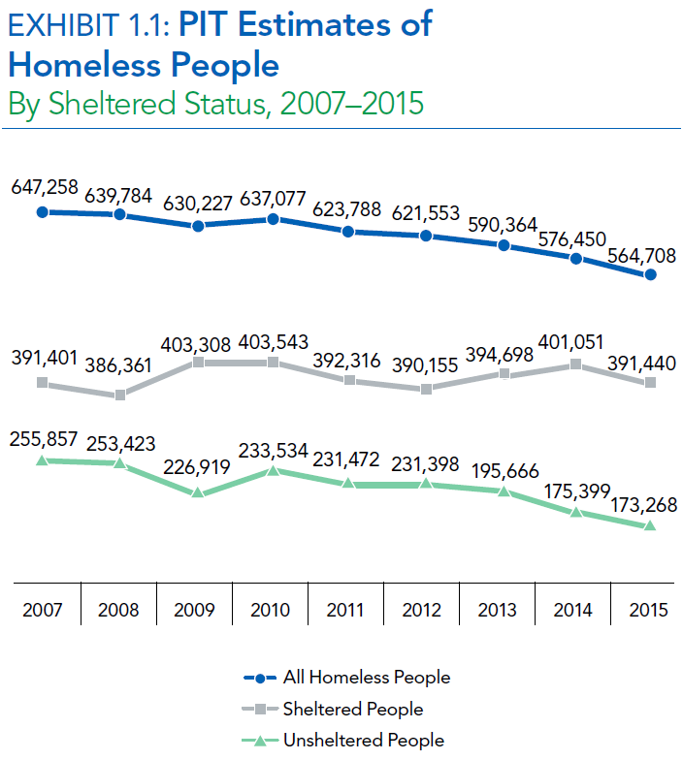
Urban Policy: Homelessness
Counting the Homeless, 2

Slide 7
Urban Policy: Homelessness
Counting the Homeless, 3
  In January 2015, 564,708 people were homeless on a given night. Most (69%) were staying in residential programs for homeless people, and 31% were found in unsheltered locations.
  Nearly one-quarter of all homeless people were children, under the age of 18 (23%) . Nine percent were between 18 and 24, and 68% were 25 years or older.
  Homelessness declined by 2% between 2014 and 2015 and by 11% since 2007.

Slide 8
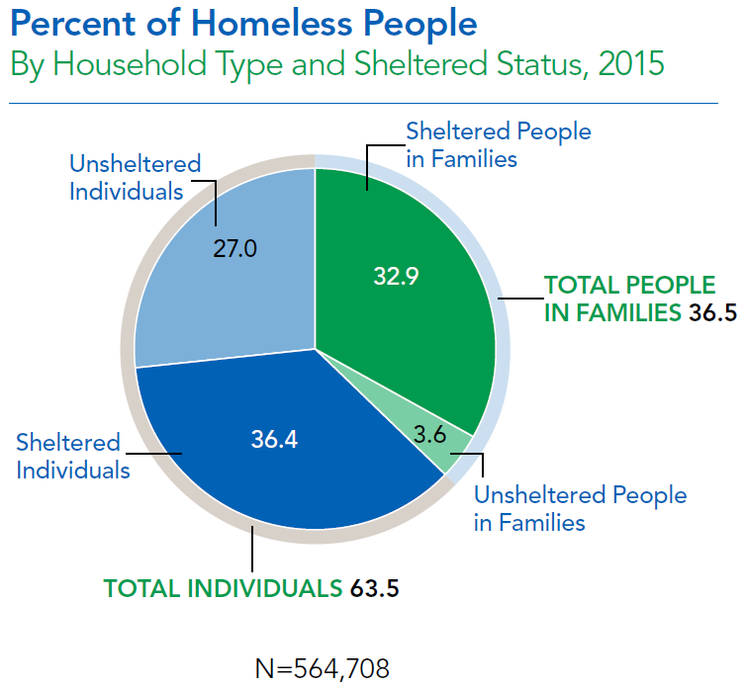
Urban Policy: Homelessness
Counting the Homeless, 4

Slide 9
Urban Policy: Homelessness
Counting the Homeless, 5

Slide 10
Urban Policy: Homelessness
Counting the Homeless, 6
  California accounted for 21 percent of the nation’s homeless population in 2015.
  More than half of the homeless population in the United States was in five states: CA (21%), NY (16%), FL (6%), TX (4%), and MA (4%).
  California had the highest percentage of homeless people counted in unsheltered locations (64%).
  Almost all homeless people were staying in shelter in Maine, Massachusetts, Rhode Island, Delaware, Nebraska, and New York.

Slide 11
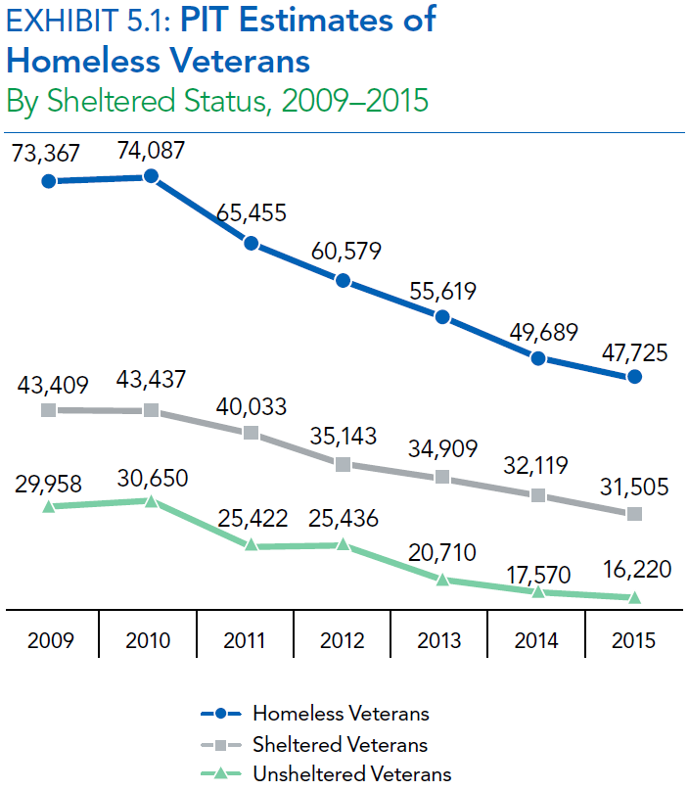
Urban Policy: Homelessness
Counting the Homeless, 7

Slide 12
Urban Policy: Homelessness
Chronic Homelessness
  HUD also estimates that in 2015
    83,170 people (about 23% of all homeless people) were chronically homeless.
    Two-thirds of these people were not in shelters.

Slide 13
Urban Policy: Homelessness
Chronic Homelessness, 2

Slide 14
Urban Policy: Homelessness
Inventory of Beds
  In January 2015, there were 830,120 year-round beds available in emergency shelters and other types of housing for homeless people.
  About half these beds were dedicated to people experiencing homelessness, while the other half targeted formerly homeless people.

Slide 15
Urban Policy: Homelessness
Inventory of Beds, 2

Slide 16
Urban Policy: Homelessness
Inventory of Beds, 3

Slide 17
Urban Policy: Homelessness
Snapshot vs. Flow
  In homelessness, as in the case of rent burdens, one can ask about homelessness at a point in time (a snapshot)
  Or about the number of households who experience homelessness over a longer period of time (a flow).
  Chronic homelessness arises when a household show up in many snapshots.

Slide 18
Urban Policy: Homelessness
The Dynamics of Homelessness
● □ □ □
● □ ● □ ● ● □ □
□ ● □ ▪ ▪
▪ ▪ ▪ ▪ ● ●
◊ ◊ ◊ ◊ ▪ ●
▪ ◊ ◊ ◊ ▪ ◊ ◊
Housing Services
Minimum
Formal
Housing
Homeless
2003 2004 2005 2006 2007 2008 2009 2010 2011

Slide 19
Urban Policy: Homelessness
According to the National Alliance to End Homelessness,
  Most people who experience homelessness enter and exit the homeless system quickly.
    80% of single adult shelter users enter the homeless system only once or twice, stay just over a month, and do not return.
    Approximately 9% enter about 5 times a year and stay about 2 months each time. This group utilizes 18% of the system’s resources.
  The remaining 10% (HUD’s chronically homeless) enter the system about twice a year and stay an average of 280 days each time.
    They often cycle between homelessness, hospitals, jails, and other institutional care and often have a complex medical problem, a serious mental illness like schizophrenia, and/or alcohol or drug addiction.
    They use up more than 50% of public homeless services.
  http://www.endhomelessness.org/

Slide 20
Urban Policy: Homelessness
Who Are the Homeless?
  The homeless are almost all extremely poor people who have run out of options.
    Illness or addiction or lack of skills prevents employment.
    No family or friends willing and able to help.

Slide 21
Urban Policy: Homelessness
Who Are the Homeless?
Extremely Poor Households
Homeless Households

Slide 22
Urban Policy: Homelessness
How Do People Become Homeless?
  People become homeless when living on the streets or in a shelter is the best option available to them.
  Another way to put this is that, when faced with severe constraints, some people “choose” to be homeless.
  This is key for policy: Even homeless people respond to incentives.

Slide 23
Urban Policy: Homelessness
The “Choice” To Be Homeless
Budget Constraint
Housing
= H
Indifference Curves
B
H_{MIN}
Minimum Formal Housing
Informal Housing
A
H_{ACT}
G₁
G₂
Other Goods = G

Slide 24
Urban Policy: Homelessness
The “Choice” To Be Homeless, Continued
Budget Constraint
Housing
= H
Indifference Curves
H_{MIN}
Minimum Formal Housing
Budget Constraint
with High Price for Informal Housing
Informal Housing
H_{ACT}
G₁
G₂
G₃
Other Goods = G

Slide 25
Urban Policy: Homelessness
Where Do Homeless People Live?
  People who “choose” to be homeless, also choose where to live.
  Thus, there is a kind of “sorting” mechanism for the use of public space.
  Homeless people often win the competition for public space in central locations in large cities.

Slide 26
Urban Policy: Homelessness
Homeless People “Bid” the Most Near:
  The social service, food, and shelter sites they rely on;
  The locations where they can earn some money by panhandling, selling community newspapers, washing car windows, etc.; and
  The locations where they can find shelter on heat vents, under bridges, in parks, and so on.

Slide 27
Urban Policy: Homelessness
Conflict in Public Spaces
  This “sorting” sometimes leads to conflict as businesses object to homeless people nearby,
  As people who live or work in nearby buildings object to homeless people in parks and on streets,
  Or as criminals prey on homeless people and lead to perceptions of an unsafe environment for others.

Slide 28
Urban Policy: Homelessness
Resolving Conflict
  Cities have responded to this type of conflict in many ways, including
    Forcibly removing homeless people (and sometimes their “houses”) from some locations,
    Using aggressive police activity in locations popular with the homeless,
    Setting aside some public spaces for the homeless,
    Encouraging homeless people to use shelters.

Slide 29
Urban Policy: Homelessness
Lessons for Policy
  Lesson 1: Prevent homeless spells from starting.
    Set up eviction prevention programs.
    Coordinate with mental health facilities to assist patients at risk of homelessness when they are released.

Slide 30
Urban Policy: Homelessness
Lessons for Policy
  Lesson 2: Coordinate housing and social service programs.
    Build SROs with attached social service offices, along with other forms of supportive housing.
    Use social service programs to help entice homeless people into shelters or SROs.
    Set up shelters with staff who can diagnose problems and help link homeless people to appropriate treatment.

Slide 31
Urban Policy: Homelessness
Lessons for Policy
  Lesson 3: Set up programs to facilitate rapid transitions into permanent supportive housing
    Identify shelter residents, especially families with children, who can be transferred to permanent supportive housing.
    Help these people find or apply to this housing (and remove barriers that prevent this transition).

Slide 32
Urban Policy: Homelessness
Lessons for Policy
  Lesson 4: Provide appropriate services to homeless people who do not have (or cannot yet follow) a path to regular housing
    Set up a shelter system that is safe and that segregates groups, as appropriate (families from singles, for example).
    Provide services, such as a mail box, job posting, and a place to shower, for homeless people.

Slide 33
Urban Policy: Homelessness
Lessons for Policy
  Lesson 5: Do not expect to solve homelessness by building or subsidizing regular housing
    Some people can be lifted out of homelessness by moving them into assisted housing.
    But an increase in assisted housing will boost the number of homeless people (as those in poor housing circumstances see better choices).
    And some homeless people are not capable (at least not without treatment) of living in regular housing.

Slide 34
Urban Policy: Homelessness
Recent Policy Developments
  Many state and city governments are implementing programs consistent with these lessons.
  The federal government has supported these efforts.
    The proposed FY2016 federal budget contained $5.5 billion in funds for homeless assistance grants.
    Many other federal programs in HUD, HHS, and Veterans’ Affairs address homelessness indirectly.
    For more, see http://www.usich.gov/ and http://www.endhomelessness.org/ .

Slide 35
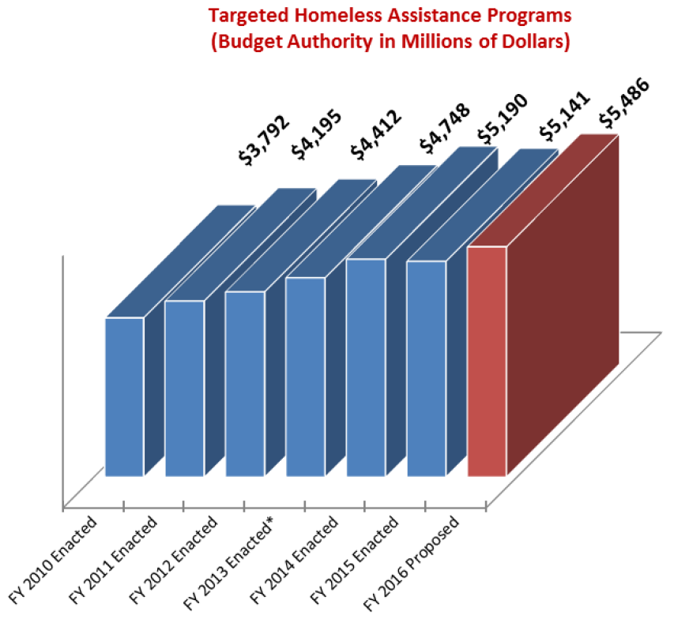
Urban Policy: Homelessness
Recent Policy Developments, 2 (from usich.gov)

