Slide 1
PAI786: Urban Policy
Class 7:
Housing Problems
and Federal Housing Programs

Slide 2
Urban Policy: Housing Problems and Programs
Class Outline
  Housing Problems
  Federal Housing Programs
  Note: This lecture draws on http://www.huduser.gov/portal/publications/affhsg/wc_HsgNeeds15.html and https://www.cbo.gov/sites/default/files/114th-congress-2015-2016/reports/50782-LowIncomeHousing-OneColumn.pdf

Slide 3
Urban Policy: Housing Problems and Programs
Worst Case Housing Needs
  HUD says that “worst case housing needs” exist for households with incomes below 50% of the area median who do not receive housing assistance and who have either of the following two housing problems:
    They live in inadequate housing.
    They pay more than 50% of income for housing costs.

Slide 4
Urban Policy: Housing Problems and Programs
Worst Case Housing Needs, 2
    In 2013, 7.7 million households had worst case housing needs, down from 8.5 million in 2011.
  Among extremely low-income renters (income below 30% of area median), 50.5% had worst case housing needs.
  Among very low-income renters (income between 30 and 50% of area median), 28.6% had worst case housing needs.

Slide 5
Urban Policy: Housing Problems and Programs
Worst Case Housing Needs, 3
  The number of very-low-income households with worst case housing needs had been growing
    5.0 million households in 2001 (= 4.8% of all very-low-income households)
    to 8.5 million households in 2011 (= 7.4% of all very-low- income households)
  Many families with children are affected.

Slide 6
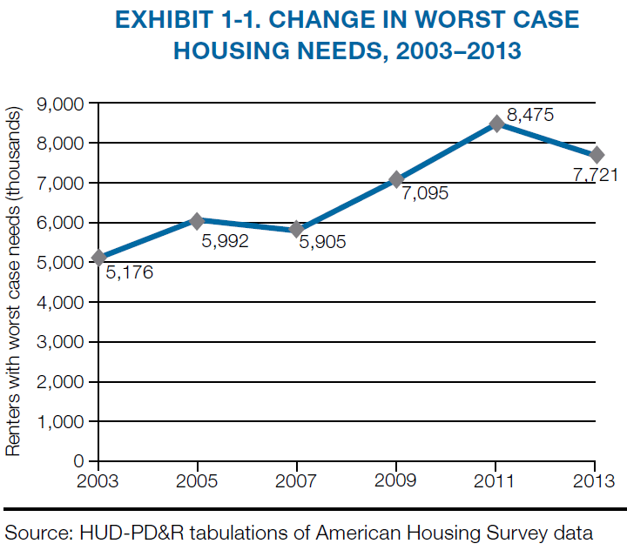
Urban Policy: Housing Problems and Programs

Slide 7
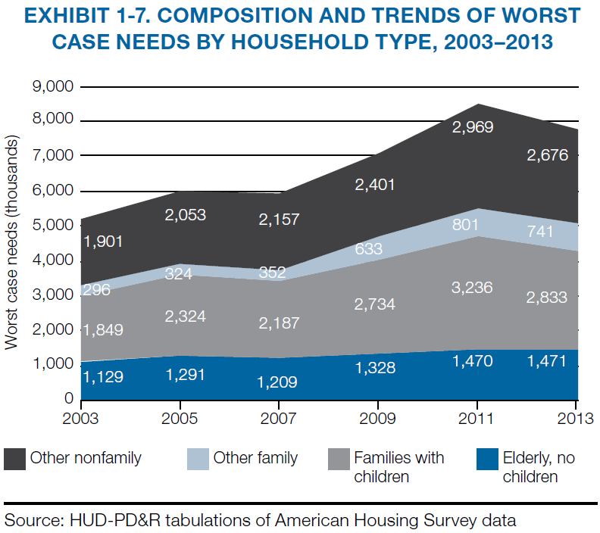
Urban Policy: Housing Problems and Programs

Slide 8
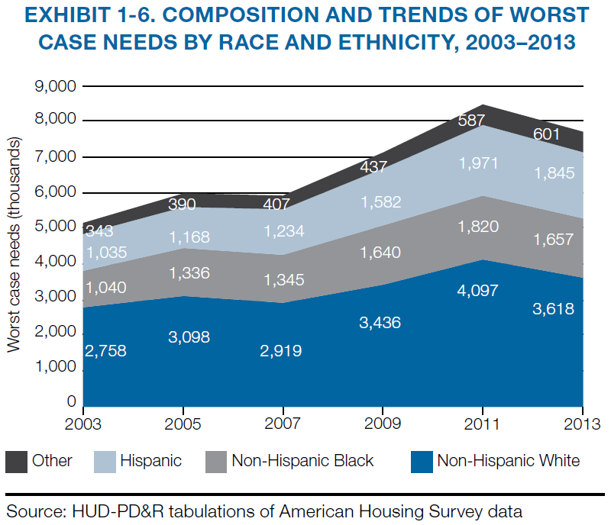
Urban Policy: Housing Problems and Programs

Slide 9
Urban Policy: Housing Problems and Programs
Worst Case Housing Needs, 4
  These figures are driven almost entirely by high rent burdens, not by poor quality housing.
  Overcrowding also sometimes occurs (more below), but HUD does not consider it to be a severe housing problem.

Slide 10
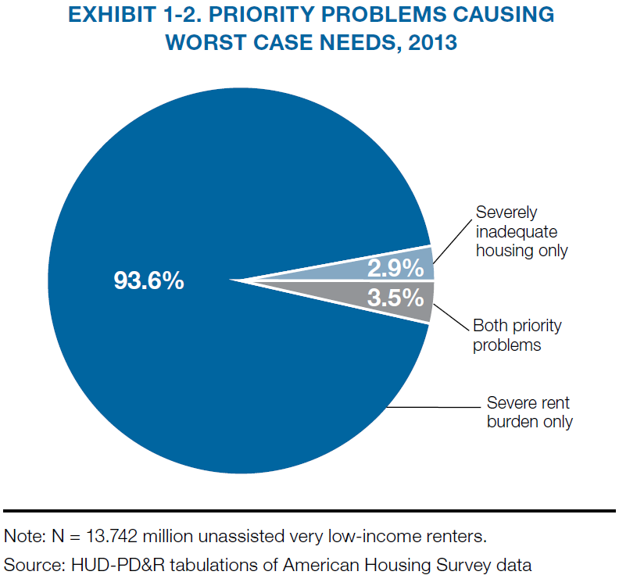
Urban Policy: Housing Problems and Programs

Slide 11
Urban Policy: Housing Problems and Programs
Severe Rent Burdens
  Housing costs include rents and utilities.
  According to HUD, a severe rent burden is more than 50% of a household’s income.
  A high rent burdens substantially limit the money households have to spend on other necessities, such as adequate nutrition and medical care.

Slide 12
Urban Policy: Housing Problems and Programs
Severely Inadequate Housing
  Severely inadequate housing includes a variety of physical problems related to heating, plumbing, electric, public spaces, or maintenance.
  Physical housing problems were the main housing problem until the mid 1970s, but are now not a serious problem.
  In 2013, only 2.9 percent of worst-case households were in that status based solely on severely inadequate housing.

Slide 13
Urban Policy: Housing Problems and Programs
Overcrowding
  HUD also keeps track of overcrowding, which is defined as more than 1 person per room.
  In the U.S. as a whole, only 1.9% of very-low-income renters lived in overcrowded conditions in 2011.
  The incidence was much higher, 7.8%, for very-low-income Hispanics, largely due to their extensive immigration.

Slide 14
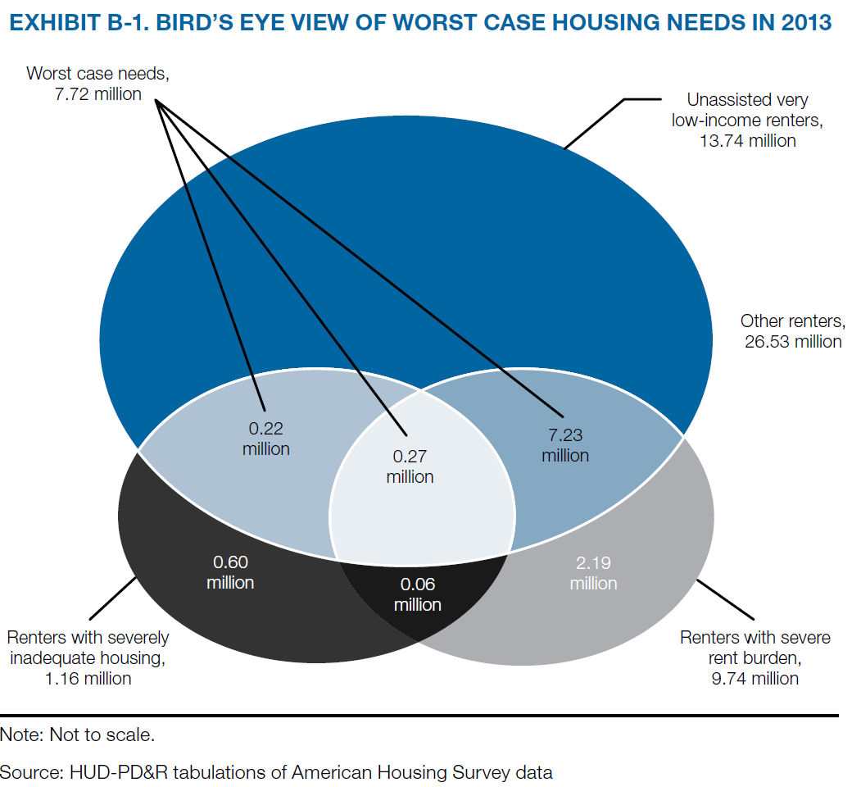
Urban Policy: Housing Problems and Programs

Slide 15
Urban Policy: Housing Problems and Programs
Housing Affordability
  A housing affordability problem arises when there is not enough available housing that low-income people can afford.
  A housing affordability problem can arise from:
    a lack of housing with affordable rents or
    higher-income people living in housing that is affordable to low-income people.

Slide 16
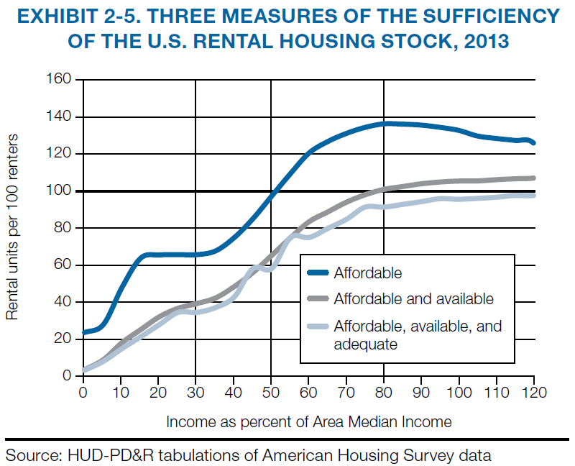
Urban Policy: Housing Problems and Programs
  Only 35 affordable, available, and adequate units are available for every 100 extremely low-income households.

Slide 17
Urban Policy: Housing Problems and Programs
The Dynamics of Housing Needs
  The incidence of housing needs changes over time.
  Some households occasionally have housing needs, others have housing needs over the long term.
  As a result, housing needs can be measured in several different ways:
    Snapshot
    Flow over time

Slide 18
Urban Policy: Housing Problems and Programs
The Dynamics of Housing Needs, Cont.
  Example: Rent burdens for 4 households
    Never experiences high rent burden (◊)
    Rarely experiences high rent burden (▪)
    Has trouble with high rent burden, but then situation improves (●)
    Starts out without high rent burden, but then long-run situation falls apart (□)

Slide 19
Urban Policy: Housing Problems and Programs
The Dynamics of Housing Needs
● □ □ □
● □ □ ● ● □ □
● □ ▪
□ ▪ ● ▪
▪ ◊ ▪ ▪ ● ● ▪
◊ ◊ ◊ ▪ ●
◊ ◊ ◊ ▪ ◊ ◊
Rent Burden
50% of Income
2007 2008 2009 2010 2011 2012 2013 2014 2015

Slide 20
Urban Policy: Housing Problems and Programs
The Dynamics of Housing Needs, continued
  In 2009 (in the example), only ¼ of households have high rent burdens.
  In 2010, ¾ of households have high rent burdens.
  In an average year, 36% (13/36) of households have a high rent burden.
  Over the 9-year period, ¾ of households experience a high rent burden at least once.
  Only 1 household has a high rent burden for more than 5 years.

Slide 21
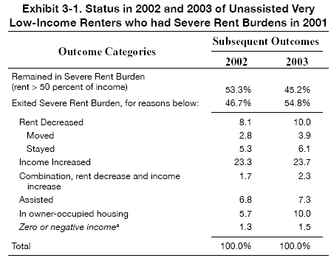
Urban Policy: Housing Problems and Programs
The Dynamics of High Rent Burdens
Source: HUD, Affordable Housing Needs, 2005

Slide 22
Urban Policy: Housing Problems and Programs
Key Federal Housing Programs
  Public housing
  Project-based assistance
  Tenant-based assistance
  Programs for homeowners
  Tax breaks
Serve about ¼ of eligible households

Slide 23
Urban Policy: Housing Problems and Programs
Key Federal Housing Programs, 2
  A good recent overview comes from the Congressional Budget Office:
  https://www.cbo.gov/publication/50782

Slide 24
Urban Policy: Housing Problems and Programs
Federal Housing Programs: Public Housing
  Public housing units are owned and managed by local public agencies; $7 billion spending in 2014.
  There are about 1.1 million public housing units, mostly built between 1937 and the mid-1980s.
  Public housing tenants usually pay 30 percent of their income in rent.
  Public housing projects in big cities constitute the nation’s highest-poverty neighborhoods.

Slide 25
Urban Policy: Housing Problems and Programs
Federal Housing Programs: Public Housing, 2
  “[T]he Northeast and South account for 73% of all occupied public housing units but only 54% of all renters.
  Public housing is also much more prevalent in central cities than in suburbs….
  Public housing …comes in … high-rise buildings, garden-style apartments, and single-family structures…. 41% of … units are in buildings with 4 or more stories, and 33% [are]… in buildings with 7 or more stories. Another 40% are in multiple-unit buildings of 3 stories or less. The remaining 19% are in single-family units.
  Forty-two % of all public housing units are located in ….census tracts [where more than 40% of the households have incomes below the poverty level].”
  https://www.huduser.gov/periodicals/ushmc/spring95/spring95.html

Slide 26
Urban Policy: Housing Problems and Programs
Federal Housing Programs: Public Housing, 3
  According to HUD:
    “In general, you may stay in public housing as long as you comply with the lease.
    If, at reexamination your family's income is sufficient to obtain housing on the private market, the HA may determine whether your family should stay in public housing.”
    http://portal.hud.gov/hudportal/HUD?src=/topics/rental_assistance/phprog

Slide 27
Urban Policy: Housing Problems and Programs
Federal Housing Programs: Public Housing, 4
  According to Turner and Kingsley and the Urban Institute,
    “The median length of stay in public housing is only 4.7 years.”
    “The elderly and disabled groups stay the longest; the median for families with children [is] only 3.2 years.”
    “[A] sizeable minority of public housing residents stay much longer. Specifically, 20 percent of families with children (nonelderly and nondisabled) in public housing have lived there 8.9 years or longer.”
  http://www.urban.org/sites/default/files/alfresco/publication-pdfs/411798-Federal-Programs-for-Addressing-Low-Income-Housing-Needs.PDF

Slide 28
Urban Policy: Housing Problems and Programs
Federal Housing Programs: Project-based Assistance
  There are 1.2 million rental units (for 2 million people) produced with federal government subsidies between 1960 and 1990; most tenants are seniors or have a disability; $12 billion spending in 2014.
  Most are now privately owned projects supported by project-based Section 8 rental assistance contracts.
  Most units are reserved for low-income tenants, who must pay 30 percent of their income for rent.
  Some projects originally built under these programs reverted to market-price projects when their initial 30-year contracts expired.

Slide 29
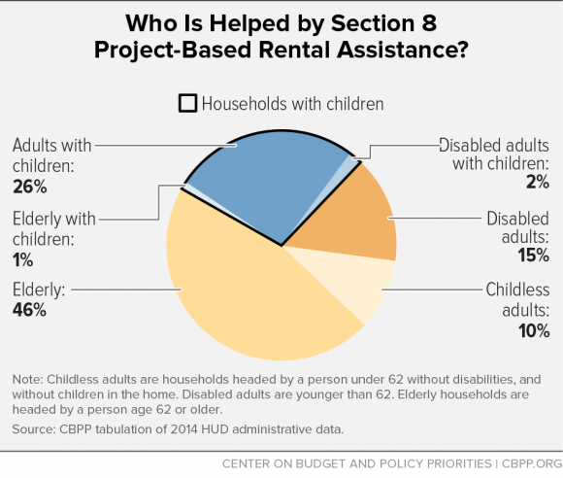
Urban Policy: Housing Problems and Programs

Slide 30
Urban Policy: Housing Problems and Programs
Federal Housing Programs: Tenant-based Assistance
  These programs provide “housing choice vouchers” to 2.1 million low-income rental households (and 5 million people), as selected by local public housing authorities (PHAs); $18 billion spending in 2014.
  Landlords can decide whether to participate; HUD sets affordability and other limits.
  Households select units from among those provided by participating landlords; vouchers are “portable.”
  Households must pay 30% of their income for rent, but may pay more if they want to spend more than the HUD limit.

Slide 31
Urban Policy: Housing Problems and Programs
Housing Choice Vouchers
  75% of a PHA’s new vouchers are supposed to go to extremely low-income households (=income below 30% of area median).
    This target is not always met, especially by small PHAs.
  After this, some PHAs may choose to provide most assistance to working families or families actively seeking employment,
  while others may choose to target assistance to those with the most severe housing needs.

Slide 32
Urban Policy: Housing Problems and Programs
Housing Choice Vouchers, 2
  Once a household starts using a voucher, it gets to keep it even if its income goes up, although higher income means a higher rent payment.
  Most of the $20 billion or so spent on vouchers goes to households selected in previous years; there are long (or closed!) waiting lists for vouchers in most cities.
  The budget battle every year is about how many new vouchers to add, that is, how much more to spend.
    The total number has been declining.
    A few new ones are sometimes added for tenants in demolished public housing or for homeless veterans.

Slide 33
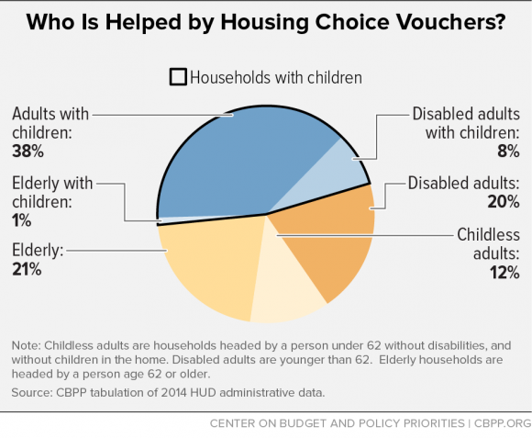
Urban Policy: Housing Problems and Programs

Slide 34
Urban Policy: Housing Problems and Programs
Housing Choice Vouchers, 3
  Although a household remains eligible when its income increases, a high income may drop the subsidy to zero, which may lead the household to leave the program.
  According to Turner and Kingsley:
    “[T]he median voucher household receives assistance for 3.1 years. The elderly and disabled groups stay the longest; the median for families with children [is] only … 2.6 years.

Slide 35
Urban Policy: Housing Problems and Programs
Housing Choice Vouchers, 4
  A UI study based on the Moving to Opportunity program (on which more later), found:
  http://www.chapa.org/sites/default/files/413163-What-Happens-to-Housing-Assistance-Leavers.pdf

Slide 36
Urban Policy: Housing Problems and Programs
Number of Tenants Assisted
LIHTC = Low Income Housing Tax Credit (discussed below)

Slide 37
Urban Policy: Housing Problems and Programs
Federal Housing Programs over Time

Slide 38
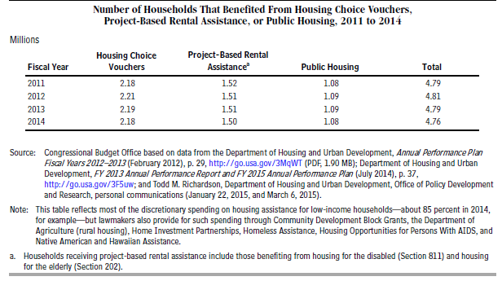
Urban Policy: Housing Problems and Programs
Federal Housing Programs over Time

Slide 39
Urban Policy: Housing Problems and Programs
Federal Housing Programs for Homeowners
  PHAs are allowed to sell some or all of the units in a public housing project to low-income families (but rarely do).
  A few programs provide subsidies to low-income homeowners.
    Under some circumstances, vouchers can be used for this purpose.
    Some federal grants to state and local governments, such as the so-called HOME grants, can be (and occasionally are) used to support homeownership.

Slide 40
Urban Policy: Housing Problems and Programs
Federal Housing Programs: Tax Deductions
  The property-tax and mortgage-interest deductions (and a few other provisions) on the federal income tax subsidize middle- and (especially) high-income homeowners.
  These breaks do not help low-income homeowners, who do not itemize; switching to a tax credit would help them.
  These deductions cost the federal government far more ($130 billion) than all other housing programs put together ($50 billion).
    The cost of these tax expenditures goes up to $218 billion if the exclusion of net rental income is added; see http://www.taxpolicycenter.org/publications/url.cfm?ID=1001726

Slide 41
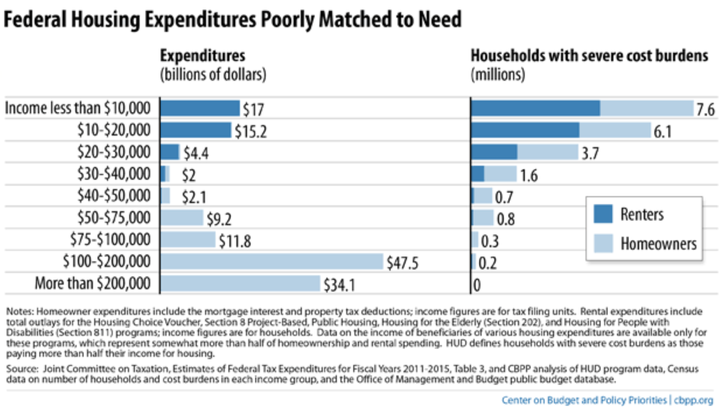
Urban Policy: Housing Problems and Programs

Slide 42
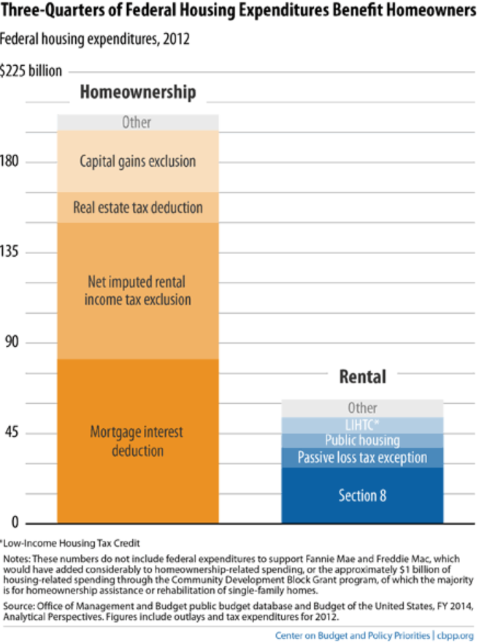
Urban Policy: Housing Problems and Programs

Slide 43
Urban Policy: Housing Problems and Programs
Federal Housing Programs: LIHTC
  The Low-Income-Housing Tax Credit uses income-tax breaks to subsidize 30 to 91 percent of construction costs for eligible projects.
  The LIHTC is linked to 1/3 of recent multifamily construction and costs roughly $7 billion per year.
  44% of units are in middle- and higher-income neighborhoods
  It appears that the LIHTC (the subject of the case!)
    Is relatively expensive per unit provided
    Crowds out other private development
    Does not serve the poorest households (at least not without other subsidies)

Slide 44
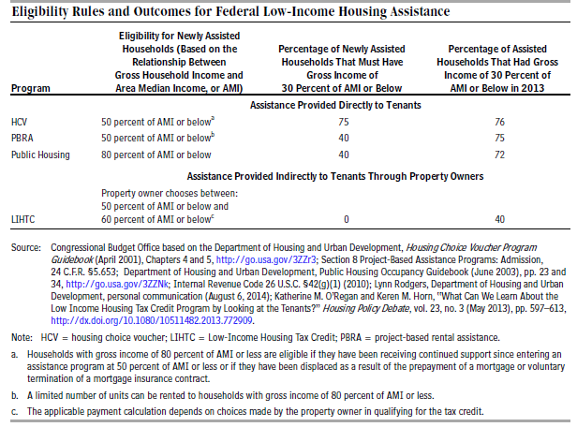
Urban Policy: Housing Problems and Programs

Slide 45
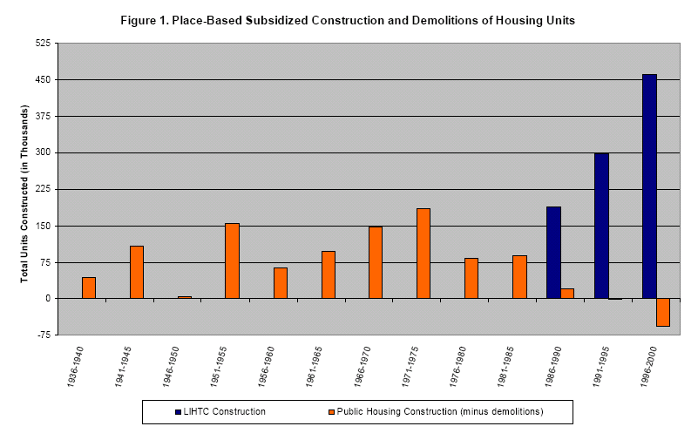
Urban Policy: Housing Problems and Programs

Slide 46
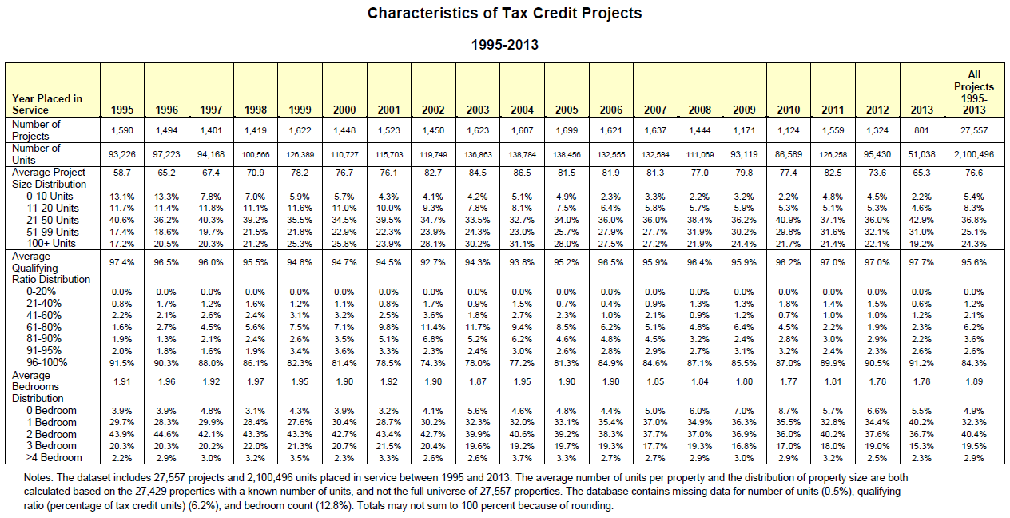
Urban Policy: Housing Problems and Programs
Source: http://www.huduser.gov/portal/datasets/lihtc/tables9513.pdf

Slide 47
Urban Policy: Housing Problems and Programs
Looking Ahead: Federal Involvement in the Mortgage Market
  The Federal Housing Administration ensures 4.8 million single-family mortgages.
  To help attract investors into the mortgage market, the federal government set up Fannie Mae (1938) and Freddie Mac (1970) to buy mortgages and re-sell them as mortgage-backed securities.
  Fannie and Freddie became private companies, but got into trouble during the financial crisis and are now under federal supervision.
  The Federal Housing Finance Agency oversees the secondary mortgage market and is the conservator for Fannie and Freddie.

