Slide 1
PAI786: Urban Policy
Class 12: Mortgage Markets and Predatory Lending

Slide 2
PAI786, Class 12: Predatory Lending
Class Outline
  A Brief History of Mortgage Market Institutions
  Predatory lending
  The default crisis
  Mortgage markets today
  Anti-predatory-lending legislation

Slide 3
PAI786, Class 12: Predatory Lending
A Brief History
    Mortgage markets before 1980
    New institutions, products, and problems

Slide 4
PAI786, Class 12: Predatory Lending
“It’s A Wonderful Life”
Mortgage markets used to be simple.
  People opened savings accounts in S&Ls; these S&Ls loaned out their deposits to other people in the form of mortgages.
  At any given time, all mortgages were issued at the same interest rate; but people with credit problems were turned down for a loan.

Slide 5
PAI786, Class 12: Predatory Lending
Types of Service in a Mortgage
A mortgage offers four types of services:
  Mortgage origination (using “underwriting”)
  Mortgage servicing
  Default and prepayment risk acceptance
  Capital provision
An S&L did all of these things; now they are often provided by different institutions.

Slide 6
PAI786, Class 12: Predatory Lending
New Institutions
How times have changed!
  Thanks to deregulation, commercial banks can issue mortgages.
  Mortgages can be issued by mortgage brokers, who do not have deposits, but instead raise capital from depository lenders or investors .
  Secondary mortgage market institutions (Fannie Mae, Freddie Mac) bring investors and borrowers together by buying mortgages and packaging them into “mortgage backed securities,” which anyone can buy.
  Complex financial products and institutions have developed to facilitate this packaging and spread the associated risk.

Slide 7
PAI786, Class 12: Predatory Lending
The Emergence of Mortgage Brokers
Mortgage brokers, often working as independent entities, originate a large share of loans and may provide the only contact with the borrower until closing.
The mortgage broker plays an important role in pricing the loan, and the broker’s compensation may depend on the interest rate and fees paid by the consumer.
But mortgage brokers sell the loans; they do not hold on to them.

Slide 8
PAI786, Class 12: Predatory Lending

Slide 9
PAI786, Class 12: Predatory Lending
New Products
In the “It’s a Wonderful Life” period, people either qualified or not—at the going rate.
Deregulation and specialization led to many mortgage products with different prices.
  Many types of mortgages are now issued, some of them, called subprime, at high interest rates.
  Many high-risk borrowers can now get a mortgage if they are willing to pay a high rate.
  Lenders buy credit scores and automated underwriting systems to predict which potential borrowers are most likely to default.

Slide 10
PAI786, Class 12: Predatory Lending
The Pros and Cons of New Products
These new products dramatically changed mortgage markets.
  These products have the great advantage that they expand the set of people who can obtain mortgages.
  And the great disadvantage that they opened the door for a lot of mischief in the form of (a) unwarranted fees and pricing practices and (b) charging some people more interest than they should have paid.

Slide 11
PAI786, Class 12: Predatory Lending
The Loss of Connection with Borrowers
Another disadvantage comes from the fact that mortgages are sold and re-sold; packaged and re-packaged.
  Data systems do not trace the participants and may not even keep track of the title.
  Links to the original broker may be lost—with no way to hold the broker accountable for poor underwriting decisions or to keep track of the title!

Slide 12
PAI786, Class 12: Predatory Lending
Predatory Lending
The complexity of today’s mortgage market puts consumers at a disadvantage.
  Sometimes high interest rates or extra fees are legitimate responses to a high-risk borrower.
  But some unscrupulous lenders use misleading or fraudulent tactics to collect interest payments or fees above competitive levels, which is called predatory lending.

Slide 13
PAI786, Class 12: Predatory Lending
Types of Predatory Lending
Questionable or illegal practices include:
  Making loans that exceed the borrower’s ability to pay, sometimes with “teaser rates” (2/28 or 3/27 loans);
  Inducing repeated refinancing accompanied by high fees (‘‘loan flipping’’);
  Inducing the consumer, through deception or fraud, to accept loan add-ons, such as credit insurance;
  ‘‘Steering’’ borrowers qualified for lower-rate loans into higher-priced loans;
  Overestimating the value of the collateral to overstate available equity or induce a consumer to pay an inflated price for a home.
For more, see: http://www.responsiblelending.org/state-lending/mortgages

Slide 14
PAI786, Class 12: Predatory Lending
Some Hints about Predatory Lending Before the Financial Crisis
Nobody knows how much predatory lending existed before the crisis or how much remains.
  Even without predatory lending, subprime loans would be more common in places with more credit problems.
But there were dramatic increases in high-interest loans, especially in minority and low-income neighborhoods,
And dramatic increases in fraud cases.

Slide 15
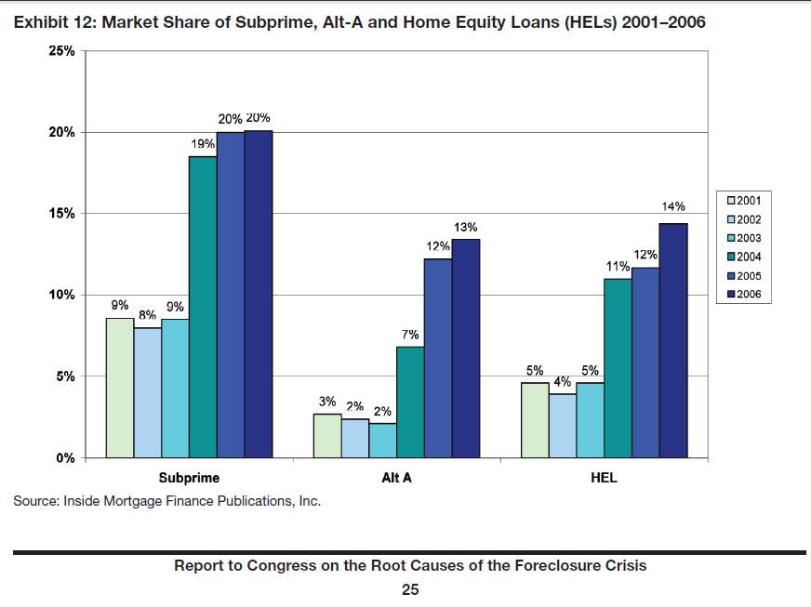
PAI786, Class 12: Predatory Lending
Increases in High Cost Loans (HUD)

Slide 16
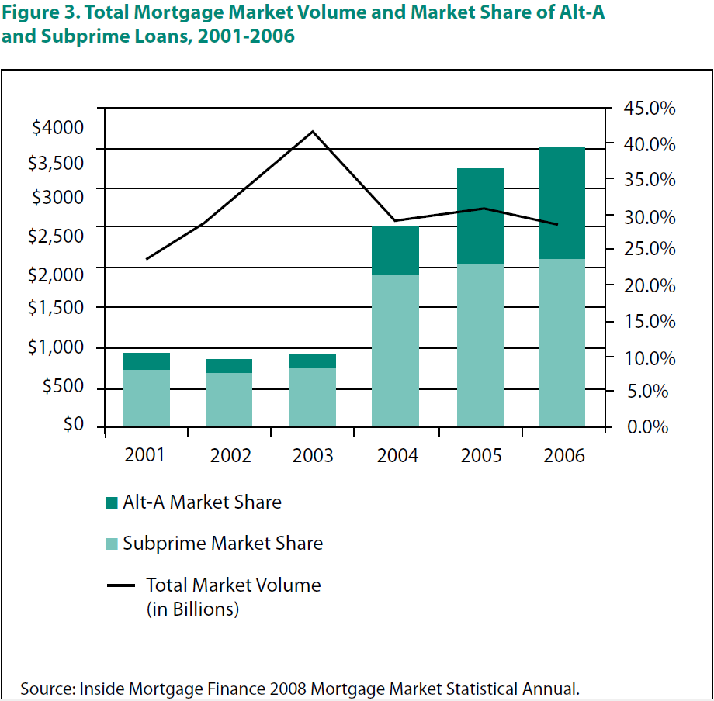
PAI786, Class 12: Predatory Lending
Downloaded from:
http://www.responsiblelending.org/state-lending/mortgages

Slide 17
PAI786, Class 12: Predatory Lending

Slide 18
PAI786, Class 12: Predatory Lending

Slide 19
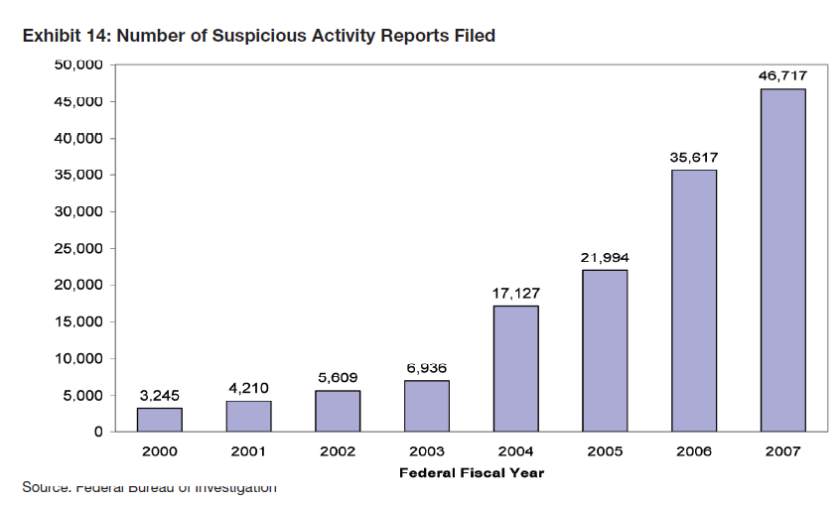
PAI786, Class 12: Predatory Lending
Huge Increase in Fraudulent Practices

Slide 20
PAI786, Class 12: Predatory Lending
The Default Crisis
Starting about 2005, the number of defaults, i.e. missed mortgage payments, started to increase.
When payments are missed over several months, lenders foreclose, that is, they take over the house.
Re-negotiation is rare; the lender holding the loan is unlikely to be the party who issued it.
Millions of homeowners have lost their homes; many more are still at risk.

Slide 21
PAI786, Class 12: Predatory Lending
Homeowners in Trouble
A homeowner is “underwater” if its mortgage is greater than the value of its house.
The number of homeowners underwater increased rapidly when the financial crisis hit.
The share of homeowners underwater went from 7% in 1997 to 16% in 2009, to over 31% in 2012 (see chart in a few slides).

Slide 22
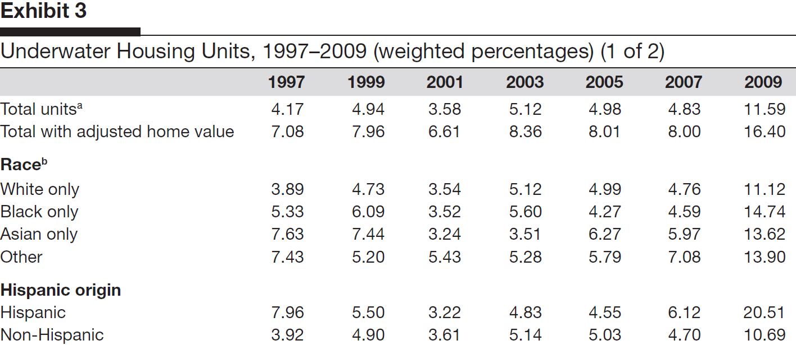
PAI786, Class 12: Predatory Lending
Source: Carter (Cityscape 2010)

Slide 23
PAI786, Class 12: Predatory Lending
Homeowners in Trouble, 3
Defaults and foreclosures started to increase rapidly in 2006,
And reached record highs by 2010.

Slide 24
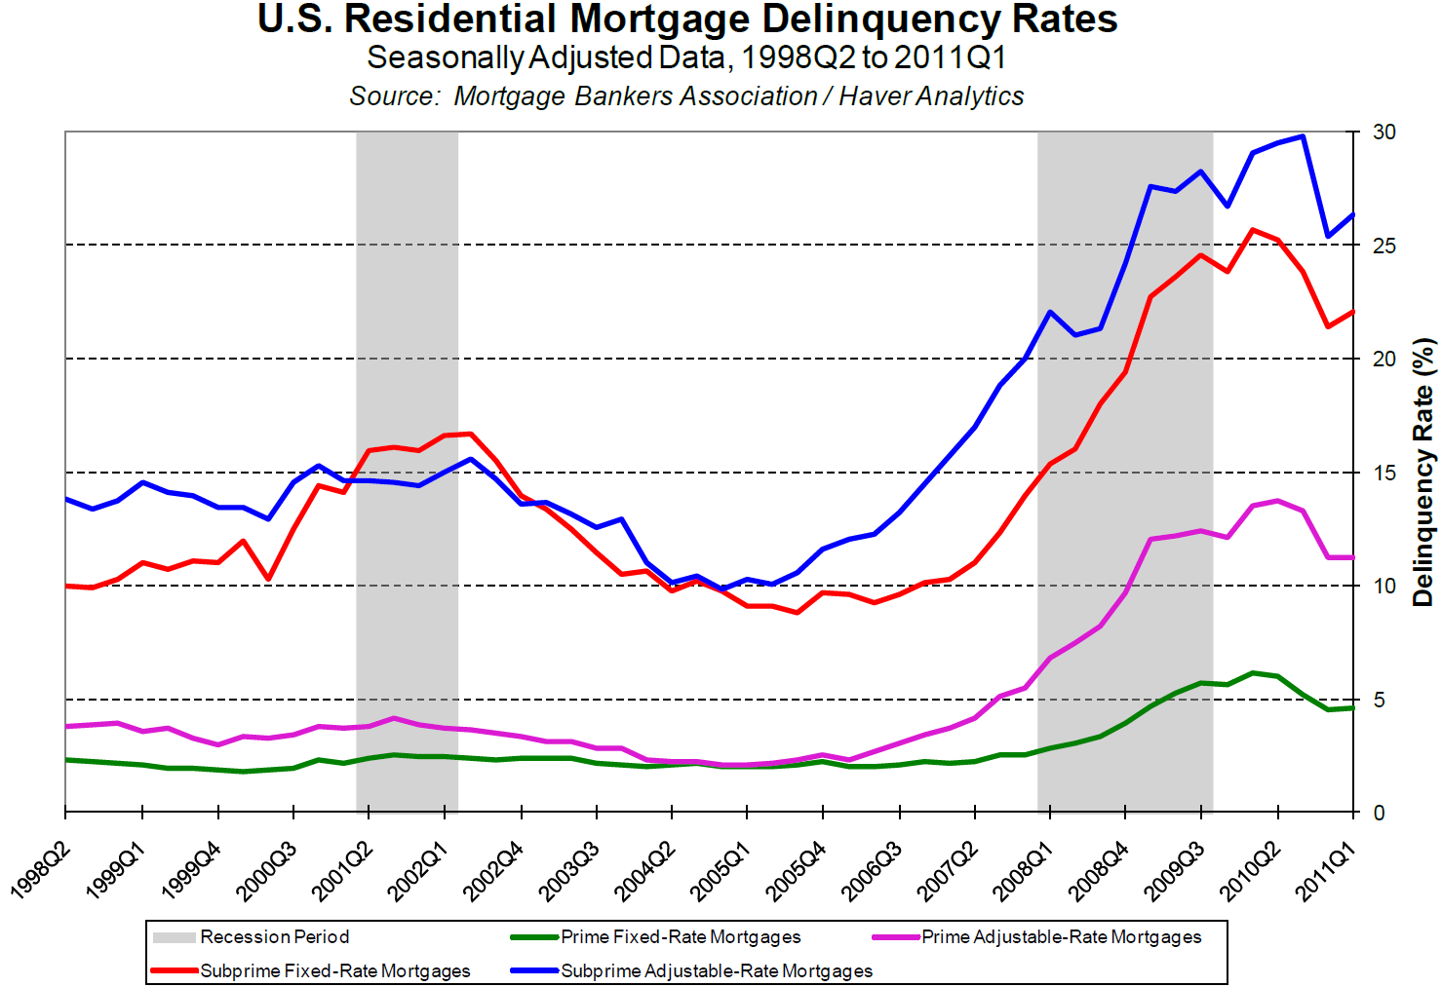
PAI786, Class 12: Predatory Lending
Source: Federal Reserve Bank of Richmond

Slide 25
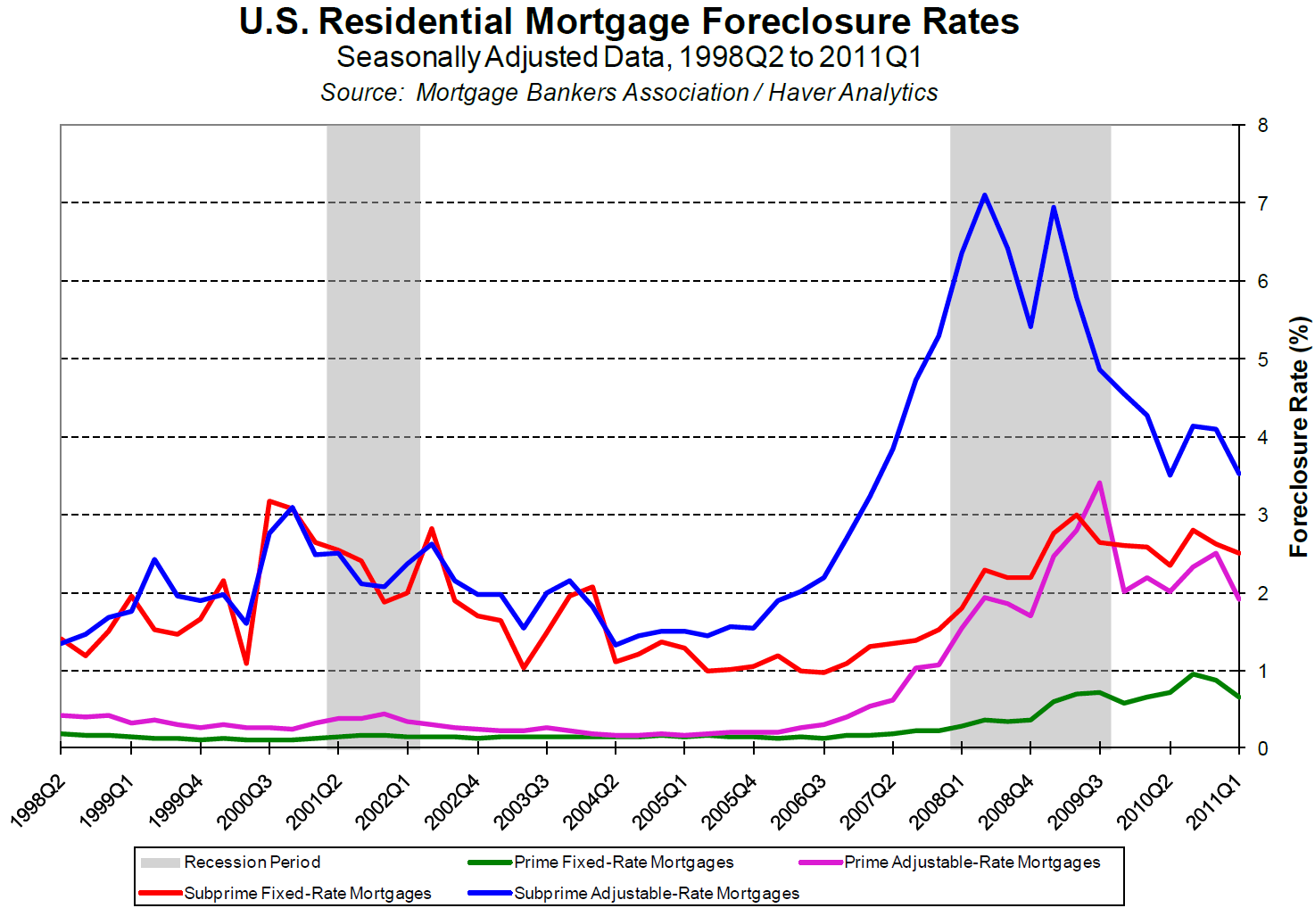
PAI786, Class 12: Predatory Lending
Source: Federal Reserve Bank of Richmond

Slide 26
PAI786, Class 12: Predatory Lending
Foreclosures and Disadvantaged Groups
The impact of foreclosures has not been even; historically disadvantaged groups have been hit particularly hard.
  Due to past discrimination, Blacks and Hispanics have poorer credit characteristics and were more likely to have sub-prime or predatory loans—even without current discrimination.
  Some lenders marketed sub-prime or predatory loans in minority neighborhoods and often gave those loans to households that qualified for more favorable terms.
  The result: Relatively high foreclosure rates—and a huge loss of equity—for Black and Hispanic households.

Slide 27
PAI786, Class 12: Predatory Lending
Source:
Center for
Responsible
Lending

Slide 28
PAI786, Class 12: Predatory Lending
The Financial Crisis
The default crisis grew into a major financial crisis in 2008.
Several large institutions specialized in insuring others against the risk of default (e.g., through Credit Default Swaps, CDSs).
  When defaults spiraled upward, these institutions went under.
  Some were rescued by the federal government, others were not.
  The trouble in these financial institutions spilled over into others, including large banks and mortgage insurance companies.

Slide 29
PAI786, Class 12: Predatory Lending
What Caused the Financial Crisis?
1. “Predatory” lending and fraud.
2. Inadequate regulation.
2. Incentives of brokers and other parties to initiate high-risk loans.
4. Complex links with financial institutions, particularly those spreading risk. (This topic is beyond the scope of today’s class!)

Slide 30
PAI786, Class 12: Predatory Lending
Mortgage Brokers and the Default Crisis
Many observers think that predatory lending by mortgage brokers played a key role in the default crisis.
The theory is that mortgage brokers do not bear the risk because they make their money simply by originating the loan.
This is called moral hazard (= being insured against a risk over which one has control)

Slide 31
PAI786, Class 12: Predatory Lending
More on Moral Hazard
Mortgage brokers could initiate a risky loan and sell it, thereby insulating themselves from default risk.
Moreover, the housing market was booming, so people bought these mortgages without being very concerned about default.
CDSs and other risk-shifting assets were developed so people could avoid risk when they were worried about it.
Everyone (including the credit ratings agencies and the institutions specializing in CDSs) underestimated the probability of market-wide problems.

Slide 32
PAI786, Class 12: Predatory Lending
Evidence of Moral Hazard
Research by Mian and Sufi (scholars at Princeton and Chicago, respectively) finds evidence that moral hazard was at work starting in about 2002:
  The share of high loan-to-value loans went up.
  The share of loans being sold went up.
  Neighborhoods where people had been turned down for loans in 2001 (and where income had not grown thereafter), called “subprime” zip codes, experienced large increases in loan approval—and in defaults.

Slide 33
PAI786, Class 12: Predatory Lending
Evidence of Moral Hazard, 2
This research was published in the Quarterly Journal of Economics in 2009.
The following charts are from the on-line appendix, which is available at:
http://www.princeton.edu/~atif/OnlineAppendix_MortgageCrisis.pdf .

Slide 34
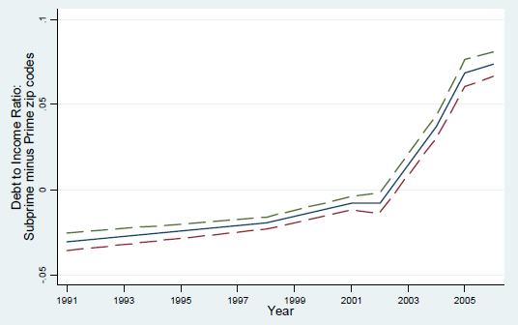
PAI786, Class 12: Predatory Lending
Huge Decrease in Quality of Approved Loans

Slide 35
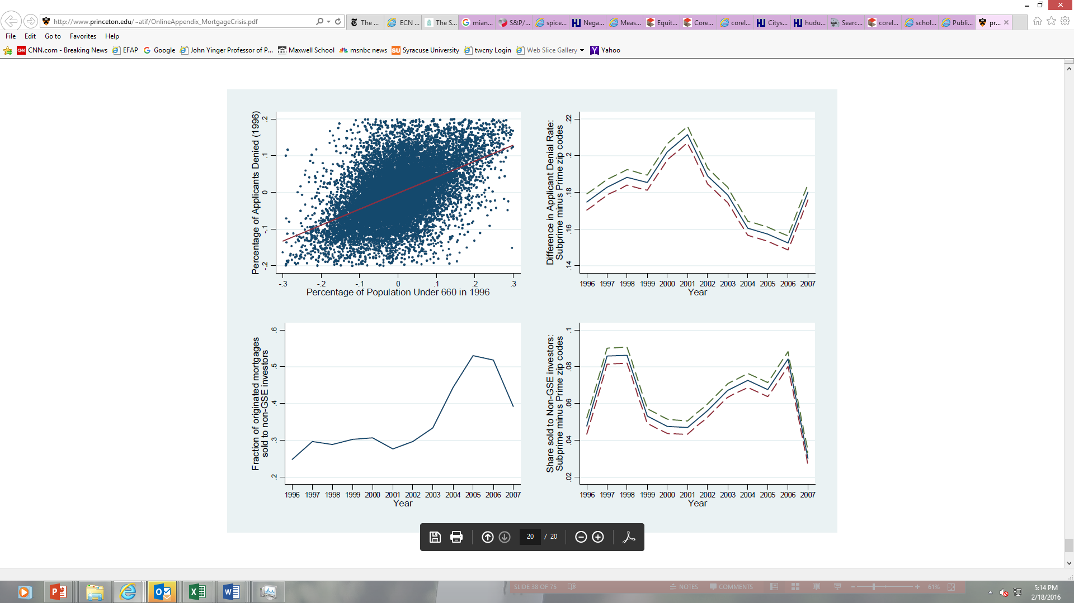
PAI786, Class 12: Predatory Lending
Huge Increase in Sales of Mortgages—and Not to the GSEs

Slide 36
PAI786, Class 12: Predatory Lending
Huge Decrease in Mortgage Denial Rate

Slide 37
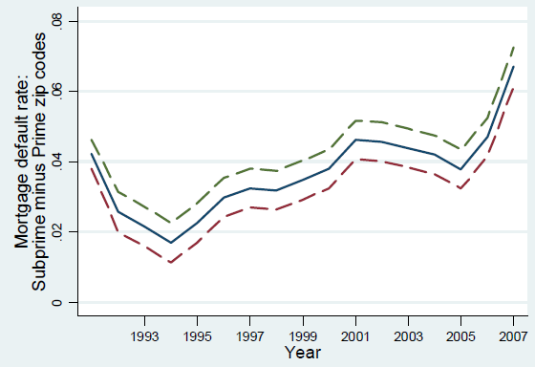
PAI786, Class 12: Predatory Lending
Huge Increase in Mortgage Default Rate

Slide 38
PAI786, Class 12: Predatory Lending
It Was Not the Fault of Fannie and Freddie
Fannie Mae and Freddie Mac were large, profitable private organizations that packaged loans meeting certain standards. At the end of the financial crisis, they were bought (back) by the federal government.
Some people say they caused the crisis by going too far in encouraging homeownership. This is nonsense.
They mainly purchased conventional, low-risk loans for purchase or refinancing; they purchased very few sub-prime loans before the crisis.
Starting in about 2004, however, they started to invest in institutions that purchased sub-prime loans, so they took huge losses when the crisis came. That’s why the federal government had to buy them back (at great cost to taxpayers!).

Slide 39
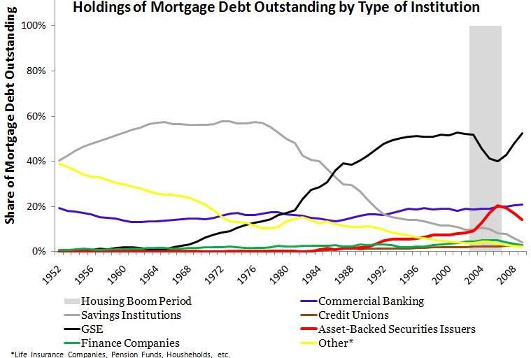
PAI786, Class 12: Predatory Lending
Fannie and Freddie Lost Market Share

Slide 40
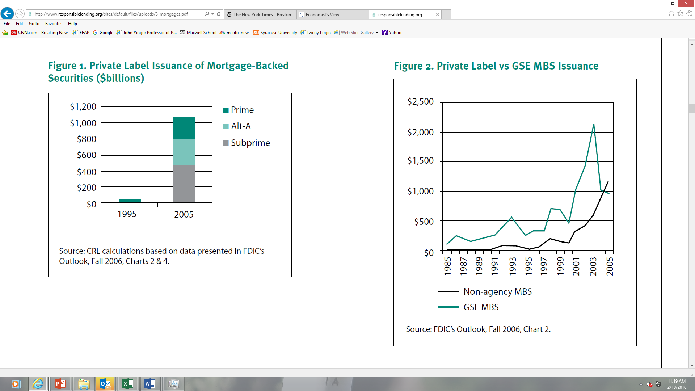
PAI786, Class 12: Predatory Lending
Private label = non-GSE
Downloaded from:
http://www.responsiblelending.org/state-lending/mortgages

Slide 41
PAI786, Class 12: Predatory Lending
MSB = Mortgage-backed security
Downloaded from:
http://www.responsiblelending.org/state-lending/mortgages

Slide 42
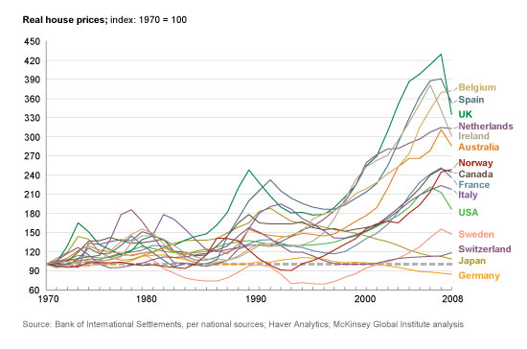
PAI786, Class 12: Predatory Lending
No Other Country Had Fannie, Freddie, But…….

Slide 43
PAI786, Class 12: Predatory Lending
It Was Not the Fault of CRA
The Community Reinvestment Act of 1977 requires depository lenders to serve all parts of their traditional lending areas.
  Lenders who do not serve low-income or minority areas may be denied the ability to set up new offices or make other business changes.
  Lenders have altered their practices because of CRA regulations, which were strengthened in the Clinton Administration.
Some people say CRA’s push to serve low-income areas is a key cause of the crisis. Nonsense.
CRA only applies to depository lenders. They were not the ones issuing subprime loans. CRA does not apply to mortgage brokers or the institutions that package mortgage loans.

Slide 44
PAI786, Class 12: Predatory Lending
Where Are We Now?
What is happening in housing and mortgage markets today?
Are foreclosures still a big problem?
What is going on with federal policy?

Slide 45
PAI786, Class 12: Predatory Lending
Post-Crash Housing & Mortgage Markets
After the collapse of the housing bubble in 2008, housing prices continued to decline until 2012; now they are rising again.
Because of the recession, household incomes declined until recently, too.
These trends slowed the recovery from all the trouble in mortgage markets.

Slide 46
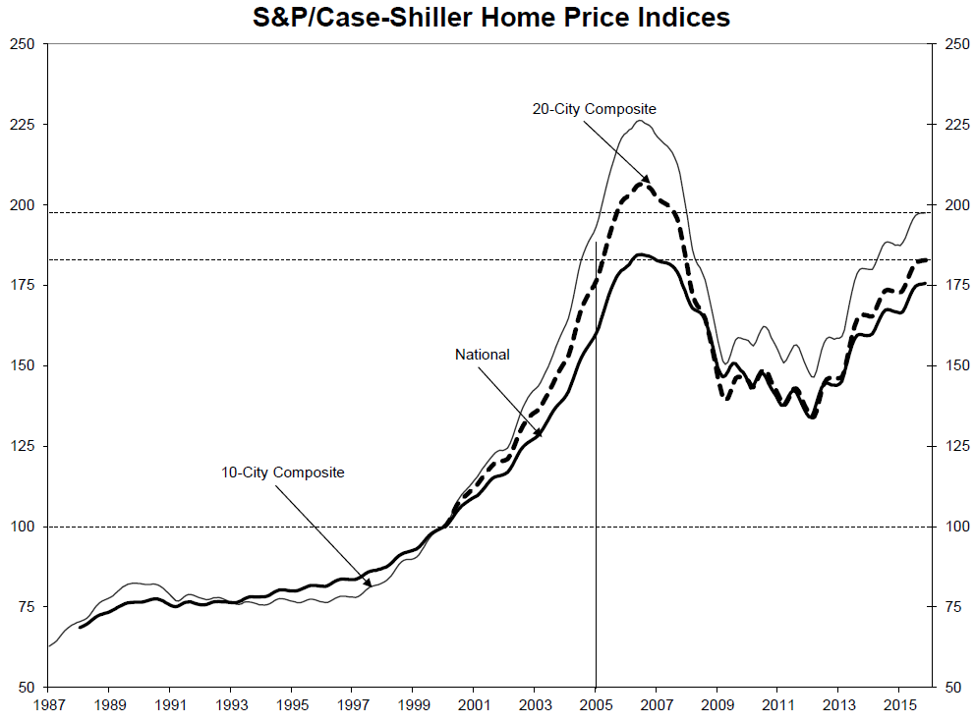
PAI786, Class 12: Predatory Lending
Downloaded from: https://www.spice-indices.com/idpfiles/spice-assets/resources/public/documents/294746_cshomeprice-release-0126.pdf?force_download=true

Slide 47
PAI786, Class 12: Predatory Lending
Homeowners Still in Trouble
The share of homeowners “underwater” (also called households with negative equity) continued to increase until 2012.
It has declined quite a bit in recent years and is now down to about 14%.

Slide 48
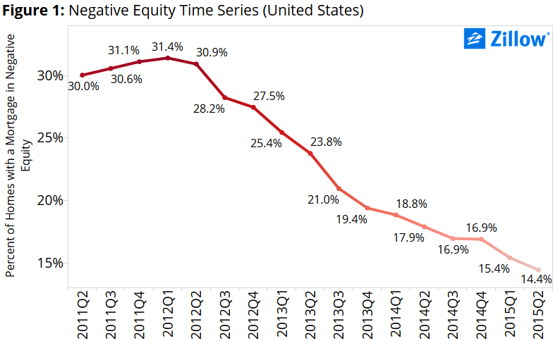
PAI786, Class 12: Predatory Lending

Slide 49
PAI786, Class 12: Predatory Lending
Homeowners Still in Trouble, 2
The default and foreclosure rates have both fallen substantially since 2012.
But rates of default and foreclosure are still relatively high by historical standards.

Slide 50
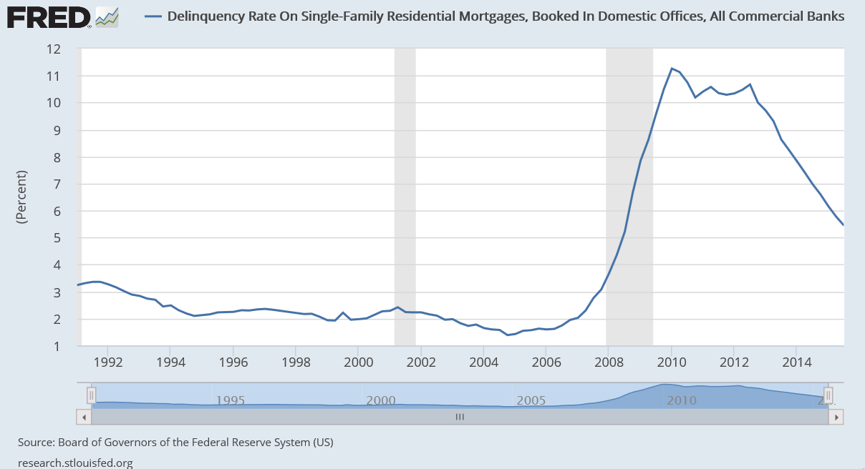
PAI786, Class 12: Predatory Lending

Slide 51
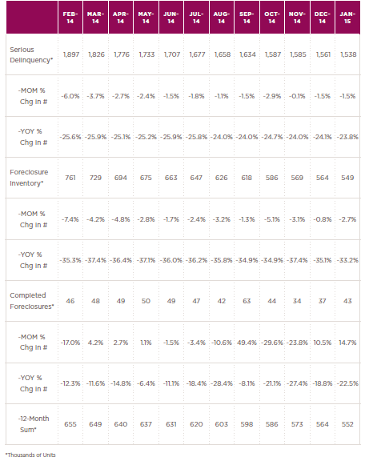
PAI786, Class 12: Predatory Lending
Recent developments in serious delinquency and foreclosure .
MOM = Month over month
YOY = Year over year.
Source: CoreLogic
http://www.corelogic.com/research/foreclosure-report/national-foreclosure-report-january-2015.pdf

Slide 52
PAI786, Class 12: Predatory Lending
Other Changes
Lenders have become much more conservative; that is, the number of mortgage loans has dropped a lot.
Moreover, sub-prime loans have become much less common.

Slide 53
PAI786, Class 12: Predatory Lending

Slide 54
PAI786, Class 12: Predatory Lending
Source: Bhutta and Ringo, Federal Reserve Bulletin

Slide 55
PAI786, Class 12: Predatory Lending

Slide 56
PAI786, Class 12: Predatory Lending
Foreclosure Policy
The Obama Administration has been trying to develop programs to minimize foreclosures.
  The latest program, negotiated with large lenders and the states, uses about $35 billion mainly to compensate lenders so that they will not foreclose on borrowers who are under water.
  This program also provides some money to encourage refinancing, to compensate people hit by fraud, and to cover states’ enforcement costs.

Slide 57
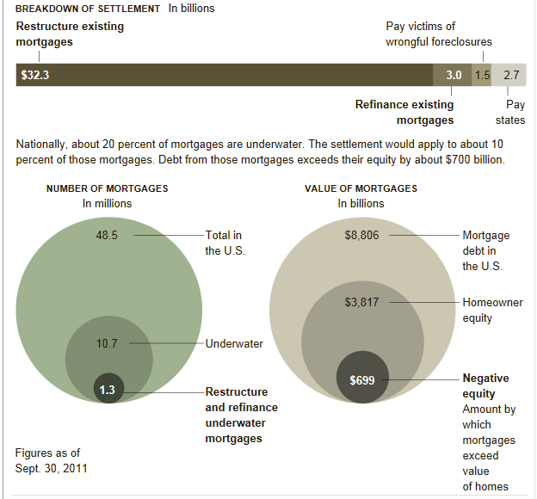
PAI786, Class 12: Predatory Lending
Source:
New York Times

Slide 58
PAI786, Class 12: Predatory Lending
The Consumer Finance Protection Bureau
Starting in the summer of 2011, the regulatory system for mortgages was completely redesigned by the new Consumer Finance Protection Bureau, which was part of the Dodd-Frank Act of 2010.
This agency takes over consumer protection actions related to lending, such as fighting predatory lending, that used to be in the federal financial regulatory agencies.
This agency also has the central responsibility for fair lending enforcement—more next time.

Slide 59
PAI786, Class 12: Predatory Lending
The CFPB, 2
The CFPB will
  Make sure that consumers have the information they need to understand the terms of their agreements with financial companies
  Make regulations and guidance as clear and streamlined as possible so providers of consumer financial products and services can follow the rules on their own.

Slide 60
PAI786, Class 12: Predatory Lending
The CFPB, 3
The CFPB will also implement and enforce new protections under the Dodd-Frank Act that will:
  Require mortgage lenders to determine that a borrower has the ability to repay a loan by verifying income and making sure borrowers can afford loans even after teaser rates expire and payments rise.
  Prohibit prepayment penalties, which can make it expensive to refinance, for high cost loans and adjustable-rate mortgages.
  Put an end to practices like paying bonuses to mortgage brokers and loan officers who steer borrowers into higher-cost loans than they otherwise qualify for.

Slide 61
PAI786, Class 12: Predatory Lending
Predatory Lending and the CFPB
Dodd-Frank creates a preference against risky loan terms through a category of safe loans called “Qualified Mortgages” (QMs). Lenders who originate QMs receive litigation protection from the ability-to-repay provision. To qualify as a QM loan, a loan must meet the following criteria:
  Fully amortizing (i.e., no deferment of principal or interest);
  No balloon payments;
  Points and fees no greater than 3% of the total loan amount;
  Loan term not to exceed 30 years;
  For adjustable-rate mortgages, lenders must evaluate the borrower’s ability to repay based on the maximum rate permitted during the first five years.
http://www.responsiblelending.org/state-lending/mortgages

Slide 62
PAI786, Class 12: Predatory Lending
Predatory Lending and CFPB, 2
The Home Ownership and Equity Protection Act of 1994 (HOEPA) was designed to (pretend to) combat predatory lending.
  But it was so restricted that it applied to less than 1% of loans!
The Dodd-Frank Act
  Expands the range of loans subject to HOEPA
  Expands the list of prohibited practices (as discussed earlier).
Can the CFPB can prevent predatory practices from returning once the housing and mortgage markets return to normal?

