Slide 1
PAI786: Urban Policy
Class 14:
Poverty: Concepts and Evidence

Slide 2
PAI786, Class 14: Poverty
Class Outline
  Poverty Concepts
  The Extent of Poverty
  Weaknesses in Current Poverty Measures
    Note: Much of the material for this lecture comes from Census and HHS websites.
  Poverty and Inequality

Slide 3
PAI786, Class 14: Poverty
Approaches to Measuring Family Poverty
  Absolute poverty
    Not enough income to meet a “reasonable” or “minimally decent” standard of living.
    The approach used in the U.S.
  Relative poverty
    Low income relative to others, usually the median
    Used in most international comparisons

Slide 4
PAI786, Class 14: Poverty

Slide 5
PAI786, Class 14: Poverty
Other Dimensions of Poverty
  Poverty and Inequality
    Poverty measures focus on the bottom of the income distribution
    Measures of inequality summarize the entire distribution and need not be correlated with poverty
  Poverty Spells
    Like many other social phenomena, poverty can be measured with a snapshot or as a flow
    Poverty lines are snapshots; we will also look at flows

Slide 6
PAI786, Class 14: Poverty
History of the U.S. Poverty Thresholds
  The poverty thresholds were devised by Mollie Orshansky and first published in 1965.
    She started with the Department of Agriculture’s “economy food plan,” which provided a nutritionally adequate diet “for temporary or emergency use when funds are low.”
    She combined this with a finding from the DoA’s 1955 Household Food Consumption Survey that families of 3 or more people spent about 1/3 of their after-tax money income on food.
    So: poverty threshold = 3 × cost of the economy food plan.
  Orshansky differentiated her thresholds by family size, by farm/nonfarm status, by the sex of the family head, by the number of family members who were children, and (for one- and two-person units only) by aged/non-aged status.

Slide 7
PAI786, Class 14: Poverty
History of the U.S. Poverty Line, Continued
  In 1969, Bureau of the Budget (the predecessor of the Office of Management and Budget) decided to index the thresholds by the Consumer Price Index and to set the farm poverty thresholds at 85 percent rather than 70 percent of corresponding nonfarm thresholds.
  In 1981, the distinctions between farm and nonfarm thresholds and between “female-headed” and “male-headed” thresholds were eliminated.
  The poverty thresholds are simplified by HHS into poverty guidelines for determining program eligibility.

Slide 8
PAI786, Class 14: Poverty
Poverty Thresholds for 2015 by Size of Family and Number of Related Children Under 18 Years
 | Related children under 18 years
Size of family unit |  |  |  |  |  |  |  |  | Eight
 | None | One | Two | Three | Four | Five | Six | Seven | or more
One person (unrelated individual)..
Under 65 years....................……… | 12,331
65 years and over.................……… | 11,367
Two people.........................………..
Householder under 65 years........ | 15,871 | 16,337
Householder 65 years and over… | 14,326 | 16,275
Three people.......................………… | 18,540 | 19,078 | 19,096
Four people........................…………… | 24,447 | 24,847 | 24,036 | 24,120
Five people........................………… | 29,482 | 29,911 | 28,995 | 28,286 | 27,853
Six people.........................……………… | 33,909 | 34,044 | 33,342 | 32,670 | 31,670 | 31,078
Seven people.......................…………… | 39,017 | 39,260 | 38,421 | 37,835 | 36,745 | 35,473 | 34,077
Eight people.......................………… | 43,637 | 44,023 | 43,230 | 42,536 | 41,551 | 40,300 | 38,999 | 38,668
Nine people or more................……… | 52,493 | 52,747 | 52,046 | 51,457 | 50,490 | 49,159 | 47,956 | 47,658 | 45,822
Source: U.S. Census Bureau.
Single parent, 2 kids

Slide 9
PAI786, Class 14: Poverty
2015 HHS Poverty Guidelines
Persons in Family or Household | Mainland U.S. | Alaska | Hawaii
1 | $11,770 | $14,720 | $13,550
2 | $15,930 | $19,920 | $18,330
3 | $20,090 | $25,120 | $23,110
4 | $24,250 | $30,320 | $27,890
5 | $28,410 | $35,520 | $32,670
6 | $32,570 | $40,720 | $37,450
7 | $36,730 | $45,920 | $42,230
8 | $40,890 | $51,120 | $47,010
For each additional person, add: | $4,160 | $5,200 | $4,780

Slide 10
PAI786, Class 14: Poverty
Poverty Guidelines and Program Eligibility
  HHS: Community Services Block Grant, Head Start, Low-Income Home Energy Assistance, Children's Health Insurance Program
  Department of Agriculture: Supplemental Nutritional Assistance Program (formerly Food Stamps), Special Supplemental Nutrition Program for Women, Infants, and Children (WIC), the National School Lunch and School Breakfast programs
  Department of Energy: Weatherization Assistance
  Department of Labor: Job Corps, Senior Community Service Employment Program, National Farmworker Jobs Program
  Legal Services Corporation: Legal services for the poor

Slide 11
PAI786, Class 14: Poverty
Poverty Guidelines and Program Eligibility, 2
  Certain recent provisions of Medicaid use the poverty guidelines, but most of the program does not.
  Major means-tested programs that do NOT use the poverty guidelines for eligibility include Temporary Assistance for Needy Families, Supplemental Security Income, the Earned Income Tax Credit, HUD’s means-tested housing assistance programs, and the Social Services Block Grant.
  Some state and local governments use the federal poverty guidelines in some of their own programs.
    Examples include state health insurance programs, financial guidelines for child support enforcement, and determination of legal indigence for court purposes.

Slide 12
PAI786, Class 14: Poverty
Extent of Poverty in the U.S. (Census)
  The official poverty rate in 2014 was 14.8% (versus 15.1 in 2010), and 46.7 million people were in poverty.
  Poverty rates in 2014 were 10.1% for non-Hispanic Whites, 26.2% for Blacks, 23.6% for Hispanics, and 112.0% for Asians.
  The poverty rate for children under 18 years old was 21.1% and the rate for the elderly was 10.0%.

Slide 13
PAI786, Class 14: Poverty

Slide 14
PAI786, Class 14: Poverty

Slide 15
PAI786, Class 14: Poverty

Slide 16
PAI786, Class 14: Poverty
Dynamics of Poverty, 2009 to 2012 (Census)
  About 34.5% of people were poor for at least 2 months between 2009 and 2012, but only 3.5% were poor every month of the 3-year period.
  Of those who were poor in 2010, 26.1% were not poor in 2010, 35.4% were not poor in 2011, and 41.9% were not poor in 2012. Of those who were not poor in 2009, 4.1% were poor in 2010, 5.4% were poor in 2011, and 6.3% were poor in 2006.
  Based on a monthly poverty measure, the median spell length in the 2009-2012 period was 6.2 months.
  See: https://www.census.gov/hhes/www/poverty/publications/dynamics09_12/index.html

Slide 17
PAI786, Class 14: Poverty
The Duration of Poverty Spells Across 2009 to 2012
Spell characteristics | 2009 to 2012 (Excludes spells underway in January 2009)
 | Estimate
Percent of spells in interval
2 to 6 months | 52.9
7 to 12 months | 19.6
13 to 18 months | 7.3
19 to 24 months | 5.0
25 to 30 months | 3.2
31 to 36 months | 2.3
37 to 42 months | 1.3
43 or more months | 8.4
Median spell length (in months) | 6.2

Slide 18
PAI786, Class 14: Poverty
Some Perspective
  The U.S. is a very rich country
  But it also has a relatively unequal distribution of income compared to other rich countries (and some poor ones).
  The poverty rate in the U.S. is much higher, for example, than it is in any European country (at least before the recent crisis).

Slide 19
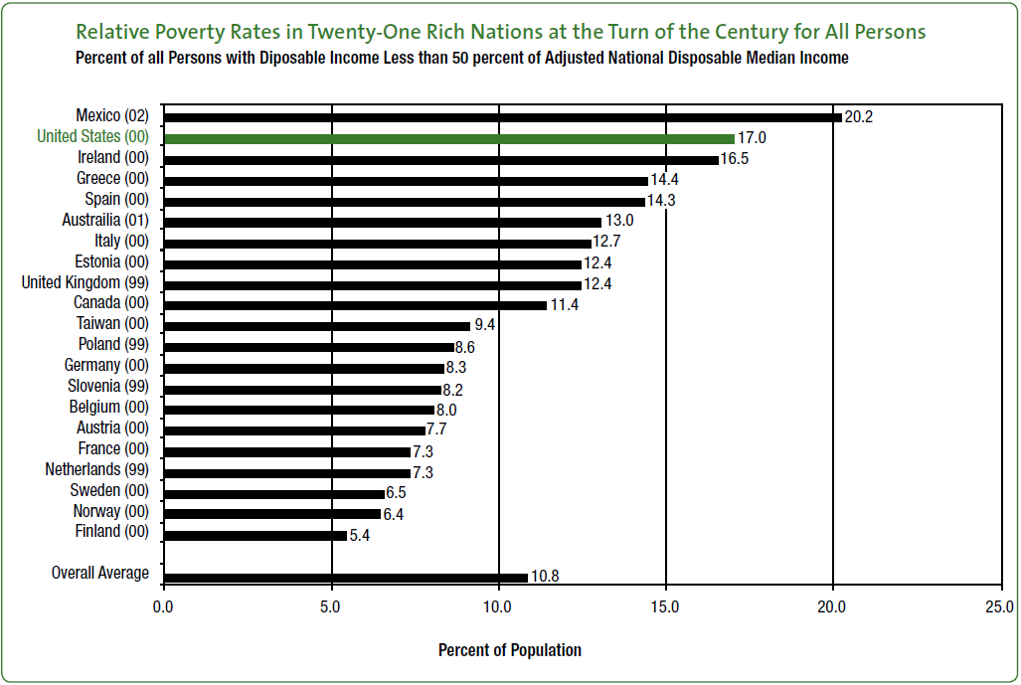
PAI786, Class 14: Poverty
Source: Smeeding (2008)

Slide 20
PAI786, Class 14: Poverty
Problems With The Official Poverty Measure
  Many observers have pointed out serious limitations of the official poverty measure, including:
    It does not reflect work expenses, taxes, or out-of-pocket medical expenses (MOOP).
    It excludes in-kind benefits, such as SNAP.
    It does not account for geographic differences in the cost of living.
    It is based on an out-of-date household budget.

Slide 21
PAI786, Class 14: Poverty
Supplemental Poverty Measure (Census)
  In response to these problems, the Census now calculates a Supplemental Poverty Measure that accounts for some of them.
  The Census also continues to work on alternative measures that deal with even more of these problems.
  The features of the new measure are outlined on the following slide.

Slide 22
PAI786, Class 14: Poverty

Slide 23
PAI786, Class 14: Poverty
SPM Cost of Living Adjustment
  Using the American Community Survey, the Census calculates the 5-year median gross rent (i.e. with utilities) for a 2-bedroom apartment with a complete kitchen and complete plumbing in each reasonably large MSA.
  The same rent is calculated for non-MSA locations combined with small MSAs.
  These rent calculations go into the mean expenditure (FCSU) calculations.
  Not surprisingly, SPM poverty rates are higher in cities and lower outside MSAs than the official rates.
  SPM does not account for housing price variation within an MSA.

Slide 24
PAI786, Class 14: Poverty
Poverty Rates by Location
 | 2013 | 2014
Official Poverty Measure
Inside MSAs | 14.3 | 14.5
Inside principal cities | 18.4 | 18.9
Outside principal cities | 11.8 | 11.8
Outside MSAs | 17.3 | 16.5
Supplemental Poverty Measure
Inside MSAs | 16.1 | 15.8
Inside principal cities | 20.0 | 20.2
Outside principal cities | 13.7 | 13.1
Outside MSAs | 13.9 | 12.8

Slide 25
PAI786, Class 14: Poverty
Does the Federal Government Reduce Poverty?
  One important question is about the extent to which poverty is lowered by government programs.
  One recent estimate comes from a paper by Wimer et al. (2013); they find a big effect (13 percentage points in 2012) using the SPM concepts (with a different adjustment over time due to data limitations).
  They also find a larger effect in recent years with the SPM than with the OPM.
  See: http://citeseerx.ist.psu.edu/viewdoc/download?doi=10.1.1.671.8269&rep=rep1&type=pdf ,
  which is the source of the following two charts.

Slide 26
PAI786, Class 14: Poverty

Slide 27
PAI786, Class 14: Poverty

Slide 28
PAI786, Class 14: Poverty
Does the Federal Government Reduce Poverty?, 2
  A recent book ($2 a Day by Edin and Schaefer) defines extreme poverty as living on less than $2 per day.
  This study addresses another limitation of the official (and SPM) poverty lines, namely that they do not look at the distribution of income among the poor.
  This study finds that federal programs make a big difference for the poorest of the poor.
  See: http://www.nytimes.com/2015/09/06/books/review/2-00-a-day-by-kathryn-j-edin-and-h-luke-shaefer.html?_r=0

Slide 29
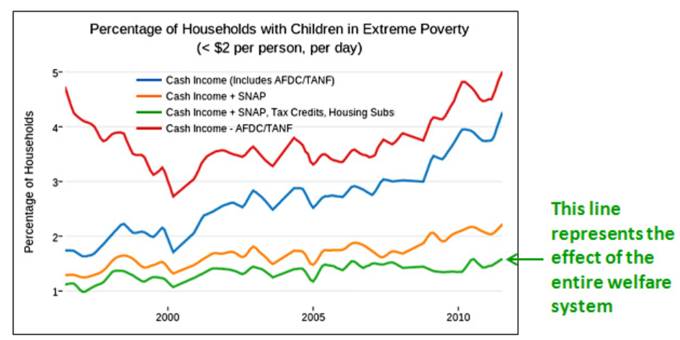
PAI786, Class 14: Poverty
Source: Eden and Shaefer as presented by K. Drum: http://www.motherjones.com/blog

Slide 30
PAI786, Class 14: Poverty
Inequality and Poverty
  Increases in poverty are usually associated with increases in inequality, but these two concepts are not perfectly correlated.
  Inequality is usually measured either by the ratio of incomes in a high percentile of the income distribution to incomes in a low percentile,
  Or by a summary statistic called a Gini coefficient.

Slide 31
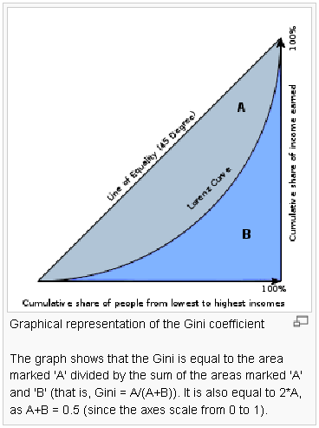
PAI786, Class 14: Poverty
Measuring Inequality: The Gini Coefficient
Source: Wikipedia

Slide 32
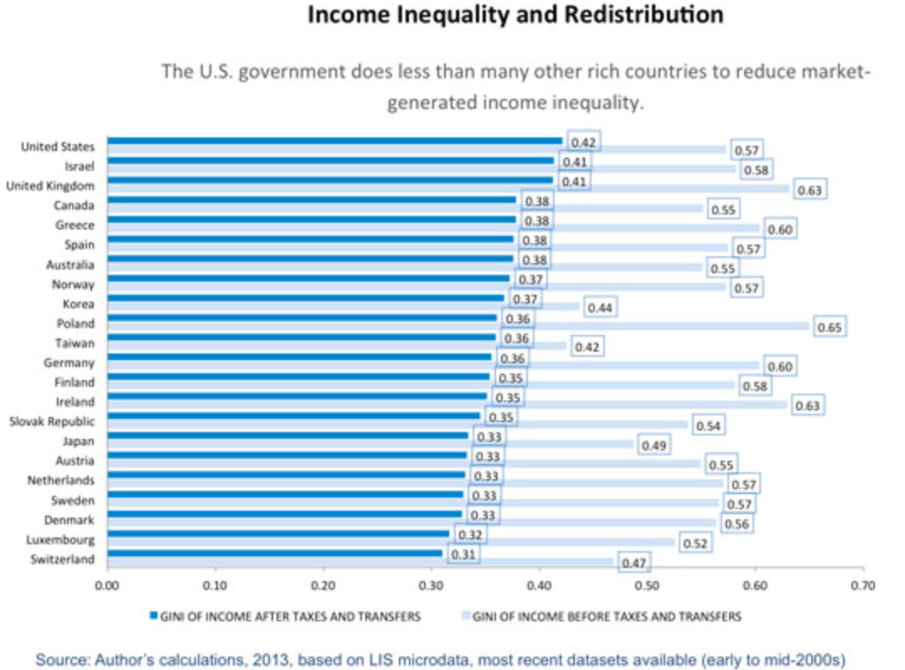
PAI786, Class 14: Poverty
Author: Gorman

Slide 33
PAI786, Class 14: Poverty
Saez on Inequality
  A lecture by Emmanuel Saez, a leading scholar on equality, provides evidence on the striking recent increases in income at the top of the income distribution.
  The following charts come from this lecture.
  See: http://eml.berkeley.edu//~saez/lecture_saez_arrow.pdf

Slide 34
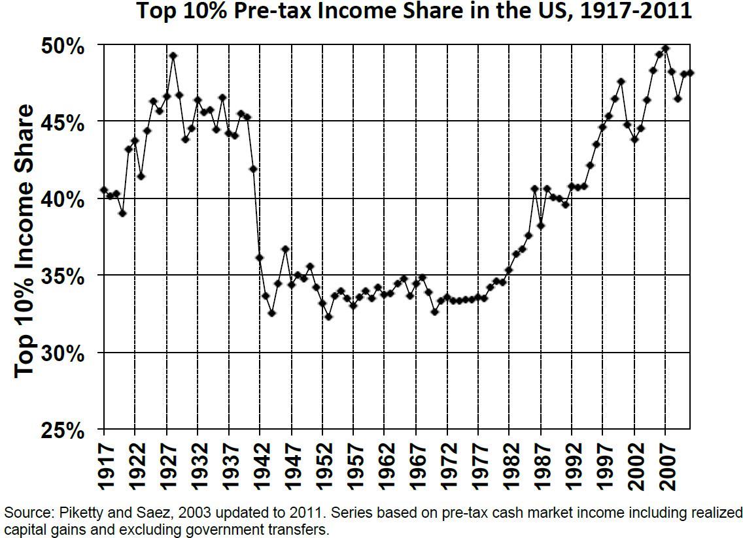
PAI786, Class 14: Poverty

Slide 35
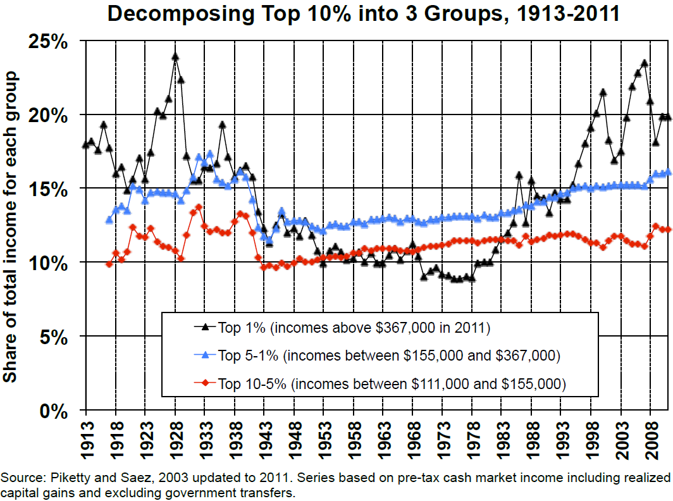
PAI786, Class 14: Poverty

Slide 36
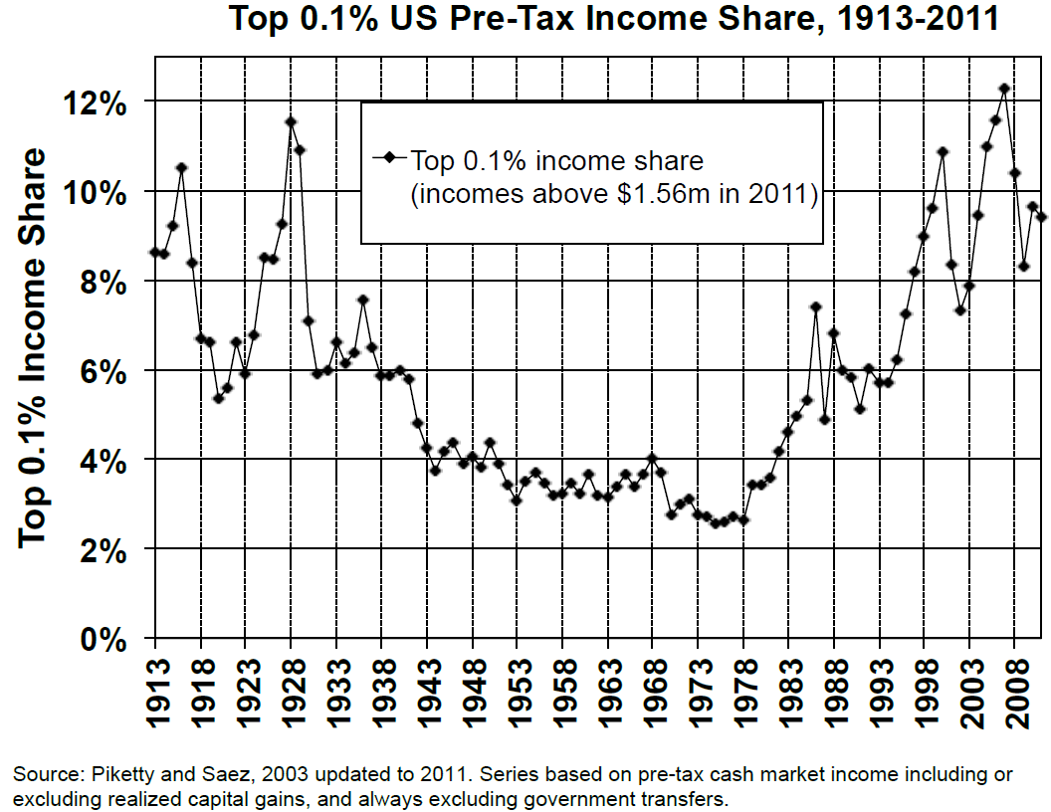
PAI786, Class 14: Poverty

Slide 37
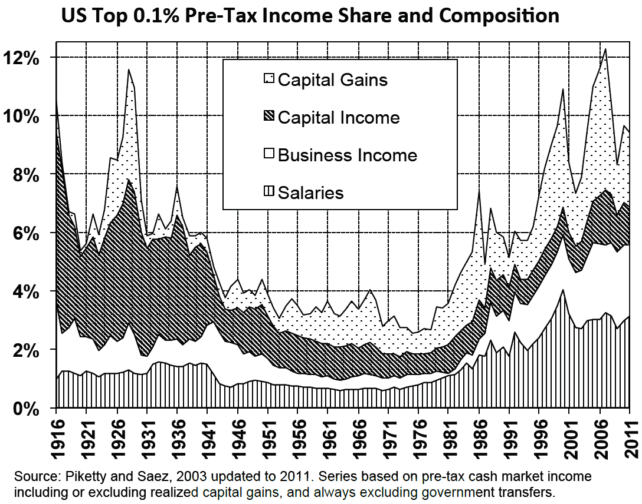
PAI786, Class 14: Poverty

Slide 38
PAI786, Class 14: Poverty
Saez on the Role of Tax Rates
  Saez also shows a striking relationship between the pre-tax income share of the top 1% and the top marginal tax rate in the income tax.
  This relationship is described on the following graph:

Slide 39
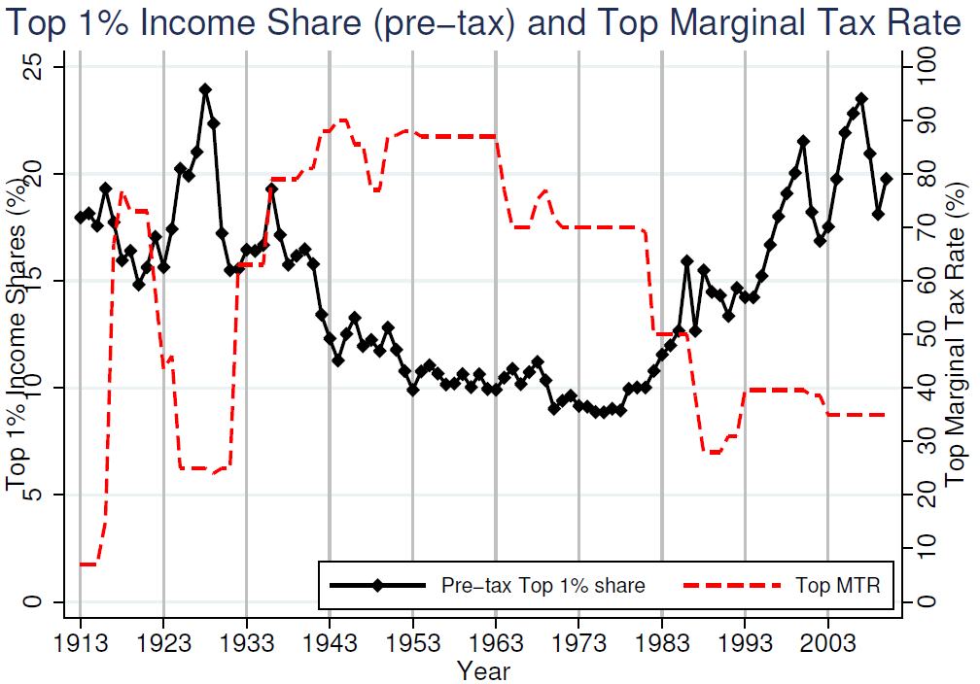
PAI786, Class 14: Poverty

Slide 40
PAI786, Class 14: Poverty
Saez Lists 3 Possible Explanations
  Supply: Top earners cut back work effort when top tax rates are high.
  Tax Avoidance/Evasion: Top earners work harder to avoid/evade taxes when top tax rates are high.
  Rent Seeking: Top earners are able to influence regulations and other policies so as to extract more pay (at the expense of the 99%) when top tax rates are high.

Slide 41
PAI786, Class 14: Poverty
Saez Finds Evidence of Rent Seeking
  Periods in which the income is growing for the top 1% are periods when income is not growing for the bottom 99% is low,
  And vice versa.
  See the following chart (and other evidence discussed by Saez).

Slide 42
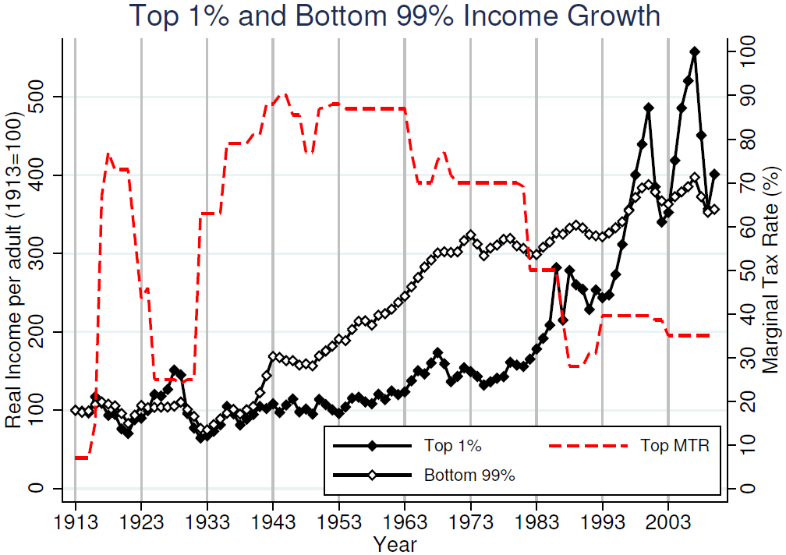
PAI786, Class 14: Poverty

