Slide 1
State and Local Public Finance
Professor Yinger
Spring 2019
Lecture 2
The Demand for Local Public services

Slide 2
State and Local Public Finance
Lecture 2: The Demand for Local Public Services
Section Outline: The Demand for Local Public Services
This section consists of three classes are about the behavior of citizen/voters
  1. Individual Demand
  2. Demand Expression
  3. Case: How New York’s School Tax Relief Program (STAR) affects the demand for education

Slide 3
State and Local Public Finance
Lecture 2: The Demand for Local Public Services
Class Outline
The Determinants of Demand for Public Services
    The Key New Concept: Tax Price
  How Demand is Revealed Through the Choice of a Community

Slide 4
State and Local Public Finance
Lecture 2: The Demand for Local Public Services
The Demand for Local Public Services
The demand for local public services (police, fire, education, and so on) is similar to the demand for a private good.
Let S measure the quality of a local public service.
    S is a function of income, price, the prices of related goods, and preferences.
    The demand curve for S can be drawn as follows, where MB stands for marginal benefit:

Slide 5
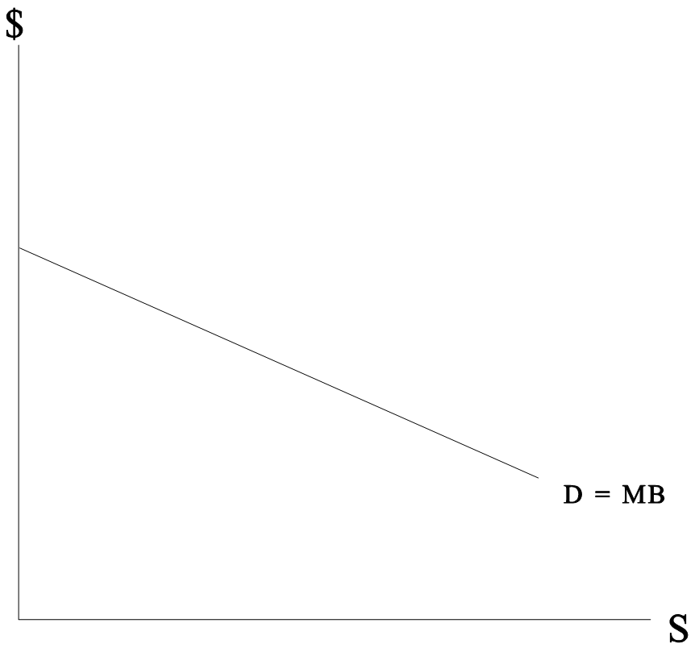
State and Local Public Finance
Lecture 2: The Demand for Local Public Services
The Demand Curve for Local Public Services
S = Local public service quality
D = Demand
MB = Marginal benefit from S

Slide 6
State and Local Public Finance
Lecture 2: The Demand for Local Public Services
Features of Public Demand
Three twists arise in studying the demand for local public services:
First, the output must be defined.
    Ultimately, we want to measure the quality of local public services.
    For today, we will define output as spending per household.
Second, the price must be defined.
    Public services are not usually sold directly to individuals.
    The price arises through the tax system.
Third, the salience of the price must be determined.
    People do not respond to price differences they cannot observe.

Slide 7
State and Local Public Finance
Lecture 2: The Demand for Local Public Services
Tax Price
Because it operates through the tax system, the price for a local public service is called a tax price.
A tax price varies with the tax used; we examine a tax price with a property tax, which is the main local tax in the U.S.
A tax price is defined as the amount a taxpayer would have to pay for another unit of services if the property tax rate were raised to pay for it.

Slide 8
State and Local Public Finance
Lecture 2: The Demand for Local Public Services
Property Taxes
A property tax payment equals a tax rate multiplied by a property’s assessed value.
  The tax rate is selected by elected officials.
  The assessed value is determined by an assessor, who may be elected or appointed.
In symbols, homeowner i’s property tax payment (T_{i}) equals the property tax rate (t) multiplied by the assessed value of her house (V_{i}):

Slide 9
State and Local Public Finance
Lecture 2: The Demand for Local Public Services
The Community Budget Constraint
The community must set spending = revenue.
Define:
    S = spending per household
    N = number of households
    = average assessed value
Then:

Slide 10
State and Local Public Finance
Lecture 2: The Demand for Local Public Services
Solving for Tax Price
Put these 2 equations together:
Note that T_{i}/S equals taxes paid per unit of S—the “price” of S.
So for every unit of S, homeowner i pays ( ); that is, ( ) is her tax price.

Slide 11
State and Local Public Finance
Lecture 2: The Demand for Local Public Services
Examples of Tax Price (= )
  A house with the average V in its community has a tax price of 1.0.
  A house worth twice the average in its community has a tax price of 2.0.
  A house worth half the average in its community has a tax price of 0.5.

Slide 12
State and Local Public Finance
Lecture 2: The Demand for Local Public Services
Tax Price and Demand
Compare 2 owners of $100,000 houses, one in a city where is $50,000 and the other in a city where is $200,000.
      The first owner has a tax price of 2.0; the second a tax price of 0.5.
      All else equal, the second owner faces a lower tax price and demands more public services as a result!

Slide 13
State and Local Public Finance
Lecture 2: The Demand for Local Public Services
The Salience of Tax Price Differences
Homeowners are not trained in public finance, so how do they figure out about tax price?
  They observe what happens to their property taxes when a large shopping center in their town goes out of business, lowering and raising their tax price.
  Owners of relatively small houses may recognize that any property tax increase will be largely born by people with much more expensive houses.
  These and other sources of information are not exact, but as we will see they are sufficient to cause significant behavioral responses—but perhaps smaller responses than those to private market prices

Slide 14
State and Local Public Finance
Lecture 2: The Demand for Local Public Services
How is Demand Revealed?
The demand for local public services is revealed in three ways:
        Voting.
        Choice of a community in which to live.
        The purchase of related private goods (such as private schools or private security).
The next class examines voting.
This class ends with a brief analysis of community choice; for more see Yinger, Housing and Commuting, Chapter 13, “Bidding and Sorting” (World Scientific, 2018).

Slide 15
State and Local Public Finance
Lecture 2: The Demand for Local Public Services
The Tiebout Hypothesis
A famous 1956 article by an economist named Tiebout made two points:
    People consider the public service-tax package when they decide where to live (a positive statement).
    The choice of a community is like the choice of a private good, so this process allocates resources in an efficient manner (a normative statement).

Slide 16
State and Local Public Finance
Lecture 2: The Demand for Local Public Services
Developments Since Tiebout
The literature since Tiebout has identified two key implications of his positive analysis:
First, better public services or lower property taxes lead to higher house values, all else equal.
      This phenomenon is known as capitalization.
      We study property tax capitalization in a later class.

Slide 17
State and Local Public Finance
Lecture 2: The Demand for Local Public Services
Public Service Capitalization
Dozens of studies establish that, all else equal, the price of housing is higher in a community with better schools or better police protection.
A recent review finds, for example, that all 50 studies of school quality capitalization published since 1999 find evidence of capitalization (Nguyen-Hoang and Yinger, Journal of Housing Economics, 2011).
Several studies also find that lower crime leads to significantly higher house values, controlling for other things.
If a policy changes the distribution of local public services, it will alter house values and therefore affect current homeowners!

Slide 18
State and Local Public Finance
Lecture 2: The Demand for Local Public Services
Income Sorting
Second, people compete for entry into communities with desirable service tax packages.
      High-income people win this competition.
      This leads to sorting: high- and low-income people tend to live in different places, with richer people in places with better public services and, often, lower property tax rates.
      Income sorting is a key feature of the U.S. federal system—and a key cause of continuing inequality. This inequality is passed from one generation to the next.

Slide 19
State and Local Public Finance
Lecture 2: The Demand for Local Public Services
Sorting in Cleveland
My recent research (Journal of Urban Economics, 2015), based on all house sales in the Cleveland area in 2000, focuses on these two points.
      I find that housing prices are up to 30% higher in school districts where more entering 12th graders pass state tests.
      I find (with a new method) that higher-income people do, indeed, sort into school districts with higher-quality schools—a key source of inequality.
        A one standard deviation increase in homeowner income leads, purely because of income sorting, to a 1.30 standard deviation increase in the rate at which entering 12th graders pass state tests.

Slide 20
State and Local Public Finance
Lecture 2: The Demand for Local Public Services
Sorting in Cleveland, 2
It is also possible to estimate the overall value in the housing market of a house’s neighborhood traits, including school quality and safety and other traits that cannot be observed. This value can be called “neighborhood quality” or “neighborhood housing value.”
The following figure shows the relationship between neighborhood quality and income in the Cleveland area.
The horizontal axis is the median income of a homeowner in a neighborhood (in log form); the vertical axis is neighborhood quality (also in log form); on average, a one percent increase in homeowner income leads to a 0.524 percent increase in neighborhood quality.
This income sorting is a central cause of inequality in local public service outcomes.

Slide 21
State and Local Public Finance
Lecture 2: The Demand for Local Public Services
Income Sorting in the Cleveland Area, 2000

Slide 22
State and Local Public Finance
Lecture 2: The Demand for Local Public Services
Housing Conversion and Zoning
Two further points about sorting are helpful for understanding community change:
      Some communities experience housing conversion (houses split into apartment or small apartments combined into large condos) when the type of household moving into a community changes.
      Some communities use large-lot zoning or some other restriction to prevent lower-income household from moving in, but sorting happens even without zoning.

Slide 23
State and Local Public Finance
Lecture 2: The Demand for Local Public Services
Sorting and Allocative Efficiency
On Tiebout’s normative point, most scholars believe that having many local governments is more efficient than having just one.
But, they disagree about:
        whether the current federal system could be made more efficient;
        whether the efficiency advantages of choice outweigh the equity costs of sorting.
These are key issues in the design of any federal system.

