Slide 1
State and Local Public Finance
Professor Yinger
Spring 2021
Lecture 5
Public Safety

Slide 2
State and Local Public Finance
Lecture 5: Public Safety
Class Outline
Public Safety in The U.S. Federal System
Fire Services
  The delivery of fire services
  The role of volunteers
Police Services
  The delivery of police services
  Should we “defund” the police?

Slide 3
State and Local Public Finance
Lecture 5: Public Safety
Local Public Safety Spending in the U.S., 2018
State and Local Spending on Public Safety, US Total, 2018 (000)
 | State & Local | State | Local
 | Government | Government | Government
 | Amount | Amount | Amount
Police protection | 118,800,031 | 16,099,464 | 102,700,567
Fire protection | 52,044,155 | 0 | 52,044,155
Correction | 81,271,621 | 50,718,809 | 30,552,812
Capital outlay | 2,300,268 | 1,506,707 | 793,561
Protective inspection and regulation | 14,869,236 | 8,654,655 | 6,214,581
Total Public Safety | 266,985,043 | 75,472,928 | 191,512,115
Census of Government Finance

Slide 4
State and Local Public Finance
Lecture 5: Public Safety
Local Safety Spending as a Share of Direct General expenditure, 2018
 | S & L Gov. Percent of Direct General Expenditure | State Gov. Percent of Direct General Expenditure | Local Gov. Percent of Direct General Expenditure
Police protection | 3.7% | 1.1% | 6.1%
Fire protection | 1.6% | 0.0% | 3.1%
Correction | 2.5% | 3.4% | 1.8%
Capital outlay | 0.1% | 0.1% | 0.0%
Protective inspection and regulation | 0.5% | 0.6% | 0.4%
Total Public Safety | 8.3% | 5.0% | 11.3%
Census of Government Finance

Slide 5
State and Local Public Finance
Lecture 5: Public Safety
State and Local Safety Spending Shares, 2018
 | S & L Gov. Percent of Safety Spending | State Gov. Percent of Safety Spending | Local Gov. Percent of Safety Spending
Police protection | 100.0% | 13.6% | 86.4%
Fire protection | 100.0% | 0.0% | 100.0%
Correction | 100.0% | 62.4% | 37.6%
Capital outlay | 100.0% | 65.5% | 34.5%
Protective inspection and regulation | 100.0% | 58.2% | 41.8%
Census of Government Finance

Slide 6
State and Local Public Finance
Lecture 5: Public Safety
Fire Services
“Fire And Emergency Services Districts (ESDs) that provide local fire protection and ambulance services have grown this decade: 150 were created from 2012 to 2017 — 130 of them in Texas.
The increase is centered in areas experiencing the fastest population growth in the country since the 2010 Census.
Often, ESDs are organized as a funding tool for existing volunteer fire departments. These allow volunteer fire districts to collect additional property and sales taxes to provide service to their expanding communities.”
Quotes from 2017 Census of Governments, “From Municipalities to Special Districts,” Ocober 29, 2019.

Slide 7
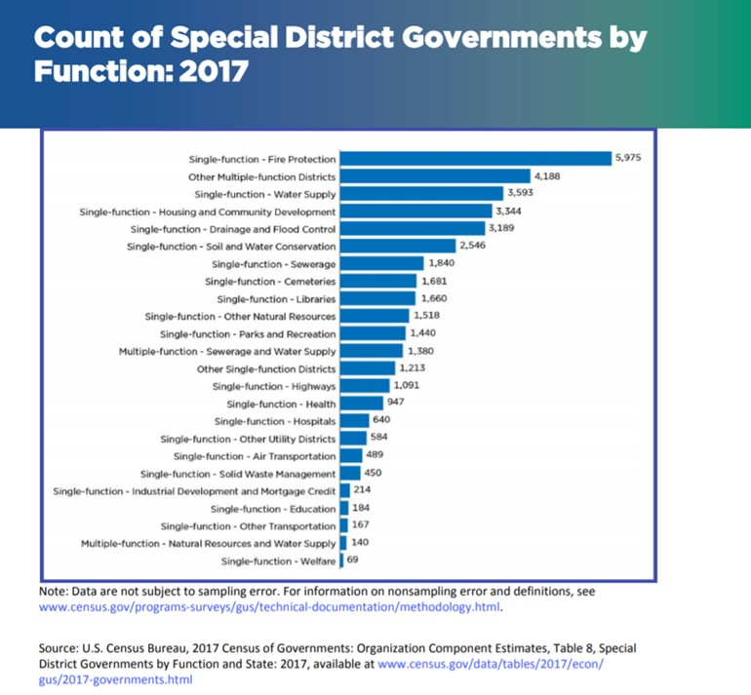
State and Local Public Finance
Lecture 5: Public Safety
Fire Services
Largest Category of Special District

Slide 8
State and Local Public Finance
Lecture 5: Public Safety
Fire Services
“It can be challenging to find fire-fighting funding in areas losing population and experiencing declining property values.
  In Arizona, for example, laws passed in 2013 allow fire districts to consolidate into fire authorities to reduce overhead costs.
The 2017 Census of Governments shows 14 new joint fire authorities in Ohio.
  Some township volunteer fire departments have recently begun to combine personnel, equipment and property tax revenue to become official special district governments.
Another way districts can improve emergency response and rescue operations is by creating Emergency Communications (911) Districts to help coordinate resources between municipalities, counties and other local governments.
  Some states, including Texas, Iowa, and Oregon, have had them since 1985. Others like Washington and Massachusetts have recently introduced laws enabling citizens to create 911 districts.”

Slide 9
State and Local Public Finance
Lecture 5: Public Safety
Volunteer Firefighters
“There are still more than twice as many volunteers as career firefighters.
But the number of volunteers has dropped by around 11 percent since the mid-1980s, while the number of career firefighters has grown more than 50 percent, according to the National Fire Protection Association.
The allure has diminished because fund-raising now takes up roughly half the time most volunteers spend on duty.
It’s also harder to fit in volunteer work. The rise in two-income households often means that there is no stay-at-home parent to run things so the other can dash off for an emergency.
Urbanization and the aging of the rural population are taking their toll as fewer young people are available to replace firefighters who retire.”
https://www.nytimes.com/2014/08/17/sunday-review/the-disappearing-volunteer-firefighter.html

Slide 10
State and Local Public Finance
Lecture 5: Public Safety
Volunteer Firefighters
“Federal, state and local officials would like to attract new volunteer recruits.
The stakes are particularly high because volunteers save not only lives but money — more than $139.8 billion annually for local governments, according to the fire protection association.
The time and training needed to become a certified firefighter have also increased. Federal standards enacted to save firefighters’ lives have unintentionally created a barrier for volunteer service: It now takes hundreds of hours to be certified, and new firefighters often must cover the cost of training.”
https://www.nytimes.com/2014/08/17/sunday-review/the-disappearing-volunteer-firefighter.html

Slide 11
State and Local Public Finance
Lecture 5: Public Safety
Volunteer Firefighters
“For decades, departments relied on benefit auctions, raffles and community bingo events to cover overhead.
In recent years, however, departments have had to resort to adding fire taxes onto local property-tax bills, or charging homeowners and insurance companies for individual response calls. Others have merged with neighboring departments to cut costs.”
The next 3 slides show recruiting material for the fire department in Fayetteville, NY.
https://www.nytimes.com/2014/08/17/sunday-review/the-disappearing-volunteer-firefighter.html

Slide 12

State and Local Public Finance
Lecture 5: Public Safety
https://fayettevillefd.org/

Slide 13

State and Local Public Finance
Lecture 5: Public Safety

Slide 14
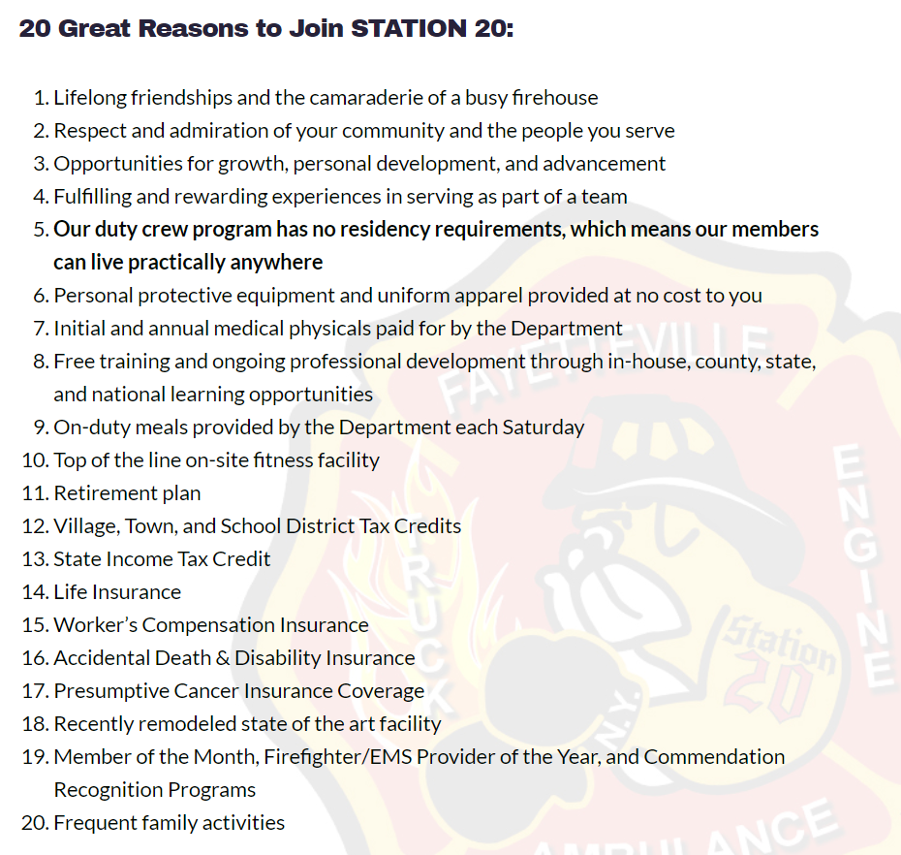
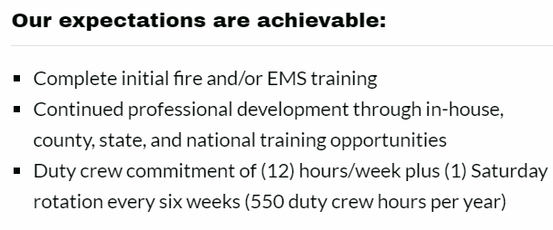
State and Local Public Finance
Lecture 5: Public Safety

Slide 15
State and Local Public Finance
Lecture 5: Public Safety
Volunteer Firefighters
“Firefighters’ duties have also shifted.
In many departments, a vast majority of calls are for medical emergencies, not fires. Much like emergency room doctors, volunteer firefighters are increasingly serving as primary care providers.
They are also routinely dispatched for water rescues, vehicle entrapments, hazardous material spills and drug overdoses.
Since 1986, the number of fire-related calls for all firefighters, volunteer and paid, has dropped by more than 3.6 million. In 2012, only 5 percent of calls were for actual fires.
But the total number of fire department responses has jumped by 167 percent in 26 years, largely because medical responses have gone up by 15.2 million.
https://www.nytimes.com/2014/08/17/sunday-review/the-disappearing-volunteer-firefighter.html

Slide 16
State and Local Public Finance
Lecture 5: Public Safety
Volunteer Firefighters
“In the meantime, … training requirements keep increasing partly because volunteers are now being called to do much more than just “putting water on fire.”
Terrorist attacks and improvised explosive devices, malfunctioning solar panels and wind turbines, ethanol and natural gas fires, and electric- and hydrogen-powered vehicle accidents — these are just some of the emergencies for which training is needed.”
https://www.nytimes.com/2014/08/17/sunday-review/the-disappearing-volunteer-firefighter.html

Slide 17
State and Local Public Finance
Lecture 5: Public Safety
Volunteer Firefighters
A key policy question: “Should volunteer firefighters be defined as public employees and afforded all the according benefits and protections?
Some states like California, Missouri and New Jersey have said yes, granting them things like taxpayer-subsidized pensions, college tuition assistance and life insurance benefits.
And in a decision that could markedly increase the number of unionized firefighters in the state, Pennsylvania labor officials have granted many volunteer firefighters the right to organize.
After some volunteers argued that they should not be categorized as public employees because requirements of the new health care act could bankrupt small firehouses, the Internal Revenue Service ruled this year that volunteer departments are exempt from the mandate.
https://www.nytimes.com/2014/08/17/sunday-review/the-disappearing-volunteer-firefighter.html

Slide 18
State and Local Public Finance
Lecture 5: Public Safety
Example: Fire Services in New York State
All the State’s cities and a majority of its villages have municipal fire departments.
There are 886 independent fire districts in the State, mostly covering areas of towns outside of villages.
94 percent of fire district revenues come from property taxes.
Towns can also contract with fire companies or departments to provide services within administrative “fire protection districts” that remain under the control of the town’s government.
Villages and even fire districts may contract for fire protection as well.
Outside of cities, most firefighting is done by volunteers. There are over 90,000 volunteer and about 18,000 paid career firefighters in the State.

Slide 19
State and Local Public Finance
Lecture 5: Public Safety
Example: Fire Services in New York State
In most cases, a village has a fire department
In some instances, however, a village may contract for fire protection services with any city, village, fire district, or with an incorporated fire company whose headquarters are located outside the village.
Towns do not have fire departments. However, most developed areas of towns outside villages have fire protection. This service may be provided by one or more fire districts, fire protection districts, or – not uncommonly – a combination of both.
Information for this example comes from “Fire Protection in New York State: How Is It Provided in Your Community?”, Office of the New York State Comptroller, March 2017.

Slide 20
State and Local Public Finance
Lecture 5: Public Safety
Example: Fire Services in New York State

Slide 21
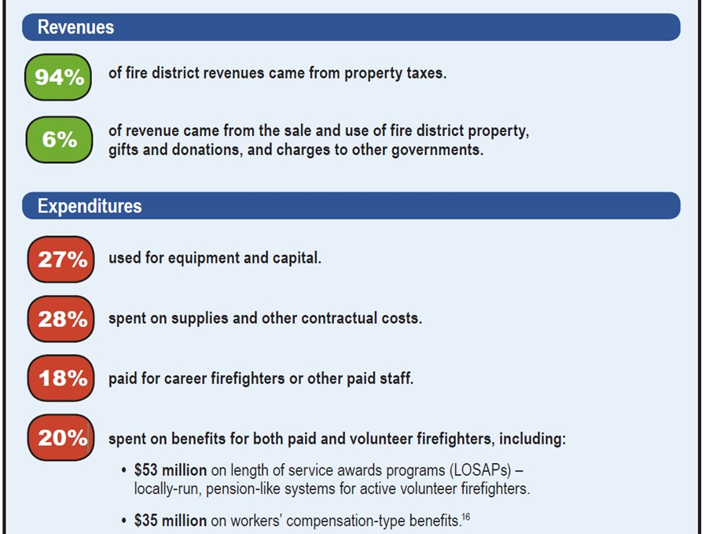
State and Local Public Finance
Lecture 5: Public Safety
Example: Fire Services
in New York State
Data for 2015

Slide 22
State and Local Public Finance
Lecture 5: Public Safety
Questions
How are fire districts organized in New York State?
What type of fire districts use volunteers?
What skills are volunteer firefighters expected to have?
Why is it difficult to attract volunteers?
What can a fire district do to attract volunteers?

Slide 23
State and Local Public Finance
Lecture 5: Public Safety
Police Services
https://www.bjs.gov/content/pub/pdf/csllea08.pdf

Slide 24
State and Local Public Finance
Lecture 5: Public Safety
Police agencies come in many forms.
Local police departments are the most common form.
Police Services

Slide 25
State and Local Public Finance
Lecture 5: Public Safety
Types of Police Agencies
Most municipal governments have Police departments.
In addition, special agencies for police are often set up to cover:
Public buildings, including public colleges
Natural resources
Transportation
Special investigations
Special enforcement
Arrangements and number of police vary widely across states.

Slide 26
State and Local Public Finance
Lecture 5: Public Safety
Police Services

Slide 27
State and Local Public Finance
Lecture 5: Public Safety
Police Services: The Case of New York
As of 2008 there were 514 law enforcement agencies in New York State
Employing 66,472 sworn police officers and/or local peace officers
Which equals about 341 for each 100,000 residents.
Some villages contract with towns.
Source: US Bureau of Justice Statistics' Census of State and Local Law Enforcement Agencies

Slide 28
State and Local Public Finance
Lecture 5: Public Safety
Contracting example: The Village of Fayetteville does not have its own police department; it relies on the Town of Manlius.
Police Agencies in Onondaga County
Source: New York Division of Criminal Justice Services

Slide 29
State and Local Public Finance
Lecture 5: Public Safety
Defund the Police
Police services involve many different policy issues
One issue that received a lot of attention in 2020 is whether or not to “defund” the police.
Very few people mean this literally; instead, the idea is to shift some government revenue from the police department to other departments that provide social services.
The movement to “defund” the police appears to have two main causes.
  A heightened distrust of many police departments because of their seemingly racist behavior.
  A longstanding trend to cut spending and federal aid for social services combined with an increase in spending and federal aid for police—who then pick up responsibilities for many social services.

Slide 30
State and Local Public Finance
Lecture 5: Public Safety
Defund the Police
We have all read about recent police killings of black men under questionable circumstances.
  These killings are a key source of the anger that is behind some calls to defund the police.
Moreover, there is informal and formal evidence that racist attitudes persist in many police departments.
  The following chart provide an example of Informal evidence.
  Formal evidence comes from many academic articles, including one described below:

Slide 31
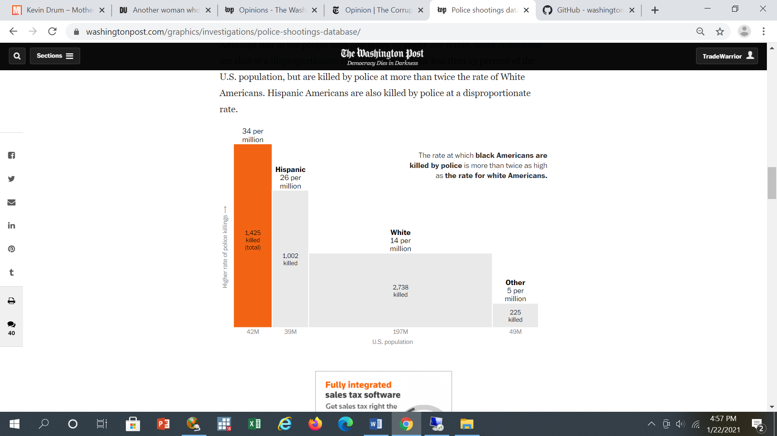
State and Local Public Finance
Lecture 5: Public Safety
Defund the Police
Source: Washington Post
https://www.washingtonpost.com/graphics/investigations/police-shootings-database/

Slide 32
State and Local Public Finance
Lecture 5: Public Safety
Defund the Police: Racial Profiling
Horrace and Rohlin (Review of Econ. and Stat. 2016)
Previous studies find that the black-white disparity in traffic stops is larger in the daytime, when the race of the driver can be observed, than at night.
The Horrace/Rohlin study points out that urban environments may be well-lit at night, eroding the power of these tests.
They refine this type of test using streetlight location data in Syracuse, and the results change in the direction of finding more profiling of black drivers.
They find that the odds of a black driver being stopped (relative to nonblack drivers) increase 15% in daylight compared to darkness.

Slide 33
State and Local Public Finance
Lecture 5: Public Safety
Defund the Police: Service Overload
The other factor behind the call to “defund” the police is the increase in police responsibility for social service activities, such as managing domestic violence and substance abuse, and of responding to growing homeless populations and keeping students safe in schools.
“The police have been used to fill the gaps where city services are not adequate,” said Charles H. Ramsey, the former police chief in Philadelphia and Washington, and a co-chair of President Obama’s Task Force on 21st Century Policing.” (Badger and Bui in the New York Times, 2020.)

Slide 34
State and Local Public Finance
Lecture 5: Public Safety
Questions
How are police services provided in the United States?
What does it mean to “defund” the police?
What are the main causes of the movement to “defund” the police?
Question for everyone: Should we “defund” the police?

