Slide 1
State and Local Public Finance Professor Yinger Spring 2020
Lecture 16
Economic Development Concepts

Slide 2
Classes on Economic Development
State and Local Public Finance Lecture 16: Economic Development Concepts
Classes on Economic Development
Conceptual Foundations
Economic Development Policy
Case: Subsidize Firms?

Slide 3
Class Outline
State and Local Public Finance Lecture 16: Economic Development Concepts
Class Outline
Simple Macroeconomic Models
Input/Output Models
Agglomeration Economies

Slide 4
Introduction
State and Local Public Finance Lecture 16: Economic Development Concepts
Introduction
Economic development is an important topic in state and local public finance.
After all, most state and local politicians run on the platform of “jobs, jobs, jobs,”
The question is: What policies actually affect the number of jobs (and the incomes they generate) in a given jurisdiction.

Slide 5
Introduction, Continued
State and Local Public Finance Lecture 16: Economic Development Concepts
Introduction, Continued
This class examines some basic concepts in state and local economic development.
The next class looks at the impact of fiscal policies, including taxes and public spending, on local economic development.
This topic is complex and frustrating: Although there is a great deal of research, there is no consensus about the best policies to follow.

Slide 6
Macroeconomic Models
State and Local Public Finance Lecture 16: Economic Development Concepts
Macroeconomic Models
This class has focused on microeconomics, that is, on the analysis of households and firms and single markets.
But economic development involves macroeconomics, which is all markets put together.
Today we will look at some highly simplified macroeconomic models: Keynesian, export-base, and input-output.

Slide 7
A Simple Keynesian Model
State and Local Public Finance Lecture 16: Economic Development Concepts
A Simple Keynesian Model
A simple Keynesian model combines accounting identities and assumptions about behavior.
The terms:
Y = Income
E = Expenditures (=GNP)
C = Consumption
I = Investment
S = Savings
X = Exports
M = Imports

Slide 8
A Simple Keynesian Model, 2
State and Local Public Finance Lecture 16: Economic Development Concepts
A Simple Keynesian Model
The identities:
The assumptions about behavior:

Slide 9
A Simple Keynesian Model, 2-2
State and Local Public Finance Lecture 16: Economic Development Concepts
A Simple Keynesian Model, 2
The equilibrium:
Interpretation:
Exports (and other exogenous factors) are multiplied into income.
These factors have a larger impact if the marginal propensity to consume (c) is larger.
These factors have a smaller impact if the marginal propensity to import (m = “leakage”) is larger.

Slide 10
A Simple Keynesian Model, 3
State and Local Public Finance Lecture 16: Economic Development Concepts
A Simple Keynesian Model, 3
Of course this model leaves out many things, such as:
Government
Prices and interest rates
Expectations
But it introduces three key concepts:
Exports (=inflows)
Multipliers
Leakage

Slide 11
Economic Base Models
State and Local Public Finance Lecture 16: Economic Development Concepts
Economic Base Models
Economic base models are the simplest possible macroeconomic models of a state or local economy.
They are highly oversimplified and should be used with great care, but also provide some useful insights.

Slide 12
Export vs. Local Jobs
State and Local Public Finance Lecture 16: Economic Development Concepts
Export vs. Local Jobs
Export base models start with a distinction between “export jobs” and “local jobs.”
Export jobs are associated with goods or services sold on a national market.
Manufacturing jobs are a key example.
Local jobs are jobs associated with goods or services that compete only in local markets.
Jobs in grocery stores, fast food restaurants, or dry cleaners are examples.

Slide 13
Export vs. Local Jobs, 2
State and Local Public Finance Lecture 16: Economic Development Concepts
Export vs. Local Jobs, 2
The distinction between export and local jobs depends on the context.
A famous restaurant or a retail store on a jurisdiction boundary may attract customers from other jurisdictions and therefore involve export jobs.

Slide 14
An Export Base Model
State and Local Public Finance Lecture 16: Economic Development Concepts
An Export Base Model
An export base model combines a definition and a simple behavioral equation.
Let:
T = Total jobs
L = Local jobs
E = Export jobs

Slide 15
An Export Base Model, 2
State and Local Public Finance Lecture 16: Economic Development Concepts
An Export Base Model, 2
Then, the definition is:
T = L + E
The behavioral equation is:
L = bE
This equation indicates that local jobs are created by resources flowing into an economy.

Slide 16
An Export Base Model, 3
State and Local Public Finance Lecture 16: Economic Development Concepts
An Export Base Model, 3
Putting these together, we have
T = bE + E = E(1+b)
In this equation, (1+b) is called the “multiplier”:
Export jobs are “multiplied up” into total jobs because they lead to income circulating around the local economy.

Slide 17
Alternative Export Base Model
State and Local Public Finance Lecture 16: Economic Development Concepts
Alternative Export Base Model
An alternative form of the behavioral equation is
L = (b*)T
In this case,
T = (b*)T + E
T(1-b*) = E
T = E/(1-b*)
Thus, 1/(1-b*) is the multiplier.

Slide 18
Export Base Models, Lessons
State and Local Public Finance Lecture 16: Economic Development Concepts
Export Base Models, Lessons
First, export jobs get “multiplied up” into total jobs.
If a government manages to attract another export job it adds more than one job to its economy.
Second, “attracting” another local job (that is, giving it a subsidy) doesn’t do anything except displace a local job on the other side of town.
Local jobs are determined by export jobs.
If you want to boost a local economy, attract export jobs!

Slide 19
Export Base Models, Limits
State and Local Public Finance Lecture 16: Economic Development Concepts
Export Base Models, Limits
Export base models are highly simplified.
E.g., they ignore market failure. A state policy might be able to add local jobs by ending some form of market failure.
But the presumption that economic development policy should focus on export jobs is a good place to start.

Slide 20
Input/Output Analysis
State and Local Public Finance Lecture 16: Economic Development Concepts
Input/Output Analysis
Input/output analysis is a fancy export-base model.
I/O analysis begins with $1 of exogenous demand for the products of industry A.
Satisfying this demand requires contributions from all industries, say $.01 from A itself, $.05 from B, $.25 from C, and so on.
Satisfying these demands requires additional contributions from each industry, etc.

Slide 21
Input/Output Analysis, 2
State and Local Public Finance Lecture 16: Economic Development Concepts
Input/Output Analysis, 2
Input/output analysis provides a formal way to summarize all these transactions.
The more purchases are made locally, the higher the multiplier.
Equivalently, the more purchases leak out to other jurisdictions, the lower the multiplier.

Slide 22
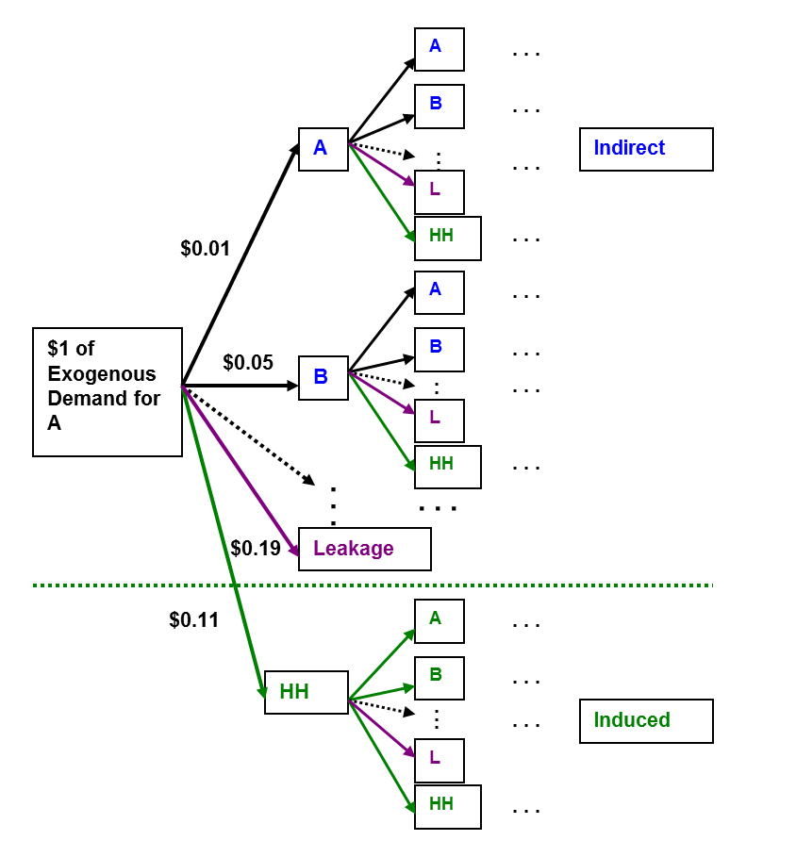
Input/Output Analysis, 2-2
Input/Output Analysis

Slide 23
Input/Output Model
State and Local Public Finance Lecture 16: Economic Development Concepts
Input/Output Model
In formal terms, an I/O model is a series of equations like:
where Y is output, X is exogenous demand, and a_{1j} is the amount of product 1 needed to produce the output for product j.

Slide 24
Input/Output Model, 2
State and Local Public Finance Lecture 16: Economic Development Concepts
Input/Output Model, 2
Stacking these equations and using matrix notation:
Note that the (I-A)⁻¹ matrix is just the matrix-algebra version of the multiplier idea in the export-base model.

Slide 25
Types of I/O Models
State and Local Public Finance Lecture 16: Economic Development Concepts
Types of I/O Models
There are 2 types of I/O Model.
The first treats the household sector as part of exogenous demand, X.
This is called an open model.
With this model, the A matrix is just about purchases of non-labor inputs, and the multipliers reflect the direct and indirect requirements from each industry to meet exogenous demand.

Slide 26
Types of I/O Models, 2
State and Local Public Finance Lecture 16: Economic Development Concepts
Types of I/O Models, 2
The second type treats households as an industry.
This is called a closed model
Households provide labor and make purchases from other industries.
The household impact on multipliers is called an induced effect.

Slide 27
Contributions of I/O
State and Local Public Finance Lecture 16: Economic Development Concepts
Contributions of I/O
I/O adds two things to the debate:
First, I/O provides a way to bring data to bear on the issue of multipliers.
The trouble is that the necessary data are not available at the local level, or even at the state level,
But regional I/O multipliers are available: See http://www.bea.gov/regional/rims/index.cfm
These multipliers are “based on 2007 national benchmark input-output data and 2016 regional data.”

Slide 28
Contributions of I/O, 2
State and Local Public Finance Lecture 16: Economic Development Concepts
Contributions of I/O, 2
Second, I/O introduces a distinction between indirect multipliers (based on purchases of inputs), and induced multipliers (based on purchases by households).
The notion of indirect multipliers is critical: The more inputs are produced locally, the less the leakage and the higher the multiplier.
Even informal analysis of economic development programs should consider inter-connections in a local economy.

Slide 29
Misuse of Multipliers
State and Local Public Finance Lecture 16: Economic Development Concepts
Misuse of Multipliers
A high multiplier for a particular industry says that attracting an export job in that industry will have a large positive impact on the economy.
But multipliers can easily be misused because it is difficult to figure out what the world would be like without a program.
Remember: The correct question for program evaluation is how the world differs with and without the program.

Slide 30
Misuse of Multipliers, 2
State and Local Public Finance Lecture 16: Economic Development Concepts
Misuse of Multipliers, 2
An I/O analysis was used in a debate about subsidizing a Mazda plant in Michigan.
The multipliers were high—12!— because so many auto inputs are made in Michigan.
The people who conducted the I/O analysis said almost any subsidy was worth it.

Slide 31
Misuse of Multipliers, 3
State and Local Public Finance Lecture 16: Economic Development Concepts
Misuse of Multipliers, 3
But the sales from the plant exaggerate the change in exogenous demand.
If the plant were not in Michigan, it would be in Indiana or Ohio and would still purchase many inputs from Michigan.
So one must compare income with the plant to income with these input purchases.
You should always think about the appropriate counter-factual situation!

Slide 32
Misuse of Multipliers, 4
State and Local Public Finance Lecture 16: Economic Development Concepts
Misuse of Multipliers, 4
A more complicated problem is that I/O multipliers are static, but the world is dynamic.
When an Mercedes-Benz plant was built in Alabama (thanks to huge subsidies from the state government subsidies), no automobile inputs were produced in Alabama.
Once the plant was built, however, many auto input firms moved to Alabama.
Because Alabama had no auto firms to begin with, a large share of the people hired by M-B and by the auto input firms came from out of state.
So predict input-firm responses, but think about whether current taxpayers should subsidize people from other states.

Slide 33
Figure 2. Auto Employment in Einning and Runner-up County of 2018 VW deal
State and Local Public Finance Lecture 16: Economic Development Concepts
Source: Slattery and Zidar, NBER Working Paper 26603

Slide 34
Agglomeration Economies
State and Local Public Finance Lecture 16: Economic Development Concepts
Agglomeration Economies
Another key concept for economic development is agglomeration economies, which come in 2 types:
Localization economies = benefits from clustering within a given industry.
Urbanization economies = savings that arise when the production costs of an individual firm decrease as the total output in its urban area increases.
These economies can be striking, but need not be permanent.

Slide 35
Examples of Localization Economies
State and Local Public Finance Lecture 16: Economic Development Concepts
Examples of Localization Economies
From a report prepared for the 1900 U.S. Census:

Slide 36
Examples of Localization Economies, 2
State and Local Public Finance Lecture 16: Economic Development Concepts
Examples of Localization Economies, 2
From The Guardian, May 24, 2005: http://www.theguardian.com/business/2005/may/25/china.g2
“Qiaotou [in western China] has transformed itself from a farming village into a manufacturing powerhouse…
The first small workshop was established in 1980 by three brothers who picked up their first buttons off the street. Now the town's 700 family-run factories churn out 16bn buttons and 200 million meters of zips a year….
The local chamber of commerce estimates that three out of every five buttons in the world are made in the town. It ships more than two million zips a day, making it the biggest winner of China's 80% share of the international zip market.”
Other Chinese cities specialize in toothbrushes or socks.

Slide 37
Localization Economies
State and Local Public Finance Lecture 16: Economic Development Concepts
Localization Economies
Localization economies could arise from three sources:
Sharing input suppliers
Economies of scale may arise when many firms are demanding the same inputs.
Transportation costs may drop as more input firms locate nearby.
Examples
Auto firms cluster to be near steel, plastic, fabric and other input firms (as in Detroit, at least until recently).
Corporate headquarters cluster around marketing firms.

Slide 38
Localization Economies, 2
State and Local Public Finance Lecture 16: Economic Development Concepts
Localization Economies, 2
Sharing a labor pool
A firm can make better matches if the labor pool is larger—and can make matches with lower transportation costs.
Sharing information (=knowledge spillovers)
E.g., more innovative industries (as measured by patents per dollar of sales) are more likely to cluster.

Slide 39
Evidence on Localization Economies
State and Local Public Finance Lecture 16: Economic Development Concepts
Evidence on Localization Economies
Rosenthal & Strange (Review of Economics and Statistics 2003) find that firm births and new-firm employment in a zip code increase with nearby employment in the same industry.
This effect declines with distance, but firms 16 miles away still have an effect in some industries.

Slide 40
Urbanization Economies
State and Local Public Finance Lecture 16: Economic Development Concepts
Urbanization Economies
Urbanization economies are agglomeration benefits that depend on the whole economy (not one industry) and fall upon the whole economy (not just one industry).
The help to explain why wages are higher in larger cities (as agglomeration economies boost worker productivity).
Their sources are similar to those of localization economies.

Slide 41
Urbanization Economies, 2
State and Local Public Finance Lecture 16: Economic Development Concepts
Urbanization Economies, 2
Intermediate Inputs
There may be economies of scale in the banking, business services, insurance, and perhaps public services.
Labor pooling
As before, there could be better matches and lower search, moving, and transportation costs.
Sharing information
Some types of knowledge might spill over from one industry to others.

Slide 42
Evidence on Urbanization Economies
State and Local Public Finance Lecture 16: Economic Development Concepts
Evidence on Urbanization Economies
Some studies find that labor productivity is, as expected, linked to city size.
But, urbanization economies do not appear to arise for many industries, and, in general, do not appear to be as large as localization economies.

Slide 43
Agglomeration and Policy
State and Local Public Finance Lecture 16: Economic Development Concepts
Agglomeration and Policy
Agglomeration economies imply that firm location decisions may involve an externality:
The arrival of a firm may raise the productivity of other firms (in the same industry or the same region)
Thus, government actions to encourage firms to locate where they cause agglomeration economies may enhance public welfare—at least in that location!

Slide 44
Agglomeration And Policy, 2
State and Local Public Finance Lecture 16: Economic Development Concepts
Agglomeration And Policy, 2
The problem is that we do not yet know enough about agglomeration economies to accurately identify cases in which these externalities exist.
And, as we will see next class, we also don’t know very much about how to attract firms.
The examples given earlier are mainly driven by random events—not government policy—but sometimes a government gets lucky.

Slide 45
Moretti On Multipliers
State and Local Public Finance Lecture 16: Economic Development Concepts
Moretti On Multipliers
A recent study by Moretti (American Economic Review 2010) points out that standard multipliers miss two key possibilities:
Increases in wages or housing prices may lessen the impacts of exogenous demand.
Agglomeration economies may magnify the impacts of exogenous demand.
Moretti also estimates city-level multipliers.

Slide 46
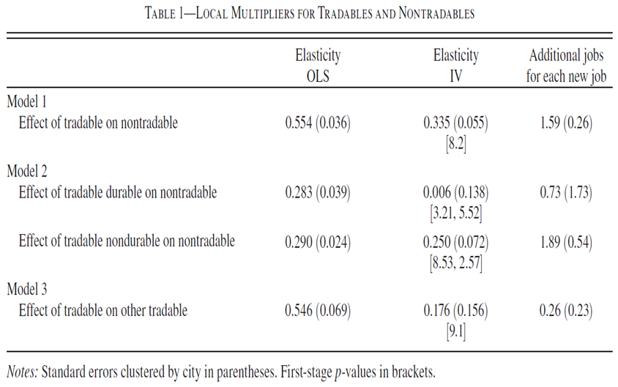
Table 1 – Local multipliers for tradables and nontradables
State and Local Public Finance Lecture 16: Economic Development Concepts
So 1 new “tradable” job leads to 1.59 “nontradable” jobs and (because of agglomeration economies?) 0.26 new tradable jobs. Note: “tradable” = “manufacturing.”
Source: Moretti, AER, May 2010

Slide 47
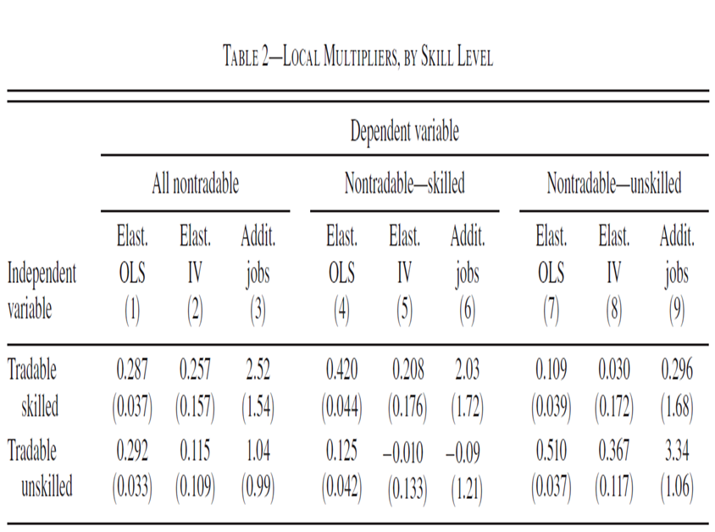
Table 2 – Local multipliers, by skill level
State and Local Public Finance Lecture 16: Economic Development Concepts
So 1 new tradable skilled job leads to 2.52 non-tradable jobs but 1 new tradable nonskilled job lead to only 1.04 new nontradable jobs. Nontradable jobs in construction, wholesale trade and personal services are most affected.
Source: Moretti, AER, May 2010

Slide 48
Moretti on Multipliers, 2
State and Local Public Finance Lecture 16: Economic Development Concepts
Moretti on Multipliers, 2
In addition, Moretti discusses the use of multipliers in policy.
He points out that new jobs may not be held by current residents,
But his estimates apply to manufacturing, not all tradables,
He cannot account for variation across cities, and
He misses the importance of the counterfactual.

