Slide 1
ECN741: Urban Economics
Neighborhood Amenities
Professor John Yinger, The Maxwell School, Syracuse University, 2020

Slide 2
Amenities
    Class Outline
    1. What Are Amenities?
    2. Amenities in an Urban Model
    3. Looking Ahead: Amenities and House Values
    4. Sorting with Amenities
    5. Endogenous Amenities

Slide 3
Amenities
    Class Outline
    1. What Are Amenities?
    2. Amenities in an Urban Model
    3. Looking Ahead: Amenities and House Values
    4. Sorting with Amenities
    5. Endogenous Amenities

Slide 4
Amenities
    Amenities
    Amenities (or neighborhood amenities) are an important topic in urban economics.
    They get us away from the assumption that the only locational characteristic people care about is access to jobs.
    They allow us to consider a long list of factors that people care about, many of which have links to public policy.

Slide 5
Amenities
    Amenity Examples
    Amenities studied in the literature include:
      Public school quality
      The property tax rate
      The crime rate
      Air quality
      Water quality
      Distance from toxic waste sites
      Access to parks
      Access to lakes or rivers

Slide 6
Amenities
    Class Outline
    1. What Are Amenities?
    2. Amenities in an Urban Model
    3. Looking Ahead: Amenities and House Values
    4. Sorting with Amenities
    5. Endogenous Amenities

Slide 7
Amenities
    Amenities in an Urban Model
    A step in the direction of amenities appears in Alonso; he included distance from the center in the utility function.
      The Alonso math is essentially the same as what is presented here, but his model refers to the “disutility of distance” and whether commuting is “easy,” not to amenities.
    This approach also appeared in Muth.

Slide 8
Amenities
    Amenities in an Urban Model, 2
    Alonso also has several less-formal examples in which he talks about (and gives graphical representations for) models with households that have:
      Differential “orientation” toward retail, financial, or manufacturing centers.
      Different attraction to neighborhoods with different “prestige.”
    More formal reference to amenities in an urban model began with Polinsky and Shavell (JPubE, Jan./Feb. 1976) and, for endogenous amenities, Yinger (JUE, October 1976).

Slide 9
Amenities
    Polinsky/Shavell
    Polinsky and Shavell assume amenities are a function of location and include them in the utility function:
    Then they restate the problem in terms of an indirect utility function:

Slide 10
Amenities
    Polinsky/Shavell, 2
    By differentiating the indirect utility function with respect to u and recognizing that every household must achieve the same utility, they show that:
    This leads to:

Slide 11
Amenities
    Polinsky/Shavell, 3
    This result implies that an improvement in the amenity boosts bids (V₁ < 0!); in other words, households must pay for the privilege of living in a nice neighborhood!
    A key issue for an urban model is whether the sign of Aʹ{u} is positive or negative: How do amenities change as one moves away from the CBD?.
      A positive sign flattens the bid function
      A negative sign makes the bid function steeper

Slide 12
Amenities
    Bid Functions with Amenities
P{u}
Price function with Aʹ{u}>>0
Price function with Aʹ{u}>0
Price function without amenities
Price function with Aʹ{u}<0
u

Slide 13
Amenities
    Solving an Urban Model with an Amenity
    Adding an amenity obviously makes an urban model more difficult to solve.
    With a Cobb-Douglas utility function, the bid function is:
    So one must make an assumption about the form of A{u}—and then find a way to solve the population integral!

Slide 14
Amenities
    Alternative Amenity Formulations
    A few scholars have examined urban models with an amenity ring.
    Son and Kim (JUE, May 1998) look at the green belt in Seoul.
    It would also be possible to solve an urban model with an amenity at a point (a lake, for example), but nobody has done this yet.

Slide 15
Amenities
    Interpreting Amenity Differences
    One important contribution of Polinsky/Shavell is to inject caution into interpreting the impacts of amenity differences or amenity changes.
    In an open model context, differences in housing prices due to amenity differences are measures of willingness to pay.
    But in a closed model context, housing-price differences linked to changes in amenities that also affect utility cannot be so easily interpreted.
    There is a large literature, to which we will return, on estimating underlying willingness to pay.

Slide 16
Amenities
    An Alternative Formulation
    We can derive comparable results using a direct utility function. Start with
    Differentiate the Lagrangian

Slide 17
Amenities
    An Alternative Formulation, 2
    Solving for Pʹ{u} yields

Slide 18
Amenities
    Class Outline
    1. What Are Amenities?
    2. Amenities in an Urban Model
    3. Looking Ahead: Amenities and House Values
    4. Sorting with Amenities
    5. Endogenous Amenities

Slide 19
Amenities
    Looking Ahead: Empirical Implications
    This formulation is difficult to estimate because it requires a specific function linking A and u.
    However, as discussed in later classes, this link is not needed for empirical work. Each amenity can be treated as a separate variable, so P=P{u, A₁, A₂, …, A_{n}}.
    Combining this result with H=H{X₁, X₂, …, X_{m}}, where the Xs are housing traits, leads to the estimating equation (called a hedonic regression):
      V = PH/r = V{u, A₁, A₂, …, A_{n}, X₁, X₂, …, X_{m}}

Slide 20
Amenities
    Looking Ahead, 2
    As we will see, the literatures on urban economics and amenities, on local public finance, and on housing hedonics are all complementary.
    Drawing on the insights from all three of these literatures, we will see how to estimate a hedonic equation of this type,
    And how to draw inferences about the underlying demand for each amenity.

Slide 21
Amenities
    An Aside: Amenities and Distance
    My Cleveland estimations yield a summary measure of neighborhood quality.
    Call this A in the above.
    How does A vary with distance?

Slide 22
Amenities
    An Aside: Amenities and Distance, 2
Source | SS df MS Number of obs = 1,665
-------------+---------------------------------- F(1, 1663) = 74.14
Model | 5.01871366 1 5.01871366 Prob > F = 0.0000
Residual | 112.57278 1,663 .067692592 R-squared = 0.0427
-------------+---------------------------------- Adj R-squared = 0.0421
Total | 117.591494 1,664 .070667965 Root MSE = .26018
------------------------------------------------------------------------------
lbidprice | Coef. Std. Err. t P>|t| [95% Conf. Interval]
-------------+----------------------------------------------------------------
dist1 | .006024 .0006996 8.61 0.000 .0046518 .0073962
_cons | 11.2325 .0113348 990.98 0.000 11.21027 11.25473
------------------------------------------------------------------------------

Slide 23
Amenities
    An Aside: Amenities and Distance, 3
Source | SS df MS Number of obs = 1,665
-------------+---------------------------------- F(2, 1662) = 197.70
Model | 22.5991335 2 11.2995667 Prob > F = 0.0000
Residual | 94.9923602 1,662 .057155451 R-squared = 0.1922
-------------+---------------------------------- Adj R-squared = 0.1912
Total | 117.591494 1,664 .070667965 Root MSE = .23907
------------------------------------------------------------------------------
lbidprice | Coef. Std. Err. t P>|t| [95% Conf. Interval]
-------------+----------------------------------------------------------------
dist1 | .0501193 .0025951 19.31 0.000 .0450293 .0552094
dist1sq | -.0012456 .000071 -17.54 0.000 -.0013849 -.0011063
_cons | 10.96881 .0182903 599.71 0.000 10.93294 11.00469
------------------------------------------------------------------------------

Slide 24
Amenities
    An Aside: Amenities and Distance, 3

Slide 25
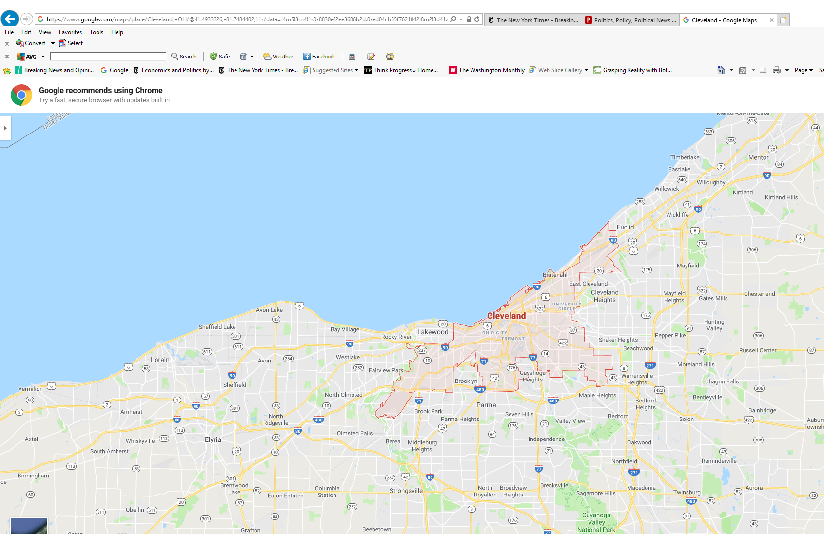
Amenities
    An Aside: Amenities and Distance, 4
    (Circle at 20 Miles from CBD)

Slide 26
Amenities
    Class Outline
    1. What Are Amenities?
    2. Amenities in an Urban Model
    3. Looking Ahead: Amenities and House Values
    4. Sorting with Amenities
    5. Endogenous Amenities

Slide 27
Amenities
    Sorting with Amenities
    With amenities in the model, moving away from the CBD increases commuting costs and changes the level of the amenity.
    Does this change alter “normal” sorting? That is, does it change the conditions under which higher-income households live farther from the CBD?
      This question is addressed in Alonso (with u, not A{u}), and by Brueckner, Thisse, and Zenou (European Economic Review, January 1999)
    Note that we will later address another “normal” sorting question: Do high-income people win the competition for housing in high-amenity neighborhoods?

Slide 28
Amenities
    Sorting with Amenities, 2
    Start with the earlier result:
    Differentiate with respect to income:

Slide 29
Amenities
    Sorting with Amenities, 3
    Normal sorting requires this derivative to be positive.
    The following condition must hold at the outer edge of the urban area (or else the city will expand forever!):
    In this case, the condition for normal sorting becomes:

Slide 30
Amenities
    Sorting with Amenities, 4
    The left side is the income elasticity of the net non-housing benefits from moving further from the CBD; these benefits now include the change in the amenity.
    If this net-benefits elasticity is less than the income elasticity of demand for H, normal sorting occurs.
    Recall that the income elasticity of demand for H is relevant here because the compensation that appears in the housing price must be spread out over the number of housing units consumed.

Slide 31
Amenities
    Sorting with Amenities, 5
    We can now ask whether the presence of amenities that increase with distance from the CBD makes normal sorting more likely.
    This is true if the left side of the above equation is smaller than the left side of the no-amenity equation, or:

Slide 32
Amenities
    Sorting with Amenities, 6
    After a little algebra, this condition can be reduced to:
    In other words, the presence of amenities that increase with distance from the CBD makes normal sorting more likely only if the income elasticity of MB_{A} is greater than the income elasticity of t.
    So this effect is not as strong as one might think.

Slide 33
Amenities
    Sorting with Amenities, 7
    A recent study of the amenity “school district quality” in New York State (Eom et al. , Education Finance and Policy, Fall 2014) finds estimates that indicate an income elasticity of MB_{A} equal to 0.84.
    With a different method, house sales data for Cleveland, and the assumption that the income elasticity of demand for H is 0.4, Yinger (JUE, March 2015) estimates that this elasticity is 1.04.
    Now if t = t₀ + t_{Y}Y, where t₀ is operating costs (assumed not to depend on Y) and t_{Y} is time costs as a share of Y, then the right side of the above formula, the elasticity of t with respect to Y, is t_{Y}Y/t.
    Operating costs are thought to be about 15% of commuting costs, which implies that the right side of the above formula is 0.85.
    Thus, the Eom et al. results indicate that amenities do not boost normal sorting; the Yinger results indicate that they do.

Slide 34
Amenities
    Sorting with Amenities, 8
    As shown in an earlier figure, an amenity may increase so fast with u that P{u} has a positive slope in some range.
    The same condition must hold for normal sorting to exist in this case.
    In the following figure, the steeper bid function (for household type B) is the high-income bid function if the income elasticity of MB_{A} is greater than the income elasticity of t.

Slide 35
Amenities
    Sorting with Amenities, 9
Sorting with a Large Positive Amenity Gradient
u*

Slide 36
Amenities
    Sorting with Amenities, 10
    Finally, Brueckner, Thisse, and Zenou (European Economic Review, January 1999) look at the case in which Aʹ{u} < 0.
    This case applies to many European cities where the central areas have parks and museums and historic buildings.
    In this case, amenities make normal sorting less likely unless the above elasticity condition (for the income elasticity of MB_{A} relative to the income elasticity of t) is reversed.

Slide 37
Amenities
Questions
How can neighborhood amenities be incorporated into an urban model?
How do neighborhood amenities affect the shape of the household bid function?
How do neighborhood amenities affect residential sorting?

Slide 38
Amenities
    Class Outline
    1. What Are Amenities?
    2. Amenities in an Urban Model
    3. Looking Ahead: Amenities and House Values
    4. Sorting with Amenities
    5. Endogenous Amenities

Slide 39
Amenities
    Endogenous Amenities
    Also Called Demographic Externalities
    People may care about the characteristics of their neighbors—their race, ethnicity, religion, etc.
    If so, the neighborhood amenity, group composition, is endogenous.
      People select a neighborhood based in part on its group composition.
      The neighborhood choices of people in different groups determine a neighborhood’s group composition.

Slide 40
Amenities
    Endogenous Amenities, 2
    Problems of this type were first analyzed by Schelling in models without prices (e.g. Micromotives and Macrobehavior, 1978).
    Many people have subsequently looked at housing market models with this feature.
    One such urban model is from Yinger’s dissertation (JUE, October 1976). See also, Schnare and MacRae (Urban Studies, October 1978), who consider heterogeneous households in a single neighborhood.

Slide 41
Amenities
    Endogenous Amenities, 3
    The most straightforward way to address this problem is to imagine a single neighborhood and two types of household, Group 1 and Group 2.
    Each household type cares about the group composition of the neighborhood.
    The equilibrium depends on the nature of their preferences (i.e., prejudices!)

Slide 42
Amenities
    Endogenous Amenities, 4
    To start, suppose everyone prefers his or her own group.
    Then complete segregation (= sorting) is the only stable equilibrium.
    This model cannot determine the pattern of segregation, but we can illustrate the market price function (the envelope of the bid functions) by assuming one group lives nearer the CBD.

Slide 43
Amenities
    Endogenous Amenities, 5
    The key to analyzing this case is to start with an integrated outcome and then determine what happens if there is a shock to group composition.
    This shock could come, for example, from a household moving out of the urban area.
    With the assumptions for this case, any shock will start a move toward complete segregation.

Slide 44
Amenities
    Neighborhood Equilibrium, Case 1
    Everyone prefers his/her own group
Bid
=P
G₂’s Bid
G₁’s Bid
0
100
%G₁ →
← %G₂

Slide 45
Amenities
    Housing Bids, Case 1
    Everyone prefers his/her own group
P{u}
G₁’s bid in G₂ area
G₂’s bid in G₁ area
No-prejudice price function
G₂
G₁
u

Slide 46
Amenities
    Endogenous Amenities, 6
    We can also consider two other cases:
      Everyone prefers G₁, but this preference is stronger for members of G₁.
      Everyone prefer G₁, but this preference is stronger for members of G₂.

Slide 47
Amenities
    Neighborhood Equilibrium, Case 2
    Everyone prefers Group 1, especially Group 1
Bid
=P
G₁’s Bid
G₂’s Bid
0
100
%G₁ →
← %G₂

Slide 48
Amenities
    Endogenous Amenities, 7
    In this case, the equilibrium price function depends on what we assume about the ability of housing sellers to influence the group composition of a neighborhood.
      One possibility, Case 2A, is that sellers have no influence over group composition.
      Another possibility, Case 2B, is that sellers are able to influence group composition when it is profitable to do so.
    In an application to racial segregation in the U.S., Kern (JUE, September 1981) argued for Case 2A and Yinger (JUE, October 1976) argued for Case 2B.

Slide 49
Amenities
    Neighborhood Equilibrium, Case 2A
    Everyone prefers Group 1, especially Group 1;
    Sellers Cannot Move Boundary
P{u}
Predictions: Higher price in
G₁ area; discrimination against Group 2 if its population grows and it tries to move into Group 1 area.
G₁’s initial bid in G₂ area
G₂’s bid in G₁ area
G₁’s final bid in G₁ area
= final price
No-prejudice price function
G₂
G₁
u

Slide 50
Amenities
    Neighborhood Equilibrium, Case 2B
    Everyone prefers Group 1, especially Group 1;
    Sellers Can Move Boundary
P{u}
G₂’s final bid in G₂ area
= final price
Prediction: Zoning or discrimination arises to keep G₂ out of G₁ area
G₂’s bid in G₁ area (not accepted!)
G₁’s final bid in G₁ area
= final price
No-prejudice price function
G₂
G₁
u

Slide 51
Amenities
    Endogenous Amenities, 8
    The final case, due to Kern, leads to stable integration.
    In this case, group attitudes have no impact on housing prices, and
    Uniform integration is a stable outcome.
    Any neighborhood that deviates from uniform integration, immediately returns to it.

Slide 52
Amenities
    Neighborhood Equilibrium, Case 3
    Everyone prefers Group 1, especially Group 2
Bid
=P
G₂’s Bid
G₁’s Bid
0
G₁*
100
%G₁ →
← %G₂

Slide 53
Amenities
    Neighborhood Equilibrium, Case 3
    Everyone prefers Group 1, especially Group 2
P{u}
Prediction: All locations have same group composition.
Price function with or without prejudice of this type
u

Slide 54
Amenities
    Endogenous Amenities, 9
    Final point #1: Uniform integration is always an equilibrium; if all neighborhoods are alike, nobody has an incentive to move.
    In Cases 1 and 2, however, uniform integration is unstable, because any random change in neighborhood composition unravels the equilibrium
    Public policies to promote, if not impose, integration would be needed in these cases to preserve an integrated outcome.

Slide 55
Amenities
    Endogenous Amenities, 10
    Final point #2: This analysis does not consider the competition that a group encounters if it moves out of the (single) neighborhood in this analysis.
    This competition makes a big difference, and we will return to this issue when we have a more complete set of tools for understanding bidding and sorting across neighborhoods.

Slide 56
Amenities
Questions
How do household bid functions help to explain residential segregation.
Under what circumstances do household bid functions support residential integration?
When is discrimination necessary to maintain residential segregation.

