Slide 1
School-Quality Capitalization
ECN741, Urban Economics
Professor John Yinger, The Maxwell School, Syracuse University, 2020

Slide 2
Class Outline
School Quality Capitalization
Class Outline
Methodological Challenges
Examples
  Recent Publications
  Cleveland Application
Outline

Slide 3
Methodological Challenges
School Quality Capitalization
Class Outline
Methodological Challenges
Examples
  Recent Publications
  Cleveland Application
Outline

Slide 4
Methodological Challenges
School Quality Capitalization
Methodological Challenges
1. Functional form
2. Defining School Quality (S)
3. Controlling for neighborhood traits
4. Controlling for housing characteristics
Challenges

Slide 5
Functional Form
School Quality Capitalization
Functional Form
As discussed in previous classes, simply regressing V on S (with or without logs) is not satisfactory.
Regressing ln{V} on S and S² is pretty reasonable—but cannot yield structural coefficients.
To obtain structural coefficients, one must use nonlinear regression or the Rosen 2-step method (with a general form for the envelope and a good instrument for the 2nd step)—or something fancier.
Challenges

Slide 6
Defining School Quality
School Quality Capitalization
Defining School Quality
Most studies use a test score measure.
A few use a value-added test score.
A few use a graduation rate.
Some use inputs (spending or student/teacher ratio), which is not compelling to me.
A few use multiple output measures—but more studies should do this!
Challenges

Slide 7
Defining School Quality, 2
School Quality Capitalization
Defining School Quality, 2
Possible approaches:
  Pick school outputs on a (visible) district report card.
  Pick the measures in the state’s accountability system.
  Pick measures correlated with key demand variables, such as income and tax price.
Challenges

Slide 8
Neighborhood Controls
School Quality Capitalization
Neighborhood Controls
Data quality varies widely; some studies have many neighborhood controls.
Many fixed-effects approaches are used (sometimes inappropriately) to account for unobservables, e.g.:
  Border fixed effects (cross section)
  Neighborhood or house-specific fixed effects (panel)
Another possible approach is to use instrumental variables—for every amenity!!!
Challenges

Slide 9
Bored Fixed Effects
School Quality Capitalization
Border Fixed Effects
BFEs were popularized by Black (QJE, May 1999); they appear in at least 16 studies.
BFEs define elementary school attendance zone boundary segments.
  Define a border fixed effect (BFE) for each segment, equal to one for houses within a selected distance from the boundary.
  Drop all observations farther from boundary.
Challenges

Slide 10
Border Fixed Effects, 2
School Quality Capitalization
Border Fixed Effects, 2
School
House Sale
Dropped Observations
Boundary Segment
Challenges

Slide 11
Border Fixed Effects, 3
School Quality Capitalization
Border Fixed Effects, 3
The idea is that the border areas are like neighborhoods, so the BFEs pick up unobservables shared by houses on each side of the border.
The size of the relevant border area is not known, so it is a good idea to try several different distances.
Challenges

Slide 12
Border Fixed Effects, 4
School Quality Capitalization
Border Fixed Effects, 4
As discussed in the previous class BFEs have three main weaknesses:
  First, they may do little to eliminate the bias from omitted neighborhood traits,
  Second, they greatly cut the sample size,
  Third, they change the question addressed by a hedonic regression and are therefore easy to misinterpret.
Challenges

Slide 13
BFEs and Sorting
School Quality Capitalization
BFEs and Sorting
Two recent articles (Kane, Riegg, and Staiger (American Law and Economics Review, Summer 2006, and Bayer, Ferreira, and McMillan, JPE, August 2007) find significant differences in demographics (e.g. average household income) across attendance-zone boundaries.
They make the reasonable argument that these differences are products of sorting; higher-income households end up on the better-school side of the boundary.
Challenges

Slide 14
BFEs and Sorting, 2
School Quality Capitalization
BFEs and Sorting, 2
B/F/M then argue that these demographic differences become neighborhood traits and they include them as controls.
This strategy (including average neighborhood income and perhaps other demographic traits) is used by the vast majority of school-quality hedonic studies.
The justification is that the coefficient of school quality will be biased without controls for these sorting-induced neighborhood differences.
Challenges

Slide 15
BFEs and Sorting, 3
School Quality Capitalization
BFEs and Sorting, 3
The problem with this approach is that, as discussed in the previous class, demographic traits of small neighborhoods are measures of demand—which do not belong in an hedonic.
  As Rosen argued long ago, the envelope is not a function of demand variables.
  Including demand variables re-introduces the endogeneity problem and changes the meaning of the results.
Challenges

Slide 16
BFEs and Sorting, 4
School Quality Capitalization
BFEs and Sorting, 4
In sum, the estimated impact of school quality on house values may be biased if neighborhood demographic traits are omitted from the regression, but including variables that are determinants of demand (even if they are also measures of neighborhood amenities) is not a solution.
  One cannot solve an omitted-variable problem by altering the meaning of a regression (in this case from a hedonic to bid functions).
  If the coefficient of school quality drops when neighborhood income is included, this just shows that the slope of the (mis-specified) bid function is lower than the slope of the (possibly biased) envelope.
Challenges

Slide 17
BFEs and Sorting, 5
School Quality Capitalization
BFEs and Sorting, 5
This problem is more serious with very small neighborhoods (e.g. block groups) than with medium neighborhoods (e.g. tracts), and may not arise with large neighborhoods (e.g. zip codes).
One way to avoid this problem is to collect data on neighborhood traits that are correlated with income but are not demand determinants, such as the distance to parks, golf courses, or lakes.
Challenges

Slide 18
Other Fixed Effects
School Quality Capitalization
Other Fixed Effects
Other types of fixed effects are possible with panel data:
  Tract fixed effects
  School district fixed effects
  House fixed effects (with a panel large enough to observe double sales).
These approaches account for some unobservable factors, but may also introduce problems.
Challenges

Slide 19
Possible Problems with Fixed Effects
School Quality Capitalization
Possible Problems with Fixed Effects
These fixed effects limit the variation in the data for estimating school quality capitalization.
  The coefficients of school quality and other amenities must be estimated based on changes in these variables over time.
  School quality and other amenities may not change much over time, so it may be difficult to estimate their effects.
  The behavioral response to short-run changes in an amenity may be different from the long-run effects that determine cross-sectional variation; for example, people may not respond to a one-year increase in student test scores that does not alter a school’s reputation.
Challenges

Slide 20
Possible Problems with Fixed Effects, 2
School Quality Capitalization
Possible Problems with Fixed Effects, 2
Fixed effects control for the level of house or neighborhood traits that do not vary over time; this is an important contribution.
But the value of these fixed traits may vary over time. The hedonic equilibrium for each trait could change due to changes in the distribution of households in the area or some other factor.
Hence the coefficients of traits that do vary over time could be biased because the regression does not account for changes in the market value of traits that do not vary over time.
Challenges

Slide 21
The IV Approach
School Quality Capitalization
The IV Approach
With omitted variables, explanatory variables are likely to be correlated with the error term.
  One possible correction is to use instrumental variables—and 2SLS.
However, credible IVs are difficult to find.
  No study had identified an IV that provides a general correction for omitted variable bias in estimating school quality capitalization.
Moreover, identification requires an instrument for every amenity—not just for one.
  An equation with more than one amenity possibly affected by omitted variable bias but with an instrument for only one amenity (school quality, say) is not identified!
Challenges

Slide 22
Controlling for Housing Traits
School Quality Capitalization
Controlling for Housing Traits
A housing hedonic requires control variables for the structural characteristics of housing.
Because housing, neighborhood, and school traits are correlated, good controls for housing traits are important (but surprisingly limited in many studies).
As discussed later, the widely cited B/F/M article has only 2 housing traits: number of rooms and year built, plus one trait correlated with housing type: whether owner-occupied.
Challenges

Slide 23
Housing Traits, 2
School Quality Capitalization
Housing Traits, 2
If good data on housing traits are available, one strategy for a cross-section is to estimate the hedonic in two stages.
  Stage 1: Define fixed effects for the smallest observable neighborhood type (e.g. block group or tract); in a sample of house sales, regress V on housing traits and these FE’s—with no neighborhood traits.
  Stage 2: Use the coefficients of the FE’s as the dependent variable in a second stage with neighborhood traits on the right side; the number of observations equals the number of neighborhoods.
Challenges

Slide 24
Housing Traits, 3
School Quality Capitalization
Housing Traits, 3
This approach has two advantages:
  The coefficients of the housing traits cannot be biased due to missing neighborhood variables.
  The second stage need not follow the same form as the first, so this approach adds functional-form flexibility.
Note that the standard errors in the 2nd stage must be corrected for heteroskedasticity.
  The coefficient of each FE is based on a different number of observations—with a different variance.
Challenges

Slide 25
Questions
School Quality Capitalization
Questions
What is a good functional form for a housing hedonic regression for school quality?
How should school quality be defined?
What are border fixed effects and what are their strengths and weaknesses?
What other fixed effects are available?
How can a researcher control for housing traits?
Challenges

Slide 26
Recent Publications
School Quality Capitalization
Class Outline
Methodological Challenges
Examples
  Recent Publications
  Cleveland Application
Outline

Slide 27
Selected Recent Examples
School Quality Capitalization
Selected Recent Examples
Epple, Peress, and Sieg (AEJ: Microecconomics, November 2010)
Bayer, Ferriera, and MacMillan (JPE, August 2007)
Clapp, Nanda, and Ross (JUE, March 2008)
Bogin (Syracuse dissertation 2011, now Bogin/Nguyen-Hoang, JRS, November 2014), building on Figlio and Lucas (AER, June 2004)
Yinger (JUE, March 2015)
Recent Studies

Slide 28
E/P/S
School Quality Capitalization
E/P/S
E/P/S have house sales data for the Pittsburgh area.
Their strategy is to solve and estimate a general equilibrium model with variation in income and one taste parameter—both assumed to have a certain form.
This allows them to have heterogeneity within a jurisdiction—a huge advantage of this approach.
The big disadvantage is that they have a single amenity index (a linear combination of 3 variables).
This method is also technically complex, although the first stage is similar to mine (discussed below).
Recent Studies

Slide 29
B/F/M
School Quality Capitalization
B/F/M
B/F/M have census data from the San Francisco area.
They estimate a linear hedonic with BFE’s, pooling sales and rental data. (They also estimate a fancy multinomial choice model, which is not considered here.)
They find that adding the BFE’s cuts the impact of school quality on housing prices.
They find that adding neighborhood income cuts the impact of school quality even more.
Recent Studies

Slide 30
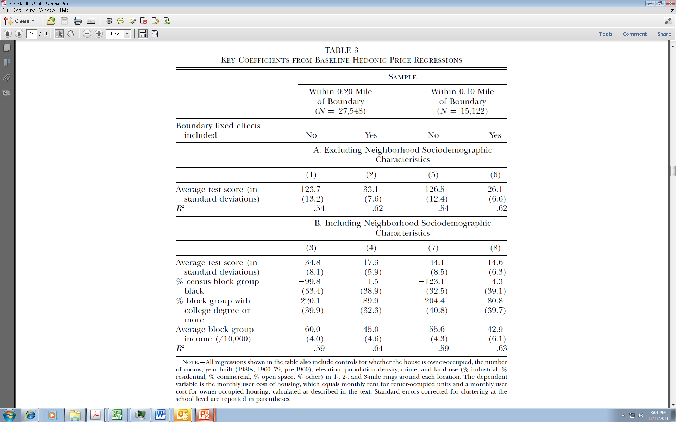
B/F/M Hedonic
School Quality Capitalization
B/F/M Hedonic
Recent Studies

Slide 31
B/F/M Issues
School Quality Capitalization
B/F/M Issues
They estimate a linear hedonic, which rules out sorting (in an article about sorting!).
Their discrete-choice model implies linear bid functions, which in turn imply an infinite price elasticity of demand and a quadratic hedonic, not a linear one (see the notes from the last class).
In addition to BFEs, they have only 2 housing traits, 1 sort-of housing trait, and 4 location controls, one of which is a set of land uses.
Recent Studies

Slide 32
B/F/M Issues, 2
School Quality Capitalization
B/F/M Issues, 2
B/F/M acknowledge that sorting exists and complicates a BFE approach by leading to different amenities on different sides of a boundary—a possible source of bias.
They claim to solve this problem by including neighborhood demographics, including income, as controls; this approach, they say, picks up higher bids in neighborhoods that, due to sorting, have higher-income residents.
But neighborhood income is a demand factor, which belongs in a bid function, not an envelope.
  Because of sorting, income is endogenous and a regression that includes income estimates bid-functions, not the envelope!
  One cannot solve a bias problem with a method that changes the meaning of the regression!
Recent Studies

Slide 33
C/N/R
School Quality Capitalization
C/N/R
C/N/R use a panel of housing transactions in Connecticut between 1994 and 2004
They use tract fixed effects to control for neighborhood quality in their panel data.
They look at math scores and cost factors (e.g. student poverty)
They find that tract fixed effects have little impact on the estimate of capitalization when income and other demographics are included.
Recent Studies

Slide 34
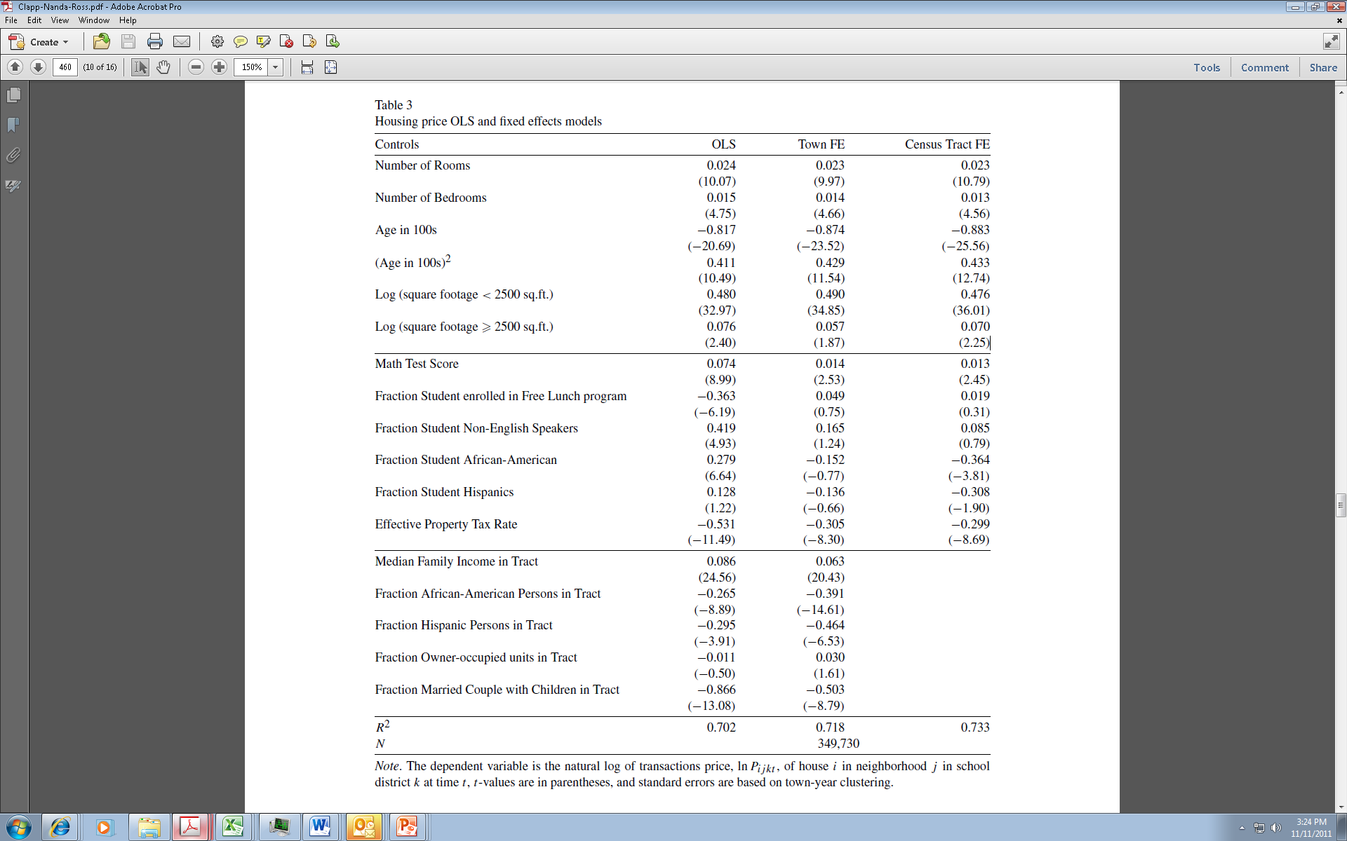
C/N/R Hedonic
School Quality Capitalization
C/N/R Hedonic
Recent Studies

Slide 35
C/N/R Issues
School Quality Capitalization
C/N/R Issues
They use a semi-log form with only one term for S, which rules out sorting.
They control for neighborhood demographics, which raises the same issue as B/F/M: Should demand variables be included?
They have only 4 housing traits and 2 non-demand neighborhood traits.
Recent Studies

Slide 36
Dhar/Ross, JUE, January 2012
School Quality Capitalization
Dhar/Ross, JUE, January 2012
In a follow up, Dhar/Ross use data from Connecticut and fixed effects for district boundary segments.
  They pool across metropolitan areas, which does not make sense to me; each area has its own equilibrium.
  They estimate a time-trend in the boundary fixed effects, which introduces (inappropriately) demographic changes into their controls.
  They use a semi-log form with only one term for S, which rules out sorting.
  They have only 4 housing traits, and only neighborhood dummies and school quality for amenities.
Recent Studies

Slide 37
Bogin/ Nguyen-Hoang
School Quality Capitalization
Bogin/ Nguyen-Hoang
The Florida school accountability program hands out “failing” grades to some schools. The Figlio/Lucas article looks at the impact of this designation on property values.
The national No Child Left Behind Act also hands out “failing” grades. The 2011 Bogin essay (and follow-up article) looks at the impact of this designation on property values around Charlotte, North Carolina.
In both cases, the failing grades are essentially uncorrelated with other measures of school quality.
Recent Studies

Slide 38
Bogin/ Nguyen-Hoang, 2
School Quality Capitalization
Bogin/ Nguyen-Hoang, 2
B/N-H find that a failing designation lowers property values by about 6%.
  This effect peaks about 7 months after the announcement and fades out after one year.
They provide a clear interpretation of results with this “change” set-up.
  Because of possible re-sorting, the change in house values cannot be interpreted as a willingness to pay.
  A failing designation might change the type of people who move into a neighborhood.
  Consider the following figure from Bogin’s thesis:
Recent Studies

Slide 39
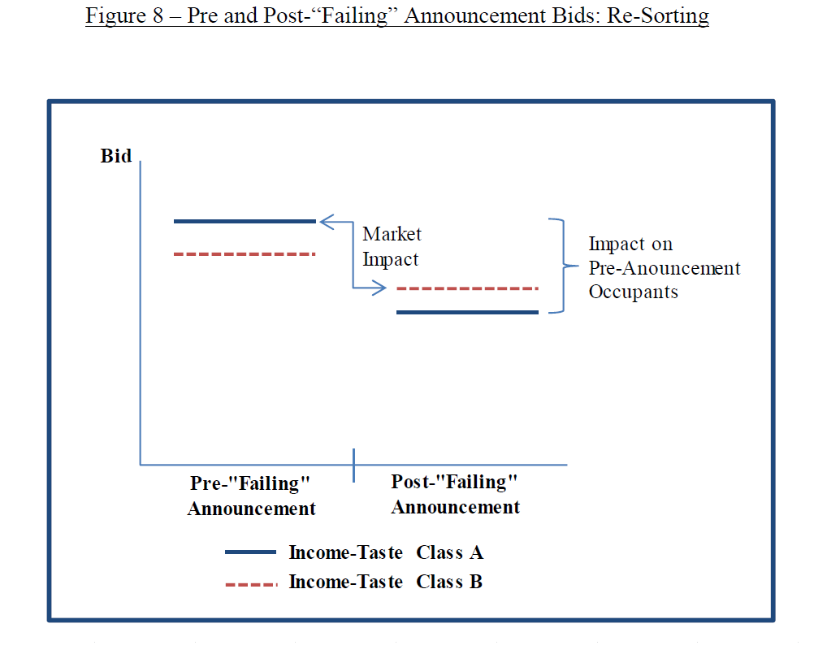
Bogin/ Nguyen-Hoang, 3
School Quality Capitalization
Bogin/ Nguyen-Hoang, 3
Recent Studies

Slide 40
Specification Summary
School Quality Capitalization
Specification Summary
Many studies estimate the following and interpret β as the average MWTP:
Problems:
  A linear specification is not appropriate because it rules out sorting.
  Average MWTP is a limited concept, even with the correct specification; it cannot be compared across place or time because it is affected by the sorting equilibrium.
Recent Studies

Slide 41
Specification, 2
School Quality Capitalization
Specification, 2
With a panel:
With sufficient observations, this approach can use double-sales data to difference out individual house fixed effects (assuming constant market value).
With fewer observations, it can still difference out tract fixed effects.
Recent Studies

Slide 42
Specification, 3
School Quality Capitalization
Specification, 3
Problems with panel applications:
  A linear specification is still not appropriate.
  The β coefficient does not measure average MWTP unless S does not change (in which case β cannot be estimated!), or there is no change in the distribution of demand for S and no re-sorting!
  These problems are usually ignored in the literature.
Recent Studies

Slide 43
Specification, 4
School Quality Capitalization
Specification, 4
Cross-Section with Demand Variables:
Problems:
  This is a bid-function regression, not an envelope.
  The income term, Y, is endogenous.
  Without an interaction between S and Y, the slope of the bid function (dV/dS) is the same for everyone and there is no sorting!!
Recent Studies

Slide 44
Summary
School Quality Capitalization
Summary
A recent paper by Yinger and Nguyen-Hoang (Journal of Benefit-Cost Analysis, online in July 2016), catalogues the hedonic “vices” found in recent studies.
Their findings are summarized in the following table.
Recent Studies

Slide 45
School Quality Capitalization
School Quality Capitalization
Table 7. Hedonic Vices in Selected Recent Empirical Hedonic Studies
 | Functional Form |  | Control Variable |  | Interpretation
 | Linear | Contradictory | Demand | Neighborhood Fixed Effects | Average MWTP | Difference Regression | Border (Neighborhood) Fixed Effects
School Quality Studies
Bayer et al. 2007 | X | X | X |  | X |  | X
Black 1999 | X |  | X |  |  |  | X
Clapp et al. 2008 | X |  |  |  | X |  | (X)
Dhar & Ross 2012 | X |  | X
Fack & Grenet 2010 | X |  | X |  |  |  | X
Gibbons et al. 2013 | X |  |  | X
Kane et al. 2006 | X |  | X |  |  |  | X
Ries & Somerville 2010 | X |  |  |  |  | X
Air Quality Studies
Anselin & Lozano-Gracia 2008 | X |  | X |  | X
Bajari et al. 2012 | X |  |  |  |  | X
Brasington & Hite 2005 | X | X | X | X
Kim et al. 2003 | X |  | X
Zabel & Kiel 2000 | X | X
Notes: This table includes all the empirical hedonic articles in the Social Science Citation Index that (a) cover school quality, or air quality, (b) were published after 2000, and (c) that were cited at least 10 times. We also include a few articles published since 2010, because it may take some time for a paper to be cited, and selected other well-known papers.
Capitalization

Slide 46
Cleveland Application
School Quality Capitalization
Class Outline
Methodological Challenges
Examples
  Recent Publications
  Cleveland Application
Outline

Slide 47
Estimates with a Derived Envelope
School Quality Capitalization
Estimates with a Derived Envelope
Finally, let’s consider some results for both the hedonic and the underlying bid functions from the application of the method Yinger developed using data from a large metropolitan area.
This method has several advantages:
  It avoids the endogeneity problem in the Rosen 2-step approach.
  It avoids inconsistency between the bid functions and their envelope (the hedonic equation).
  It includes most parametric forms for a hedonic as special cases.
  It allows for household heterogeneity.
  It leads to tests of key sorting theorems.
A New Approach

Slide 48
Estimates with a Derived Envelope, 2
School Quality Capitalization
Estimates with a Derived Envelope, 2
This approach applies only to continuous amenities, such as school quality or particulates in the air, not to discrete amenities, such as a good view.
This approach is based on the assumption of one-to-one matching, that is, to an equilibrium with a unique amenity level for each household type.
  It cannot address heterogeneity in a large city.
  It may not be a good approximation in other places.
This approach relies on the assumption of constant elasticity demand functions, which may not be appropriate.
  However, most other forms implicitly rely on this assumption, too.
A New Approach

Slide 49
The Yinger Envelope
School Quality Capitalization
The Yinger Envelope
The form derived in an earlier class:
and X^{(λ)} is the Box-Cox form.
A starting point is a quadratic form, which corresponds to
  μ = -∞ and σ₃ = 1
A New Approach

Slide 50
The Brasington Data
School Quality Capitalization
The Brasington Data
All home sales in Ohio in 2000, with detailed housing characteristics and house location; compiled by Prof. David Brasington.
Matched to:
  School district and characteristics
  Census block group and characteristics
  Police district and characteristics
  Air and water pollution data
Yinger focuses on the 5-county Cleveland area and add many neighborhood traits.
A New Approach

Slide 51
Yinger’s Two-Step Approach
School Quality Capitalization
Yinger’s Two-Step Approach
Step 1: Estimate the envelope using Yinger’s functional form assumptions to identify the price elasticity of demand, μ.
  Step 1A: Estimate hedonic with neighborhood fixed effects
  Step 1B: Estimate P^{E}{S, t} for the sample of neighborhoods with their coefficients from Step 1A as the dependent variable.
Step 2: Estimate the impact of income and other factors (except price) on demand.
A New Approach

Slide 52
Neighborhood Fixed Effects
School Quality Capitalization
Neighborhood Fixed Effects
Start with Census block groups containing more than one observation.
Split block-groups in more than one school district.
Total number of “neighborhoods” in Cleveland area sub-sample: 1,665.
A New Approach

Slide 53
Step 1A: Run Hedonic Regression with Neighborhood Fixed Effects
School Quality Capitalization
Step 1A: Run Hedonic Regression with Neighborhood Fixed Effects
Dependent variable: Log of sales price in 2000.
Explanatory variables:
  Structural housing characteristics.
  Corrections for within-neighborhood variation in seven locational traits.
  Neighborhood fixed effects.
22,880 observations in Cleveland subsample.
A New Approach

Slide 54
Variable Definitions and Results for Basic Hedonic…
School Quality Capitalization
Table 1. Variable Definitions and Results for Basic Hedonic with Neighborhood Fixed Effects
Variable | Definition | Coefficient | Std. Error
One Story | House has one story | - 0.0072 | 0.0050
Brick | House is made of bricks | 0.0153*** | 0.0052
Basement | House has a finished basement | 0.0308*** | 0.0050
Garage | House has a garage | 0.1414*** | 0.0067
Air Cond. | House has central air conditioning | 0.0254*** | 0.0055
Fireplaces | Number of fireplaces | 0.0316*** | 0.0038
Bedrooms | Number of bedrooms | - 0.0082*** | 0.0028
Full Baths | Number of full bathrooms | 0.0601*** | 0.0042
Part Baths | Number of partial bathrooms | 0.0412*** | 0.0041
Age of House | Log of the age of the house | - 0.0839*** | 0.0032
House Area | Log of square feet of living area | 0.4237*** | 0.0086
Lot Area | Log of lot size | 0.0844*** | 0.0037
Outbuildings | Number of outbuildings | 0.1320*** | 0.0396
Porch | House has a porch | 0.0327*** | 0.0073
Deck | House has a deck | 0.0545*** | 0.0053
Pool | House has a pool | 0.0910*** | 0.0180
Date of Sale | Date of house sale (January 1=1, December 31=365) | 0.0002*** | 0.0000
A New Approach

Slide 55
Variable Definitions and Results for Basic Hedonic…, 2
School Quality Capitalization
Table 1. Variable Definitions and Results for Basic Hedonic with Neighborhood Fixed Effects
Variable | Definition | Coefficient | Std. Error
Commute 1ª | Employment wtd. commuting dist. (house-CBG), worksite 1 | - 0.0952*** | 0.0272
Commute 2ª | Employment wtd. commuting dist. (house-CBG), worksite 2 | - 0.0991*** | 0.0321
Commute 3ª | Employment wtd. commuting dist. (house-CBG), worksite 3 | - 0.1239*** | 0.0302
Commute 4ª | Employment wtd. commuting dist. (house-CBG), worksite 4 | - 0.1012*** | 0.0295
Commute 5ª | Employment wtd. commuting dist. (house-CBG), worksite 5 | - 0.0942*** | 0.0344
Dist. to Pub. Schoolª | Dist. to nearest pub. elementary school in district (house-CBG) | - 0.0032 | 0.0061
Elem. School Scoreª | Average math and English test scores of nearest pub. elementary school relative to district (house-CBG) | 0.0170 | 0.0197
Dist. to Private School | Distance to nearest private school (house-CBG) | - 0.0168*** | 0.0057
Distance to Hazard | Dist. to nearest environmental hazard (house-CBG) | 0.0332*** | 0.0082
Distance to Erieª | Dist. to Lake Erie (if < 2; house-CBG) | - 0.0021** | 0.0010
Distance to Ghettoª | Dist. to black ghetto (if < 5; house-CBG) | - 0.1020*** | 0.0331
Distance to Airportª | Dist. to Cleveland airport (if < 10; house-CBG) | 0.0259** | 0.0122
Dist. to CBG Center | Distance from house to center of CBG | - 0.0239*** | 0.0074
Historic Districtª | In historic district on national register (house-CBG) | 0.0120 | 0.0178
Elderly Housingª | Within 1/2 mile of elderly housing project (house-CBG) | - 0.0327* | 0.0194
Family Housingª | Within 1/2 mile of small family housing project (house-CBG) | 0.0836** | 0.0403
Large Hsg Projectª | Within 1/2 mile of large family housing project (>200 units; house-CBG) | - 0.0568** | 0.0257
High Crime | Distance to nearest high-crime location (house-CBG) | 0.0701*** | 0.0246
A New Approach

Slide 56
Step 1B: Run Envelope Regression
School Quality Capitalization
Step 1B: Run Envelope Regression
Dependent variable: coefficient of neighborhood fixed effect plus the constant.
Explanatory variables:
  Public services and neighborhood amenities
  Commuting variables
  Income and property tax variables
  Neighborhood control variables
A New Approach

Slide 57
School Variables
School Quality Capitalization
School Variables
Variable Definition
----------------------------------------------------
Elementary Average percent passing in 4th grade in nearest elementary school on 5 state tests (math, reading, writing, science, and citizenship) minus the district average (for 1998-99 and 1999-2000).
High School The share of students entering the 12th grade who pass all 5 tests (= the passing rate on the tests, which reflects students who do not drop out, multiplied by the graduation rate, which indicates the share of students who stay in school) averaged over 1998-99 and 1999-2000.
Value Added A school district's sixth grade passing rate (on the 5 tests) in 2000-2001 minus its fourth grade passing rate in 1998-99.
Minority Teachers The share of a district’s teachers who belong to a minority group
A New Approach

Slide 58
Cleveland and East Cleveland
School Quality Capitalization
Cleveland and East Cleveland
The Cleveland School District is unique in 2000 because:
  It was the only district to have private school vouchers
  It was the only district to have charter schools (except for 1 in Parma).
  The private and charter schools tend to be located near low-performing public schools.
The East Cleveland School District is unique in 2000 because:
  It received a state grant for school construction in 1998-2000 that was triple the size of its operating budget.
  No other district in the region received such a grant.
A New Approach

Slide 59
Descriptive Statistics for Key Variables
School Quality Capitalization
Table 2. Descriptive Statistics for Key Variables
 | Mean | Std. Dev. | Minimum | Maximum
CBG Price per unit of Housing | 84835.68 | 23331.25 | 32215.83 | 345162.50
Relative Elementary Scoreª | 0.3148 | 0.0894 | 0.0010 | 0.6465
High School Passing Rate | 0.3197 | 0.2040 | 0.0491 | 0.7675
Elementary Value Addedª | 0.2400 | 0.0942 | 0.0100 | 0.4960
Share Minority Teachers^{b} | 0.1329 | 0.1548 | 0.0010 | 0.6146
Share Non-Black in CBG^{b} | 0.8022 | 0.3226 | 0.0010 | 1.0000
Share Hispanic in CBG | 0.9623 | 0.0810 | 0.3673 | 1.0000
Weighted Commuting Distance | 13.2046 | 7.4567 | 7.2660 | 39.5236
Income Tax Rate^{c} | 0.0091 | 0.0012 | 0.0075 | 0.0100
School Tax Rate | 0.0309 | 0.0083 | 0.0172 | 0.0643
City Tax Rate^{d} | 0.0578 | 0.0140 | 0.0227 | 0.1033
Tax Break Rate^{d} | 0.0330 | 0.0121 | 0.0047 | 0.0791
No A-to-S | 0.1339 | 0.3407 | 0.0000 | 1.0000
Not a City | 0.1393 | 0.3464 | 0.0000 | 1.0000
Crime Lowhigh | 0.0252 | 0.1569 | 0.0000 | 1.0000
Crime Highlow | 0.1291 | 0.3354 | 0.0000 | 1.0000
Crime Highhigh | 0.1934 | 0.3951 | 0.0000 | 1.0000
Crime Hotspot1 | 0.0126 | 0.1116 | 0.0000 | 1.0000
Crime Hotspot2 | 0.0354 | 0.1849 | 0.0000 | 1.0000
Crime Hotspot3 | 0.0847 | 0.2785 | 0.0000 | 1.0000
Crime Hotspot4 | 0.2667 | 0.4423 | 0.0000 | 1.0000
A New Approach

Slide 60
Some Preliminary Results
School Quality Capitalization
Some Preliminary Results
In their “Vices” article, Yinger and Nguyen-Hoang use this data set to look at some of the problems that arise with hedonic regressions.
The following figure shows results for the high school variable based on:
  A full-controls quadratic (the best choice without nonlinear estimation)
  A limited-controls quadratic
  A limited-controls quadratic with CBG demographics (a mis-specified bid-function regression)
  A limited-controls quadratic with CBG demographics and an interaction between CBG income and the high school variable (a better bid-function regression, drawn for mean income).
A New Approach

Slide 61
Comparison of Alternative Specifications
School Quality Capitalization
A New Approach

Slide 62
The Main Results
School Quality Capitalization
The Main Results
The following three tables and two graphs present the main results in Yinger’s JUE article.
  Table 3. Results for Tax, Commuting, Crime, Pollution, and Ancillary School Variables
  Table 4. Results for Other Geographic Controls
  Table 5. Specification Tests and Results for Key School and Ethnicity Variables
  Envelope for Relative Elementary Score
  Envelope for High School Passing Rate
A New Approach

Slide 63
Results for Tax, Commuting, Crime, Pollution, and Ancillary School Variables
School Quality Capitalization
Table 3. Results for Tax, Commuting, Crime, Pollution, and Ancillary School Variables
Variable | Definition | Coefficient | R.Std. Error
Income Tax Rate | School district income tax rate. | 1.8818 | 5.1607
School Tax Rate | School district effective property tax rate. | 3.8335*** | 1.2968
City Tax Rate | Effective city property tax rate beyond school tax. | - 1.9647 | 1.3896
Tax Break Rate | Exemption rate for city property tax | 4.0874* | 2.1146
Not a City | CBG not in a city | 0.0673* | 0.0385
Commute 1 | Job-weighted distance to worksites | - 0.0265*** | 0.0072
Commute 2 | (Commute 1) squared | 0.0004*** | 0.0002
Crime Lowhigh | Low property, high violent crime | - 0.0869*** | 0.0333
Crime Highlow | High property, low violent crime | - 0.0341** | 0.0149
Crime Highhigh | High property and violent crime | - 0.0773*** | 0.0214
Crime Hotspot1 | CBG within ½ mile of crime hot spot | - 0.2030*** | 0.0500
Crime Hotspot2 | CBG ½ to 1 mile from crime hot spot | - 0.0689* | 0.0392
Crime Hotspot3 | CBG 1 to 2 miles from crime hot spot | - 0.0908*** | 0.0341
Crime Hotspot4 | CBG 2 to 5 miles from crime hot spot | - 0.0410* | 0.0392
Village | CBG receives police from a village | - 0.1056** | 0.0493
Township | CBG receives police from a township | - 0.1118*** | 0.0431
County Police | CBG receives police from a county | - 0.1758*** | 0.0452
City Population | Population of city (if CBG in a city) | -2.09E-05*** | 0.0000
Smog | CBG within 20 miles of air pollution cluster | - 0.2331*** | 0.0701
Smog Distance | (Smog)×Distance to cluster (not to the NW) | 0.0080** | 0.0039
Near Hazard | CBG is within 1 mile of a hazardous waste site | - 0.0607*** | 0.0169
Distance to Hazard | Distance to nearest hazardous waste site (if <1) | 0.0749*** | 0.0229
Value Added 1 | School district's 6th grade passing rate on 5 state tests in 2000-2001 minus its 4th grade passing rate in 1998-99 | 1.1913*** | 0.3924
Value Added 2 | (Value Added 1) squared | - 1.8283*** | 0.6998
Minority Teachers 1 | Share of district's teachers from a minority group | 0.3260 | 0.2169
Minority Teachers 2 | (Minority Teachers 1) squared | - 0.7161* | 0.3921
Cleveland SD | Dummy for Cleveland & E. Cleveland Schl. Dists. | 0.4755 | 0.3269
Near Public | CBG is within 2 miles of public elem. school | - 0.0133 | 0.0220
Distance to Public | (Near Public) ×Distance to public school | - 0.0167 | 0.0108
Near Private | CBG is within 5 miles of a private school | 0.0209 | 0.0229
Distance to Private | (Near Private) ×Distance to private school | - 0.0031 | 0.0050
A New Approach

Slide 64
Results for Other Geographic Controls
School Quality Capitalization
Table 4. Results for Other Geographic Controls
Variable | Definition | Coefficient | Robust
 |  |  | Std. Error
Lakefront | Within 2 miles of Lake Erie | 0.070*** | 0.0239
Distance to Lake | (Lakefront) ×(Distance to Lake Erie) | - 0.0297 | 0.0192
Snowbelt 1 | (East of Pepper Pike) ×(Distance to Lake Erie) | 0.0291*** | 0.0066
Snowbelt 2 | (Snowbelt 1) squared | - 0.0013*** | 0.0004
Ghetto | CBG in the black ghetto | - 0.0309 | 0.0439
Near Ghetto | CBG within 5 miles of ghetto center | - 0.0033 | 0.0246
Near Airport | CBG within 10 miles of Cleveland airport | 0.0292 | 0.0329
Airport Distance | (Near Airport) ×(Distance to airport) | - 0.0017 | 0.0038
Local Amenities | No. of parks, golf courses, rivers, or lakes within ¼ mile of CBG | 0.0189** | 0.0081
Freeway | CBG within ¼ mile of freeway | 0.0123 | 0.0116
Railroad | CBG within ¼ mile of railroad | - 0.0305*** | 0.0104
Shopping | CBG within 1 mile of shopping center | - 0.0161* | 0.0094
Hospital | CBG within 1 mile of hospital | 0.0117 | 0.0098
Small Airport | CBG within 1 mile of small airport | 0.0295 | 0.0219
Big Park | CBG within 1 mile of regional park | 0.0037 | 0.0108
Historic District | CBG within an historic district | 0.0072 | 0.0183
Near Elderly PH | CBG within ½ mile of elderly public housing | - 0.0040 | 0.0237
Near Small Fam. PH | CBG within ½ mile of small family public housing | - 0.0256 | 0.0267
Near Big Fam. PH | CBG within ½ mile of large family public housing (>200 units) | - 0.0909** | 0.0420
A New Approach

Slide 65
Specification Tests and Results for Key School and Ethnicity Variables
School Quality Capitalization
Table 5. Specification Tests and Results for Key School and Ethnicity Variables
Variable | Linear | Quadratic | Nonlinear, σ₃ = 1 | Nonlinear, σ₃ = 1, Split Eth.Vars.
Relative Elementary Score
First Term (=σ₁) | 0.1268** | 0.2448 | 0.5676 | 0.6032
 | (0.0595) | (0.2480) | (0.3912) | (0.5057)
Second Term (=σ₂) | - | - 0.2086 | - 2.2281 | - 2.5101
 |  | (0.3584) | (3.5516) | (4.5470)
First Term Cleveland (=σ₁) | - 0.0606 | - 1.2976*** | 0.3903*** | 0.3908***
 | (0.0722) | (0.3911) | (0.0230) | (0.0229)
Second Term Cleveland (=σ₂) |  | 1.6740*** | 0.3004*** | 0.2979***
 |  | (0.4876) | (0.0885) | (0.0875)
μ | -∞ | -∞ | -∞ | -∞
High School Passing Rate
First Term (=σ₁) | 0.4826*** | - 0.0862 | 0.2177*** | 0.2166***
 | (0.0587) | (0.2631) | (0.0338) | (0.0342)
Second Term (=σ₂) | - | 0.6049** | 1.3139** | 1.3255**
 |  | (0.2849) | (0.5328) | (0.5366)
μ | -∞ | -∞ | - 0.7555*** | - 0.7511***
 |  |  | (0.2752) | (0.2704)
R-Squared | 0.7046 | 0.7156 | 0.7167 | 0.7169
Test of Hypothesis that Model Adds to Explanatory Power
Test statistic | - | 6.66 | 2.04 | n.a.
P-value |  | 0.000 | 0.042 | n.a.
A New Approach

Slide 66
Envelope for Relative Elementary Score
School Quality Capitalization
A New Approach

Slide 67
A New Approach
School Quality Capitalization

Slide 68
Estimated Impacts
School Quality Capitalization
Estimated Impacts
In the case of the High School variable, housing prices are about 30% higher in a district with the highest value (77% passing) compared to a district with a 20% passing rate.
Prices are also about 3% higher at a 13 percent passing rate than at a 20% passing rate, but this result is not statistically significant (and involves only a few observations).
The results for the Elementary variable in Cleveland are consistent with the view that parents care about elementary school quality, but also care about education opportunities, which are clustered in the neighborhoods with the worst regular public schools.
A New Approach

Slide 69
Conclusions, Theory
School Quality Capitalization
Conclusions, Theory
The envelope derived in Yinger’s paper:
  Is based on a general characterization of household heterogeneity.
  Makes it possible to estimate demand elasticities (and program benefits) from the first-step equation—avoiding endogeneity.
  Ensures consistency between the envelope and the underlying bid functions.
  Sheds light on sorting.
A New Approach

Slide 70
Conclusions, Empirical Results
School Quality Capitalization
Conclusions, Empirical Results
Willingness to pay for some aspects of school quality can be estimated with precision.
  The price elasticity of demand for high school quality is about -0.75 and housing prices are up to 30% higher where high school quality is than where it is low.
The theory of sorting is strongly supported in most cases.
  Household types with steeper bid functions for high school quality tend to live where school quality is higher.
A New Approach

Slide 71
Conclusions, Empirical, Continued
School Quality Capitalization
Conclusions, Empirical, Continued
Household seem to care about several dimensions of school quality, but precise demand parameters cannot be estimated in many cases.
  The price elasticity and other parameters cannot be precisely estimated for relative elementary scores.
  Results for elementary value added suggest a relationship that is too complex for current specifications; parents appear concerned about schools with low starting scores even when they improve.
  Results for percent minority teachers hint that some households prefer teacher diversity, which calls for a specification different from any used up to now.
A New Approach

Slide 72
Tests for Normal Sorting
School Quality Capitalization
Tests for Normal Sorting
Once the envelope has been estimated, one can recover its slope with respect to S, which is a function of income and other demand variables (for S and H).
The theory says that the income coefficient is (-θ/μ - γ).
  Normal sorting requires this coefficient to be positive.
  Recall that the amenity price elasticity, μ, is negative.
A New Approach

Slide 73
Direct and Indirect Tests
School Quality Capitalization
Direct and Indirect Tests
Direct and indirect tests are possible.
  A direct test looks at the income coefficient controlling for all other observable demand determinants.
  An indirect test says that normal sorting for S may arise indirectly through the correlation between S and other amenities (and the impact of income on these other amenities).
  Based on the omitted variable theorem, the indirect test comes from the sign of the income term in a regression omitting all other demand variables.
A New Approach

Slide 74
Tests for Normal Sorting
School Quality Capitalization
Table 7. Tests for Normal Sorting
Type of Test | Relative Elementary Score | High School Passing Rate
Indirect Test
Income Coefficient | 1.7699*** | 1.0189***
Standard Error | (0.5793) | (0.0564)
R-squared | 0.0849 | 0.2028
Observations | 142 | 1113
Conclusion | Support | Support
Direct Test
Income Coefficient | 1.3540* | 0.6426***
Standard Error | (0.8059) | (0.0906)
R-squared | 0.2236 | 0.3026
Observations | 142 | 1113
Conclusion | Weak Support | Support
A New Approach

Slide 75
Conclusions, Normal Sorting
School Quality Capitalization
Conclusions, Normal Sorting
Normal sorting is supported for relative elementary school, when only the positively-sloped envelope portions in Cleveland are considered.
Normal sorting is strongly supported for high school quality.
A New Approach

Slide 76
Questions
School Quality Capitalization
Questions
What is the problem with a semi-log specification for a housing hedonic?
What assumptions are needed to derive a housing hedonic envelope?
How does the Yinger method avoid the endogeneity problem in the Rosen method?
What is normal sorting and how can a scholar estimate whether it exists?
Challenges

