Slide 1
ECN741: Urban Economics
Housing Discrimination
Professor John Yinger, The Maxwell School, Syracuse University, 2020

Slide 2
Housing Discrimination
Class Outline
  1. Definition of Key Concepts:
  2. Housing Audits: Methodology
  3. Housing Audits: Results
  4. Fair Housing Legislation

Slide 3
Housing Discrimination
Class Outline
  1. Definition of Key Concepts:
  2. Housing Audits: Methodology
  3. Housing Audits: Results
  4. Fair Housing Legislation

Slide 4
Housing Discrimination
Concepts to be Defined
  Ethnicity
  Race
  Prejudice
  Discrimination
  Segregation & Integration

Slide 5
Housing Discrimination
Ethnicity
  Ethnicity is a socially defined identity based on language, religion, dress, customs, and/or country of origin
  “Hispanic” (some prefer “Latino”) is an ethnic designation

Slide 6
Housing Discrimination
Race
    Race is a socially defined category in which people are grouped according to visible physical characteristics, such as skin color, eye shape, hair type, or the shape of facial features.
    Racial distinctions are social, not biological.
      A person’s race has no demonstrable connection to his or her intrinsic abilities or skills in any human endeavor.
      Racial distinctions do not have a significant genetic component beyond the superficial traits on which they are based (more on this shortly).
      But past and current mistreatment based on race can lead to observable average differences across races in, say income, that feed stereotypes (defined below).

Slide 7
Housing Discrimination
Race, Continued
    Because it is socially defined, race can be defined as a subset of ethnicity, in which the social distinctions consider superficial physical traits, perhaps along with religion, custom, or country of origin.
    In the U.S.,
      “Blacks” include all people with superficial physical traits that appear “African,” regardless of their ancestry
      “Hispanics” include many people with darker skin, which generally reflects African or Native-American ancestry.

Slide 8
Housing Discrimination
Race and Ethnicity in the U.S. Census
  The U.S. Census asks people to indicate one or more races to which they belong and (separately) to indicate whether they are Hispanic.
  Very few people indicate that they are of mixed “race,” although many, if not most, people are!
  Before 2000, people were asked to pick one race.
  Before 1980, the “Hispanic” designation was based on surname.

Slide 9
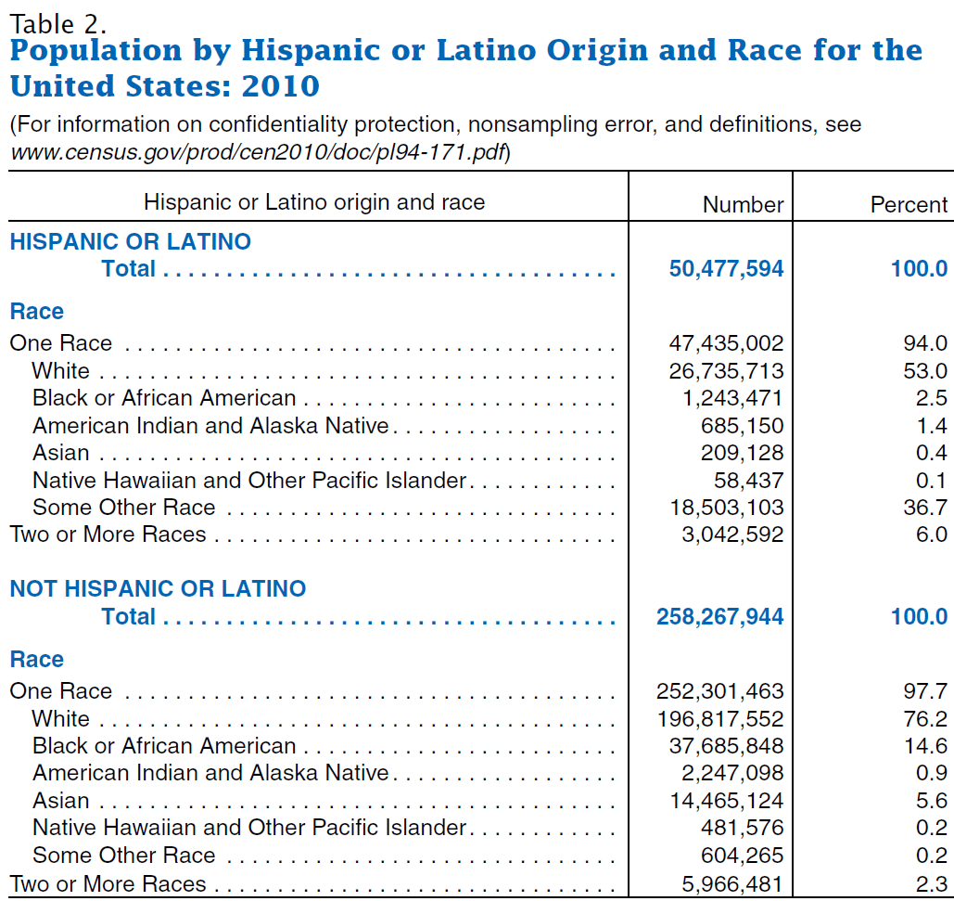
Housing Discrimination
16.3% of total population
83.7% of total population

Slide 10
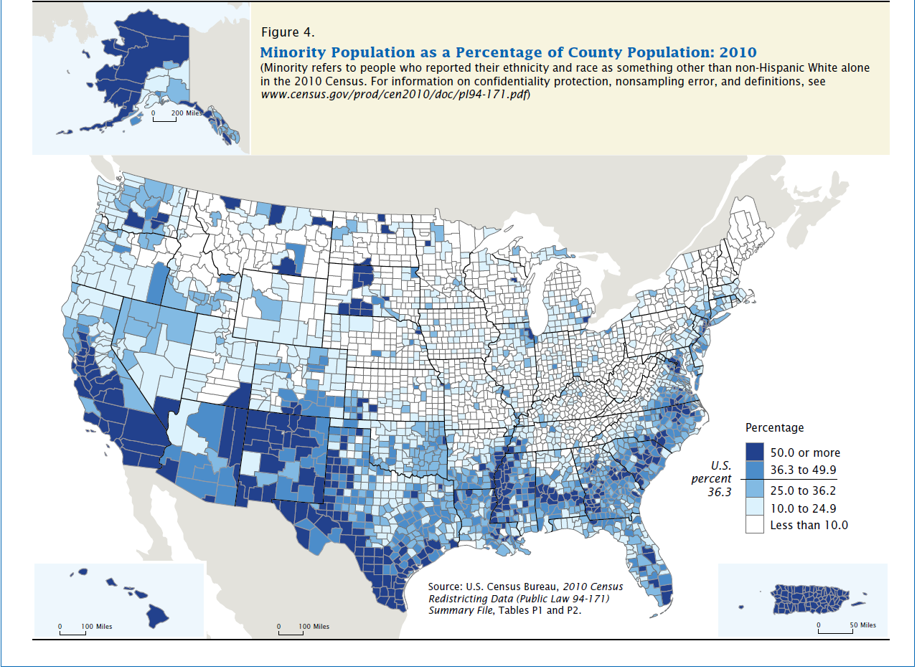
Housing Discrimination

Slide 11
Housing Discrimination
Race and Genetics
    The link between socially defined races and genetics has been widely studied.
      There are 3 billion “base pairs” in the human genome.
      Of these, 99.9% are shared by all people.
      Of the 0.1% that varies across people, 85-90% varies within groups with different geographic origins.
      The other 10-15% of 0.1% varies across groups and can be used to identify the geographic origins of a person’s ancestors (with some error).

Slide 12
Housing Discrimination
Race and Genetics, Continued
    However, the 10-15% of the 0.1% of the human genome that can be linked to geographic origins
      Does not closely correspond to socially defined races,
      And does not appear to have any links to a persons “phenotype,” that is, to a person’s talents and tendencies.
    Moreover, the ability to predict geographic origins breaks down for some groups, including South Asians and African Americans.

Slide 13
Housing Discrimination
Prejudice
  Prejudice is an emotional, rigid attitude toward particular group of people.
  Prejudice is often based on a stereotype, which is a social caricature of a group that is used to make judgments about all the members of a group regardless of their individual traits.
    A stereotype is partly based on the false assumption that all members of a group are like the average member,
    And is often based on inaccurate beliefs about the average.

Slide 14
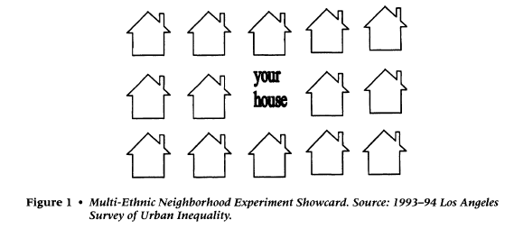
Housing Discrimination
Evidence About Prejudice
  Survey “showcard” (from Charles, Social Problems, 2000, as are next two slides):

Slide 15
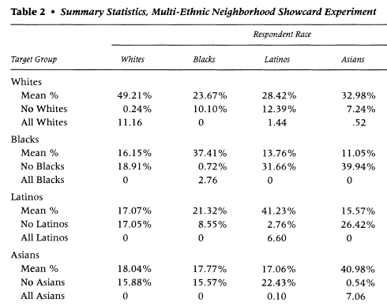
Housing Discrimination
Evidence About Prejudice, 2
  “Ideal” neighborhoods by group

Slide 16
Housing Discrimination
Evidence About Prejudice, 3
  Krysan, Couper, Farley, and Forman (American J of Sociology, 2009)
  Krysan et al. use video portraits of various neighborhoods plus random assignment of the race of the actors posing as residents.
  They find that whites and blacks care about the race of their neighbors, not just about perceived neighborhood quality.
    “[F]or whites living in metropolitan Chicago and Detroit, neighborhoods portrayed as having only black residents were viewed less favorably than identical neighborhoods with either only white residents or a mix of white and black residents.”
    “When neighborhoods had identical observable social class characteristics, it was the all-white neighborhood that was evaluated as least desirable by African-Americans. The evaluations for the racially mixed and the all-black neighborhoods were generally indistinguishable from each other.”

Slide 17
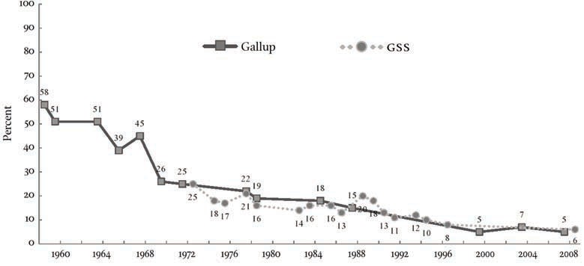
Housing Discrimination
Evidence About Prejudice, 4
  From L. Bobo, Daedalus, 2011
Percent of Whites Who Said They Would Not Vote for a Black Presidential Candidate, 1958 to 2008

Slide 18
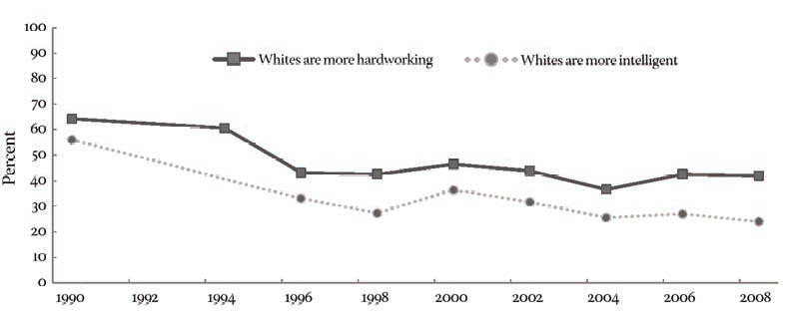
Housing Discrimination
Evidence About Prejudice, 5
  From L. Bobo, Daedalus, 2011
Percent of Respondents Who Said Whites Are More Hardworking or More Intelligent
than Blacks, 1990 to 2008

Slide 19
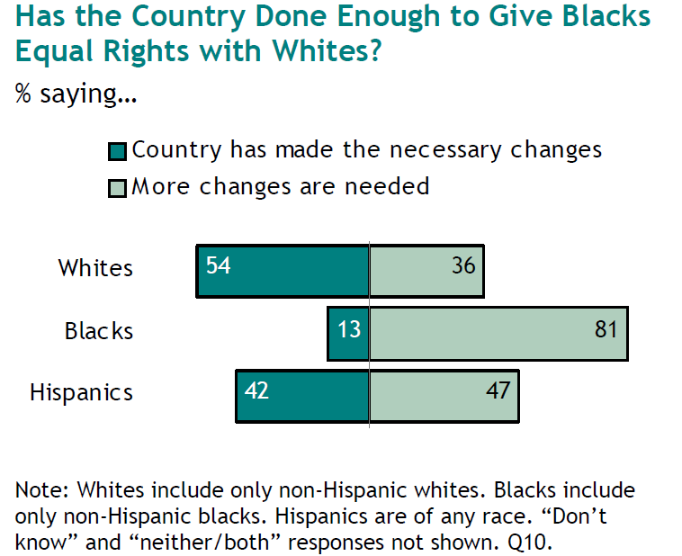
Housing Discrimination
Evidence About Prejudice, 6
  Pew national survey, 2011

Slide 20
Housing Discrimination
Discrimination
  Unfavorable treatment of the people in a group solely because of their membership in that group.
  Unfavorable treatment of the members in a group that is not justified based on the circumstances.
    Refusing to hire a poorly qualified black person is not discrimination.
    Refusing to hire a qualified black person (while hiring equally qualified white people) is discrimination.

Slide 21
Housing Discrimination
Segregation
  Segregation is a synonym for sorting, that is, it is the physical separation of different groups.
  Racial residential segregation refers to the extent to which two different racial groups live in different neighborhoods.
  Racial occupational segregation refers to the extent to which two racial groups work in different occupations.

Slide 22
Housing Discrimination
Integration
  Integration is the inverse of segregation.
  An integrated neighborhood is one in which different racial or ethnic groups live together.
  Stable racial integration refers to a situation in which different racial groups live together in a given neighborhood for an extended period of time.
  Stable racial integration with equals shares of blacks and whites tends not to arise in this country without active involvement of neighborhood groups or local government.

Slide 23
Housing Discrimination
Topics in Housing Discrimination
  A Hint: Race/Ethnicity and Homeownership
  Measuring housing discrimination with audits
  Theories about the causes of housing discrimination
  Evidence about the causes of housing discrimination

Slide 24
Housing Discrimination
Homeownership
  Differences in homeownership by group do not prove discrimination.
  But discrimination and disadvantages (including lower wealth and income) from past discrimination are the most likely explanations.
  Moreover, these gaps have not changed much in decades, suggesting, but not proving, that discrimination (and its legacy) are still important problems.

Slide 25
Annual Homeownership Rate, 1983-2019

Slide 26
Housing Discrimination
Questions
  Define ethnicity, race, prejudice, discrimination, segregation, and integration.
  How large is the black/white gap in homeownership, and what are its possible causes?

Slide 27
Housing Discrimination
Class Outline
  1. Definition of Key Concepts:
  2. Housing Audits: Methodology
  3. Housing Audits: Results
  4. Fair Housing Legislation

Slide 28
Housing Discrimination
Studying Discrimination
  Recent studies of discrimination have focused on methods that try to isolate the impact of discrimination from the impact of other factors.
  The main technique is called a housing “audit.”
    Most audits allow a researcher to control for factors other than discrimination.
    Some recent “correspondence” audits use a random-assignment design.
  Audits can be used both to measure discrimination in to investigate its causes.

Slide 29
Housing Discrimination
Housing Audits (Also Called “Tests”)
  Matched pair design with two teammates who
    Are equally qualified for housing,
    Have the same characteristics, training, timing, and request,
    Differ on race or ethnicity.
  Audit teammates successively inquire about an advertised housing unit randomly selected from the newspaper.
  The order of their visits is randomized.

Slide 30
Housing Discrimination
Housing Audits
  Used to Measure How Much Discrimination Exists.
    Discrimination exists if the minority auditors are systematically given less favorable treatment than their (equally qualified) teammates.
  Used to Test Hypotheses About the Causes of Discrimination.
    Audit studies can observe the circumstances under which discrimination occurs—and hence test theories that predict discrimination under some circumstances.

Slide 31
Housing Discrimination
Strengths of Housing Audits
  Audits yield a powerful narrative, which makes cases of discrimination plausible in both research and court settings.
  Audits can control for virtually everything that a housing agent should consider in making decisions about a potential customer.
  Audits provide direct measures of discrimination, unlike other approaches, which look for signs of discrimination in housing prices, segregation patterns, and so on.

Slide 32
Housing Discrimination
Weaknesses of Housing Audits
  Audits are expensive and hard to manage.
  Audits only observe the marketing phase of a transaction.
  Standard audits do not involve random assignment, so the possibility that the results reflect unobserved differences between teammates cannot be ruled out (although it can be minimized by good management).
  For important practical reasons, standard housing audits are not “double blind,” so the possibility that auditors try to influence the results cannot be ruled out (although it can be minimized by good management).

Slide 33
Housing Discrimination
Audit Statistics
  A key feature of audits is that teammates share unobservable factors, such as the number of houses available to the agent or the agent’s mood.
  This means there is a shared error component that is not correlated with an auditor’s group membership.
  So regressing treatment on the auditor’s group does not yield biased coefficients, but it does yield biased standard errors (Yinger, AER, December 1986).
  In this case, standard errors are biased upwards!

Slide 34
Housing Discrimination
Audit Statistics, 2
  For simple yes or no treatments (e.g., the advertised unit was shown), a paired difference of means test can be used.
  Simple regressions, say for number of units shown, can use random effects.
  But multivariate analysis, based on interactions with an auditor’s group, is needed to test hypotheses about the causes of discrimination.

Slide 35
Housing Discrimination
Audit Statistics, 3
  Examples of statistical techniques that recognize the non-continuous dependent variables and the error components:
    Fixed-effects logit (Ondrich, Stricker, and Yinger, SEJ, 1998; Zhao, Ondrich, and Yinger, JUE, 2006).
    Poisson regression (Page, JUE, 1995; Zhao, JUE, 2005).
    Multinomial logit with random error component (Ondrich, Ross, and Yinger, ReStat, 2003).

Slide 36
Housing Discrimination
Correspondence Audits
  Many correspondence audit studies (in several countries) look into rental housing discrimination using apartment ads on a selected web site.
  Race or ethnicity is signaled by the name attached to each inquiry; some clever methods are used to identify the ethnicity associated with a given name, but no face-to-face contact is involved.
  Discrimination is usually measured by ethnic differences in the number of return calls or e-mails from the landlord.

Slide 37
Housing Discrimination
Correspondence Audits, 2
  Correspondence audits have two important advantages:
    They use random assignment and are therefore not subject to bias from unobserved auditor traits.
    They can be conducted with computer programs over the internet and are therefore much cheaper than in-person audits.
  Correspondence audits also have two important disadvantages:
    They can only observe the initial response of a landlord to an inquiry, and therefore cannot measure discrimination in all the types of behavior observed with in-person audits.
    They may underestimate the discrimination that would occur in an actual transaction if landlords do not associate the selected names with the expected ethnicities.

Slide 38
Housing Discrimination
Correspondence Audits, 3
  Some correspondence audits do not use a “paired” design.
  These studies randomly pick the group membership of the single auditor for each advertisement.
  This approach minimizes the risk of detection—but loses the narrative power of a matched-pair design and requires a much larger sample of advertised units to achieve the same statistical precision.

Slide 39
Housing Discrimination
Questions
  What is a fair housing audit and how can it be used to measure the extent of discrimination?
  What is a correspondence audit?
  What are the strengths and weaknesses of correspondence audits compared to in-person audits?

Slide 40
Housing Discrimination
Class Outline
  1. Definition of Key Concepts:
  2. Housing Audits: Methodology
  3. Housing Audits: Results
  4. Fair Housing Legislation

Slide 41
Housing Discrimination
The Housing Discrimination Studies
  National in-person audit studies were conducted in 1977, 1989, 2000, and 2012.
  They were funded by HUD and
  Designed to give nationally representative estimates of discrimination.
  All 4 studies involved black-white audits and Hispanic-white audits in both the sales and rental markets (with about 1,000 audits in each category).
  HDS 2000 and 2012 also looked at discrimination against Asian-Americans and Native-Americans.

Slide 42
Housing Discrimination
The Housing Discrimination Studies, 2
  The 1989 HDS (for which Yinger was the research director) is discussed in Yinger, Closed Doors, Opportunities Lost, 1995).
  Steve Ross (an Economics Ph.D. from Syracuse who teaches at the University of Connecticut) was the research director for the 2000 HDS. See Ross and Turner (Social Problems, May 2005)
  Oh and Yinger recently published a review of audit methods and evidence (Cityscape: A Journal of Policy Development and Research, Issue 3, 2015), from which the following evidence is taken.

Slide 43
Housing Discrimination
The Housing Discrimination Studies, 3
  The HDS studies all find statistically significant discrimination against both blacks and Hispanics in some types of housing agent behavior.
  In most cases, the incidence of discrimination is fairly low, that is, below 10 percent.
  For most (but not all) types of behavior, the incidence of discrimination has declined over time.

Slide 44
Housing Discrimination
Discrimination in National Rental Audits
Minority | Study | Advertised unit available |  | Inspected more units
 |  | % white favored | Net measure | % white favored | Net measure
Black | HMPS1977 | 30% | 19%* | 27% | 6%*
 | HDS1989 | 19% | 7%* | 34% | 19%*
 | HDS2000 | 12% | 4%* | 23% | 7%*
 | HDS2012 | 5% | 0% | 18% | 3%*
Hispanic | HDS1989 | 17% | 9%* | 27% | 10%*
 | HDS2000 | 12% | 7%* | 21% | 6%*
 | HDS2012 | 5% | 3%* | 21% | 8%*
Asian | HDS2000 | 7% | 0% | 13% | -5%
 | HDS2012 | 5% | 2% | 22% | 6%*

Slide 45
Housing Discrimination
Discrimination in National Sales Audits
Minority | Study | Advertised unit available |  | Inspected more units |  | Help with financing offered
 |  | % white favored | Net measure | % white favored | Net measure | % white favored | Net measure
Black | HMPS1977 | 21% | 10%* | 38% | 10%* | - | -
 | HDS1989 | 10% | 4%* | 24% | 12%* | 21% | 5%*
 | HDS2000 | 16% | 1% | 43% | 12%* | 19% | 1%
 | HDS2012 | 13% | -1% | 37% | 9%* | 19% | 2%
Hispanic | HDS1989 | 9% | 4%* | 27% | 13%* | 19% | -1%
 | HDS2000 | 12% | -3% | 36% | -2% | 22% | 12%*
 | HDS2012 | 13% | 0% | 34% | 1% | 16% | 1%
Asian | HDS2000 | 16% | 1% | 46% | 14% | 29% | 15%
 | HDS2012 | 15% | 3% | 38% | 10%* | 19% | 8%*

Slide 46
Housing Discrimination
Steering
  Steering arises when the people in different groups are shown houses in different locations, such as locations with different ethnic composition.
  An excellent new study uses a supplemented version of the latest HDS data to show that black customers are also steered toward locations with relatively high crime rates or environmental problems.
    See Peter Christensen and Christopher Timmins, 2018, “Sorting or Steering: Experimental Evidence on the Economic Effects of Housing Discrimination,” NBER Working paper 24826, July.

Slide 47
Housing Discrimination
Steering in National Sales Audits
Minority | Study | Houses recommended in whiter tracts |  | Houses inspected in whiter tracts
 |  | % white favored | Net measure | % white favored | Net measure
Black | HDS1989 | 6% | -6% | 4% | -2%
 | HDS2000 | 16% | 4%* | 11% | 4%*
 | HDS2012 | 25% | 8%* | 21% | 5%*
Hispanic |  | % non-Hisp. white favored | Net measure | % non-Hisp. white favored | Net measure
 | HDS1989 | 12% | 4% | 7% | 2%
 | HDS2000 | 17% | 2% | 15% | 5%*
 | HDS2012 | 23% | 2% | 26% | 5%

Slide 48
Housing Discrimination
Newsday Audits on Long Island, 2019
  Newsday is a newspaper on Long Island, New York.
  It conducted dozens of careful audits (=tests) under the supervision of academic experts.
  This investigation found that black testers encounter discrimination 49% of the time.
  Hispanic testers encounter discrimination 39% of the time.
  Asian encounter discrimination 19% of the time.
  See: projects.newsday.com/long-island/real-estate-agents-investigation.

Slide 49
Housing Discrimination
Newsday Audits on Long Island, 2019, p. 2
  In 11 cases, agents directed black testers to different neighborhoods than white testers.
  In 5 cases, agents imposed extra conditions on black testers that amounted to the denial of equal service.
  In 3 cases, agents spoke about steering to the white tester but not the black tester or volunteered information about the ethnic makeup of communities only to white testers.
  Agents provided white testers an average of 50% more listings than they gave to blacks–39 compared with 26.

Slide 50
Housing Discrimination
Correspondence Audits
  Several correspondence audits have been conducted in the U.S., and many have been conducted in Europe.
  The studies in the U.S. tend to find statistically significant, but fairly small levels of discrimination against blacks and Hispanics (as identified by their names) in responses to e-mail queries.
  The studies in Europe tend to find statistically significant and varying levels of discrimination against disadvantaged minority groups, which have different identities, of course, in different countries.

Slide 51
Housing Discrimination
Correspondence Audit Studies in the United States
Study | Location | Main Finding
Carpusor & Loges (2006) | Los Angeles, 2003 | Discrimination against Blacks and Arabs
Ewens, Tomlin, & Wang (2014) | 34 U.S. cities, 2000s | Discrimination against Blacks
Hanson & Hawley (2011) | 10 U.S. cities, 2009 | Discrimination against Blacks, unless higher social class
Hanson, Hawley, & Taylor (2011) | 10 U.S. cities, 2009 | Discrimination against Blacks
Massey & Lundy (2001) | Philadelphia, 1999 | Discrimination against Blacks; higher for lower class
Purnell, Idsardi, & Baugh (1999) | San Francisco area, 1997 | Discrimination against Blacks in White areas only; discrimination against Mexican Americans

Slide 52
Housing Discrimination
Correspondence Audit Studies in Europe
Study | Country | Main Finding
Ahmed & Hammarstedt (2008) | Sweden, 2007 | Discrimination against Arabic/Muslim males
Ahmed, Andersson, & Hammarstedt (2010) | Sweden, 2008 | Discrimination against Arabic/Muslim males
Baldini, & Federici (2011) | Italy, 2010 | Discrimination against Arab/Muslims and East Europeans; higher against males than females
Bosch, Carnero, & Farre (2010) | Spain, 2008 & 2009 | Discrimination against Moroccan immigrants; higher against males than females
Carlsson & Ericksson (2014) | UK, 2011 & 2012 | Discrimination against ethnic minorities

Slide 53
Housing Discrimination
Hanson & Hawley (JUE, Sept./Nov. 2011)
  This study is based on ads posted on Craigslist. Hanson has a Syracuse Ph.D. in economics.
  They conducted 4,725 paired audits in 10 large cities.
  Overall, the probability of a response for an applicant with a “white” name was 4.54% higher than for an applicant with a “black” name.
  This difference ranged from over 8% in Boston and Los Angeles to less than 1% in Atlanta and Dallas.

Slide 54
Housing Discrimination
Another Approach
  Two recent studies (both on the syllabus) look at the impact of race on house sales prices.
  They both find small, significant levels of price discrimination against blacks.
    P. Bayer, M. Casey, F. Ferreira, and R. McMillan (JUE, November 2017).
    K. Ihlanfeldt and T. Mayock (JUE, September 2009).

Slide 55
Housing Discrimination
Hypotheses about the Causes of Housing Discrimination
  Agent Prejudice
    Agents may act out of their own prejudice.
  White Customer Prejudice
    Agents may act to protect an existing white customer base.
  Statistical Discrimination
    Agents may make a greater effort if transaction is thought to be more likely.
    This could reflect perceived preferences of their customers, agent stereotypes, or perceived constraints, such as discrimination by lenders.

Slide 56
Housing Discrimination
Findings on the Causes of Discrimination
  To be presented in the next class.

Slide 57
Housing Discrimination
Class Outline
  1. Definition of Key Concepts:
  2. Housing Audits: Methodology
  3. Housing Audits: Results
  4. Fair Housing Legislation

Slide 58
Housing Discrimination
Fair Housing Legislation
  The Civil Rights Act of 1866
  The Civil Rights Act of 1968
  The Fair Housing Amendments Act of 1988
  Legislation creating FHAP and FHIP in the 1980s

Slide 59
Housing Discrimination
The Civil Rights Act of 1866
  This act was resurrected by a U.S. Supreme Court decision in 1968.
  It prohibits disparate-treatment discrimination on the basis of race in all forms of contracting.
  It has been widely used in fair housing litigation by local fair housing organizations.

Slide 60
Housing Discrimination
The Civil Rights Act of 1968
  This important law was passed right after the assassination of Martin Luther King, Jr.
  It has strong language prohibiting discrimination in housing of many forms, including redlining and disparate-impact.
  It had very weak enforcement provisions and excludes sales by owner and rentals in owner-occupied 1-4 family buildings.
  It gives private fair housing groups standing to sue.

Slide 61
Housing Discrimination
The Fair Housing Amendments Act of 1988
  This law added much stronger enforcement provisions, including large fines.
  It set up administrative law judge system (although either party can request federal court).
  It gave HUD extensive investigative powers, which have been little-used so far.

Slide 62
Housing Discrimination
FHAP and FHIP
  FHAP is the Fair Housing Assistance Program.
    It provides financial assistance to state and local government fair housing offices,
    Which are required to process cases first (if their law is “equivalent” to federal law)
  FHIP is the Fair Housing Initiatives Program.
    It supports private fair housing groups,
    Such as the Fair Housing Council of Central New York,
    Which are the backbone of the enforcement system.

Slide 63
Housing Discrimination
Audits as an Enforcement Tool
  Audits were developed by private fair housing groups (with the help of scholars) to aid their enforcement efforts.
    See the appendix on the history of audits in Oh and Yinger.
  HUD, Justice, and private fair housing groups have made extensive use of audits as an enforcement tool.
  Audit evidence of discrimination has proven to be very effective in court proceedings.

