Slide 1
ECN741: Urban Economics
Homeownership
Gaps Between Ethnic Groups
Professor John Yinger, The Maxwell School, Syracuse University, 2020

Slide 2
Homeownership Gaps
    Class Outline
    1. Homeownership Gaps
    2. Explaining Homeownership Gaps
    3. Interpretation of Existing Literature

Slide 3
Homeownership Gaps
    Class Outline
    1. Homeownership Gaps
    2. Explaining Homeownership Gaps
    3. Interpretation of Existing Literature

Slide 4
Homeownership Gaps
    Homeownership Gaps
    The U.S. is a nation of homeowners; about two-thirds of households own their own home.
    The U.S. also has had long-standing and surprisingly consistent homeownership gaps between blacks and whites and between Hispanics and non-Hispanic-whites.
    In both cases, the homeownership rate has been about 25 percentage points lower for the minority group since the early 1980s.
    The question is: Why?

Slide 5
Annual Homeownership Rate, 1983-209

Slide 6
Homeownership Gaps
    Class Outline
    1. Homeownership Gaps
    2. Explaining Homeownership Gaps
    3. Interpretation of Existing Literature

Slide 7
Homeownership Gaps
    Gaps in Income and Wealth
    Homeownership obviously depends on income and wealth.
    The black-white gaps in income and (especially) wealth are large,
    Thanks to centuries of private and public discrimination.

Slide 8
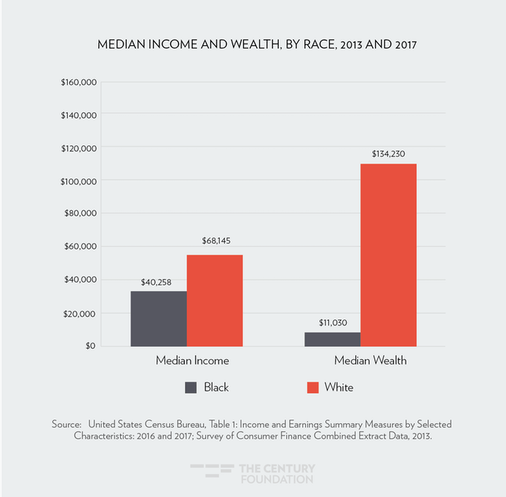
Homeownership Gaps

Slide 9
Homeownership Gaps
    Gabriel and Rosenthal, JUE, January 2005
    Homeownership depends on income, education (linked to permanent income), wealth, family size, age, etc.
    A link between homeownership and ethnicity after controlling for all these things might be a sign of current discrimination.
    But it could also reflect some omitted homeownership determinant, such as being credit-constrained.

Slide 10
Homeownership Gaps
    Comment on Past Discrimination
    Although the focus in G/R and the rest of this literature is on current discrimination, the studies in this literature also shed light on past discrimination.
    Past discrimination is the cause of racial and ethnic gaps in the control variables, such as income, wealth, and education.
    So estimating the impact of racial or ethnic differences in these variables on the homeownership gap is an estimate of the impact of past discrimination on current differences in homeownership.

Slide 11
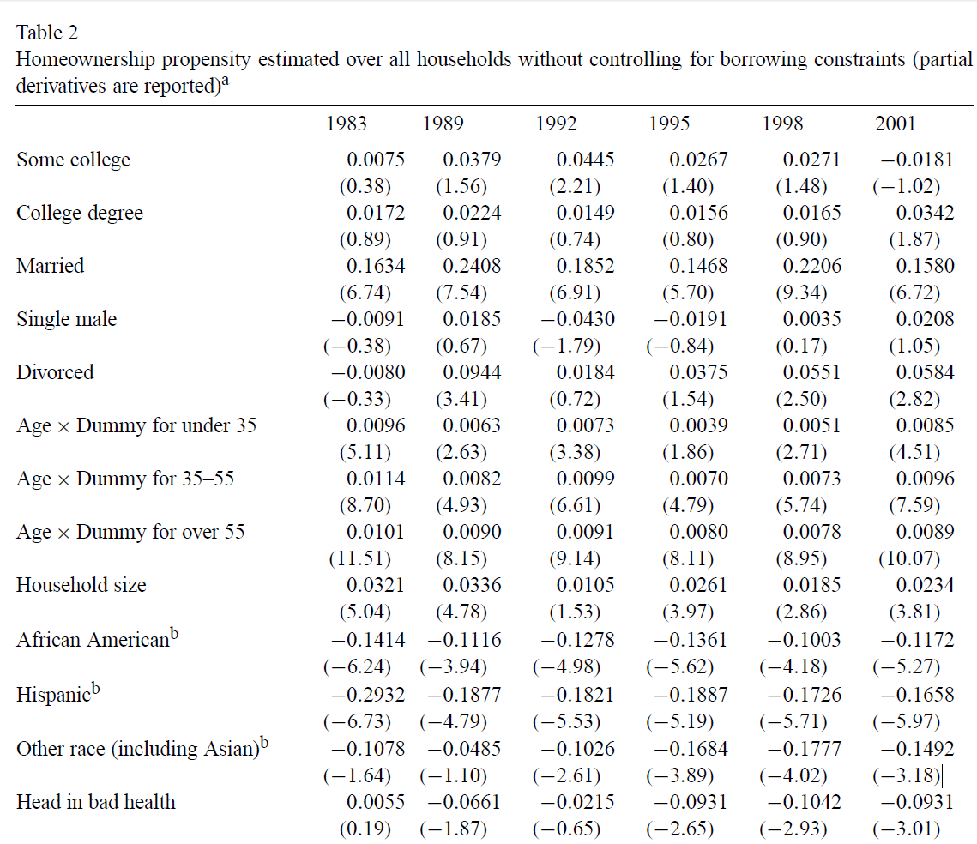
Homeownership Gaps

Slide 12
Homeownership Gaps
    Gabriel and Rosenthal, 2
Gabriel and Rosenthal use the Survey of Consumer Finances, which provides some information on credit constraints:
“[I]ndividuals are coded as not credit constrained if they report that they had not had any loan request turned down or partially rejected, and also that they had not been discouraged from applying for credit in the previous years. In the discussion to follow, these individuals are characterized as not constrained. All other households are characterized as possibly constrained.”

Slide 13
Homeownership Gaps
    Gabriel and Rosenthal, 3
The Gabriel/Rosenthal model starts with two latent variables, which reflect the likelihood that(1) the family is not credit constrained and (2) that the family prefers to own (if barriers were not an issue):
I_{NotCC} = xc + μ₁
I_{POwn} = xb + μ₂
where x is a set of household traits and other controls. The error terms are drawn from a bivariate normal distribution.
Given their data, they assume that a household is not credit constrained if I_{NotCC} > 0, but might be constrained otherwise.

Slide 14
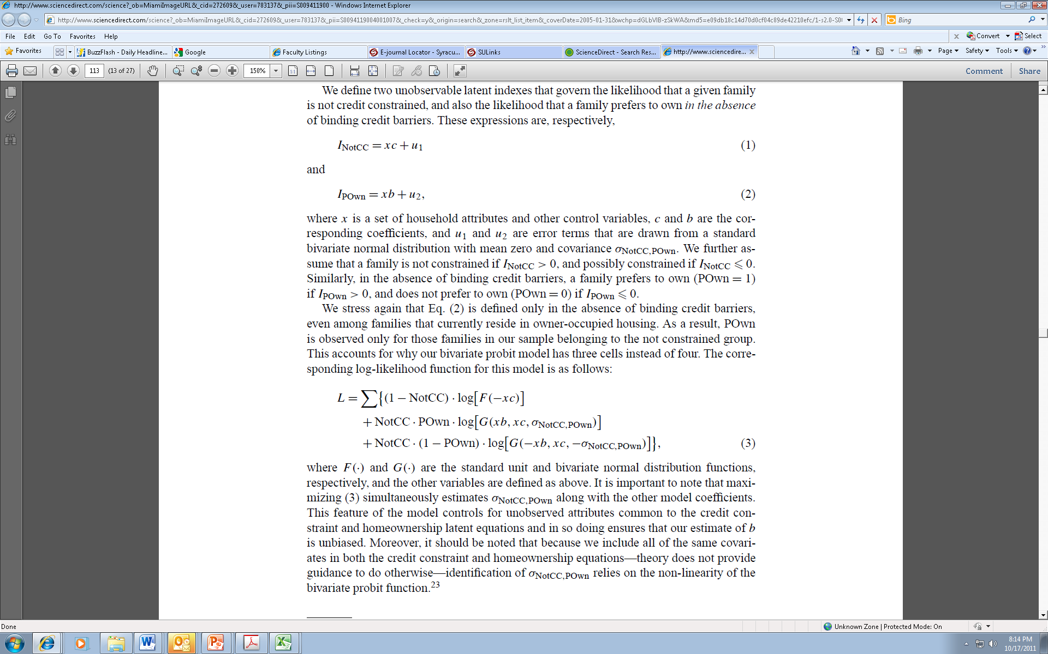
Homeownership Gaps
    Gabriel and Rosenthal, 4
This set-up leads to the following log-likelihood function:
where F(.) and G(.) are the standard unit and bivariate normal distributions and the σ’s indicate covariances.
They then estimate c, b, and the σ’s; that is, they find the values of these parameters that maximize L.
This set-up allows them to estimate the probability for homeownership among households who are not credit constrained. In other words, they can see if credit constraints explain a large share of the black-white homeownership gap.

Slide 15
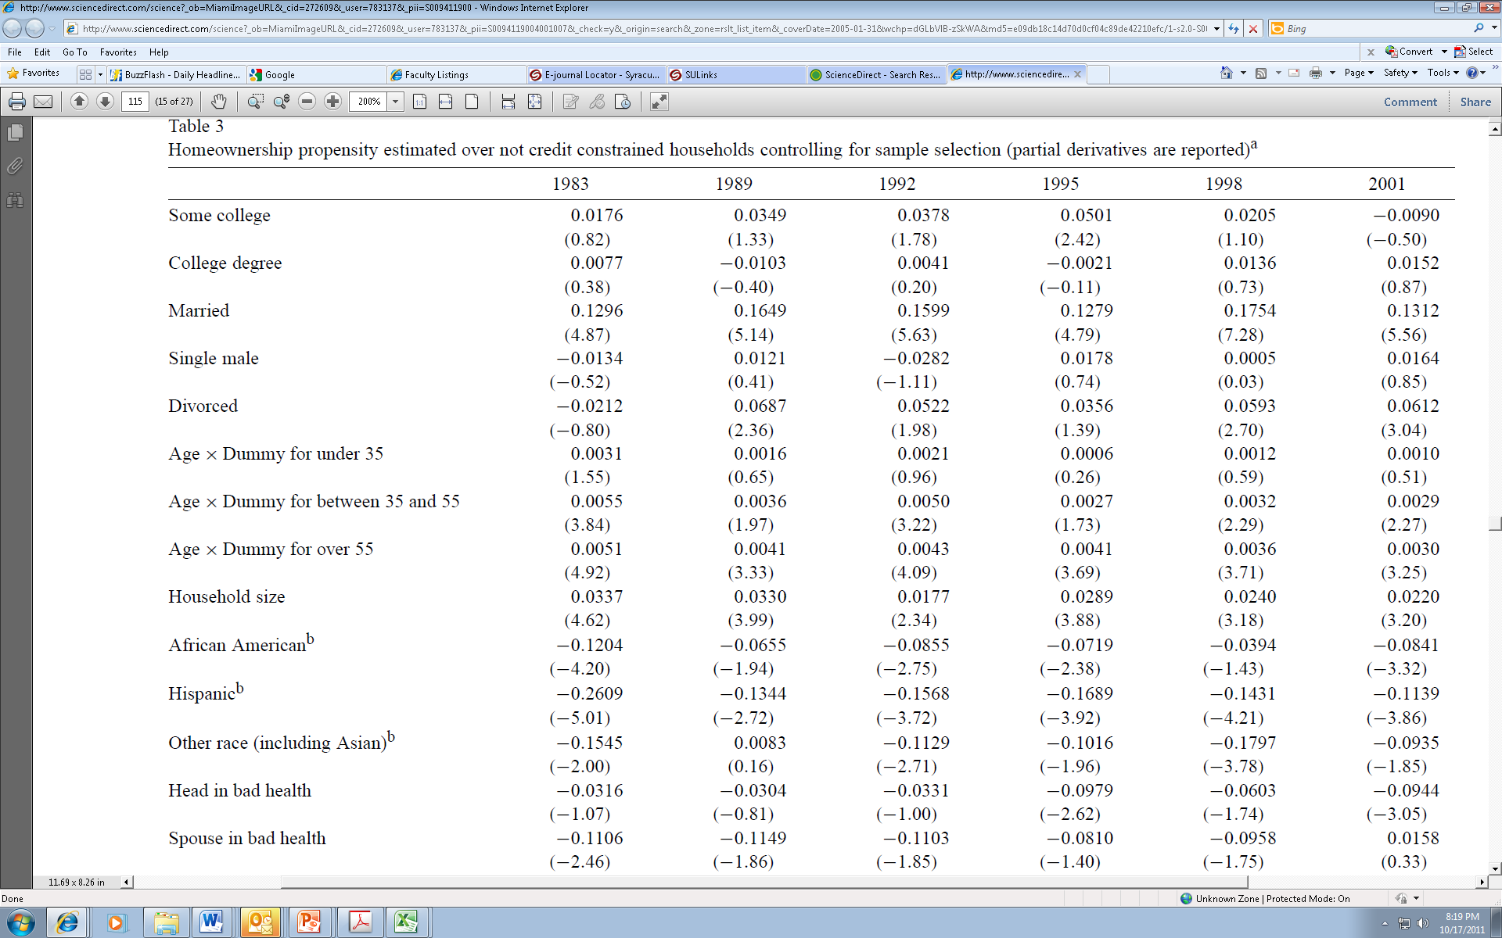
Homeownership Gaps

Slide 16
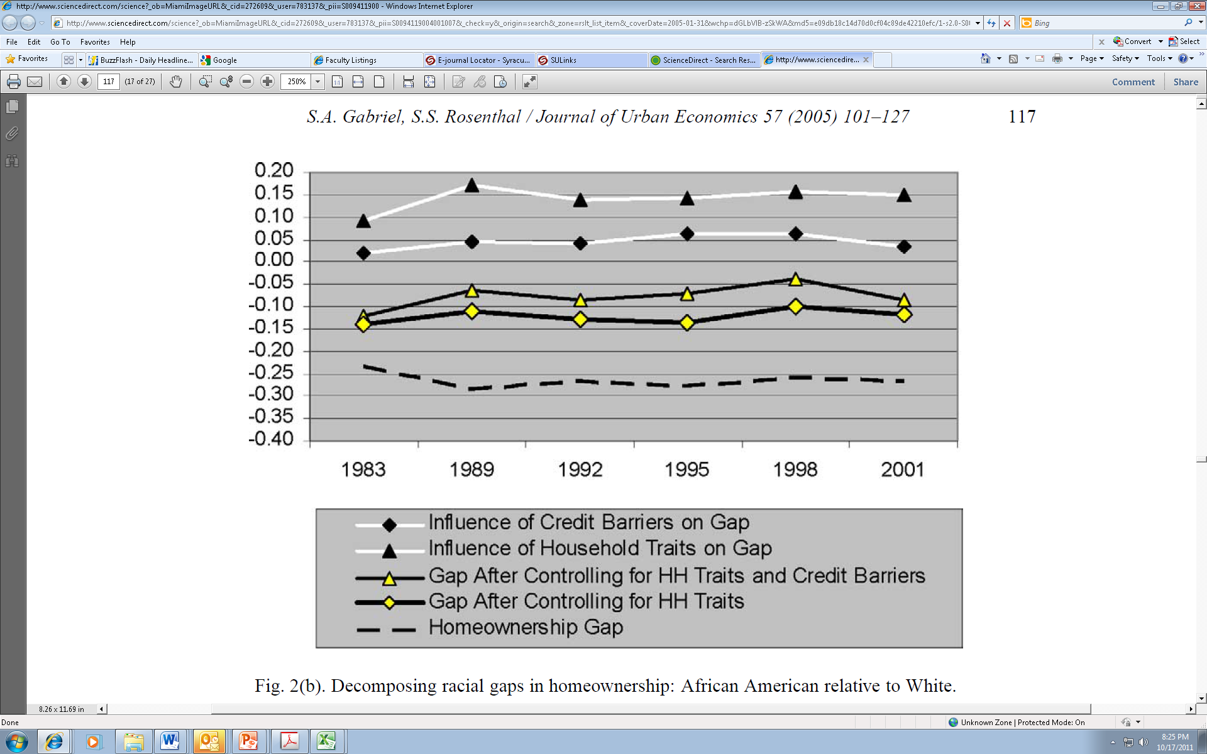
Homeownership Gaps

Slide 17
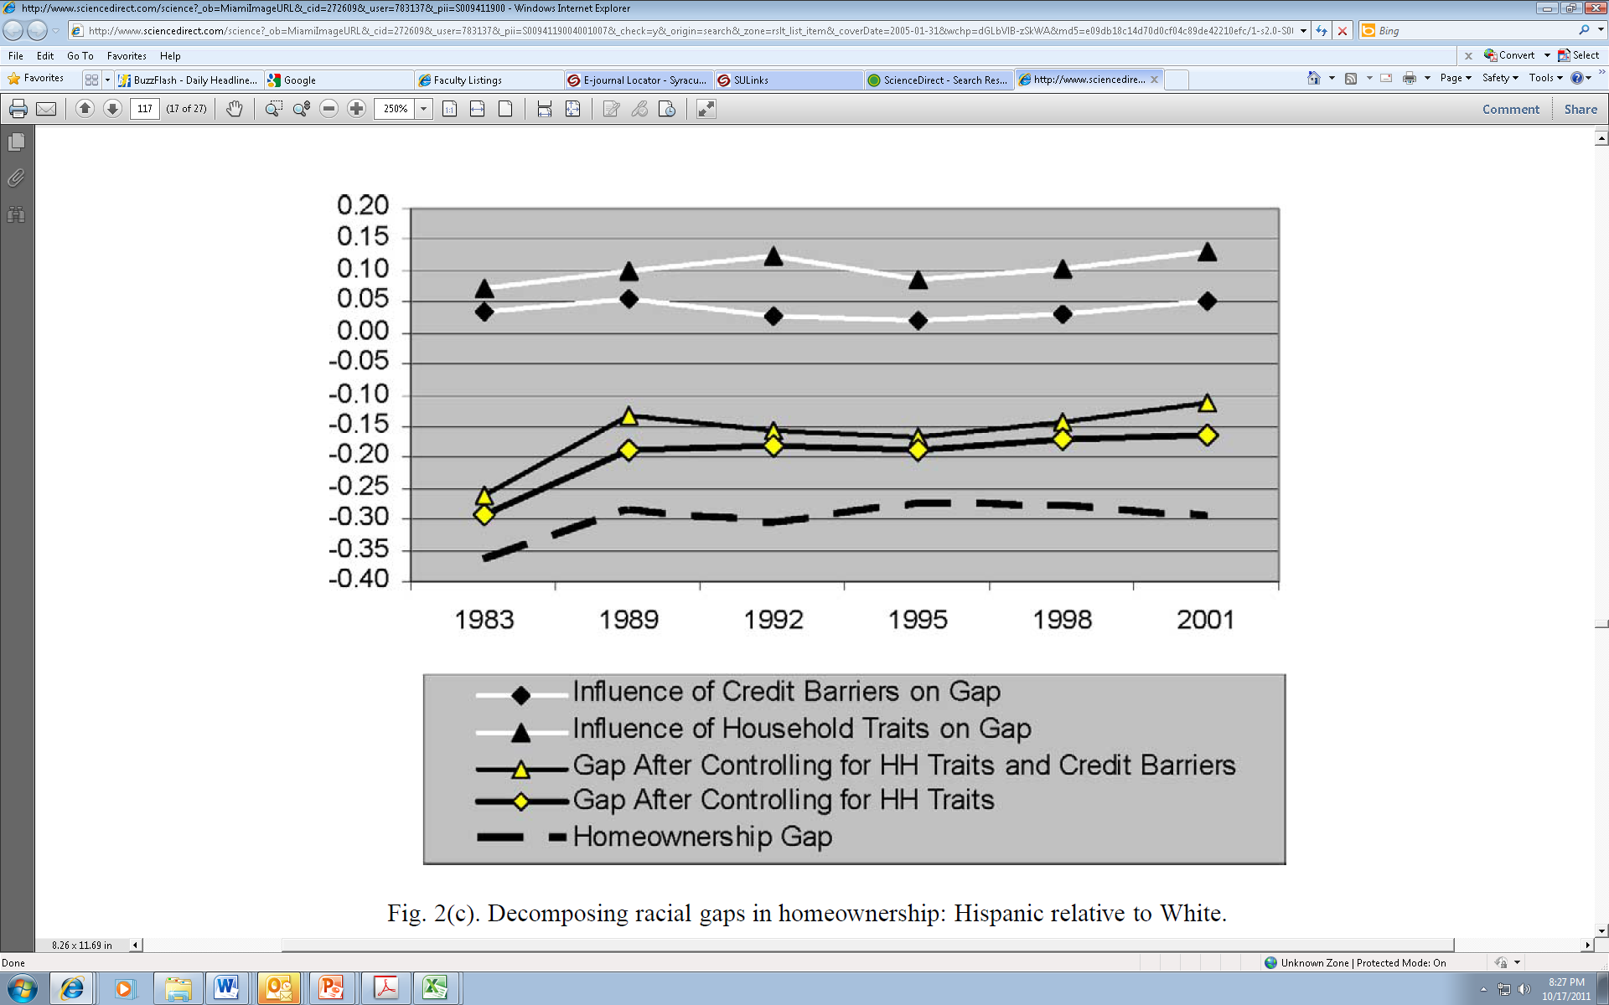
Homeownership Gaps

Slide 18
Homeownership Gaps
    Interpretation
    As Gabriel and Rosenthal emphasize, the ethnic gaps that remain after controls (about 10% for blacks and Hispanics in 2001) are caused by discrimination and other unobservable factors.
    They are consistent with discrimination, but not proof of discrimination.
    Audit studies provide much more direct and compelling evidence about discrimination.

Slide 19
Homeownership Gaps
    Deng, Ross, and Wachter, RSUE, September 2003
“Three tenure choice models are estimated:
  Model I, a basic model that controls for household characteristics and is comparable to traditional models.
  Model II, which includes additional controls for the characteristics of each household’s residential location, such as percent of households in poverty and percent African–American, and assumes that decisions on residential location are exogenous to the tenure choice.
  Model III, which considers the influence of residential location options on homeownership endogenously based on a nested multinomial logit specification.”

Slide 20
Homeownership Gaps
    The D/R/W Nested Multinomial Logit Model
Own
Rent
Neigh 1 Neigh 2 … Neigh n
Neigh 1 Neigh 2 … Neigh n

Slide 21
Homeownership Gaps
    Neighborhood Variables in D/R/W
The models “include standard location attributes, such as the racial or income composition of a location or whether the location is located in the central city.”
The models also include two variables “constructed using the estimates from standard house value and rental price models that control for the physical characteristics of the housing unit and location dummy variables. The estimated coefficients on the location dummy variables are price fixed effects. ..[which are] a proxy for the amenity level associated with that location.”
The ratio of the rental and owner-occupied price fixed effects are used as a proxy for equity risk.

Slide 22
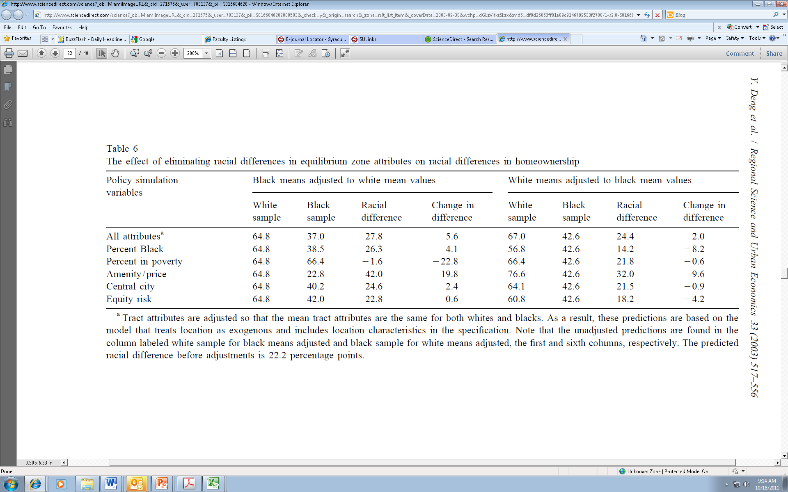
Homeownership Gaps
    D/R/W Results
In a simulation in which all neighborhood attributes are the same for blacks and whites, the homeownership gap between blacks and whites goes up.

Slide 23
Homeownership Gaps
    D/R/W Results, 2
The main results in these simulations involve poverty and amenity prices.
“A decrease in the neighborhood poverty faced by African–Americans to the level faced by white households on average lowers predicted racial differences in homeownership” (controlling for amenities and racial composition).
“When African–Americans face the higher prices for housing that are associated with better neighborhood amenities, racial differences in homeownership rates increase.”

Slide 24
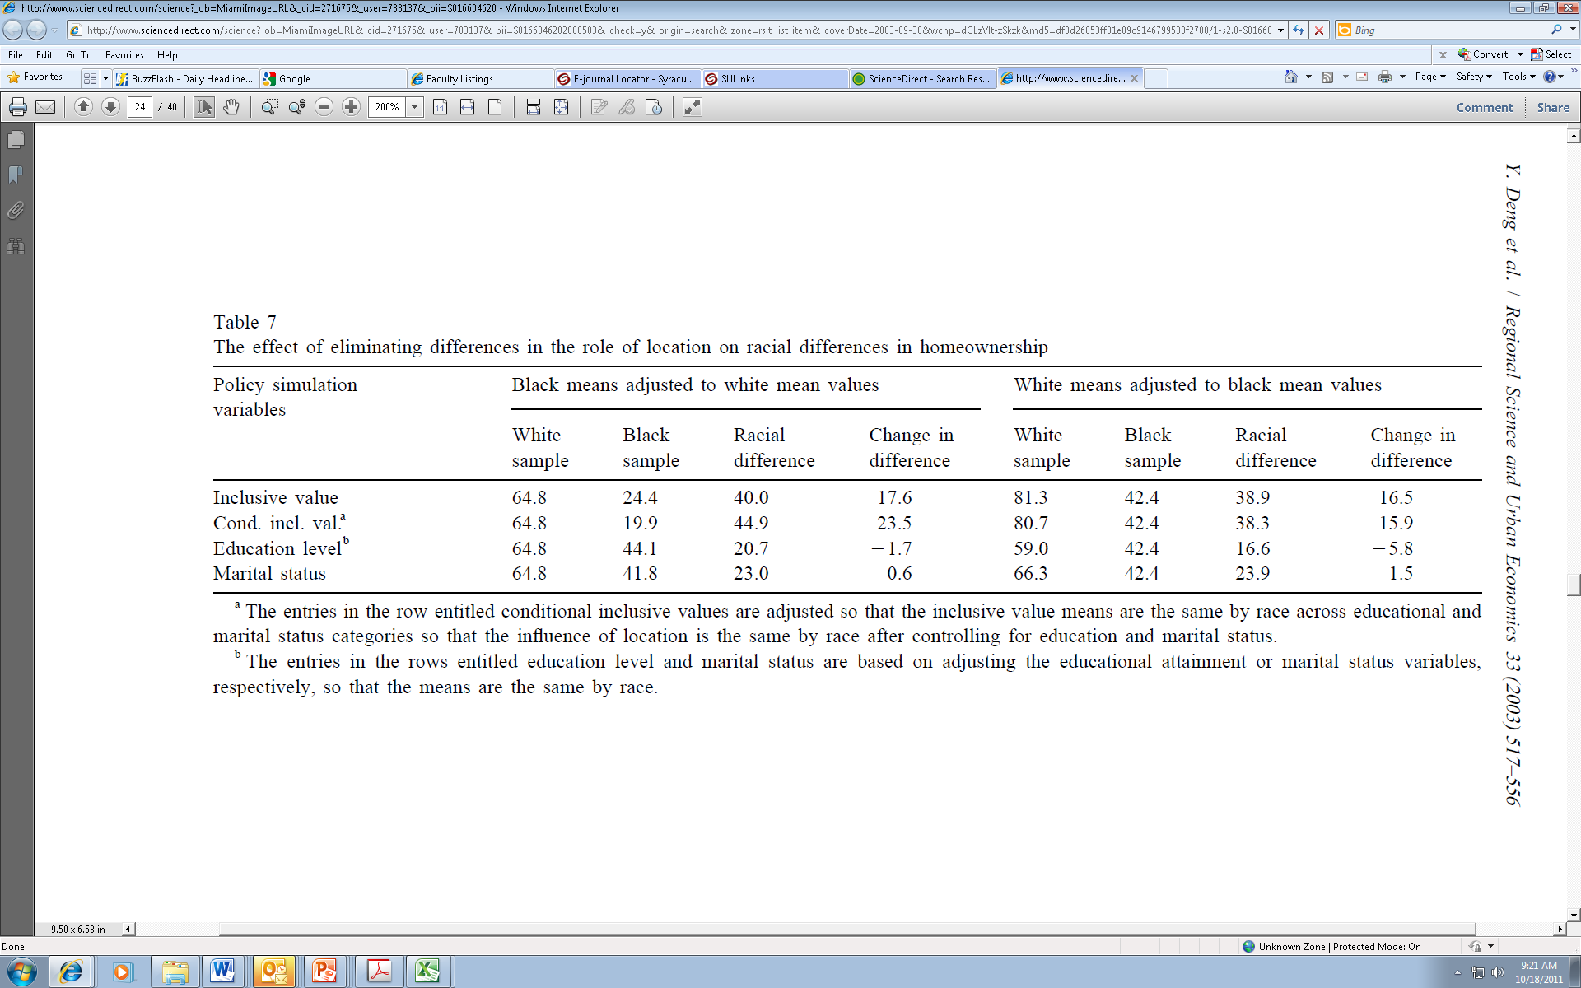
Homeownership Gaps
    D/R/W Results, 3
In a simulation in which a summary measure of neighborhood quality is the same for blacks and whites, the homeownership gap between blacks and whites goes up.

Slide 25
Homeownership Gaps
    D/R/W Results, 4
Note that an “inclusive value” is the expected utility from the neighborhood choice given the tenure choice.
So the exercise in the first row of their Table 7 holds neighborhood satisfaction constant across groups.
The other rows refer to a more complex, but similar, simulation.

Slide 26
Homeownership Gaps
    D/W/R Conclusions
“The influence of location choice appears to mitigate racial differences in homeownership rates, rather than contribute to these differences…. [T]he elimination of these differences [in neighborhood quality] increases racial differences in homeownership rates by 17 percentage points. An important implication of these findings is that previous studies may have overstated the importance of endowment differences. This paper finds that credit constraints can explain 77 percent of racial differences in homeownership using a traditional model, but when homeownership rates are compared while controlling for location, credit constraints explain less than half of the predicted racial differences in homeownership rates.”

Slide 27
Homeownership Gaps
    Class Outline
    1. Homeownership Gaps
    2. Explaining Homeownership Gaps
    3. Interpretation of Existing Literature

Slide 28
Homeownership Gaps
    Interpretation Review
    As indicated earlier, studies in this literature control for observable factors and conclude that any remaining homeownership gap could be due to discrimination.
    The studies consistently find gaps after controls.
    These results do not prove that housing discrimination still exists, but they do prove that this possibility cannot be ruled out—and is worth further investigation.
    Limits on data and the reduced-form nature of existing studies leaves plenty of room for further research.

Slide 29
Homeownership Gaps
    Other Recent Contributions
    Fesselmeyer, Le, and Seah, RSUE, January 2012
    Hilber and Liu, J. Housing Econ., June 2008.
    Charles and Hurst, ReStat, May 2002

Slide 30
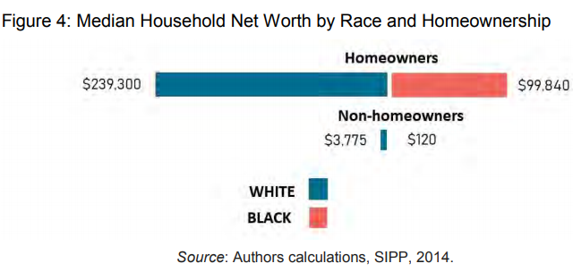
Homeownership Gaps
    Homeownership and Wealth Gaps
    Homeownership and wealth are clearly correlated, but it is a severe misstatement to claim that if blacks owned homes at the same rate as whites the racial wealth gap would be closed.
    Darity et al. “2018. What We Get Wrong about Closing the Racial Wealth Gap.” http://narrowthegap.org/images/documents/Wealth-Gap---FINAL-COMPLETE-REPORT.pdf

Slide 31
Homeownership Gaps
    Homeownership across Generations
    Are homeownership gaps transmitted across generations within families?
      Charles and Hurst find that parental down-payment support makes getting a mortgage more likely—and that far more whites than blacks receive such support.
      Hilber and Liu find that parental wealth does not help to explain homeownership gaps.
      Both studies use the Panel Study of Income Dynamics, which follows families.

Slide 32
Homeownership Gaps
    Questions
    How can scholars isolate the role of current discrimination in the black-white homeownership gap?
    How should one interpret the coefficient of a race or ethnicity variable in a study of homeownership?
    How can a scholar account for past discrimination in a study of the black-white homeownership gap?
    How can a scholar account for neighborhood choice in a study of the black-white homeownership gap?

