Slide 1
ECN741: Urban Economics
Residential Segregation:
Measurement, Causes, Consequences
Professor John Yinger, The Maxwell School, Syracuse University, 2020

Slide 2
Residential Segregation
Class Outline
  1. Measurement of Segregation
  2. Causes of Segregation
  3. Consequences of Segregation

Slide 3
Residential Segregation
Survey
  Note: An excellent survey of the literature is:
  Leah P. Boustan, "Racial Residential Segregation in American Cities." in Handbook of Urban Economics and Planning, eds. Nancy Brooks, Kieran Donaghy and Gerrit Knaap. Oxford University Press, 2011.
  Available at: http://www.princeton.edu/~lboustan/research_pdfs/research13_handbook.pdf

Slide 4
Residential Segregation
Class Outline
  1. Measurement of Segregation
  2. Causes of Segregation
  3. Consequences of Segregation

Slide 5
Residential Segregation
Definition of Segregation
  Segregation is the physical separation of different groups = a synonym for sorting.
  We focus on racial and ethnic residential segregation, but many other kinds of segregation exist (in schools, firms, occupations, etc.).
  Segregation is a complex social phenomenon, with many different dimensions.

Slide 6
Residential Segregation
Measures of Segregation
  Dissimilarity Index: Evenness of segregation
  Isolation Index: Potential contact between groups
  Delta Index: Relative physical space occupied
  Centralization Index: Degree to which a group lives near the CBD
  Proximity Index: Degree to which a group lives in contiguous areas

Slide 7
Residential Segregation
The Dissimilarity Index
  The dissimilarity index, D, is the most common measure of discrimination.
  It indicates the share of either group that would have to move to reach an even distribution.
  Its formula is:

Slide 8
Residential Segregation
Black-White Segregation
  In the case of black-white segregation, over the last 40 years we have seen declines in segregation measured by
    Dissimilarity Index
    Isolation Index
  And little change in segregation (up to 2000) using
    Delta Index
    Centralization Index
    Proximity Index

Slide 9
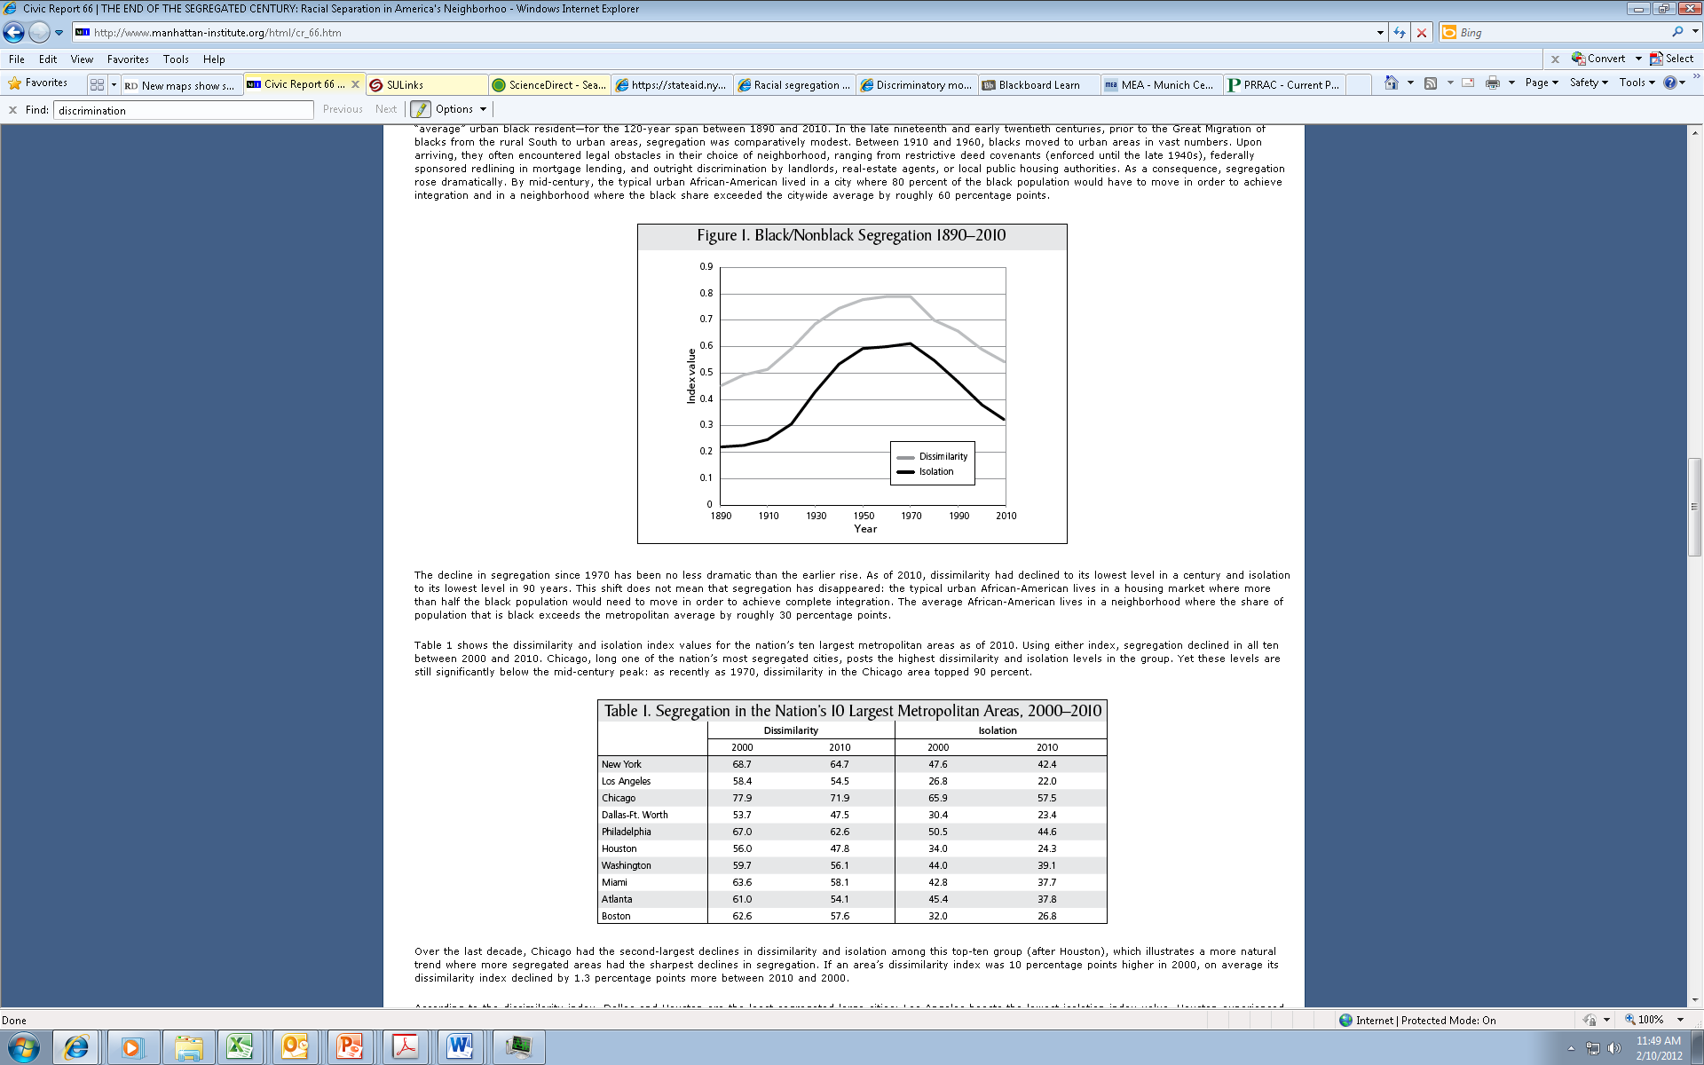
Residential Segregation
Segregation Indexes for Blacks
Source: Glaeser/Vigdor, 2012, http://www.manhattan-institute.org/pdf/cr_66.pdf

Slide 10
Residential Segregation
Segregation Indexes for Blacks
Source: Glaeser/Vigdor

Slide 11
Residential Segregation
Black-White Dissimilarity Indexes for Nation's Largest Metro Areas
 | Glaeser/Vigdor |  |  | Frey |  |  | Governing
 | 2000 | 2010 |  | 2000 | 2010 |  | 2017
New York | 68.7 | 64.7 |  | 80.2 | 78.0 |  | 76.8
Los Angeles | 58.4 | 54.5 |  | 70.0 | 67.8 |  | 66.8
Chicago | 77.9 | 71.9 |  | 81.2 | 76.4 |  | 75.3
Dallas-Ft. Worth | 53.7 | 47.5 |  | 59.8 | 56.6 |  | 56.6
Philadelphia | 67.0 | 62.6 |  | 71.0 | 68.4 |  | 67.0
Houston | 56.0 | 47.8 |  | 65.7 | 61.4 |  | 60.3
Washington, D.C. | 59.7 | 56.1 |  | 63.8 | 62.3 |  | 61.4
Miami | 63.6 | 58.1 |  | 69.2 | 64.8 |  | 63.9
Atlanta | 61.0 | 54.1 |  | 64.3 | 59.0 |  | 58.8
Boston | 62.6 | 57.6 |  | 67.6 | 64.0 |  | 65.0
Average | 62.9 | 57.5 |  | 69.3 | 65.9 |  | 52.6
Glaeser/Vigdor and Governing magazine based on census tracts; Frey (cite on next slide) based on census block-groups.

Slide 12
Residential Segregation
Most Segregated Areas for Blacks
Source: Frey, Population Studies Center, University of Michigan
http://www.psc.isr.umich.edu/dis/census/segregation2010.html
Rank (2010) | Name | 1990 | 2000 | 2010
1 | Milwaukee-Waukesha-West Allis, WI | 82.8 | 83.3 | 81.5
2 | New York-Northern New Jersey-Long Island, NY-NJ-PA | 80.9 | 80.2 | 78.0
3 | Chicago-Naperville-Joliet, IL-IN-WI | 84.4 | 81.2 | 76.4
4 | Detroit-Warren-Livonia, MI | 87.6 | 85.7 | 75.3
5 | Cleveland-Elyria-Mentor, OH | 82.8 | 78.2 | 74.1
6 | Buffalo-Niagara Falls, NY | 80.1 | 78.0 | 73.2
7 | St. Louis, MO-IL | 77.2 | 74.1 | 72.3
8 | Cincinnati-Middletown, OH-KY-IN | 75.9 | 73.7 | 69.4
9 | Philadelphia-Camden-Wilmington, PA-NJ-DE-MD | 75.2 | 71.0 | 68.4
10 | Los Angeles-Long Beach-Santa Ana, CA | 72.7 | 70.0 | 67.8
11 | Syracuse, NY | 73.0 | 71.4 | 67.8
12 | Bridgeport-Stamford-Norwalk, CT | 69.2 | 69.6 | 67.5
13 | Youngstown-Warren-Boardman, OH-PA | 74.7 | 72.7 | 67.5
14 | Dayton, OH | 76.6 | 73.0 | 66.4
15 | Indianapolis-Carmel, IN | 74.4 | 72.1 | 66.4
16 | Birmingham-Hoover, AL | 70.3 | 69.1 | 65.8
17 | Pittsburgh, PA | 70.8 | 68.9 | 65.8
18 | Harrisburg-Carlisle, PA | 74.3 | 71.1 | 65.7
19 | Baltimore-Towson, MD | 71.4 | 68.2 | 65.4
20 | Toledo, OH | 74.4 | 71.2 | 65.3

Slide 13
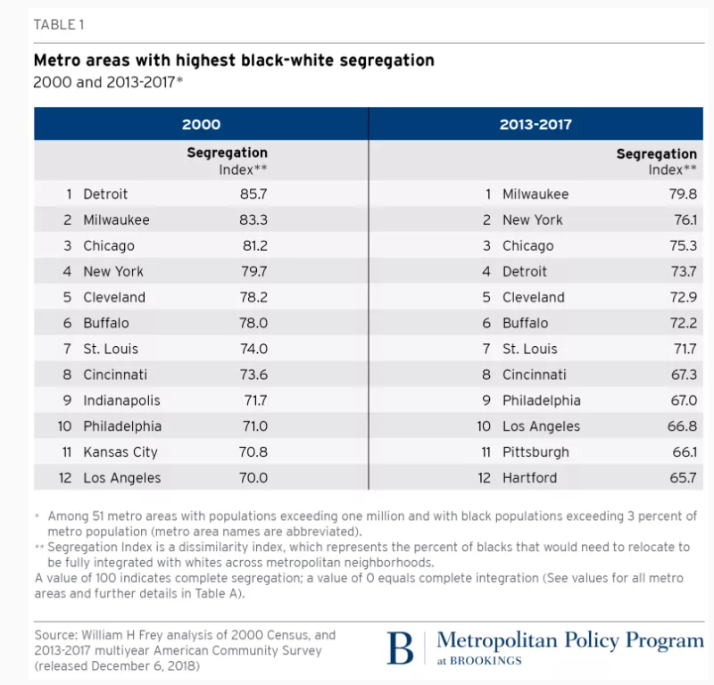
Residential Segregation
The Latest Black-White Segregation Measures
Syracuse=66.4!

Slide 14
Residential Segregation
Perspective on Black-White Segregation
  Comparisons with 1900 are misleading; social segregation did not require residential segregation back then.
    As late as the 1960s, many southern cities had low segregation indexes because black workers lived close to the white homes in which they worked.
  Cities with large black populations have seen relatively little decline in segregation.
  Black-white segregation is still much greater than Hispanic/non-Hispanic or Asian/white segregation.

Slide 15
Residential Segregation
Hispanic/Non-Hispanic-White Segregation
  In the case of Hispanic/white segregation, the decades preceding 2000 saw increases in segregation measured by
    Dissimilarity Index
    Isolation Index
  And little change in segregation using
    Delta Index
    Centralization Index
    Proximity Index

Slide 16
Residential Segregation
Dissimilarity Index for Hispanics (Frey)
Hispanic/non-Hispanic-white Dissimilarity Indexes, 10 Largest Metropolitan Areas, 1990-2010
 | 1990 | 2000 | 2010
New York-Northern New Jersey-Long Island, NY-NJ-PA | 66.2 | 65.6 | 62.0
Los Angeles-Long Beach-Santa Ana, CA | 60.3 | 62.5 | 62.2
Chicago-Naperville-Joliet, IL-IN-WI | 61.4 | 60.7 | 56.3
Dallas-Fort Worth-Arlington, TX | 48.8 | 52.3 | 50.3
Philadelphia-Camden-Wilmington, PA-NJ-DE-MD | 60.9 | 58.5 | 55.1
Houston-Sugar Land-Baytown, TX | 47.8 | 53.4 | 52.5
Washington-Arlington-Alexandria, DC-VA-MD-WV | 41.8 | 47.4 | 48.3
Miami-Fort Lauderdale-Pompano Beach, FL | 32.5 | 59.0 | 57.4
Atlanta-Sandy Springs-Marietta, GA | 35.3 | 51.6 | 49.5
Boston-Cambridge-Quincy, MA-NH | 59.3 | 62.5 | 59.6
Syracuse, NY | 39.6 | 44.4 | 42.2
Average (102 Areas with Population > 500,000) | 38.6 | 43.9 | 43.5

Slide 17
Residential Segregation
Perspective on Hispanic Segregation
  Segregation between Hispanics and non-Hispanic whites appears to be linked to immigration.
  Low-income immigrants from non-English-speaking countries tend to move into neighborhoods where they can find other people who speak the same language and institutions with which they are familiar, such as certain churches or certain types of restaurants.
  The period between 2000 and 2010 witnessed extensive immigration into the U.S. from Mexico, Central America, and South America, thereby increasing Hispanic segregation.

Slide 18
Residential Segregation
Dissimilarity Index for Asians (Frey)
Asian/White Dissimilarity Indexes for the 10 Largest Metropolitan Areas, 1990-2010
 | 1990 | 2000 | 2010
New York-Northern New Jersey-Long Island, NY-NJ-PA | 47.4 | 50.8 | 51.9
Los Angeles-Long Beach-Santa Ana, CA | 43.5 | 47.9 | 48.4
Chicago-Naperville-Joliet, IL-IN-WI | 46.5 | 46.8 | 44.9
Dallas-Fort Worth-Arlington, TX | 41.8 | 45.6 | 46.6
Philadelphia-Camden-Wilmington, PA-NJ-DE-MD | 42.4 | 44.1 | 42.3
Houston-Sugar Land-Baytown, TX | 48.0 | 51.4 | 50.4
Washington-Arlington-Alexandria, DC-VA-MD-WV | 34.5 | 38.7 | 38.9
Miami-Fort Lauderdale-Pompano Beach, FL | 26.8 | 33.3 | 34.2
Atlanta-Sandy Springs-Marietta, GA | 42.5 | 46.9 | 48.5
Boston-Cambridge-Quincy, MA-NH | 45.5 | 47.8 | 45.4
Syracuse, NY | 45.2 | 48.1 | 51.5
Average (102 Areas with Population > 500,000) | 38.4 | 39.8 | 39.7

Slide 19
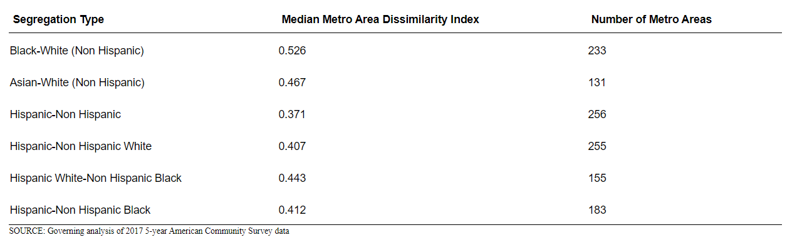
Residential Segregation
Median Segregation by Group, 2017

Slide 20
Residential Segregation
Class Outline
  1. Measurement of Segregation
  2. Causes of Segregation
  3. Consequences of Segregation

Slide 21
Residential Segregation
Questions
What is the “dissimilarity index” how is it interpreted?
What are the trends in black-white residential segregation?
What are the trends in Hispanic-white residential segregation?

Slide 22
Residential Segregation
Causes of Segregation
  Discrimination
  Preferences (which are based on experiences)
  Income and wealth differences (which reflect past and current discrimination)

Slide 23
Residential Segregation
Causes of Segregation: Discrimination
  Discrimination obviously can contribute to segregation.
  Specifically, segregation is reinforced by
    Denial of information about available housing,
    Racial/ethnic steering,
    Lack of cooperation in completing transactions.

Slide 24
Residential Segregation
Causes of Segregation: Government Discrimination
  Governmental actions also have led to segregation. See Rothstein (The Color of Law).
    Racial zoning (before 1917)
    Enforcing racial restrictive covenants (before 1948)
    Explicit redlining in federal loan programs (until the 1960s)
    Discriminatory siting and admission in federal public housing projects
    Failure to outlaw discrimination in housing or, after 1968, to enforce prohibitions

Slide 25
Residential Segregation
Causes of Segregation: Government Discrimination, Recent Debates
  Some scholars have found a lingering effect of redlining associated with government lending in the 1920s and before (on syllabus).
    A. Shertzer and R. P. Walsh (ReStat, 2019).
    D. Aaronson, D. Hartley,and B. Mazumder (Chicago Fed Working Paper. 2019). Available at: https://www.chicagofed.org/publications/working-papers/2017/wp2017-12 .
  There is a debate about the importance of government actions versus prejudice and discrimination.
    An op-ed by Boustan: https://www.nytimes.com/2017/05/15/opinion/white-flight.html
    A letter in response from Rothstein: https://www.nytimes.com/2017/05/24/opinion/dissecting-white-flight.html

Slide 26
Residential Segregation
Causes of Segregation: Attitudes
  Historically, prejudice has been a powerful cause of segregation.
  Boustan (QJE, February 2010) finds that
    “The distinctive American pattern—in which blacks live in cities and whites in suburbs—was enhanced by a large black migration from the rural South. I show that whites responded to this black influx by leaving cities and rule out an indirect effect on housing prices as a sole cause. I instrument for changes in black population by using local economic conditions to predict black migration from southern states and assigning predicted flows to northern cities according to established settlement patterns. The best causal estimates imply that each black arrival led to 2.7 white departures.”

Slide 27
Residential Segregation
Causes of Segregation: Attitudes, Continued
  An excellent article by Ihlanfeldt and Scafidi (Housing Studies, May 2004; data from Atlanta, Boston, and LA) examines the simultaneity between racial attitudes and racial segregation.
    Whites’ neighborhood racial preferences play an important role in explaining the racial composition of their neighborhoods.
    Inter-racial contact in neighborhoods and workplaces leads to a greater willingness among whites to live with blacks.

Slide 28
Residential Segregation
Causes of Segregation: Attitudes, Continued
  A hedonic regression can also shed light on the role of attitudes.
  The following slides illustrate the hedonic results for percent black and percent Hispanic in a block group from my study of Cleveland in 2000.
  Clearly, some people prefer high-white neighborhoods and others prefer high-minority neighborhoods.

Slide 29
Cleveland Application

Slide 30
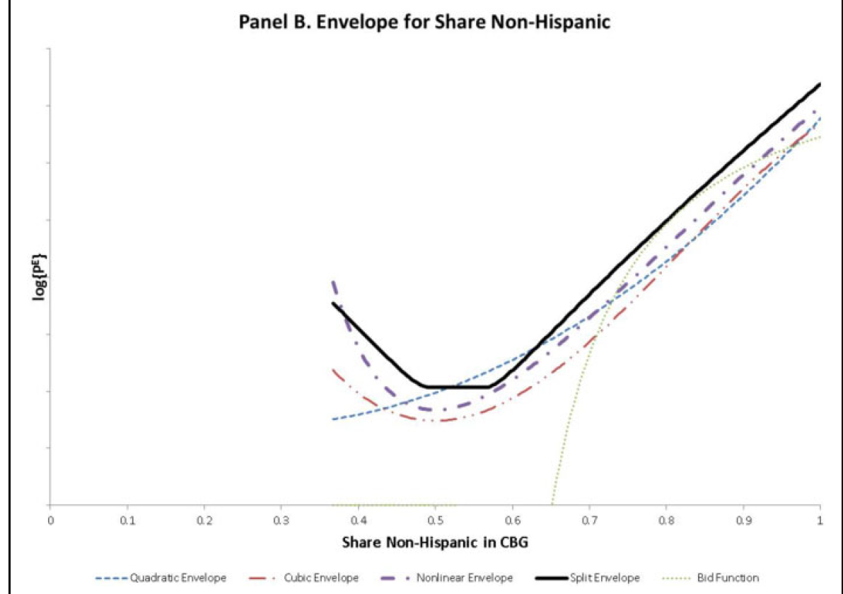
Panel B. Envelope for Share Non-Hispanic

Slide 31
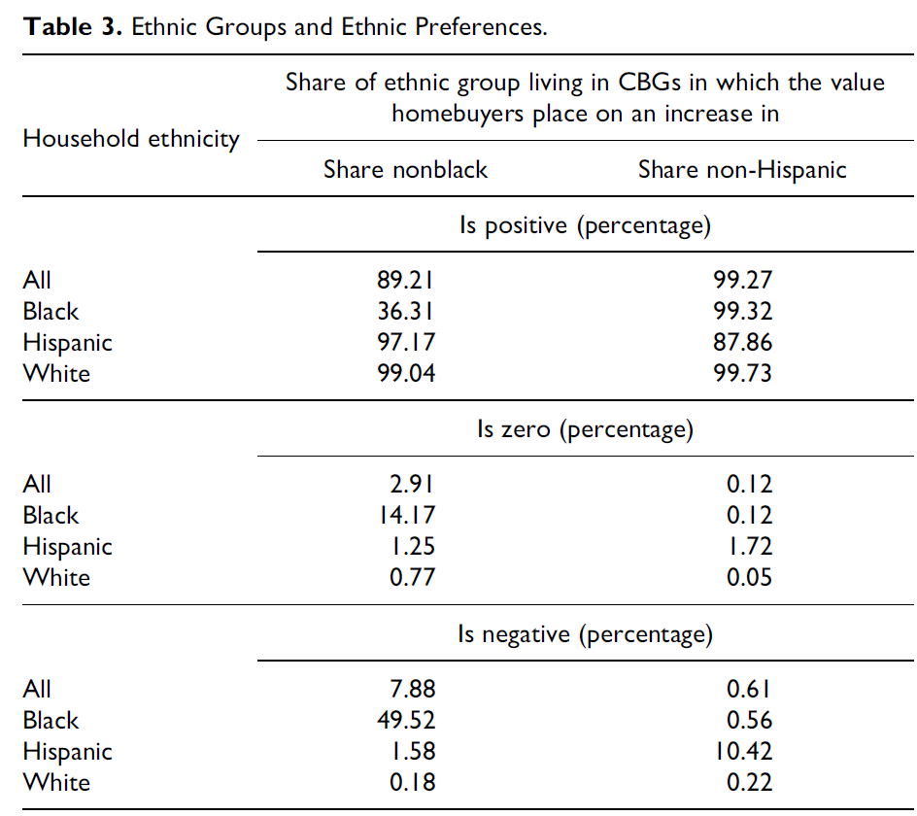
Ethnic Groups and Ethnic Preferences

Slide 32
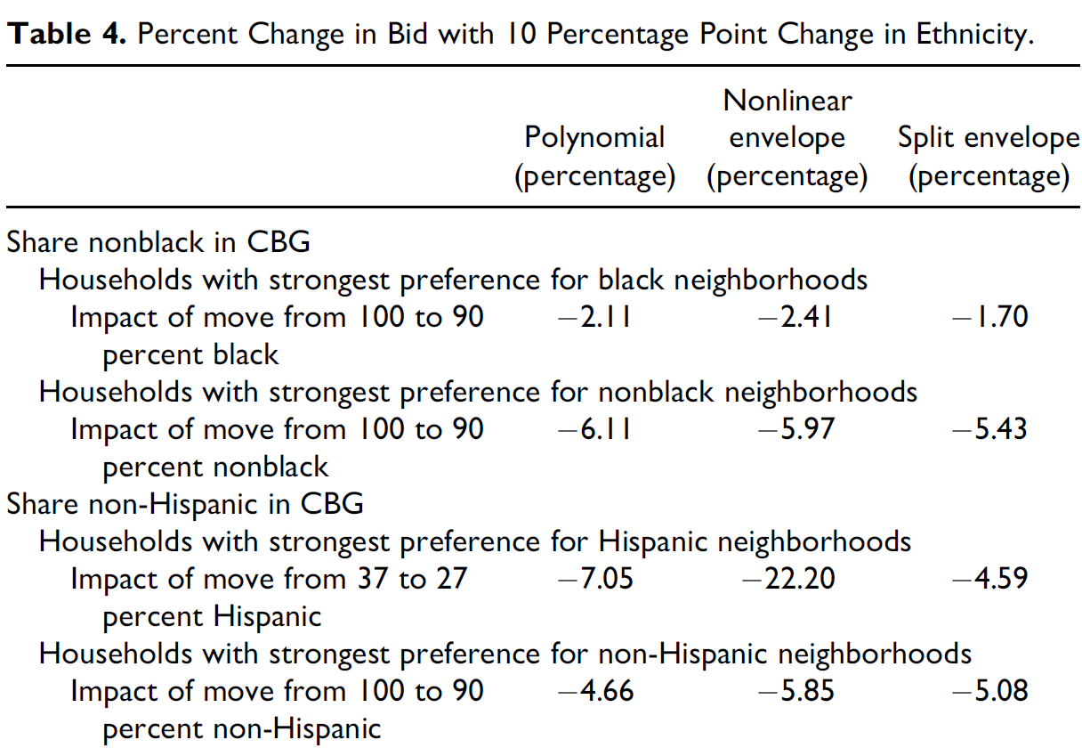
Percent Change in Bid with 10 Percentage Point Change in Ethnicity

Slide 33
Residential Segregation
Causes of Segregation: Income
  Income sorting and segregation
    The basic logic of income-taste sorting suggests that socio-economic differences between groups will contribute to residential segregation.
  A study of the San Francisco area (Bayer, McMillan, Rueben, JUE, November 2004) finds that education, income, language, and immigration status, explain
    Almost 95% of segregation for Hispanic households
    Over 50% of segregation Asian households, and
    Only 30% of segregation for Black households.

Slide 34
Residential Segregation
Class Outline
  1. Measurement of Segregation
  2. Causes of Segregation
  3. Consequences of Segregation

Slide 35
Residential Segregation
Consequences of Segregation:
  Differences in opportunities.
  Persistence of stereotypes and prejudice.
  Segregation is an outcome that becomes a cause!

Slide 36
Residential Segregation
Segregation and Opportunities
  Spatial Mismatch Hypothesis
    Kain, QJE, May 1968: High unemployment among blacks is due to mismatch between their residences and location of jobs—and to factors maintaining segregation.
    Job suburbanization is a long-run trend.
    Without barriers, all households could adjust to changes in job location, but blacks have a harder time making this adjustment that whites because they have less information about suburban housing and face housing discrimination.

Slide 37
Residential Segregation
Segregation and Opportunities
  Spatial Mismatch Hypothesis, 2
    Ihlanfeldt and Sjoquist (AER, March 1990) find that black youth (who do not pick their housing location) have much lower job access than white youth, which explains one-third or more of their higher unemployment rate.
    But recent evidence indicates that having more jobs held by whites nearby does not lower black unemployment (Hellerstein, Neumark, and McInerney, JUE, September 2008)—a sign of discrimination in labor markets.

Slide 38
Residential Segregation
Segregation and Opportunities, Cont.
  Another approach is to determine whether blacks have poorer socio-economic outcomes in urban areas with higher levels of segregation (Cutler and Glaeser, QJE, August 1997).
  Higher segregation leads to larger white-black gaps in employment, earnings, not being a single mother, and high-school graduation.
  A one-standard deviation decrease in segregation would cut the black-white gap on most outcomes by one-third.

Slide 39
Residential Segregation
Segregation and Prejudice
  Remember the evidence from Ihlanfeldt and Scafidi:
    Inter-racial contact in neighborhoods and workplaces leads to a greater willingness among whites to live with blacks.
    It follows that a lack of contact undermines the willingness of whites to live with blacks.

Slide 40
Residential Segregation
Questions
What are the main causes of residential segregation?
How does our nation’s history help to explain residential segregation?
How do racial prejudice and racial segregation reinforce each other?
What is the “Spatial Mismatch Hypothesis” and how can it be tested?

