Slide 1
ECN741: Urban Economics
Public Cost Functions
Professor John Yinger, The Maxwell School, Syracuse University, 2020

Slide 2
Cost Functions
Class Outline
Cost Functions and Production Functions
The Bradford/Malt/Oates Framework
Issues in Estimating Cost Functions

Slide 3
Cost Functions
Cost Functions
Production functions lead to cost functions.
Production functions indicate the maximum output at a given level of inputs.
Cost functions indicate the minimum spending required to produce a given output at given input prices.
Both assume maximizing behavior.

Slide 4
Cost Functions
Which is the Best Approach?
Although they both shed light on the technology of public production, cost functions and production functions have different strengths and weaknesses for empirical analysis.
You have to figure out the best approach given the question you want to answer and the data that are available to you.

Slide 5
Cost Functions
Cost Functions in Education
Cost functions are ideal at the school district level, where spending and output are observed.
A cost function, unlike a production function, can include many outputs.
Many public policies, such as state aid, are linked to the district level, so district-level cost studies link directly to policy.

Slide 6
Cost Functions
Cost Functions in Education, 2
Cost functions do not work well for other scales, however.
It is not possible to estimate cost functions at the individual or classroom level because the dependent variable, spending, is unavailable (and even hard to define).
Studies of school-level cost functions run into serious endogeneity problems without obvious instruments.

Slide 7
Cost Functions
District Production Functions in Education
As we have seen, production functions work well with student-level data.
Several studies use classroom data.
They do not work well at the school or district level, however, because many inputs (e.g. counseling) cannot be observed.

Slide 8
Cost Functions
District Production Functions in Education, 2
Hanushek has argued (in presentations at AEFP and, with co-authors, in the Peabody Journal of Education (2008)) that one can estimate production functions with “spending” as the input.
Using this approach, he finds that spending does not affect performance.
I disagree.
The assumption that spending is the input, implies that any equal-cost combination of inputs yields the same performance.
Spending includes inefficiency, so this approach has a huge errors-in-variables problem.
See Duncombe/Yinger in the Peabody Journal in 2011.

Slide 9
Cost Functions
B/M/O Framework
Research on public cost functions builds on a framework first proposed in a famous 1969 NTJ article by Bradford, Malt, and Oates.
They model government production in two stages and argue that “environmental” conditions, defined below, play a big role.
They show that these conditions need to be considered in any cost function estimation.

Slide 10
Cost Functions
B/M/O Framework, 2
B/M/O start with a 1st-stage production function for intermediate outputs (their direct or D-outputs):
Then G goes into a 2nd-stage production function for final outputs (their consumed or C-outputs).

Slide 11
Cost Functions
B/M/O Framework, 3
The first stage is similar to private production. Police patrol hours (G) as a function of police officers (L) and police cars (K), for example.
But what people really care about is the final output (S), such as protection from crime.
The key insight is that the production of S depends on the environment (N) in which it is produced.

Slide 12
Cost Functions
B/M/O Framework, 4
Examples of “Environment”
Police: Poor people are more likely to be victims of crime and to be desperate enough to turn to crime,
Fire: Old houses catch fire more often and burn faster; fire spreads faster when housing is closely packed.
Education: Children from poor families are more likely to bring health or behavioral problems to school, and less likely to have lessons reinforced at home.

Slide 13
Cost Functions
B/M/O Framework, 5
Adding input prices (P) and a random error (ε) leads to the 1st-stage cost function:
Now insert the inverted 2nd-stage production functions:
To get the 2nd-stage cost function:

Slide 14
Cost Functions
Issues in Estimating Cost Functions
Cost-function studies should address 5 key questions (See Duncombe/Nguyen-Hoang/Yinger in AEFP Handbook).
What is the output?
What is the best way to account for inefficiency?
What student traits should be included?
How should the endogeneity of output and wages be handled?
What is the best functional form?

Slide 15
Cost Functions
Picking the Output
Public services are often complex and output measures (S) are often difficult to find.
Some studies use determinants of voter demand for the output, such income, instead of measuring output directly.
Starting with Downes and Pogue (NTJ 1994) education cost function studies now use output measures.

Slide 16
Cost Functions
Picking the Output, 2
So what are good output measures?
Fire: Probability of fire and loss from a fire.
Education: Test scores (what grade? what test?), graduation rate (based on what cohort?), ….
Assessment: COD

Slide 17
Cost Functions
Accounting for Efficiency
Cost is defined as minimum possible spending or spending using best practices.
We only observe actual spending, which also reflects deviations from best practices = deviations from efficiency (e = 1).
Thus, a more accurate formulation is

Slide 18
Cost Functions
Accounting for Efficiency, 2
Some perspective:
e depends on S .
There is no such thing as efficiency in general—only in efficiency in producing a specified S .
If S is defined as math and English scores, a school district that provides extensive science, social studies, art, and music may be judged to be efficient.
If S is defined as music contest victories, school districts with great math and English scores may be judged inefficient.
A wasteful district may be judged inefficient in everything, but waste is only a subset of inefficiency.

Slide 19
Cost Functions
Accounting for Efficiency, 3
The problem:
e cannot be directly observed.
Several methods are available.
Include variables that determine e (examples below).
Use data envelopment analysis (e.g. D/Y, NTJ, June 1998).
Use stochastic frontiers analysis (e.g. Gronberg, Janson, and Taylor, PJE, 2011).
Use district fixed effects (Downes and Pogue, NTJ 1994).

Slide 20
Cost Functions
Accounting for Efficiency, 4
Key Assumptions:
1st Approach: Can identify variables that influence e.
2nd Approach: The functional form restrictions in DEA are correct.
3rd Approach: e is not correlated with observable factors in the cost regression.
4th Approach: Ignores efficiency factors that vary over time.

Slide 21
Cost Functions
Student Traits
Many student traits might affect costs, including:
Coming from a family below the poverty line,
Speaking English as a second language,
Being an immigrant,
Having special needs.
Enrollment also matters; most studies find a U-shaped link between enrollment and costs.

Slide 22
Cost Functions
Cost Indexes and Pupil Weights
In some applications, it is helpful to have a cost index for each district.
Cost indexes are equivalent (exactly in some cases) to pupil weights plus a teacher-cost adjustment.
See Duncombe and Yinger. 2005. “How Much More Does a Disadvantaged Student Cost?” Economics of Education Review (October).

Slide 23
Cost Functions
Functional Form
Most Studies Use
But a few studies use trans-log or some other more general method; these methods require larger sample sizes than are generally available.

Slide 24
Cost Functions
Endogeneity
Performance is endogenous because it is a product of the same set of decisions (and unobserved district traits) as is spending.
Teacher wages are endogenous because they may reflect unobserved district traits that affect both bargaining and spending.

Slide 25
Cost Functions
Endogeneity, 2
Instruments for performance are difficult to come by.
Bill Duncombe and I draw on the “copy-cat” or “yardstick” theory, which is that districts are influenced by the decisions of similar districts.
Our instruments are exogenous characteristics of comparison districts.
We do not use choices by comparison districts because the copy-cat theory says causation runs in both directions!
We do not use traits of neighboring districts, because these traits might reflect household sorting across districts in response to performance.
Some other scholars use the number of districts or the presence of private schools as indicators of competition.

Slide 26
Cost Functions
Endogeneity, 3
Instruments for wages are not so difficult to find.
First, make the wage variable comparable across districts by controlling for teacher experience.
Use starting wages or wages at a certain level of experience.
Then use some measure of private sector wages as a control.
Private sector wages in a particular sector or occupation roughly comparable to teaching.
Metropolitan area population, which clearly affects wages.

Slide 27
Cost Functions
Example: D/Y, ITPF 2011
A study of school districts in California.
Data for 2003-04 and 2004-05 are pooled; year fixed effects.
District fixed effects are not included because there is not enough over-time variation to estimate the model’s coefficients.

Slide 28
Cost Functions
Example: D/Y, ITPF 2011
The instruments for S come from the copy-cat (or yardstick competition) theory.
The comparison-district characteristics we include are the share of students in poverty, the share of the student who are African-American, and median house value.
Comparison districts are districts in the same labor market area = MSA.
“Our instrument for teacher salaries is the log of estimated comparable private wages in the same labor market area.”
Tests for weak instruments and instrument exogeneity.

Slide 29
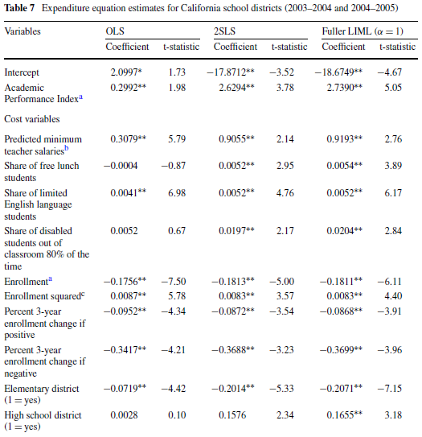
Cost Functions: D/Y 2011

Slide 30
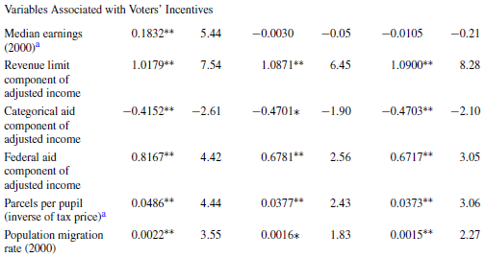
Cost Functions: D/Y 2011

Slide 31
Cost Functions
Example: N-H/Y, JEF 2014
A study of school districts in Massachusetts.
Data for 2001-2006; 296 districts.
District and year fixed effects are included.

Slide 32
Cost Functions
Example: N-H/Y, JEF 2014
“We designate all of the other districts in the same county as comparison jurisdictions; this approach ensures that the comparison jurisdictions are close enough to be visible but are not limited to neighboring jurisdictions, which might share a district’s unobservable traits.
The yardstick competition theory indicates that a jurisdiction responds to the performance of jurisdictions in its comparison group. Therefore, we use as IVs exogenous traits of comparison jurisdictions that influence their performance.
More specifically, the IVs are the average percentages of low-income and special education students in comparison school districts.”

Slide 33
Cost Functions
Example: N-H/Y, JEF 2014
Our two IVs for W [teacher wages] are the log of the annual average wage in comparable private sector jobs and the average share of African American population in comparison districts.
The yardstick competition discussed previously justifies the use of the second IV, as several studies show that teacher mobility—and thus salaries to attract and retain them—varies significantly, depending on the district demographics.
Tests for weak instruments and instrument exogeneity.

Slide 34
Cost Functions: N-H/Y, ITPF 2014

Slide 35
Cost Functions: N-H/Y, ITPF 2014

Slide 36
Cost Functions
Example: E/D/N-H/Y, EF&P 2014
A study of school districts in New York.
Data for 1999-2011; about 610 districts.
District and year fixed effects are included.

Slide 37
Cost Functions
Example: E/D/N-H/Y, EF&P 2014
Instruments for student performance:
Average percent of high cost students in the rest of the county
Average percent of LEP students in the rest of the county
Instrument for teacher wage:
Annual county average salary of manufacturing jobs
Tests for weak instruments and instrument exogeneity.

Slide 38
Cost Functions: E/D/N-H/Y EF&P 2014

Slide 39
Cost Functions
E/D/N-H/Y, Results
The performance coefficient(instrumented) shows that money matters!!
Costs rise with teacher salaries (instrumented).
It costs about 140% more for a poor kid than for a non-poor kid to reach the same performance.
Kids with severe disabilities raise costs for other kids.
Costs are a U-shaped function of enrollment (although 2nd term is not significant).
In the short run, an increase in enrollment decreases costs per pupil (by raising class size—ask SU!), and a decrease in enrollment raises costs (by shrinking class size).
Efficiency controls work as expected.

Slide 40
Cost Functions
Other Examples
Downes and Pogue (NTJ 1994)
Reschovsky/Imazeki (NTJ 2004)
Imazeki (EF&P 2008)
Review by Golebiewski (PJE 2011)

Slide 41
Cost Functions
Questions
What is a public cost function and how can it be estimated?
What are the advantages and disadvantages of estimating cost functions instead of production functions?
What is the role of the “environment” in a public cost function?
What are the endogeneity problems in estimating a public cost function?
How can a scholar account for inefficiency in estimating a public cost function?

